Slide 1

Watson
Discovery

Slide 2
Agenda
Discovery Introduction
Key concepts
Usecase
Hands on
References

Slide 3
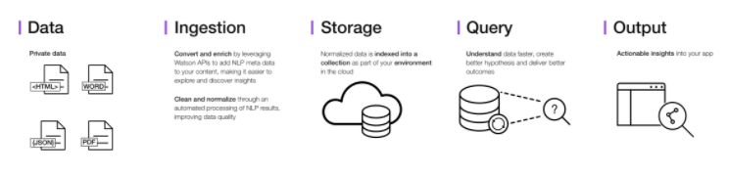
Discovery Introduction
- makes it possible to rapidly build cognitive, cloud-based exploration applications that unlock actionable insights hidden in unstructured data — including your own proprietary data, as well as public and third-party data.

Slide 4
Discovery Introduction
With Discovery, it only takes a few steps to prepare your unstructured data, create a query that will pinpoint the information you need, and then integrate those insights into your new application or existing solution.
Discovery brings together a functionally rich set of integrated, automated Watson APIs to:
Crawl, convert, enrich and normalize data.
Securely explore your proprietary content as well as free and licensed public content.
Apply additional enrichments such as concepts, relations, and sentiment through natural language processing.
Simplify development while still providing direct access to APIs.

Slide 5
Discovery Concepts
WATSON INSIGHTS ON YOUR ENRICHED DOCUMENTS
General sentiments displays the percentage breakdown of documents tagged as positive, neutral, and negative discovered by the Sentiment Analysis enrichment.
Top entities displays persons, places, and organizations discovered in your documents by the Entity Extraction enrichment.
Content hierarchy displays the hierarchical taxonomies discovered in your documents by the Category Classification enrichment.
Related concepts displays the concepts discovered in your documents by the Concept Tagging enrichment.

Slide 6
Discovery Concepts
WATSON DISCOVERY NEWS
Discovery News, a public data set that has been pre-enriched with cognitive insights, is also included with Discovery. You can use this public, unstructured data set to query for insights that you can integrate into your applications.

Slide 7
Discovery Concepts
DISCOVERY TOOLING
The Discovery service includes a complete set of online tools - the Discovery tooling - to help you quickly setup an instance of the service and populate it with data.
The Discovery service tooling has been designed to save time by eliminating the need to use APIs to configure and populate your service.

Slide 8
Discovery Use Case
Help Desk personnel of companies providing Production Support services can search their Knowledge Base to provide answers to customers.
Long tail chatbot

Slide 9

Discovery Hands On - https://console.bluemix.net/docs/services/discovery/getting-started-tool.html#getting-started-with-the-tooling
BEFORE YOU BEGIN:
Create instance of the service
Login to IBM Cloud. Go to Catalog. Select Watson under Platform. Then Select Discovery.
Give a service name. Select region, org and space. Then click Create.
Copy the credentials to authenticate your service instance.
From the Dashboard, Select your discovery service, under service credentials add a new credential, give a credential name then click on Add. Copy the username, password, and url values from the credential you created.
Configure Watson Discovery using the launch tool
From the Dashboard, Select your discovery service > Manage > Launch tool
Create environment: Click icon and choose create envirionment.
Create collection: Click on create data collection > Enter collection name > Default Configuration > Select language: English

Slide 10
Discovery Hands On - https://console.bluemix.net/docs/services/discovery/getting-started-tool.html#getting-started-with-the-tooling
BEFORE YOU BEGIN:
Download sample documents (test-doc1.html, test-doc2.html, test-doc3.html, test-doc4.html) and put it in your project folder
Upload your documents.
QUERY USING THE TOOL:
Click on build queries > Choose a collection to query > Select your collection > Get Started. Filter which document to query > Enter field, operation and value > Run the query.
To search for results with entities named "IBM": Click Field and select enriched_text.entities.text. Select contains for Operator and IBM for Value. The query enriched_text.entities.text:IBM is displayed in Visual Query Builder. Click Run Query. The query returns 4 results.
To search for results with entities named "Watson": Click Field and select enriched_text.entities.text. Select contains for Operator and watson for Value. The query enriched_text.entities.text:watson is displayed in Visual Query Builder. Click Run Query. The query returns 2 results.
To search for results with both entities named "Watson" and "Slack": Click Field and select enriched_text.entities.text. Select contains for Operator and watson for Value. Click Add rule, then repeat your selections, but choose the Value of Slack. The query enriched_text.entities.text:watson,enriched_text.entities.text:Slack is displayed in Visual Query Builder. Click Run Query. The query returns 1 result.

Slide 11
Discovery Hands On
QUERY USING API
Create a maven project in eclipse. File > New > Maven Project > Create a simple project > Next
Enter group id, (ex: com.acn.watson) and artifact id (ex. discovery) > Finish
Check Build Path > Right click on project > Build path > Configure Build Path > Libraries > Remove JRE 1.5
Add JRE 1.8 Library > Add Library > JRE System Library > Next > Click on Workspace Default > Finish > Apply >Apply and Close

Slide 12
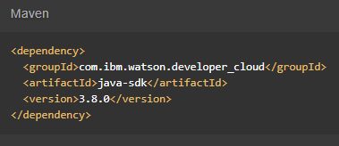

Discovery Hands On
Go to https://console.bluemix.net/docs/services/discovery/index.html#about
Copy Maven dependency in pom.xml
Add main class > Right click on src/main/java > Give a class name > under Which method stubs would you like to create? Tick public static void main(String[] args) > Click on Finish
On the api website > Click Query your collection profile under Queries

Slide 13
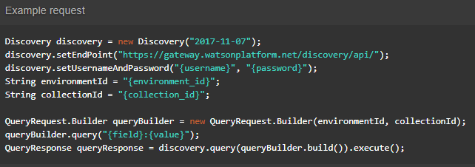
Discovery Hands On
Copy the code in the main method:

Slide 14
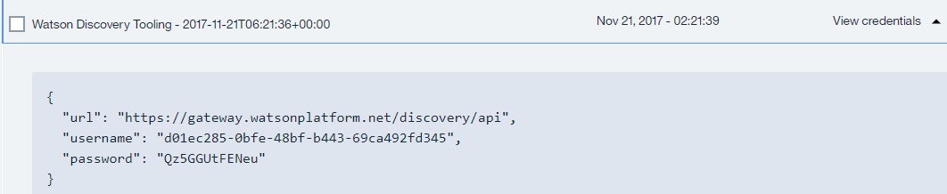
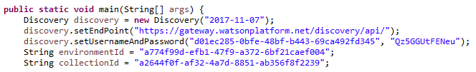
Discovery Hands On
Import all necessary libraries
Copy and change the username, password based on the speech to text service credentials.
Sample credentials:
Right click on your project then run as java application.

Slide 15
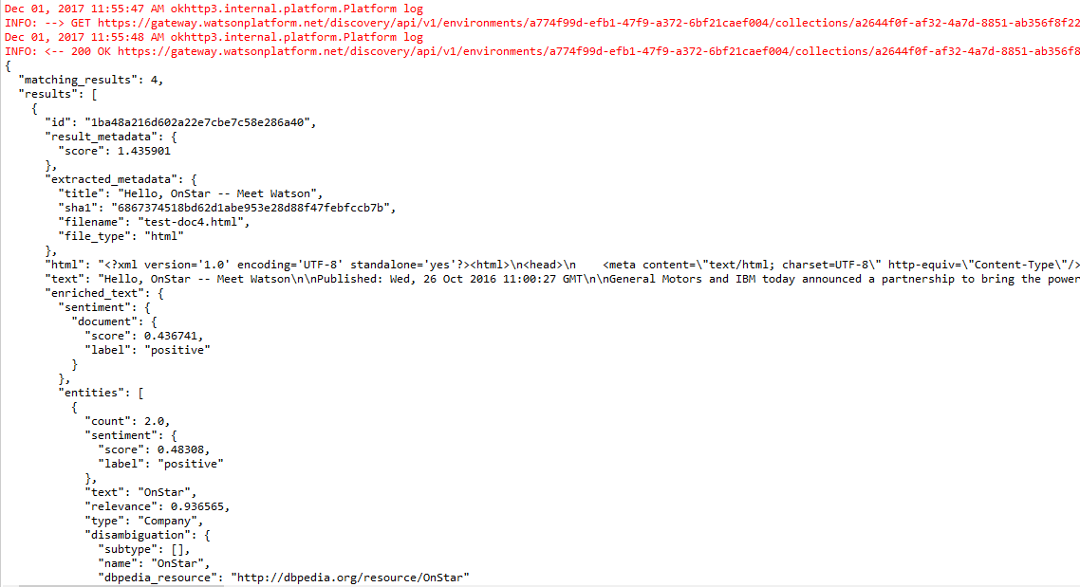
Discovery Hands On
Sample result:
Console:

Slide 16
Discovery References
About Discovery:
https://console.bluemix.net/docs/services/discovery/index.html#about
Getting Started Tutorial:
https://console.bluemix.net/docs/services/discovery/getting-started-tool.html#getting-started-with-the-tooling
API:
https://www.ibm.com/watson/developercloud/discovery/api/v1/

