Slide 1

Watson
Language
Translator

Slide 2
Agenda
Language Translator Introduction
Key concepts
Usecase
Hands on
References

Slide 3
Language Translator Introduction
- allows you to programmatically translate text in news, conversational, and patent domains.
- can create an application that identifies the language of input text and uses a domain-specific linguistic model to translate the text into another language.

Slide 4
Language Translator Concepts
HOW TO USE THIS SERVICE
Use the service to identify the language of text, and to translate text from one language to another. For example, pass an English word, such as Hello, and the service can identify it as English. Or translate the English greeting into its Spanish equivalent, Hola.
To teach the service to perform domain-specific translations, you can make the following enhancements to one of the linguistic models that is provided with the service:
Add your own glossary of terms or phrases in a source and target language. The glossary can supplement standard translations or be identified as the only terms to use.
Upload a large body of text in your target language to serve as a language sample. The service can evaluate the sample and use what it learns to improve the quality of its translation.

Slide 5
Language Translator Concepts
SUPPORTED LANGUAGES
The linguistic models that are provided with the service can perform translations between the following languages:
News: Targeted at news articles and transcripts. Translate English to and from Arabic, Brazilian Portuguese, French, German, Italian, Japanese, Korean, and Spanish. You can also translate Spanish to and from French.
Conversational: Targeted at conversational colloquialisms. Translate English to and from Arabic, Brazilian Portuguese, French, Italian, and Spanish.
Patents: Targeted at technical and legal terminology. Translate Brazilian Portuguese, Chinese, Korean, and Spanish to English.

Slide 6
Language Translator Concepts: The /identify endpoint can recognize the following languages:
Afrikaans
Albanian
Arabic
Armenian
Azerbaijani
Bashkir
Basque
Belarusian
Bengali
Bosnian
Bulgarian
Central Khmer
Chinese
Chuvash
Czech
Danish
Dutch
English
Esperanto
Estonian
Finnish
French
Georgian
German
Greek
Gujarati
Haitian
Hebrew
Hindi
Hungarian
Icelandic
Indonesian
Italian
Japanese
Kazakh
Kirghiz
Korean
Kurdish
Latvian
Lithuanian
Malayalam
Mongolian
Norwegian Bokmal
Norwegian Nynorsk
Panjabi
Persian
Polish
Portuguese
Pushto
Romanian
Russian
Slovakian
Somali
Spanish
Swedish
Tamil
Telugu
Traditional Chinese
Turkish
Ukrainian
Urdu
Vietnamese

Slide 7
Language Translator Use Case
English-speaking help desk representative can assist a Spanish-speaking customer through chat.
A West African news website can curate English news from across the globe and present it in French to its constituents.
A bank can translate all of their product descriptions from English to Arabic using a custom model tailored to that bank’s product name and terminology.

Slide 8
Language Translator Hands On
BEFORE YOU BEGIN:
Create instance of the service
Login to IBM Cloud. Go to Catalog. Select Watson under Platform. Then Select Language Translator.
Give a service name. Then click Create.
Copy the credentials to authenticate your service instance.
From your project in the Developer Console, add a new credential, give a credential name then click on Add. Copy the username, password, and url values from the credential you created.
Create a maven project in eclipse. File > New > Maven Project > Create a simple project > Next
Enter group id, (ex: com.acn.watson) and artifact id (ex. languagetranslator) > Finish
Check Build Path > Right click on project > Build path > Configure Build Path > Libraries > Remove JRE 1.5
Add JRE 1.8 Library > Add Library > JRE System Library > Next > Click on Workspace Default > Finish > Apply >Apply and Close

Slide 9
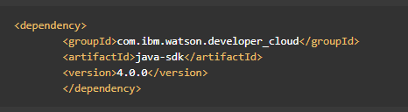

Language Translator Hands On
Go to https://www.ibm.com/watson/developercloud/language-translator/api/v2/
Copy Maven dependency in pom.xml
Add main class > Right click on src/main/java > Give a class name > under Which method stubs would you like to create? Tick public static void main(String[] args) > Click on Finish
On the api website > Click Translate audio under Methods

Slide 10
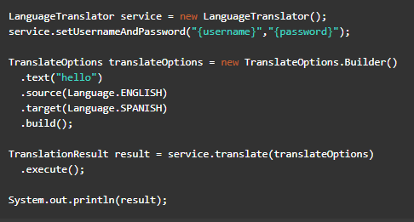
Language Translator Hands On
Copy the code in the main method:

Slide 11
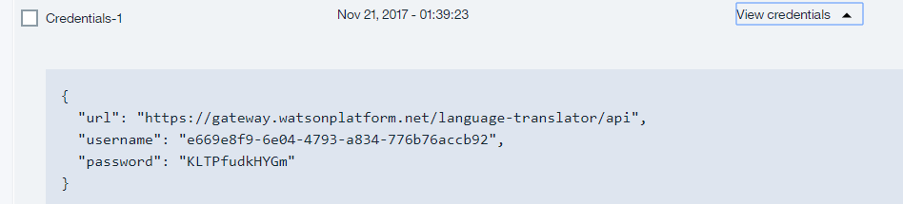

Language Translator Hands On
Import all necessary libraries
Copy and change the username, password based on the speech to text service credentials.
Sample credentials:
Right click on your project then run as java application.

Slide 12
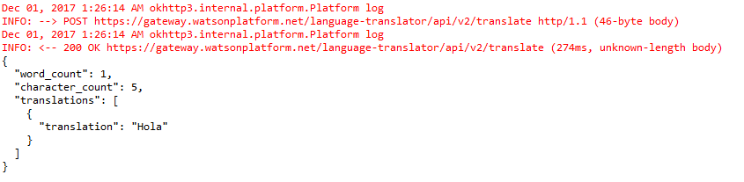
Language Translator Hands On
Sample result:
Console:

Slide 13
Language Translator References
About Language Translator:
https://console.bluemix.net/docs/services/language-translator/index.html#about
Getting Started Tutorial:
https://console.bluemix.net/docs/services/language-translator/getting-started.html#gettingstarted
API:
https://www.ibm.com/watson/developercloud/language-translator/api/v2/

