Slide 1

Watson
Personality
Insights

Slide 2
Agenda
Personality Insights Introduction
Key concepts
Usecase
Hands on
References

Slide 3
Personality Insights Introduction
- derives insights about personality characteristics from social media, enterprise data, or other digital communications.
- provides an Application Programming Interface (API) for deriving insights from social media, enterprise data, or other digital communications. The service uses linguistic analytics to infer individuals' intrinsic personality characteristics from digital communications such as email, text messages, tweets, and forum posts.
- The service infers, from potentially noisy social media, portraits of individuals that reflect their personality characteristics. It can also determine individuals' consumption preferences, which indicate their likelihood to prefer various products, services, and activities.

Slide 4
Personality Insights Concepts
PERSONALITY CHARACTERISTICS
The Personality Insights service infers personality characteristics based on three primary models:
Big Five personality characteristics represent the most widely used model for generally describing how a person engages with the world. The model includes five primary dimensions: Agreeableness, Conscientiousness, Extraversion, Emotional range, and Openness. Each dimension has six facets that further characterize an individual according to the dimension.
Needs describe which aspects of a product will resonate with a person. The model includes twelve characteristic needs: Excitement, Harmony, Curiosity, Ideal, Closeness, Self-expression, Liberty, Love, Practicality, Stability, Challenge, and Structure.
Values describe motivating factors that influence a person's decision making. The model includes five values: Self-transcendence / Helping others, Conservation / Tradition, Hedonism / Taking pleasure in life, Self-enhancement / Achieving success, and Open to change / Excitement.

Slide 5
Personality Insights Concepts
CONSUMPTION PREFERENCES
Based on the personality characteristics inferred from the input text, the service can also return an indication of the author's consumption preferences. Consumption preferences indicate the author's likelihood to pursue different products, services, and activities. The service groups the individual preferences into eight categories: Shopping, Music, Movies, Reading and learning, Health and activity, Volunteering, Environmental concern, and Entrepreneurship. Each category contains from one to as many as a dozen individual preferences.

Slide 6
Personality Insights Concepts
BENEFITS OF THE SERVICE
Understand their customers at a deeper level by learning their clients' preferences, improving customer satisfaction, and strengthening client relations.
Improve client acquisition, retention, and engagement.
Guide highly personalized engagements and interactions to better tailor their products, services, campaigns, and communications for individual clients.

Slide 7
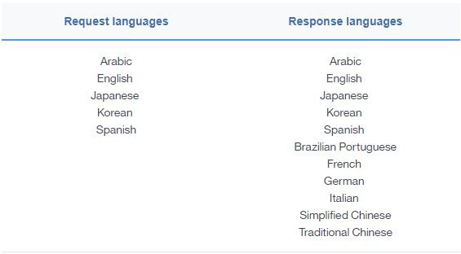
Personality Insights Concepts
LANGUAGE SUPPORT

Slide 8
Personality Insights Use Case
Targeted Advertising
Marketing Campaigns
Customer Acquisition
Customer Care
Personal Connections
Resume Writing

Slide 9
Personality Insights Hands On
BEFORE YOU BEGIN:
Create instance of the service
Login to IBM Cloud. Go to Catalog. Select Watson under Platform. Then Select Personality Insights.
Give a service name. Then click Create.
Copy the credentials to authenticate your service instance.
From your project in the Developer Console, add a new credential, give a credential name then click on Add. Copy the username, password, and url values from the credential you created.
Create a maven project in eclipse. File > New > Maven Project > Create a simple project > Next
Enter group id, (ex: com.acn.watson) and artifact id (ex. personality-insights) > Finish
Check Build Path > Right click on project > Build path > Configure Build Path > Libraries > Remove JRE 1.5
Add JRE 1.8 Library > Add Library > JRE System Library > Next > Click on Workspace Default > Finish > Apply >Apply and Close

Slide 10
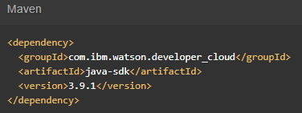

Personality Insights Hands On
Go to https://www.ibm.com/watson/developercloud/personality-insights/api
Copy Maven dependency in pom.xml
Add main class > Right click on src/main/java > Give a class name > under Which method stubs would you like to create? Tick public static void main(String[] args) > Click on Finish
On the api website > Click Get profile under Methods
Download the sample file > profile.json > put this in the project folder

Slide 11
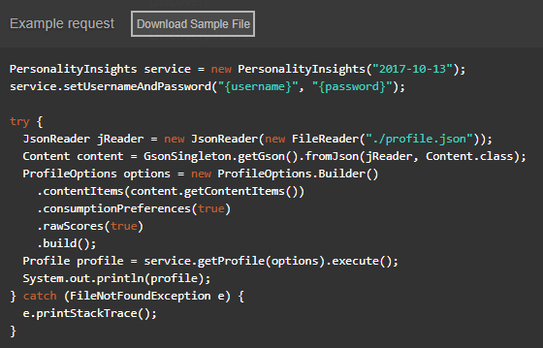
Personality Insights Hands On
Copy the code in the main method:

Slide 12
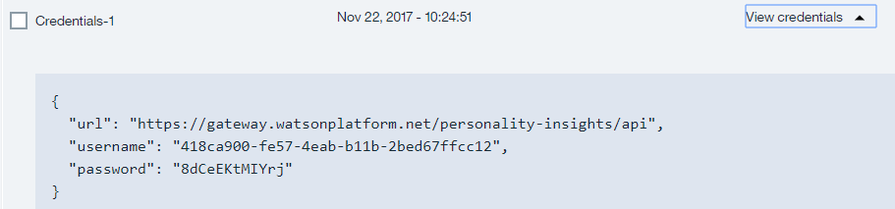

Personality Insights Hands On
Import all necessary libraries
Copy and change the username, password based on the speech to text service credentials.
Sample credentials:
Right click on your project then run as java application.

Slide 13
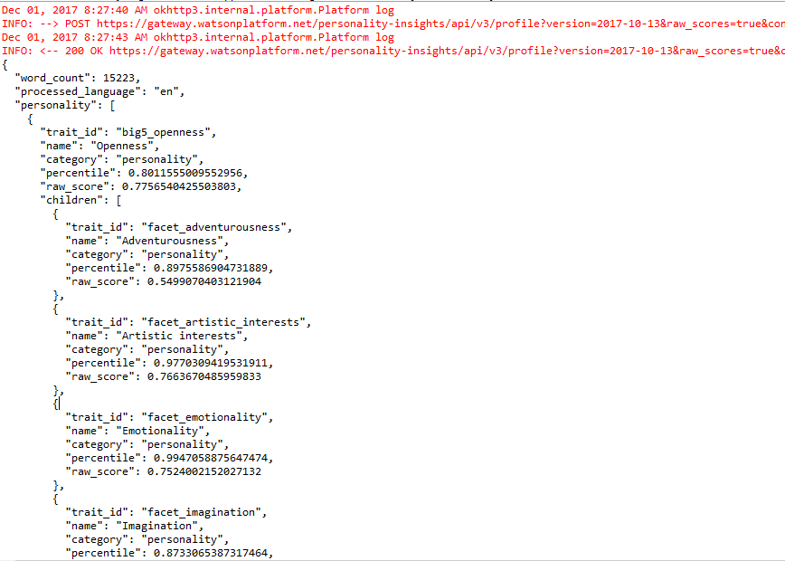
Personality Insights Hands On
Sample result:
Console:

Slide 14
Personality Insights References
About Personality Insights:
https://console.bluemix.net/docs/services/personality-insights/index.html#about
Getting Started Tutorial:
https://console.bluemix.net/docs/services/personality-insights/getting-started.html#getting-started-tutorial
API:
https://www.ibm.com/watson/developercloud/personality-insights/api

