Slide 1

Watson
Speech to Text

Slide 2
Agenda
Speech to Text Introduction
Key concepts
Usecase
Hands on
References

Slide 3
Speech to Text Introduction
- transcribes audio to text to enable speech transcription capabilities for applications. It converts the human voice into written words. It can be used in any application where speech or audio files are used as input and in which text is the desired output.
- provides Application Programming Interfaces (APIs) that let you add speech transcription capabilities to your applications. To transcribe the human voice accurately, the service leverages machine intelligence to combine information about grammar and language structure with knowledge of the composition of the audio signal. The service continuously returns and retroactively updates a transcription as more speech is heard.

Slide 4
Speech to Text Concepts
SUPPORTED INTERFACES
The Speech to Text service offers three interfaces for speech recognition:
A WebSocket interface for establishing persistent, full-duplex connections with the service.
An HTTP REST interface that supports both sessionless and session-based calls to the service.
An asynchronous HTTP interface that provides non-blocking calls to the service.

Slide 5
Speech to Text Concepts
INPUT FEATURES
The service's interfaces share many common input features for transcribing speech to text:
Audio formats: You can transcribe Ogg or Web Media (WebM) audio with the Opus or Vorbis codec, MP3 or MPEG, Waveform Audio File Format (WAV), Free Lossless Audio Codec (FLAC), Linear 16-bit Pulse-Code Modulation (PCM), mu-law (or u-law) audio, and basic audio.
Languages and models: For most languages, you can use transcribe audio by using broadband or narrowband models. Use broadband for audio that is sampled at a minimum rate of 16 kHz; use narrowband for audio that is sampled at a minimum rate of 8 kHz.
Audio transmission: You can pass as much as 100 MB of audio to the service as a continuous stream of data chunks or as a one-shot delivery, passing all of the data at one time. With streaming, the service enforces various timeouts to preserve resources.

Slide 6
Speech to Text Concepts
OUTPUT FEATURES
The interfaces also support the following output features:
Speaker labels: You can recognize different speakers from audio in US English, Spanish, or Japanese. The transcription labels each speaker's contributions to a multi-participant conversation. (Beta functionality.)
Keyword spotting: You can identify spoken phrases that match specified keyword strings with a user-defined level of confidence. This is especially useful when individual phrases from the audio are more important than the full transcription, for example, for a customer support system to determine how to route user requests. (Beta functionality.)
Maximum alternatives and interim results: You can request alternative and interim transcription results. The former provide different possible transcriptions; the latter represent interim hypotheses as a transcription progresses. In both cases, the service indicates final results in which it has the greatest confidence.

Slide 7
Speech to Text Concepts
OUTPUT FEATURES
Word alternatives, word confidence, and word timestamps: You can request alternative words that are acoustically similar to the words of a transcript, confidence levels for each of the words, and timestamps for the start and end of each word. (Word alternatives are beta functionality.)
Profanity filtering: You can censor profanity from US English transcriptions to sanitize a transcript.
Smart formatting: You can convert dates, times, numbers, phone numbers, and currency values in final transcripts of US English audio into more readable, conventional forms. (Beta functionality.)

Slide 8
Speech to Text Concepts
LANGUAGE SUPPORT
The service offers models for the following languages: Brazilian Portuguese, French, Japanese, Mandarin Chinese, Modern Standard Arabic, Spanish, UK English, and US English. The service does not support all features for all languages. In addition, it supports some features as generally available (GA) for production use and others as beta offerings for different languages.

Slide 9
Speech to Text Use Case
Voice control of applications, embedded devices, vehicle accessories.
Transcribing meetings and conference calls
Dictating email messages, notes.

Slide 10
Speech to Text Hands On
BEFORE YOU BEGIN:
Create instance of the service
Login to IBM Cloud. Go to Catalog. Select Watson under Platform. Then Select Speech To Text.
Give a service name, choose region, organization and space. Then click Create.
Copy the credentials to authenticate your service instance.
From your project in the Developer Console, add a new credential, give a credential name then click on Add. Copy the username, password, and url values from the credential you created.
Create a maven project in eclipse. File > New > Maven Project > Create a simple project > Next
Enter group id, (ex: com.acn.watson) and artifact id (ex. speechtotext) > Finish
Check Build Path > Right click on project > Build path > Configure Build Path > Libraries > Remove JRE 1.5
Add JRE 1.8 Library > Add Library > JRE System Library > Next > Click on Workspace Default > Finish > Apply >Apply and Close

Slide 11
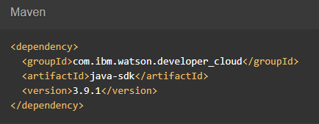

Speech to Text Hands On
Go to https://www.ibm.com/watson/developercloud/speech-to-text/api/v1/#introduction
Copy Maven dependency in pom.xml
Add main class > Right click on src/main/java > Give a class name > under Which method stubs would you like to create? Tick public static void main(String[] args) > Click on Finish
On the api website > Click Recognize audio under WebSockets
Download the sample audio flac file (audio-file.flac) > then put it in the project folder

Slide 12
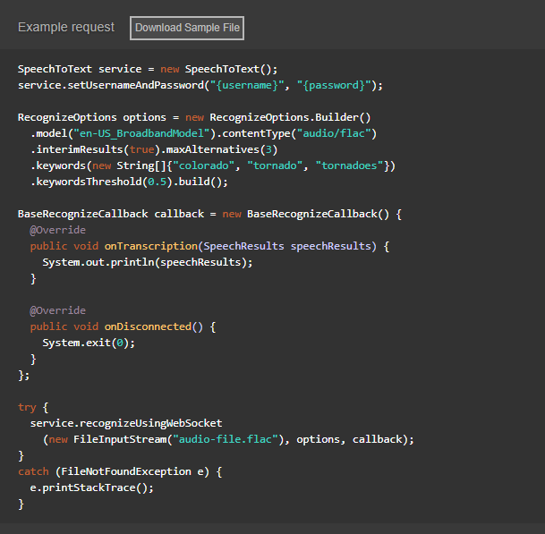
Speech to Text Hands On
Copy the code in the main method:

Slide 13
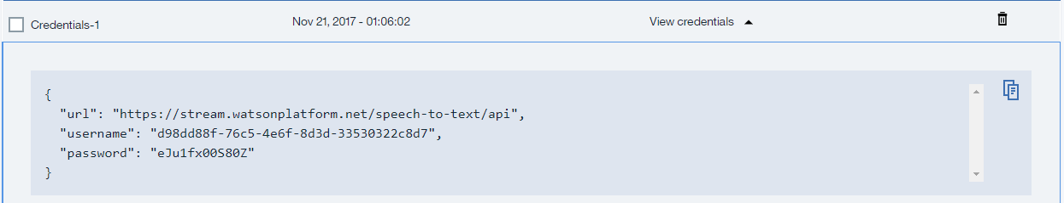
Speech to Text Hands On
Import all necessary libraries
Copy and change the username, password based on the speech to text service credentials.
Sample credentials:
Right click on your project then run as java application.

Slide 14
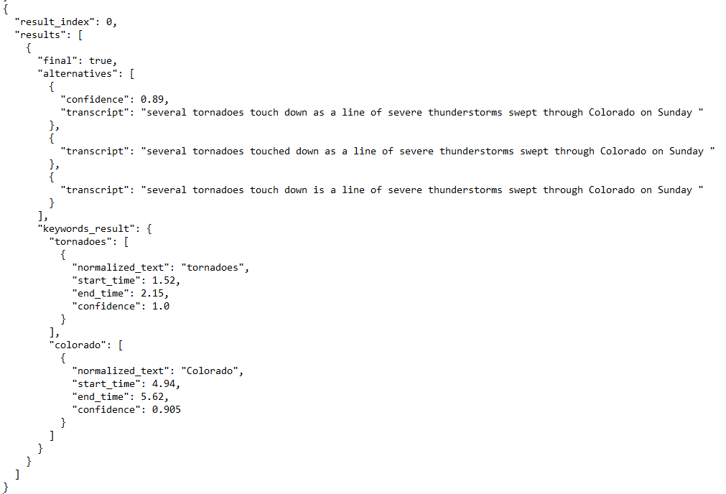
Speech to Text Hands On
Sample result:

Slide 15
Speech To Text References
About Speech to Text:
https://console.bluemix.net/docs/services/speech-to-text/index.html#about
Getting Started Tutorial:
https://console.bluemix.net/docs/services/speech-to-text/getting-started.html#gettingStarted
API:
https://www.ibm.com/watson/developercloud/speech-to-text/api/v1/

