Slide 1

Watson
Text to Speech

Slide 2
Agenda
Text to Speech Introduction
Key concepts
Usecase
Hands on
References

Slide 3
Text to Speech Introduction
- converts written text to natural-sounding speech to provide speech-synthesis capabilities for applications.
- provides an Application Programming Interface (API) that uses IBM's speech-synthesis capabilities to convert written text to natural-sounding speech. The service streams the results back to the client with minimal delay. The service offers both HTTP REST and WebSocket interfaces.

Slide 4
Text to Speech Concepts
FEATURES AND CAPABILITIES
The Text to Speech service offers the following features and capabilities:
Audio formats: Produces audio in Ogg or WebM with the Opus or Vorbis codec, WAV, FLAC, MP3 (MPEG), l16 (PCM), mulaw, or basic format. See Specifying an audio format.
Voices: Synthesizes text to audio in a variety of languages, voices, and dialects. See Specifying a voice.
SSML: Accepts plain text or text that is marked up with the XML-based Speech Synthesis Markup Language (SSML). See Using SSML.
Expressiveness: Extends SSML with an expressive element that lets you indicate a speaking style of GoodNews, Apology, or Uncertainty. Currently available only for the US English Allison voice. See Expressive SSML.

Slide 5
Text to Speech Concepts
FEATURES AND CAPABILITIES
Voice transformation: Extends SSML by adding a voice transformation element that lets you expand the range of possible voices by controlling aspects such as pitch, rate, and timbre. Also offers two built-in virtual voices, Young and Soft. Currently available only for US English voices. See Voice transformation SSML.
Word timings: With the WebSocket interface, supports the SSML <mark> element as well as optional word timing information for all strings of the input text. Timing information lets you synchronize the input text and the resulting audio. See Obtaining word timings.
Customization: Provides a customization interface that lets you specify how the service pronounces unusual words that occur in your input. You can define pronunciations with the International Phonetic Alphabet (IPA) or IBM Symbolic Phonetic Representation (SPR). See Understanding customization.

Slide 6
Text to Speech Concepts
LANGUAGE SUPPORT
The service supports voices in the following languages: Brazilian Portuguese, English (UK and US dialects), French, German, Italian, Japanese, and Spanish (Castilian, Latin American, and North American dialects). The service offers at least one male or female voice, sometimes both, for each language. Each voice uses appropriate cadence and intonation for its dialect.

Slide 7
Text to Speech Use Case
In home automation solutions
Assistance tools for the vision-impaired
Reading text and email messages aloud to drivers
Video script narration and Voice over
Reading based educational tools

Slide 8
Text to Speech Hands On
BEFORE YOU BEGIN:
Create instance of the service
Login to IBM Cloud. Go to Catalog. Select Watson under Platform. Then Select Text To Speech.
Give a service name, choose region, organization and space. Then click Create.
Copy the credentials to authenticate your service instance.
From your project in the Developer Console, add a new credential, give a credential name then click on Add. Copy the username, password, and url values from the credential you created.
Create a maven project in eclipse. File > New > Maven Project > Create a simple project > Next
Enter group id, (ex: com.acn.watson) and artifact id (ex. texttospeech) > Finish
Check Build Path > Right click on project > Build path > Configure Build Path > Libraries > Remove JRE 1.5
Add JRE 1.8 Library > Add Library > JRE System Library > Next > Click on Workspace Default > Finish > Apply >Apply and Close

Slide 9
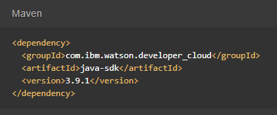

Text to Speech Hands On
Go to https://www.ibm.com/watson/developercloud/text-to-speech/api/v1/
Copy Maven dependency in pom.xml
Add main class > Right click on src/main/java > Give a class name > under Which method stubs would you like to create? Tick public static void main(String[] args) > Click on Finish
On the api website > Click Synthesize audio under Synthesis

Slide 10
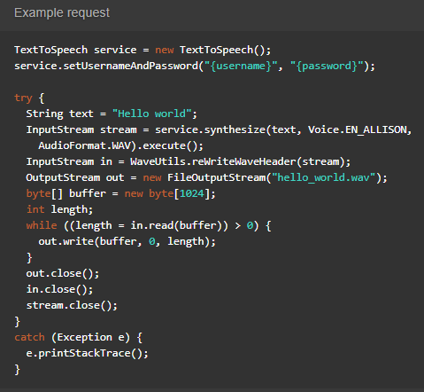
Text to Speech Hands On
Copy the code in the main method:

Slide 11
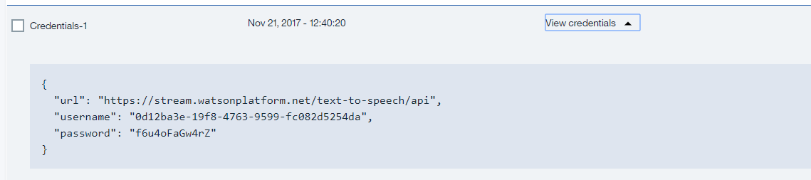

Text to Speech Hands On
Import all necessary libraries
Copy and change the username, password based on the speech to text service credentials.
Sample credentials:
Right click on your project then run as java application.
Refresh your project > you will see hello_world.wav > open the wav file in your media player.

Slide 12
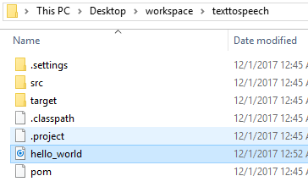
Text to Speech Hands On
Sample result:
Console:
Created wav file:

Slide 13
Text to Speech References
About Text to Speech:
https://console.bluemix.net/docs/services/text-to-speech/index.html#about
Getting Started Tutorial:
https://console.bluemix.net/docs/services/text-to-speech/getting-started.html#gettingStarted
API:
https://www.ibm.com/watson/developercloud/text-to-speech/api/v1/

