Slide 1

Watson
Tone
Analyzer

Slide 2
Agenda
Tone Analyzer Introduction
Key concepts
Usecase
Hands on
References

Slide 3
Tone Analyzer Introduction
- analyzes the tone of input content.
- uses linguistic analysis to detect emotional and language tones in written text. The service can analyze tone at both the document and sentence levels. You can use the service to understand how your written communications are perceived and then to improve the tone of your communications. Businesses can use the service to learn the tone of their customers' communications and to respond to each customer appropriately, or to understand and improve their customer conversations in general.

Slide 4
Tone Analyzer Introduction
- You submit JSON, plain text, or HTML input that contains your written content to the service. The service accepts up to 128 KB of text, which is about 1000 sentences. The service returns JSON results that report the tone of your input. You can use these results to improve the perception and effectiveness of your communications, ensuring that your writing conveys the tone and style that you want for your intended audience.

Slide 5
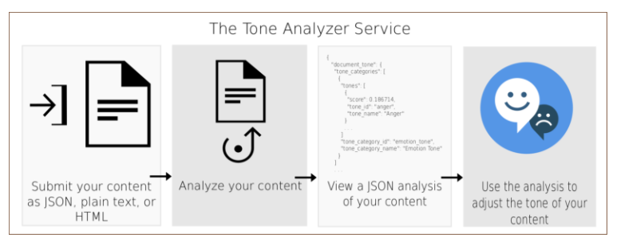
Tone Analyzer Concepts

Slide 6
Language Translator Concepts
TONE ANALYZER ENDPOINTS
General purpose endpoint (GET or POST /v3/tone)
Use the Tone Analyzer general purpose endpoint to analyze shorter web data, such as email messages or tweets, or longer documents, such as articles or blog posts. Monitor social media to understand what customers are saying about a brand and to determine whom to target with specific messaging. The endpoint accepts JSON, plain text, or HTML input. For more information about the method and the tones that it returns, see Using the general purpose endpoint.
The general purpose demo External link icon lets you submit content to the service for analysis. The service returns overall and sentence-level analyses of the tone of the content.

Slide 7
Language Translator Concepts
TONE ANALYZER ENDPOINTS
Customer engagement endpoint (POST /v3/tone_chat)
Use the Tone Analyzer customer engagement endpoint to monitor customer service and support conversations. Escalate customer conversations when they turn sour or find opportunities to improve customer service scripts, dialog strategies, and customer journeys. The endpoint accepts JSON input. For more information about the method and the tones that it returns, see Using the customer engagement endpoint.
The customer engagement demo External link icon analyzes conversations between customers and customer service agents. The service measures customer satisfaction and concerns, assesses agent performance, and lets you gauge how the interaction evolves.

Slide 8
Language Translator Concepts
LANGUAGE SUPPORT
The /v3/tone method can analyze content in English (en) and French (fr); the /v3/tone_chat method supports only English. Both methods can respond with localized content in a variety of languages. For more information, see Using the general purpose endpoint and Using the customer engagement endpoint.

Slide 9
Tone Analyzer Use Case
Social listening and audience monitoring
Personalized marketing
Chat bots
Customer engagement monitoring and quality assurance

Slide 10
Tone Analyzer Hands On
BEFORE YOU BEGIN:
Create instance of the service
Login to IBM Cloud. Go to Catalog. Select Watson under Platform. Then Select Tone Analyzer.
Give a service name, select region, org and space. Then click Create.
Copy the credentials to authenticate your service instance.
From your project in the Developer Console, add a new credential, give a credential name then click on Add. Copy the username, password, and url values from the credential you created.
Create a maven project in eclipse. File > New > Maven Project > Create a simple project > Next
Enter group id, (ex: com.acn.watson) and artifact id (ex. toneanalyzer) > Finish
Check Build Path > Right click on project > Build path > Configure Build Path > Libraries > Remove JRE 1.5
Add JRE 1.8 Library > Add Library > JRE System Library > Next > Click on Workspace Default > Finish > Apply >Apply and Close

Slide 11
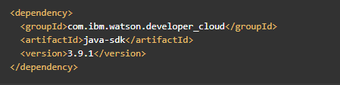

Tone Analyzer Hands On
Go to https://www.ibm.com/watson/developercloud/tone-analyzer/api/v3/
Copy Maven dependency in pom.xml
Add main class > Right click on src/main/java > Give a class name > under Which method stubs would you like to create? Tick public static void main(String[] args) > Click on Finish
On the api website > Click Translate audio under Methods
Download sample files: General Tone (tone.json) and Customer Engagement Tone (tone-chat.json)
Copy both files in project folder.

Slide 12
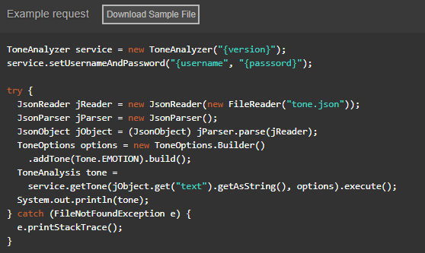
Tone Analyzer Hands On (Analyze General Tone)
Copy the code in the main method:

Slide 13
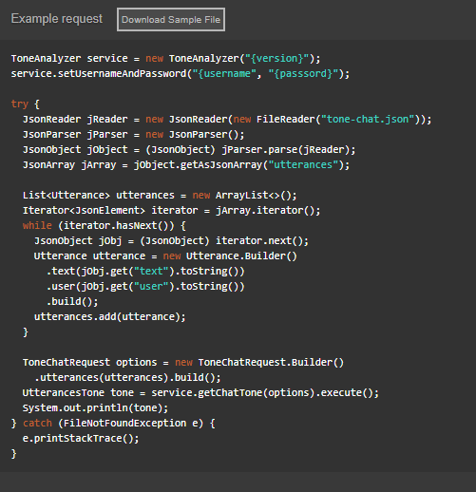
Tone Analyzer Hands On (Analyze Customer Engagement Tone)
Copy the code in the main method:

Slide 14
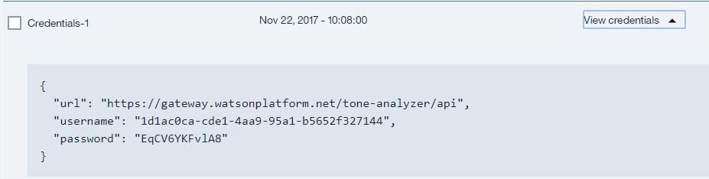
Tone Analyzer Hands On
Import all necessary libraries
Copy and change the version, username, password based on the speech to text service credentials.
Sample credentials:
Right click on your project then run as java application.

Slide 15
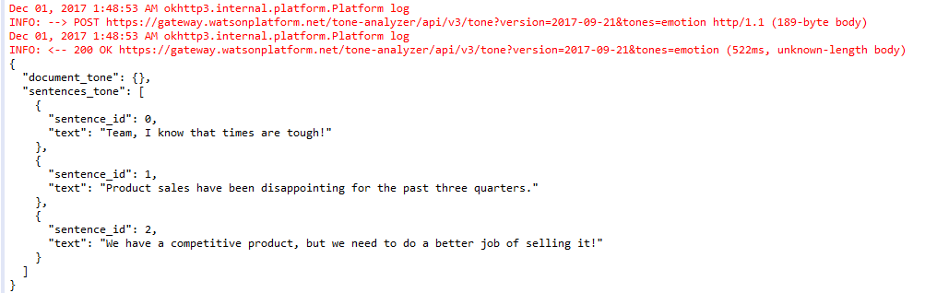
Tone Analyzer Hands On
Console:
General Tone Analyzer Output:

Slide 16
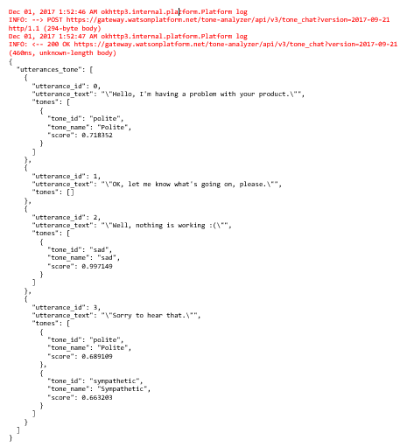
Tone Analyzer Hands On
Console:
Customer Engagement Tone Analyzer Output:

Slide 17
Tone Analyzer References
About Tone Analyzer:
https://console.bluemix.net/docs/services/tone-analyzer/index.html#about
Getting Started Tutorial:
https://console.bluemix.net/docs/services/tone-analyzer/getting-started.html#getting-started-tutorial
API:
https://www.ibm.com/watson/developercloud/tone-analyzer/api/v3/

