Slide 1
Architectural Design
Team Two:
Jessica DiMariano
Sean McDonald
Xi Chen
Jason Lueckenhoff
Aaron Gershman

Slide 2
Class Structure
main-subroutine
allows methods to be separated into specialized functions
allows multiple team members to experiment with a single method implementation, without interfering with other methods
initiating program is done in “Main”
formatting addresses will be done in "AddressFormatter"
aggregates “addresses” from data input
where most of our program logic will be done
“Views” can be written separately from the program logic

Slide 3
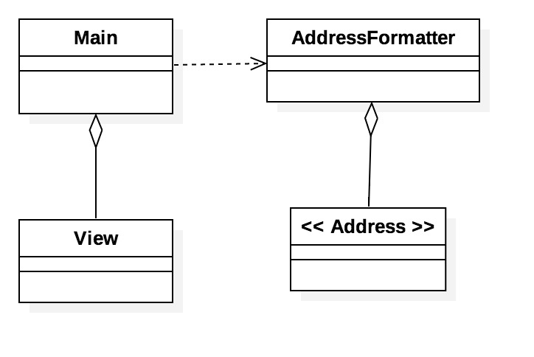
Class Diagram
Main
View
simple navigation screens
AddressFormatter
aggregates multiple addresses
where the program logic resides, making changes to the data
Address
individual address entities

Slide 4
Decoupling Benefits of Design
the "main-subroutine" architectural pattern is simple and modular
new features could easily added
adding “AI engines” or other optional discussed enhancements can be added in the future without interfering with existing structures
new experimental features can be tested by multiple members simultaneously
separating the addresses into specialized functions helps maintain information hiding principles
methods which format ZIP will only receive information on ZIP, etc.

Slide 5
Implementation Language
Python 3.4+
readable code without verbosity of Java
supports multi-paradigm styles
object-oriented, functional, etc.
does not require a special IDE
PyCharm, Sublime Text … Notepad.
very portable language (usable on nearly all machines)
many built-in methods for manipulating strings, lists, tuples, etc.

Slide 6
Implementation Language Cont.
Python 3.4+
many graphics packages for user interface design
TkInter (ships with python, lightweight, multi-paradigm, etc.)
Python 2.x only supported until 2020
healthy open-source community
packages such as “usaddress” can be used for tagging different parts of the addresses

Slide 7
Bonus: usaddress + part of speech tagging
code | output
import usaddress gersh_address = ('303 Hillcrest Drive, Kirksville MO 63501-2292') out = usaddress.parse(gersh_address) for x in out: print (x) | (u'303', 'AddressNumber') (u'Hillcrest', 'StreetName') (u'Drive,', 'StreetNamePostType') (u'Kirksville', 'PlaceName') (u'MO', 'StateName') (u'63501-2292', 'ZipCode')

