Slide 1
DSCI 4520/5240 (DATA MINING)
DSCI 4520/5240 Lecture 3
Comparing Models
Some slide material taken from: Cerrito, SAS Education

Slide 2
Objectives
  Present various charts used to compare models.
  Explain how these charts are created

Slide 3
Creating Model Assessment charts
  Steps:
  Using the model, produce estimated probabilities for the target event for each case
  Sort all cases by decreasing estimated probability. If the model is good, cases where the target event actually shows up should have higher estimated probabilities, therefore should end up higher in the list
  Split the cases into, say 10 bins, so that Bin #1 has the highest probabilities, and Bin #10 the lowest probabilities
  Now look at the number of cases where the target event actually happens. These are shown as blue balls in the next graph

Slide 4
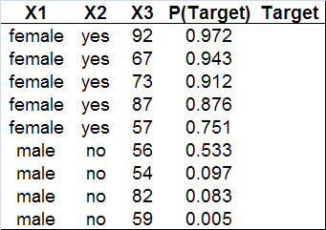
Creating Model Assessment charts
Predicted probabilities, estimated using the model we are trying to assess
Actually observed values of the target variable

Slide 5
Looking inside the bins
  Good models assign high probabilities to cases which will actually have the target even (defaulting, donating, etc.)
  Bin #1
  (high probabilities)
  Bin #10
  (low probabilities)
  = target event has ACTUALLY occurred
  = target event has actually not occurred

Slide 6
%Response
  %Response shows you what percentage of each bin’s contents are target cases (defaulters, donors, etc., indicated here as blue balls)
  For example, 85% of cases that ended up in the 1st bin (because they had high probabilities) were observed to actually become target events (defaulters, donors, etc.)

Slide 7
%Captured Response
  %Captured Response shows you what percentage of all target cases (defaulters, donors, etc.) are “captured” by each bin
  For example, 35% of all defaulters may have been captured by the first bin

Slide 8
Baseline Model
  What if we assigned cases into the 10 bins randomly? This would create a “baseline” model. Comparing our model to this baseline, allows us to see how much better our model can do. This is quantified in a Lift Chart.

Slide 9
Lift Chart
  For each bin, get the ratio of “target cases in the model’s bin over target cases in the baseline.” This is called “Lift Value” for that bin.
  Lift Value for Bin#1 =
  = 5
  Bin #1

Slide 10
Lift Chart
  Lift Value for Bin#4 =
  = 1
  Bin #4

Slide 11
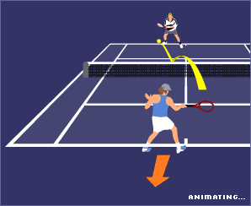

Baseline vs. the Perfect Model
  In order to investigate the differences in model performance, we contrast our model to two models with extreme performance: The baseline (bad performance) and the Perfect Model (excellent performance)

Slide 12
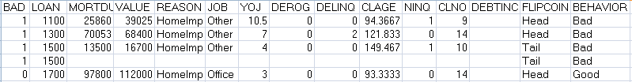
Baseline vs. the Perfect Model
  After exporting the HMEQ data from SAS to Excel, we create two new columns: FLIPCOIN (random Heads or Tails) and BEHAVIOR (Bad if BAD=1, Good if BAD=0)
  We then re-import the file to SAS as HMEQ_NEW. See HW3 for more details

Slide 13
Readings on model assessment
  Read Sarma text, chapter 7, for more info on:
    7.2 Models for Binary Targets (pp. 305-316)

Slide 14
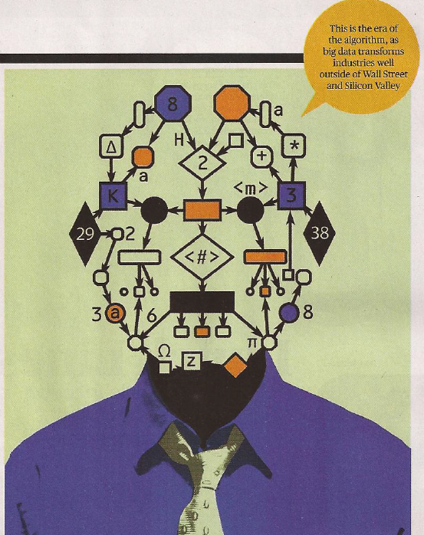
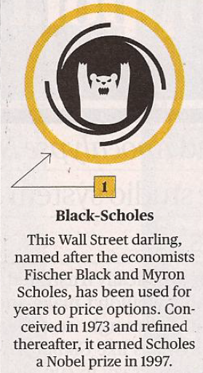
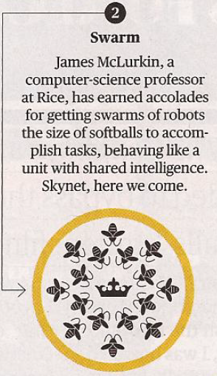
On the News: The End of Free Will
  Bloomberg BusinessWeek, Sep 10, 2012: Five of the most influential algorithms

Slide 15
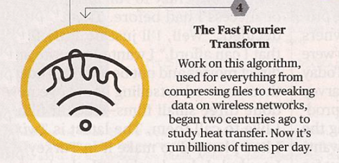
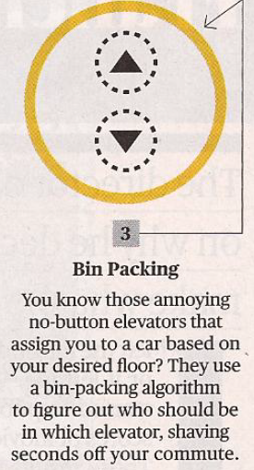
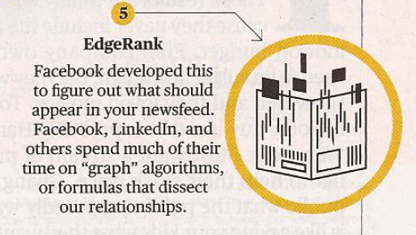
Five of the most influential algorithms - continued

