Slide 1
Topology
Host0
TCP
TCP
Host3
TCP
100Mbps
100Mbps
Router1
Router2
5Mbps
10Mbps
5Mbps
Host1
UDP
Host4
UDP
UDP
Tcp: 2s-40s
Udp: 10s-20s

Slide 2
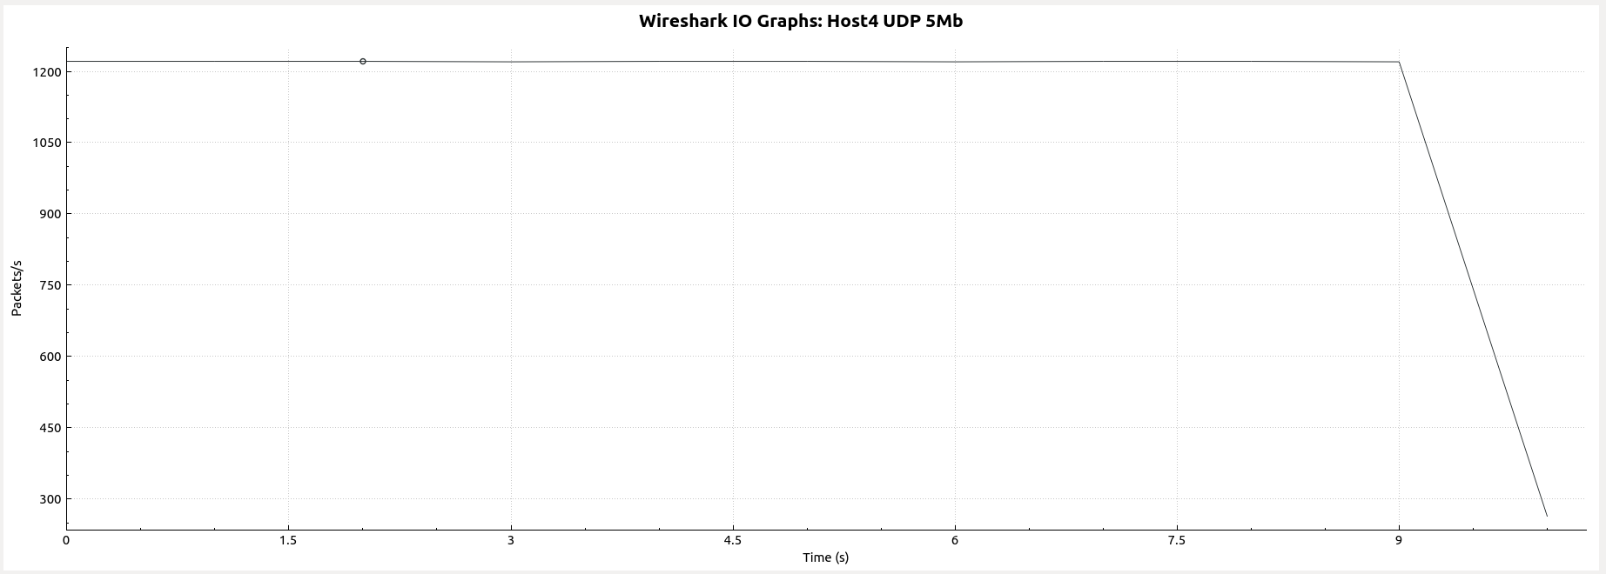
Host4 UDP Throughput
12471packets, average:531.75bytes

Slide 3
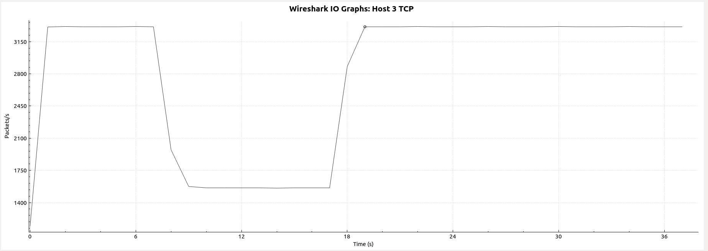
Host3 TCP Throughput
106179 packets, average:395.90bytes

Slide 4
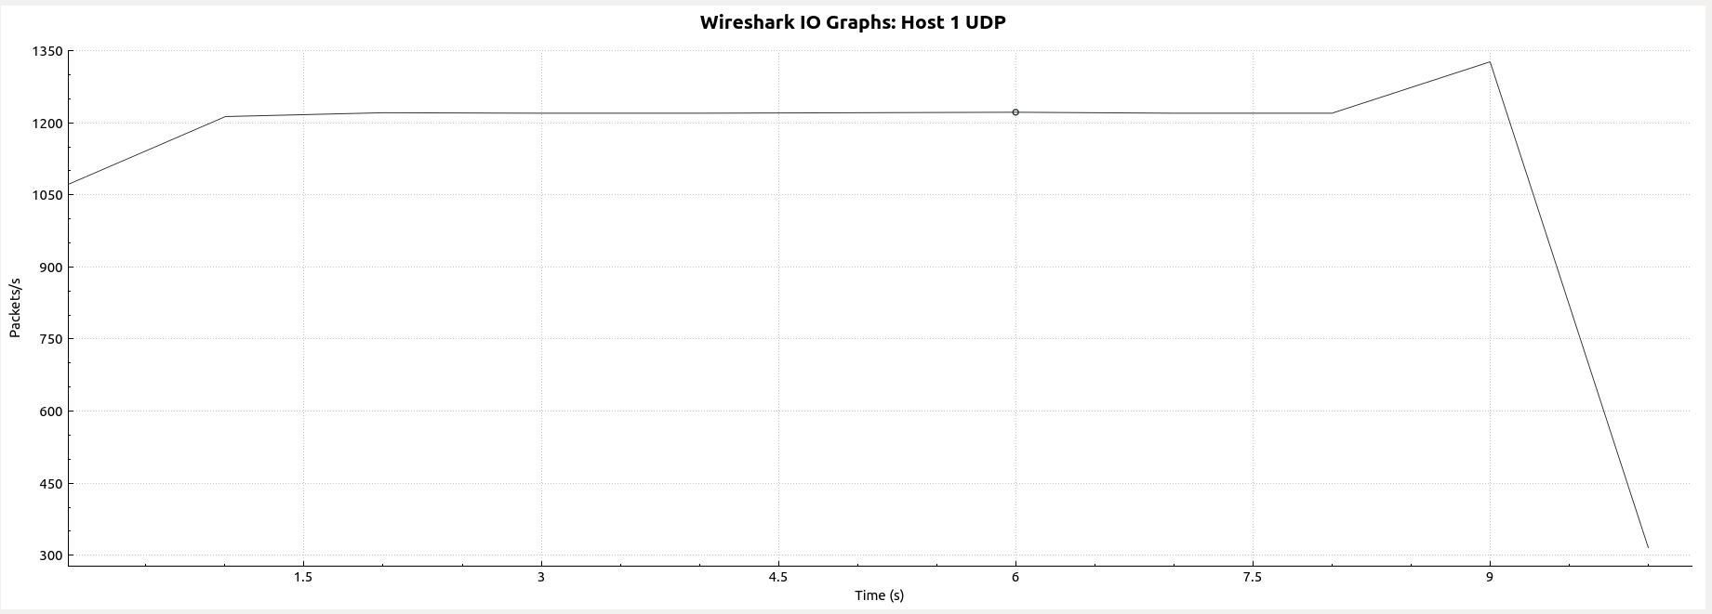
Host 1 UDP Throughput
12471 packets, average:531.75bytes

Slide 5
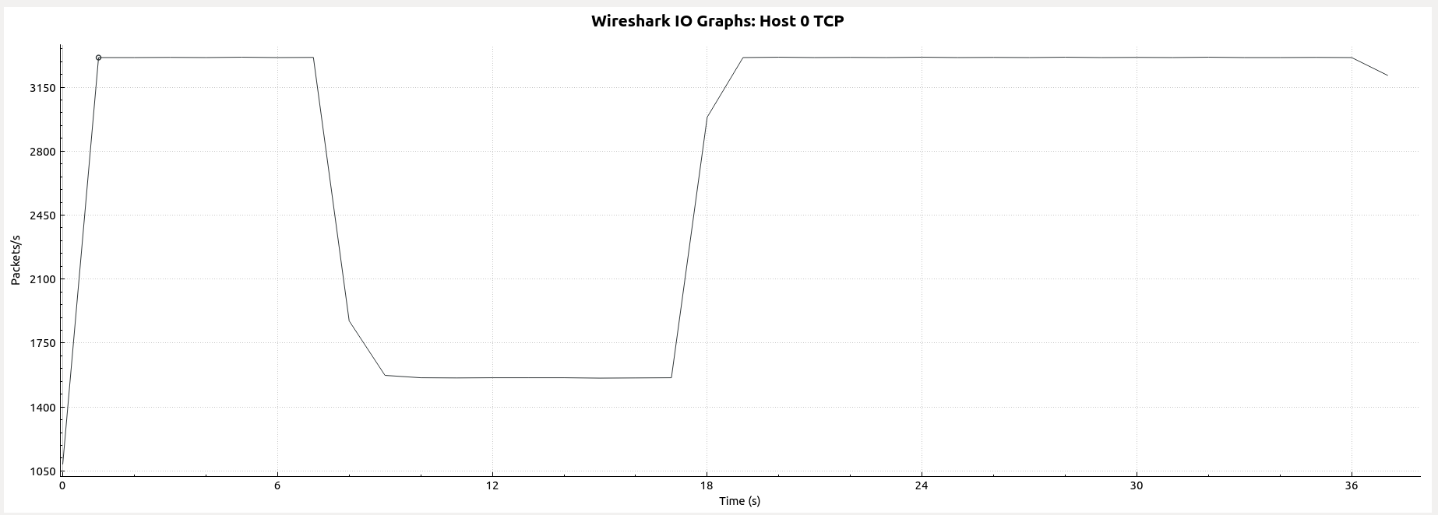
Host 0 TCP Throughput
106025packets, average:395.49bytes

Slide 6
Topology
TCP
TCP
Host2
1ms
Router
2ms
Host1
100Mbps
UDP
Router Buffer:
30 Packets
UDP
8Mbps: 1-6s
3Mbps: 6-11s
1Mbps: 11-16s
9Mbps:16-21s
2Mbps: 21-26s
7Mbps: 26-31s
3Mbps: 31-End
We change the data rate of the link between Rounter and Host2 every 5 seconds.

Slide 7
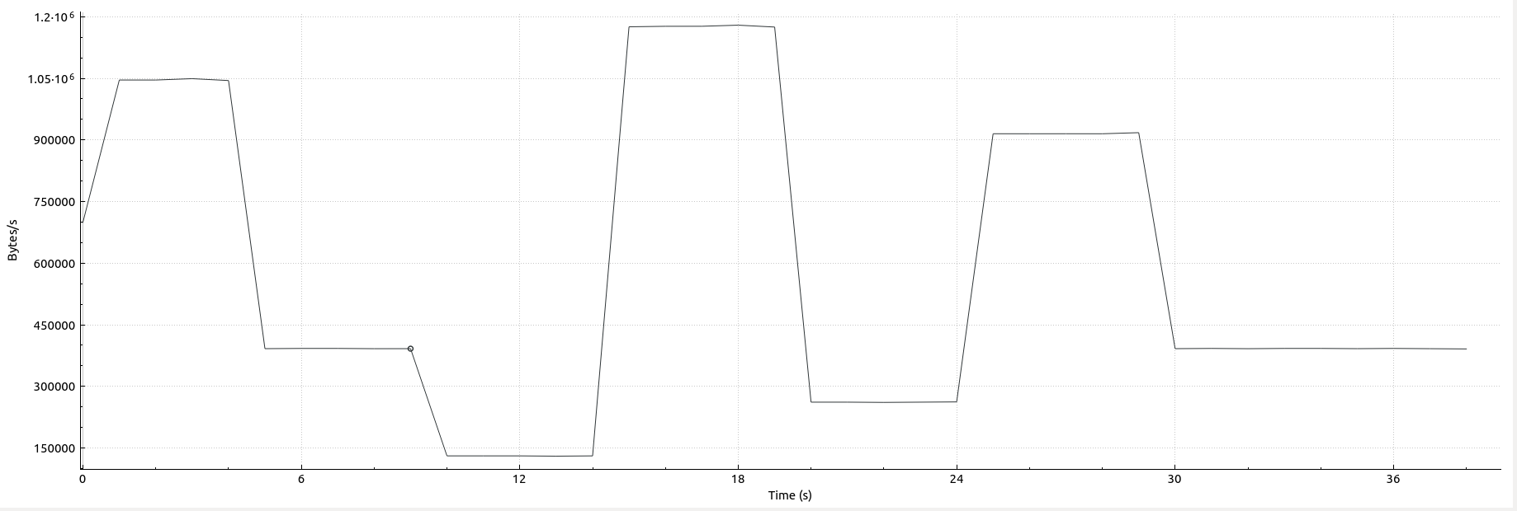
Host2 TCP Throughput

Slide 8
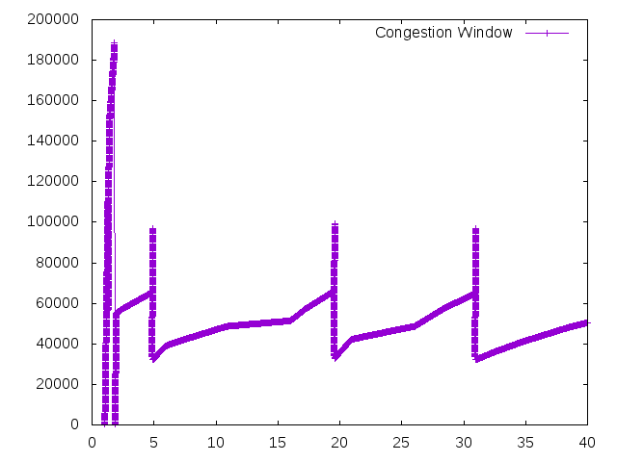
Congestion Window

Slide 9
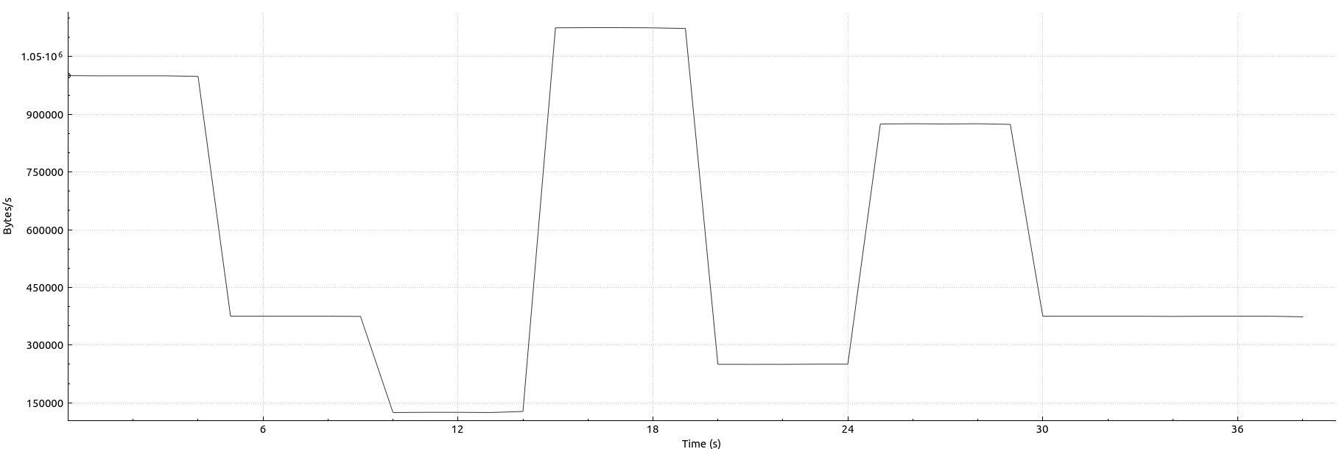
Host2 UDP Throughput

Slide 10
Topology
TCP
TCP
Host2
5ms
Router
10ms
Host1
100Mbps
UDP
Router Buffer:
30 Packets
UDP
8Mbps: 1-6s
3Mbps: 6-11s
1Mbps: 11-16s
9Mbps:16-21s
2Mbps: 21-26s
7Mbps: 26-31s
3Mbps: 31-End
We change the data rate of the link between Rounter and Host2 every 5 seconds.

Slide 11
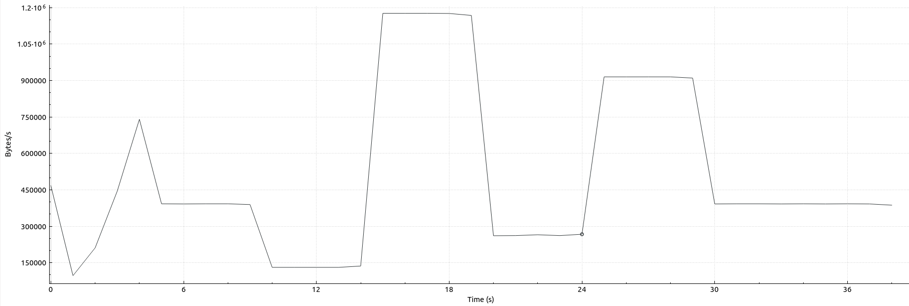
Host2 TCP Throughput

Slide 12
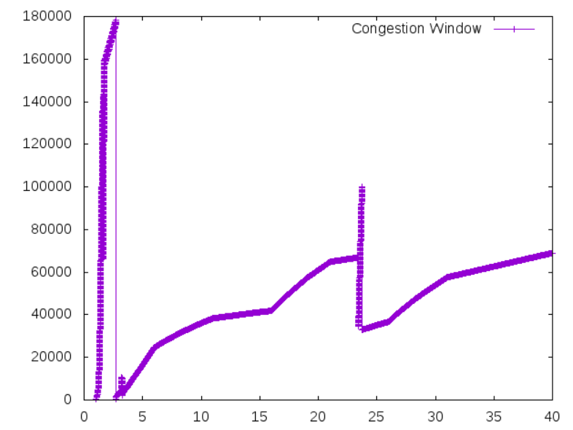
Congestion Window

Slide 13
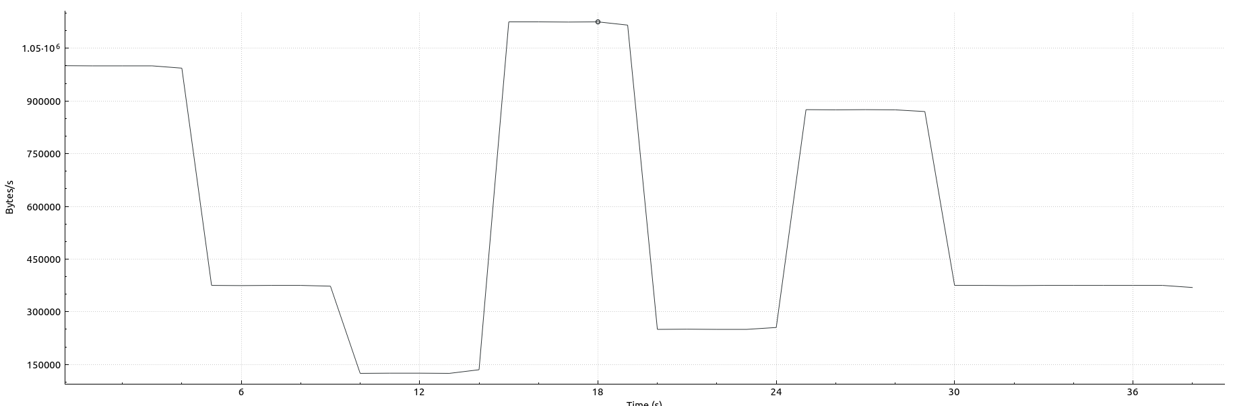
Host2 UDP Throughput

Slide 14
Topology
TCP
TCP
Host2
Router
2ms
Host1
10Mbps
100Mbps
UDP
Router Buffer:
30 Packets
UDP
80ms: 1-6s
30ms: 6-11s
10ms: 11-16s
90ms:16-21s
20ms: 21-26s
70ms: 26-31s
30ms: 31-End
We change the delay of the link between Rounter and Host2 every 5 seconds.

Slide 15
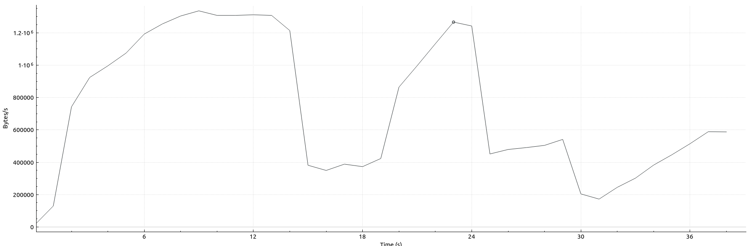
Host2 TCP Throughput

Slide 16
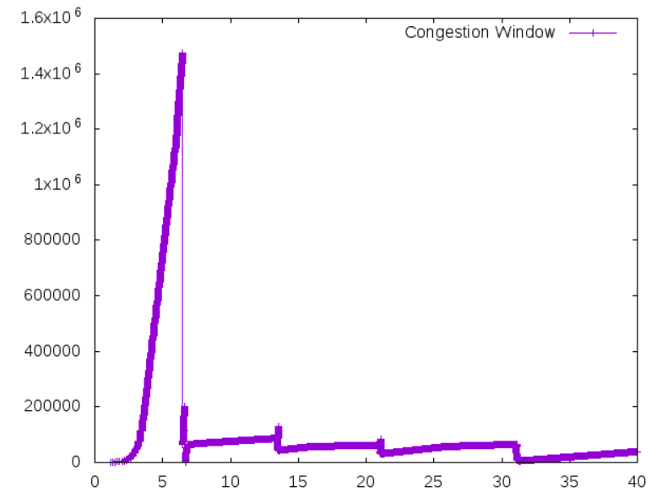
Congestion Window

Slide 17
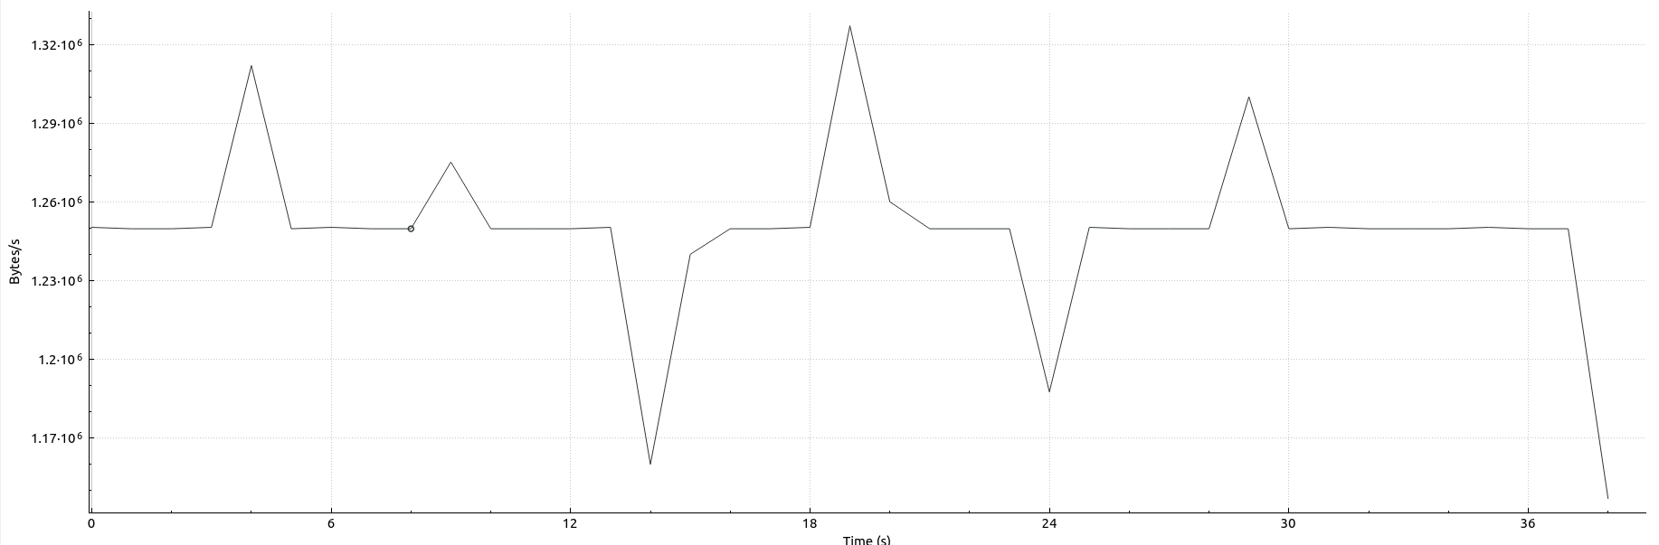
Host2 UDP Throughput

Slide 18
Topology
TCP
TCP
Host2
55ms
Router
2ms
Host1
10Mbps
100Mbps
UDP
Router Buffer:
30 Packets
UDP

Slide 19
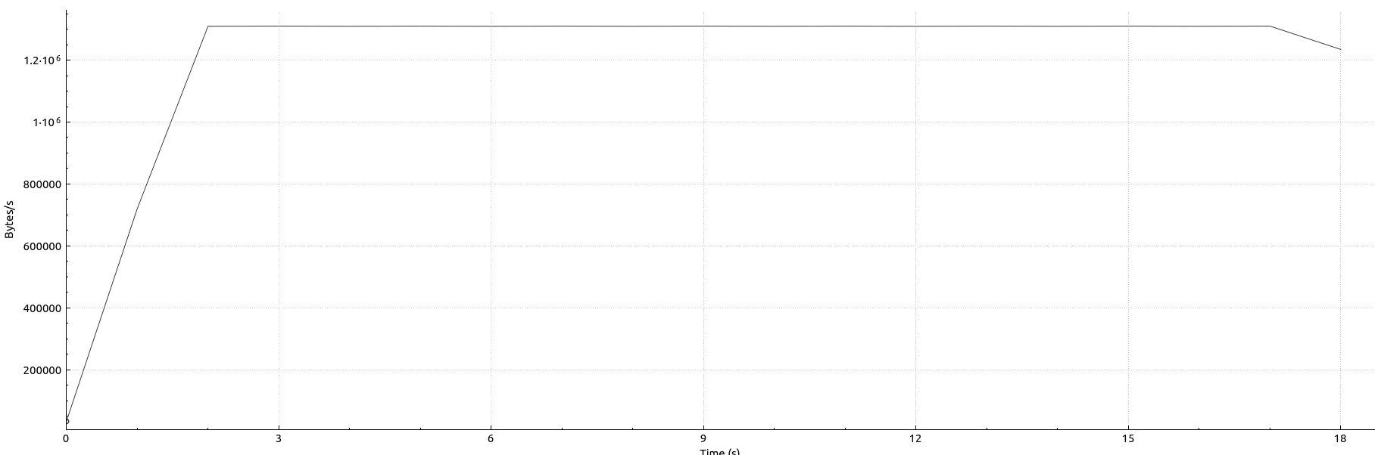
TCP Throughput with 55ms delay

Slide 20
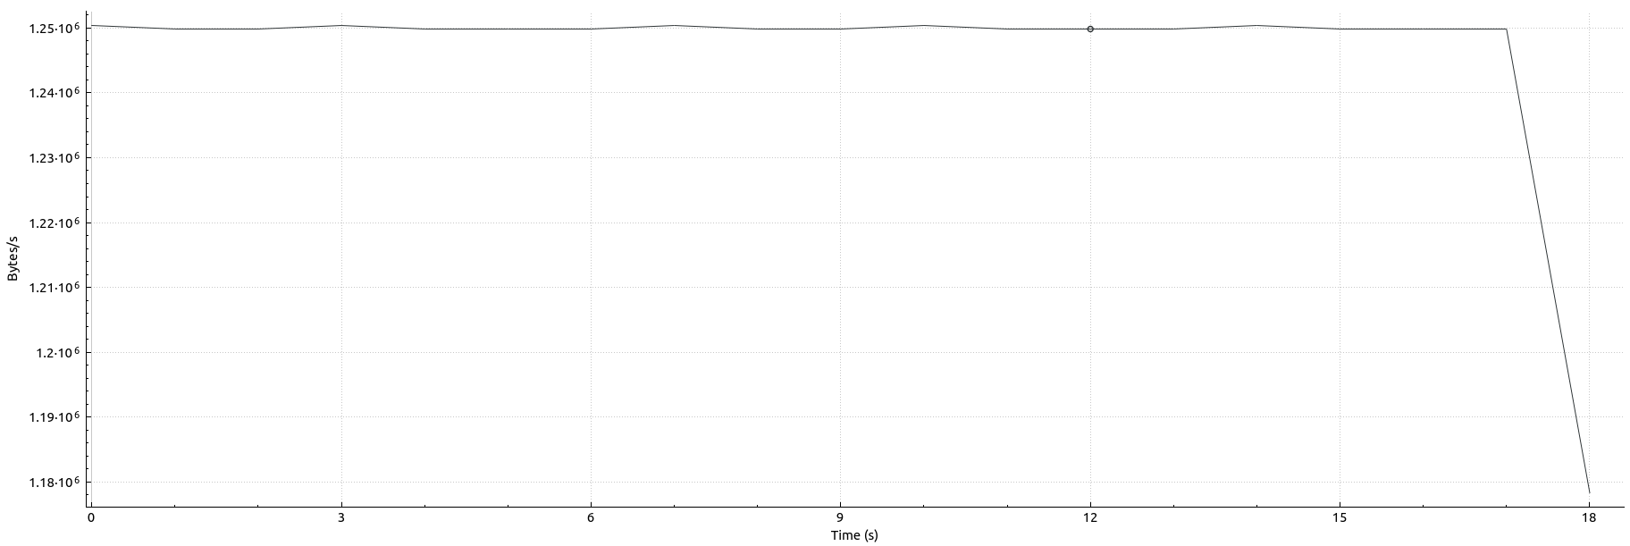
UDP Throughput with 55ms delay

Slide 21
Topology
TCP
TCP
Host2
60ms
Router
2ms
Host1
10Mbps
100Mbps
UDP
Router Buffer:
30 Packets
UDP

Slide 22
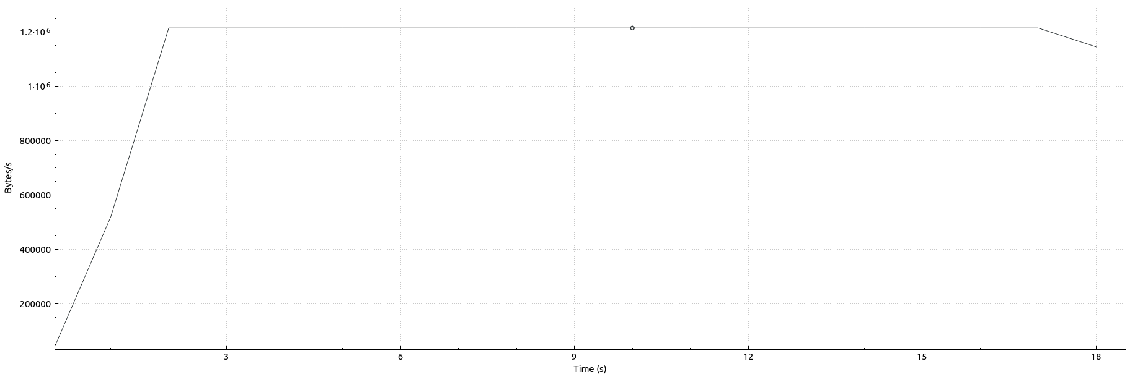
Host2 TCP Throughput with 60ms delay

Slide 23
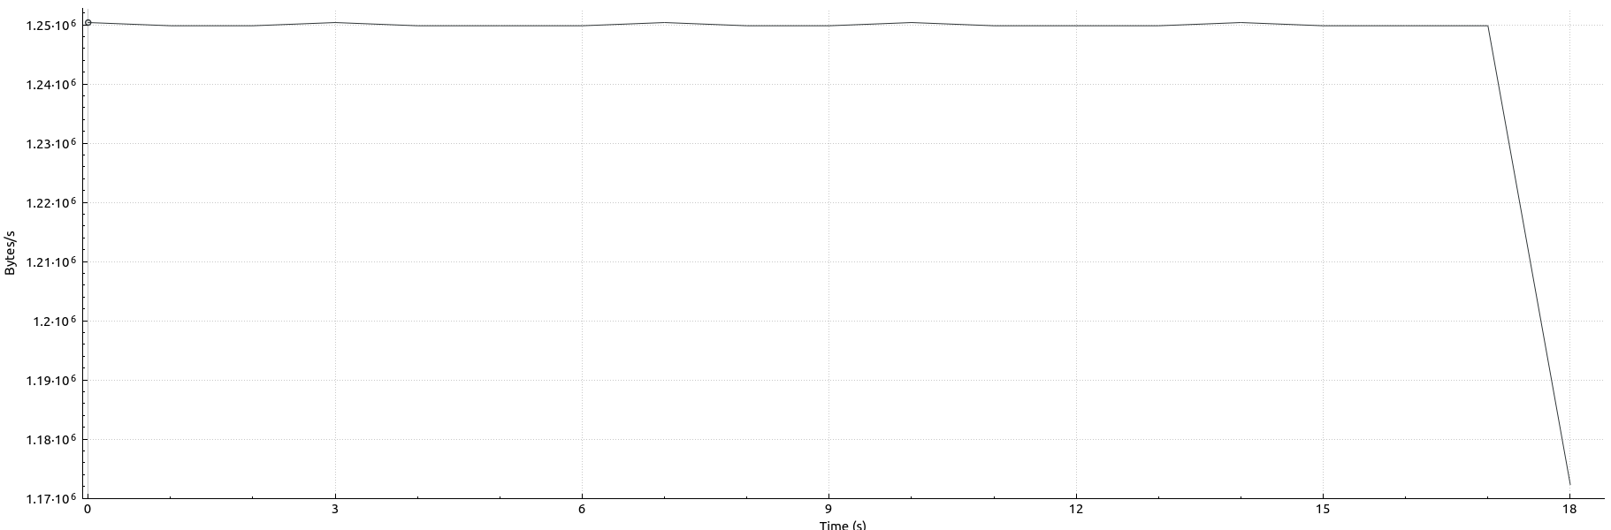
Host2 UDP Throughput with 60ms delay

Slide 24
Topology
TCP
TCP
Host2
65ms
Router
2ms
Host1
10Mbps
100Mbps
UDP
Router Buffer:
30 Packets
UDP

Slide 25
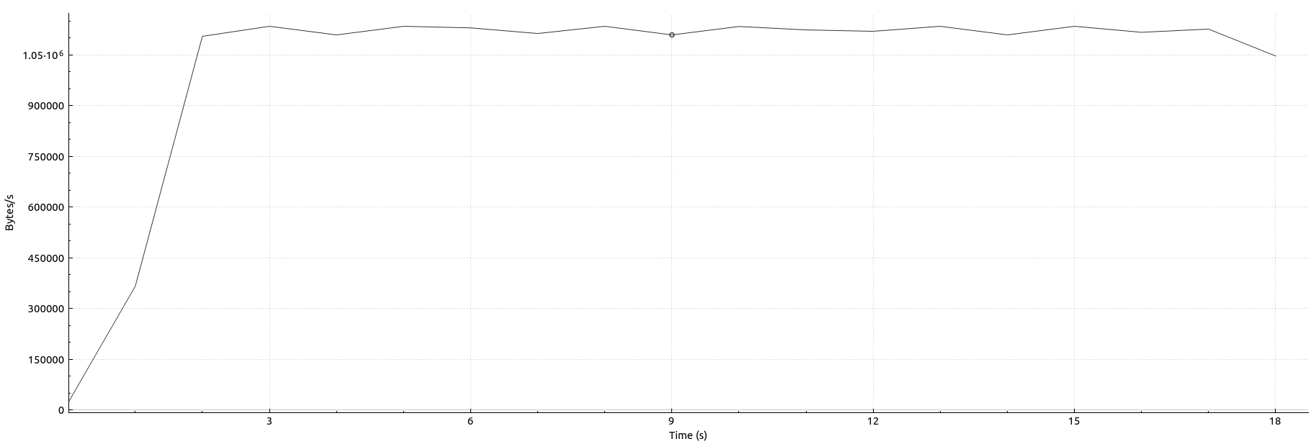
TCP Throughput with 65ms delay

Slide 26
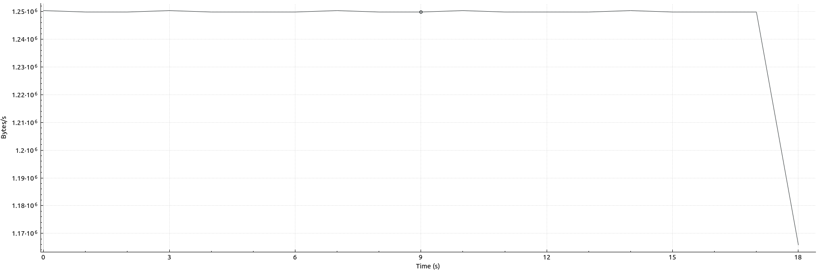
Host2 UDP Throughput with 65ms delay

