Slide 1
MAUL: Machine Agent User Learning
(some unscrambling necessary)
Mozilla/5.0 (Windows; U; Windows NT 6.1; en-US) AppleWebKit/534.10 (KHTML, like Gecko) Chrome/8.0.552.215 Safari/534.10
Robert Holley
Daniel Rosenfeld
CS229 Group Project
December 7, 2010
ML
BROWSER

Slide 2
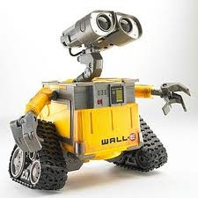
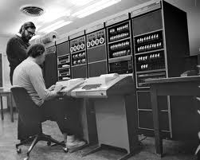

The User-agent String
Robot
HTTP Request
HEADERS{
…
User-agent string
…}
BODY
TRAILER
Server
Web Entity
or
Human
RESPONSE for specific UA
Decision based on UA String
Typical User Agent Strings:
Mozilla/4.0 (compatible; MSIE 5.01; Windows NT 5.0; SV1; .NET CLR 1.1.4322; .NET CLR 1.0.3705; .NET CLR 2.0.50727)
Mozilla/5.0 (compatible; Googlebot/2.1; http://www.google.com/bot.html)
Mozilla/5.0 (Windows; U; Windows NT 5.1; de; rv:1.9.2.3) Gecko/20100401 Firefox/3.6.3 (.NET CLR 3.5.
30729) (Prevx 3.0.5)
BaiduImagespider+(+http://help.baidu.jp/system/05.html)

Slide 3
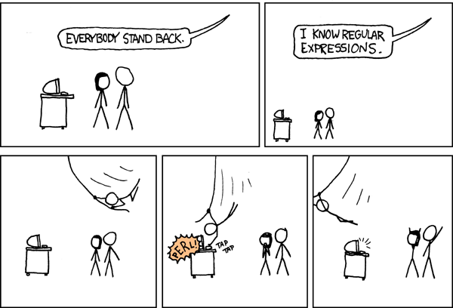
Classifying User-agent Strings
Previous Work:
Brittle parsing
Regular expressions
Efforts to maintain UA classifiers since early days of internet.
Browscap.dll in early MS webservers (since replaced).
10-20 new UA strings per week.
New UA strings break parsers.
Parsing engine must be updated by human.
No attempts at applying text classification ML algorithms to UA strings.
Problems with Std. Approaches:
Many user agents attempt to deceive the server parsing engine in order to get specific content, i.e. pages optimized for GoogleBot, by adding specific tokens to the UA string. A hierarchal regexp engine will be confused by such additions. A discriminative algorithm may still classify the modified string correctly.

Slide 4
SVM Based Text Classification
Dictionary/Feature Vector with Linear/Poly/RBF Kernels
Tokenization
Levenshtein Edit Distance Kernel
Subsequence Kernel

Slide 5
Multi-class Classification
Type
Multiclass SVM
Bot
SVM
Browser
With k classes, form k(k-1)/2 SVMs where each SVM is 1 class vs. 1 class.
For prediction on new input, all 1-vs.-1 classifiers are run. The class with the most wins is the final prediction.
Family
Firefox
Multiclass SVM
Chrome
…
OS
Windows
Multiclass SVM
Mac OS
…

Slide 6
Results

