Slide 1
MAUL: Machine Agent User Learning
(some unscrambling necessary)
Mozilla/5.0 (Windows; U; Windows NT 6.1; en-US) AppleWebKit/534.10 (KHTML, like Gecko) Chrome/8.0.552.215 Safari/534.10
Robert Holley
Daniel Rosenfeld
CS229 Group Project
December 7, 2010
ML
BROWSER

Slide 2
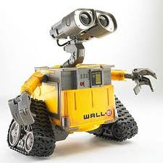
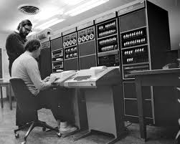

The User-agent String
Robot
HTTP Request
HEADERS{
…
User-agent string
…}
BODY
TRAILER
Server
Web Entity
or
Human
RESPONSE for specific UA
Decision based on UA String
Typical User Agent Strings:
Mozilla/4.0 (compatible; MSIE 5.01; Windows NT 5.0; SV1; .NET CLR 1.1.4322; .NET CLR 1.0.3705; .NET CLR 2.0.50727)
Mozilla/5.0 (compatible; Googlebot/2.1; http://www.google.com/bot.html)
Mozilla/5.0 (Windows; U; Windows NT 5.1; de; rv:1.9.2.3) Gecko/20100401 Firefox/3.6.3 (.NET CLR 3.5.
30729) (Prevx 3.0.5)
BaiduImagespider+(+http://help.baidu.jp/system/05.html)

Slide 3
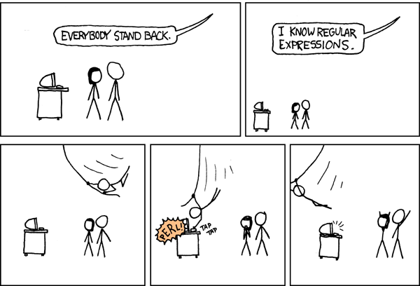
Classifying User-agent Strings
Previous Work:
Brittle parsing
Regular expressions
Efforts to maintain UA classifiers since early days of internet.
Browscap.dll in early MS webservers (since replaced).
10-20 new UA strings per week.
New UA strings break parsers.
Parsing engine must be updated by human.
No attempts at applying text classification ML algorithms to UA strings.

Slide 4
SVM Based Text Classification
Dictionary/Feature Vector with Linear/Poly/RBF Kernels
Tokenization
Levenshtein Edit Distance Kernel
Subsequence Kernel

Slide 5
Multi-class Classification
Type
Multiclass SVM
Bot
SVM
Browser
With k classes, form k(k-1)/2 SVMs where each SVM is 1 class vs. 1 class.
For prediction on new input, all 1-vs.-1 classifiers are run. The class with the most wins is the final prediction.
Family
Firefox
Multiclass SVM
Chrome
…
OS
Windows
Multiclass SVM
Mac OS
…

Slide 6
Results

