Slide 1
MAUL: Machine Agent User Learning
(some unscrambling necessary)
Mozilla/5.0 (Windows; U; Windows NT 6.1; en-US) AppleWebKit/534.10 (KHTML, like Gecko) Chrome/8.0.552.215 Safari/534.10
Robert Holley
Daniel Rosenfeld
CS229 Group Project
December 7, 2010
ML
BROWSER

Slide 2
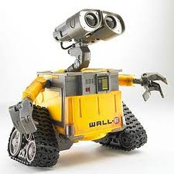
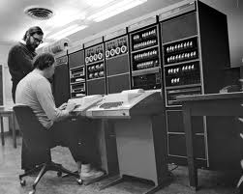

The User-agent String
HTTP Request
Robot
HEADERS{
…
User-agent string
…}
BODY
TRAILER
Server
Web Entity
or
Human
RESPONSE for specific UA
Decision based on UA String
Typical User Agent Strings:
Mozilla/4.0 (compatible; MSIE 5.01; Windows NT 5.0; SV1; .NET CLR 1.1.4322; .NET CLR 1.0.3705; .NET CLR 2.0.50727)
Mozilla/5.0 (compatible; Googlebot/2.1; http://www.google.com/bot.html)
Mozilla/5.0 (Windows; U; Windows NT 5.1; de; rv:1.9.2.3) Gecko/20100401 Firefox/3.6.3 (.NET CLR 3.5.30729) (Prevx 3.0.5)
BaiduImagespider+(+http://help.baidu.jp/system/05.html)

Slide 3
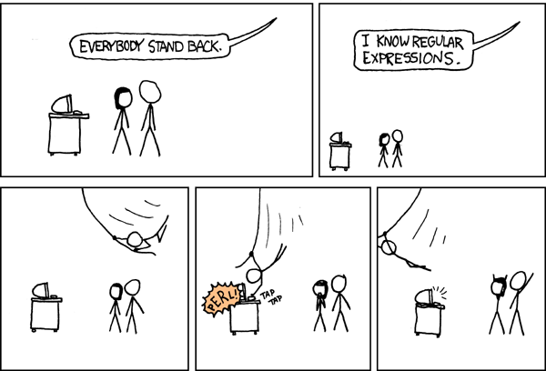
Classifying User-agent Strings
Previous Work:
Brittle parsing
Regular expressions
Efforts to maintain UA classifiers since early days of internet.
Browscap.dll in early MS web servers (since replaced).
10-20 new UA strings per week.
New UA strings break parsers.
Parsing engine must be updated by human.
No attempts at applying text classification ML algorithms to UA strings.
Problems with Std. Approaches:
Many user agents attempt to deceive the server parsing engine in order to get specific content, i.e. pages optimized for GoogleBot, by adding specific tokens to the UA string. A hierarchal regex engine will be confused by such additions. A discriminative algorithm may still classify the modified string correctly.
UA strings are frequently mangled due to plugins and other modifications. For example many UA strings in our dataset have an entirely different UA string inserted midstream. These UA strings sometimes do not have properly terminated parentheses and are hard to parse robustly.

Slide 4
SVM Based Text Classification
SVMs can be used as robust text classifiers due to over fitting protection property of maximal margin classifier.
Dictionary/Feature Vector with Linear/Poly/RBF Kernels
Tokenization of UA strings (for our data set) creates 10⁴ features. Tokens are generated by breaking the string apart at any of following characters: [],./\() or whitespace. This method is robust, and does not depend on parsing for paired parentheses. For numbers, all numbers of length d are coalesced into a single token.
Tokenization Example:
AmigaVoyager/2.95 (compatible; MC680x0; AmigaOS)
2353 0 10 8 3348 1045
Levenshtein Edit Distance Kernel
Edit distance is defined as minimum number of single character edits to change one string into another.
Edit distance kernel:
This kernel scales as (string length)², therefore we implement a tokenized version where the string is instead a list of tokens (see above).
Subsequence Kernel:
This kernel compares all shared subsequences of two strings. Subsequences do not have to be contiguous. The longer each string is, the lower its weight in the Kernel. {See: Lodhi et al., Journal of ML Research, Vol. 2, 2002, 419-444 for more details. }
This Kernel was also tokenized. Our goal was to include order and position information in the Kernel, which could be important in UA string classification.

Slide 5
Multi-class Classification
Type
Bot
Multiclass SVM
Browser
Multiclass SVM
Family
With k classes, form k(k-1)/2 SVMs where each SVM is 1 class vs. 1 class.
For prediction on new input, all 1-vs.-1 classifiers are run. The class with the most wins is the final prediction.
Mobile Browser
Firefox
Multiclass SVM
Chrome
…
OS
Multiclass SVM
Windows
Mac OS
…

Slide 6
Results
For testing purposes, each category under test (chosen from our dataset of >53,000 UA strings) was split, where 80% was used for training and 20% used for testing.
Kernel\Accuracy(%) | Browser v. MB v. Bot | Family | OS
Linear | 99.68 | 99.81 | 99.90
RBF | 99.51 | 98.69 | 99.66
Edit String | 99.60 | 98.61 | 99.68
Subsequence | 99.30 | 99.28 | 99.67
Examples where many parsers fail, but MAUL works:
Bot: Mozilla/5.0 (compatible; Butterfly/1.0; +http://labs.topsy.com/butterfly/) Gecko/2009032608 Firefox/3.0.8
Bot: ArabyBot (compatible; Mozilla/5.0; GoogleBot; FAST Crawler 6.4; http://www.araby.com;)
-Browser: Googlebot/2.1 (+http://www.googlebot.com/bot.html; MSIE 7.0; Windows NT 5.1; GoogleT5; .NET CLR 2.0.50727; .NET CLR 3.0.4506.2152; .NET CLR 3.5.30729; .NET CLR 1.1.4322)
Conclusions:
Robust classification possible. Robots can be identified, even with some deception. Browser and OS are easily classified by Linear classifier. Edit string and subsequence kernels, despite additional complexity over Linear Kernel and inclusion of position and order information, do not outperform the linear classifier.

Slide 7
Tokenization Figure
AmigaVoyager/2.95 (compatible; MC680x0; AmigaOS)
2353 0 10 8 3348 1045

