Slide 1
NetCanvas – Shared drawing board
By
Yogesh Makhija
Lokesh Kukreja
Kashyap Kotak

Slide 2
Abstract
Visual communication has played a major role in the evolution of mankind and even today is the most powerful form of expression of human emotions.
This app exploits this fact and targets a particular use case where people can communicate visually with each other instantly via doodling or drawing with the help of the cloud.

Slide 3
Working Model
The app allows the users to create a shared space on the cloud platform.
This shared space is termed as a canvas.
This canvas can receive inputs in the form of swipes and touch inputs that are recorded by the input device which is a mobile phone in most of the cases.
The mobile phone records the inputs given to it by the user and uploads it on the cloud.
The receiving mobile phone on the other end downloads these recorded inputs and updates its canvas.

Slide 4
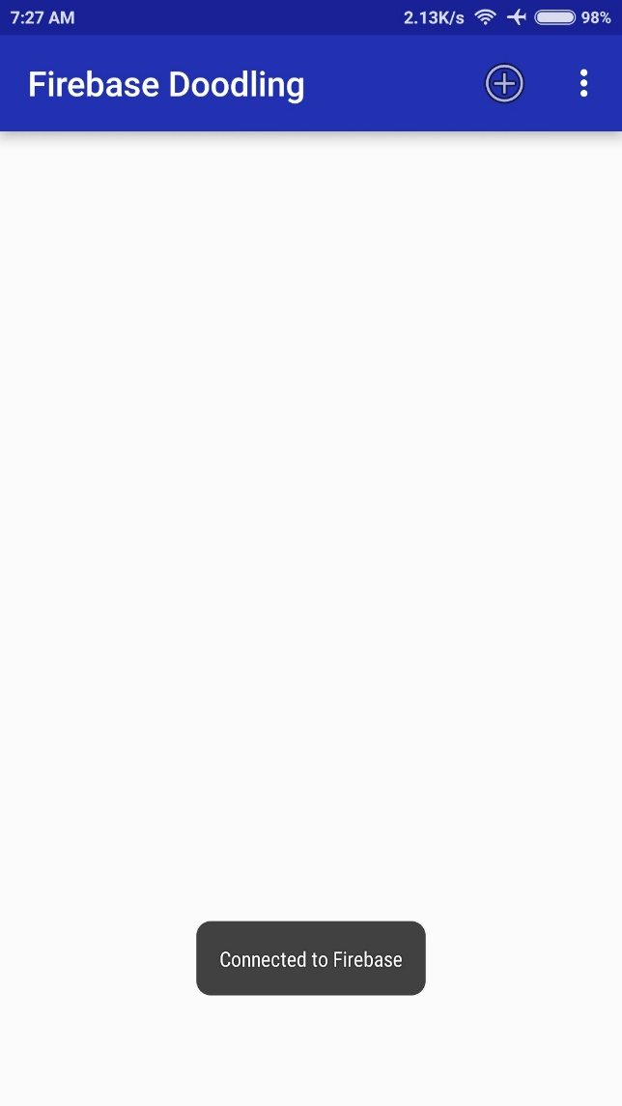
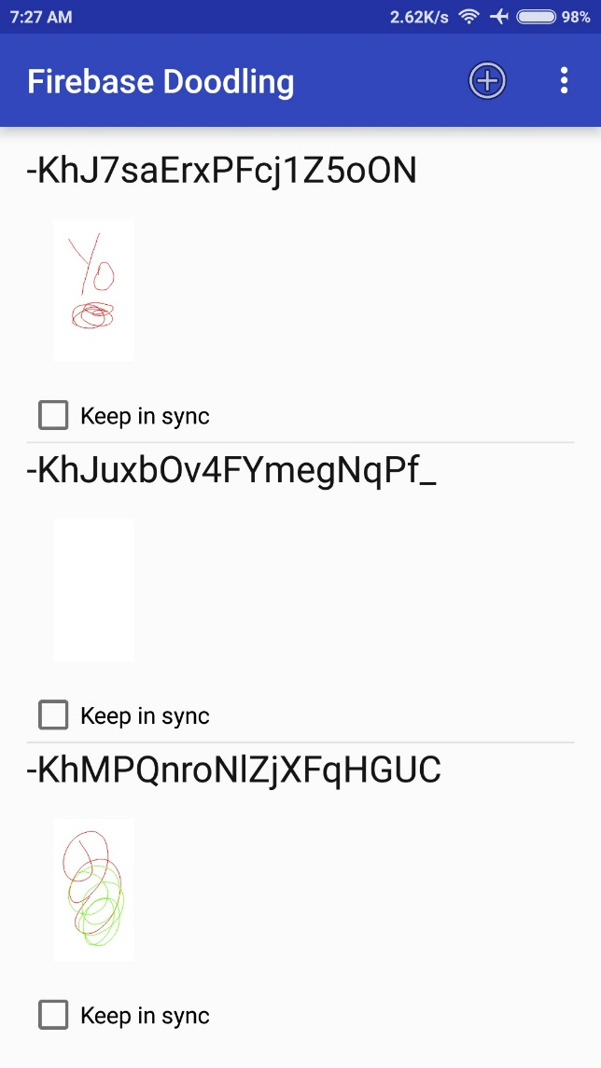
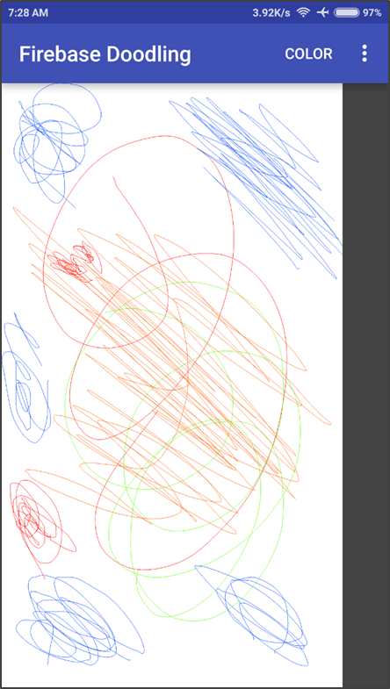
Snapshots

Slide 5
CONCLUSION
This Android app can be used in situations where you need to explain something to a person but in visual form. For example, you want to show an architect how you want your room to be constructed, or he wants to show you his final sketch of your house or this app is a good learning tool for toddlers and kids to understand the principles of drawing.
The app is in development stages now, but in future it can have complex functions to record inputs such as auto straightening of lines and curves input by the user.

