Slide 1
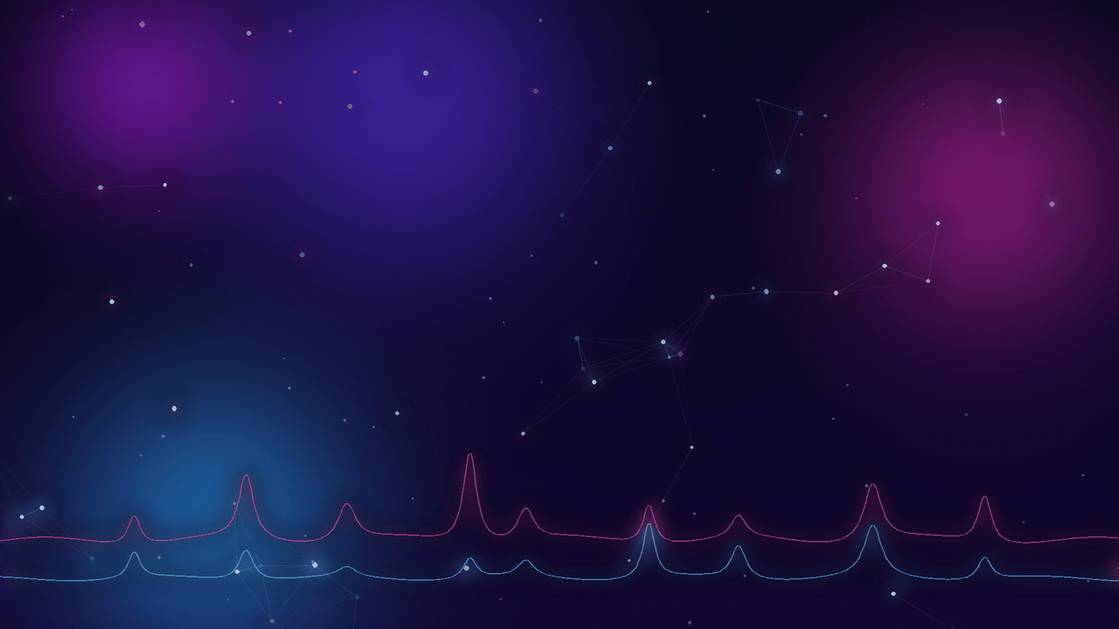






PhD Programme in “Information Engineering” – 41st Cycle
Department of Information Engineering, Infrastructure and Sustainable Energy (DIIES)
Activity of Research and Training
2025 – 2026
Sample
Raman measurement
AI analysis
Spectrum interpretation
Chemical identification
PhD Student: Hira Aman Mentor: Prof. Giuliana Faggio

Slide 2
Research Activity
01
First year · Raman mapping, SERS and machine learning for biomolecules and nanostructured materials

Slide 3

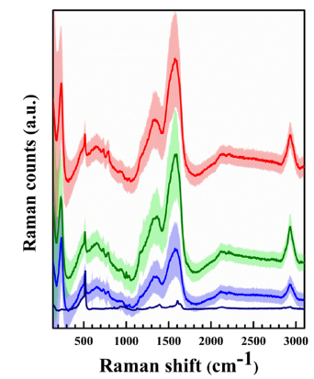
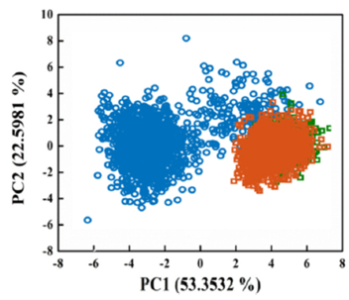
Research Activity – First Year: Motivation
Advanced characterization and AI-based analysis of biological molecules and nanostructured materials
Label-free DNA discrimination
Our group’s path to this PhD
Raman spectra
PCA of the spectra
2016
Au-coated SiNW arrays for SERS biosensing with electrochemical detection
Convertino et al., Sci. Rep. 6, 25099
2018
Au-coated SiNW for NIR photothermal treatment of cancer cells, monitored by Raman
Convertino et al., Nanotechnology 29, 415102
2020
Ag-coated SiNW for label-free detection of glycated albumin
Paria et al., Adv. Healthcare Mater., 2001110
2021
Raman mapping of single DNA bases on disordered nanostructured surfaces
Mussi et al., Micromachines 12, 264
HaCaT · normal
SK-Mel-28 · melanoma
A375 · melanoma
This PhD: Raman mapping + machine learning to analyse thousands of spectra automatically
Genomic DNA drops from normal and melanoma cells on Ag-coated SiNW are separated by Raman spectroscopy and PCA, with no labels.
V. Mussi, M. Ledda, D. Polese, L. Maiolo, D. Paria, I. Barman, M. G. Lolli, A. Lisi, A. Convertino, Mater. Sci. Eng. C 2021, 122, 111951
Hira Aman · Activity of Research and Training 2025–2026
Notes:
Full references:
1. A. Convertino, V. Mussi, L. Maiolo, "Disordered array of Au covered silicon nanowires for SERS biosensing combined with electrochemical detection," Sci. Rep. 2016, 6, 25099.
2. A. Convertino, V. Mussi, L. Maiolo, M. Ledda, M. G. Lolli, F. A. Bovino, G. Fortunato, M. Rocchia, A. Lisi, "Array of disordered silicon nanowires coated by a gold film for combined NIR photothermal treatment of cancer cells and Raman monitoring of the process evolution," Nanotechnology 2018, 29, 415102.
3. D. Paria, A. Convertino, V. Mussi, L. Maiolo, I. Barman, "Silver-Coated Disordered Silicon Nanowires Provide Highly Sensitive Label-Free Glycated Albumin Detection through Molecular Trapping and Plasmonic Hotspot Formation," Adv. Healthcare Mater. 2020, 2001110.
4. V. Mussi, M. Ledda, A. Convertino, A. Lisi, "Raman Mapping of Biological Systems Interacting with a Disordered Nanostructured Surface: A Simple and Powerful Approach to the Label-Free Analysis of Single DNA Bases," Micromachines 2021, 12, 264.

Slide 4
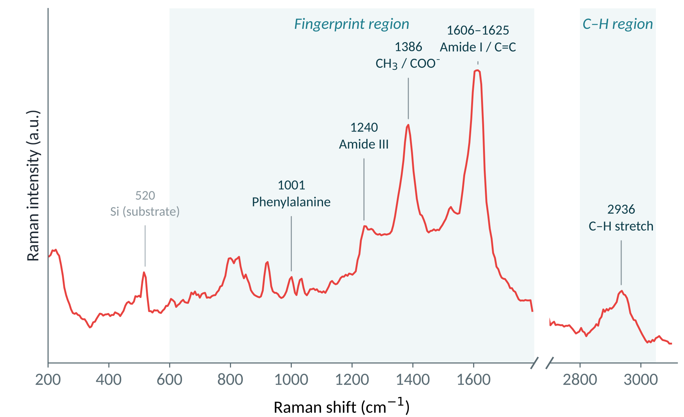
Raman Mapping: A Chemical Fingerprint at Every Pixel
Instead of checking single spectra by hand, we map the whole sample
Each pixel = one full spectrum
100s
spectra per map
Fingerprints of proteins and lipids
Where each biomolecule sits in the sample
Example spectrum: Acacia extracellular vesicles
Hira Aman · Activity of Research and Training 2025–2026
Notes:
In our lab we don't look at single spectra one by one. We use Raman mapping: the laser scans across the sample and records a full spectrum at every pixel, so one map gives us hundreds to thousands of spectra. Each spectrum is a chemical fingerprint. Here you can see bands for proteins, such as phenylalanine at 1001, amide III at 1240 and amide I around 1600, and C-H stretching around 2936 from lipids and proteins. From the map we learn not only what biomolecules are present but where they are.

Slide 5
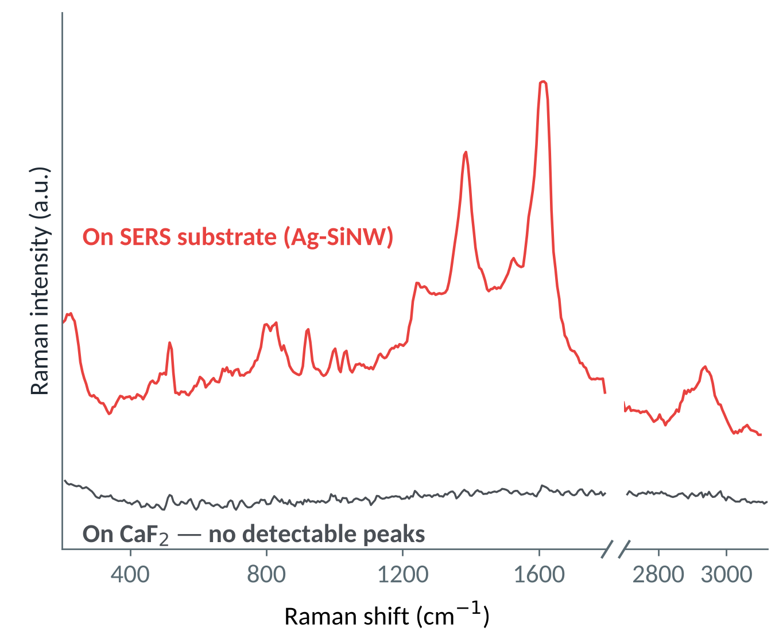
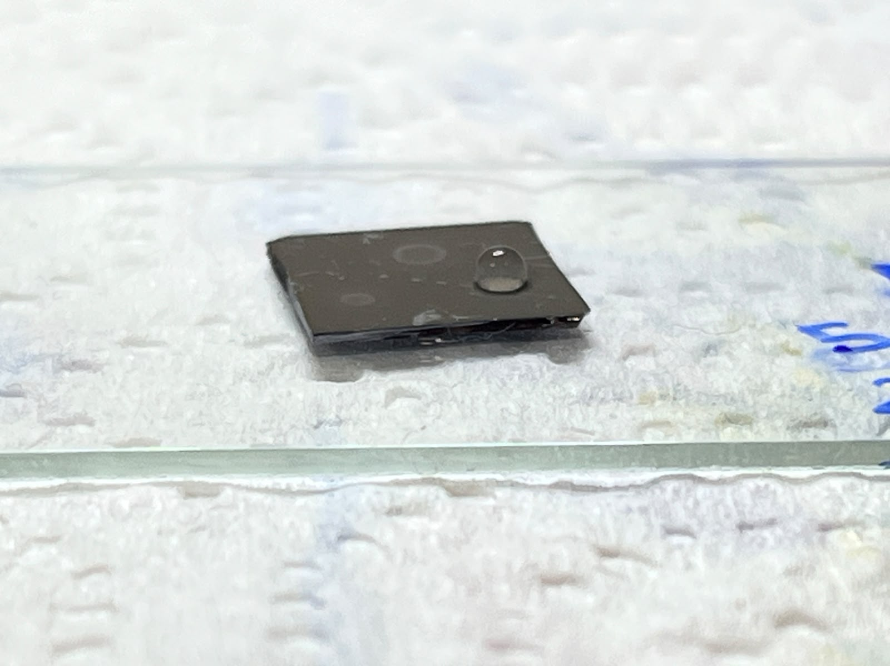
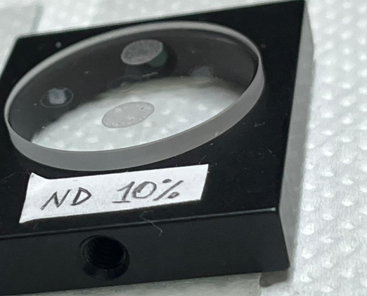
Weak Signal? SERS Makes It Visible
Surface-enhanced Raman scattering on our nanowire substrate
Laser
Strong Raman signal
Hot spot
Biomolecule
Ag/Au on Si nanowire
Some biomolecules scatter too little light to detect on a normal substrate
The laser excites surface plasmons in the metal: intense fields form in the gaps (hot spots)
Molecules in hot spots give a 10⁴⁠–⁠10⁸× stronger Raman signal
Same Acacia EV sample: peaks appear only on the SERS substrate
Our Ag/SiNW SERS substrate with a dried sample drop, and the measurement setup
Hira Aman · Activity of Research and Training 2025–2026
Notes:
A problem with Raman mapping is that some biomolecules have a very weak Raman signal. To solve this we use SERS, surface-enhanced Raman scattering. Our substrate is silicon nanowires coated with metal. When the laser hits the metal, it excites surface plasmons, which create very strong electromagnetic fields in the small gaps between the wires, the so-called hot spots. Molecules sitting there give a Raman signal that is typically enhanced by ten thousand to a hundred million times. You can see it here: the bottom grey line is the same Acacia EV sample on a standard CaF2 substrate, with no detectable peaks. The red line is on our SERS substrate, where the protein and lipid bands appear clearly.

Slide 6
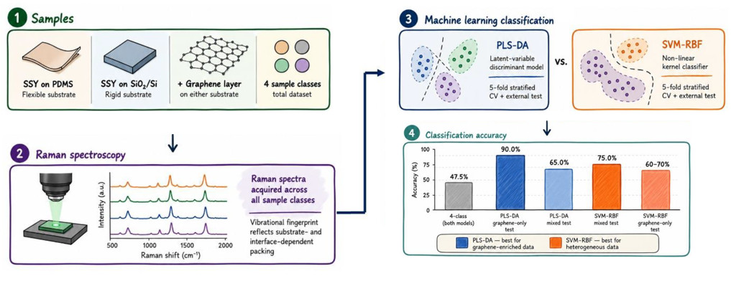
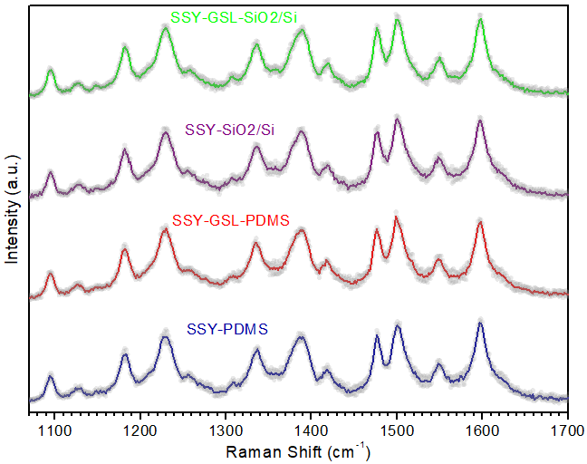
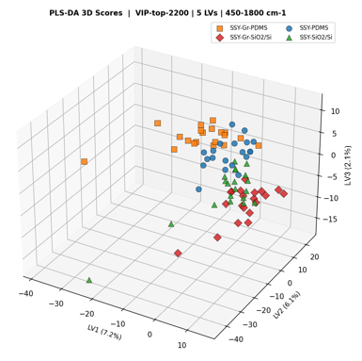
ML-Raman Classification of Chromonic Liquid Crystals
SUBMITTED · UNDER REVIEW
Sunset Yellow (SSY) on PDMS, Gr-PDMS, SiO₂/Si and Gr-SiO₂/Si · 80 Raman spectra (20/class) · λ = 473 nm · Python (scikit-learn)
1
Raw spectra 450–1800 cm⁻¹
2
Savitzky–Golay + scaling
3
VIP feature selection
4
PLS-DA & SVM-RBF
5
CV · external · permutation
Samples → Raman spectroscopy → ML classification
Spectra: visually indistinguishable
PLS-DA: PDMS vs SiO₂/Si split
75%
90%
p = 0.001
Conclusion: ML reveals substrate- and graphene-dependent SSY self-organisation invisible by eye. The main discriminating axis is the substrate (PDMS vs SiO₂/Si); SVM-RBF suits mixed sets, PLS-DA graphene-coated sets.
Binary, mixed external test (SVM)
Graphene-only external test (PLS-DA)
Permutation test (999 permutations)
Hira Aman · Activity of Research and Training 2025–2026

Slide 7
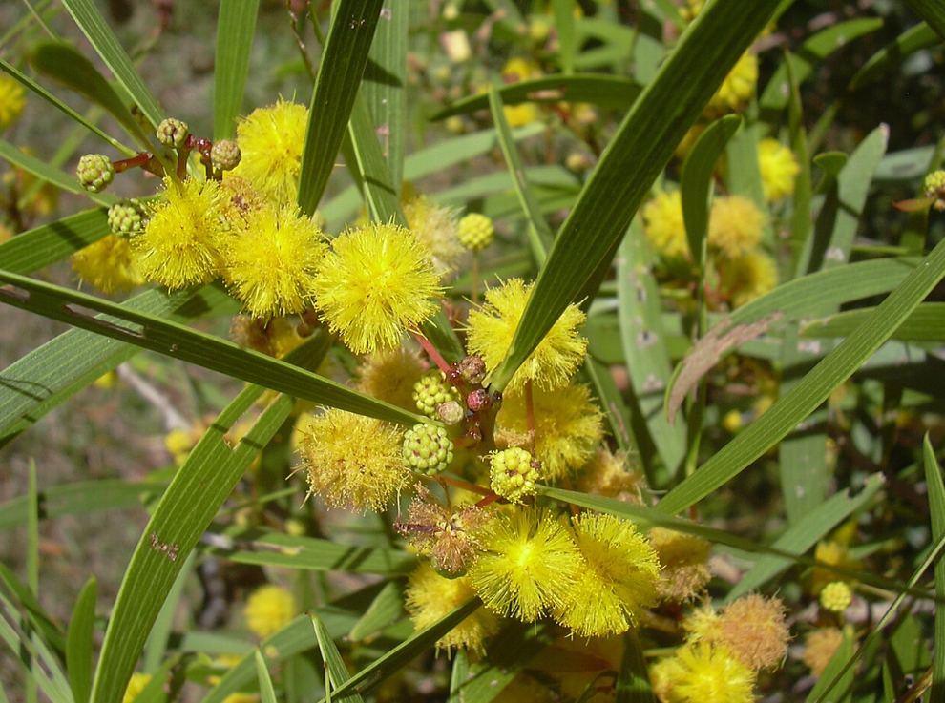
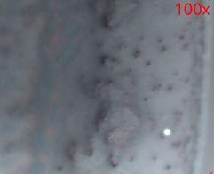


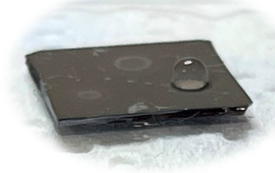
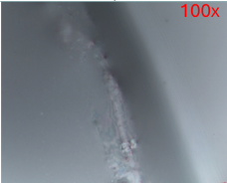
Ag/SiNW SERS: Acacia EVs vs Nanovesicles
UNPUBLISHED
From plant sample to machine-learning classification
1
Sample
2
Raman mapping
3
Preprocessing
4
Machine learning
›
›
›
Python pipeline
Crop the informative spectral region
Smoothing
SNV normalisation
PCA for dimensionality reduction
PCA-LDA classification
Cross-checked with PLS‑DA
Site-grouped 5-fold cross-validation
EV Acacia
Acacia vesicles dropped on the Ag/SiNW SERS substrate
NV Acacia
100× optical images of mapped areas
Hira Aman · Activity of Research and Training 2025–2026
Notes:
We extract extracellular vesicles (EV) and nanovesicles (NV) from Acacia and drop them on our Ag/SiNW SERS substrate. We record Raman maps on the dried drops. The spectra are preprocessed in Python: we crop the informative region, smooth, and normalise with SNV. Then we use PCA for dimensionality reduction, followed by PCA-LDA classification, cross-checked with PLS-DA, using site-grouped 5-fold cross-validation so that spectra from the same spot never appear in both training and test sets.

Slide 8
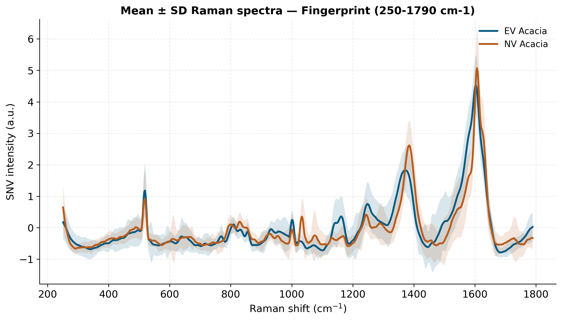
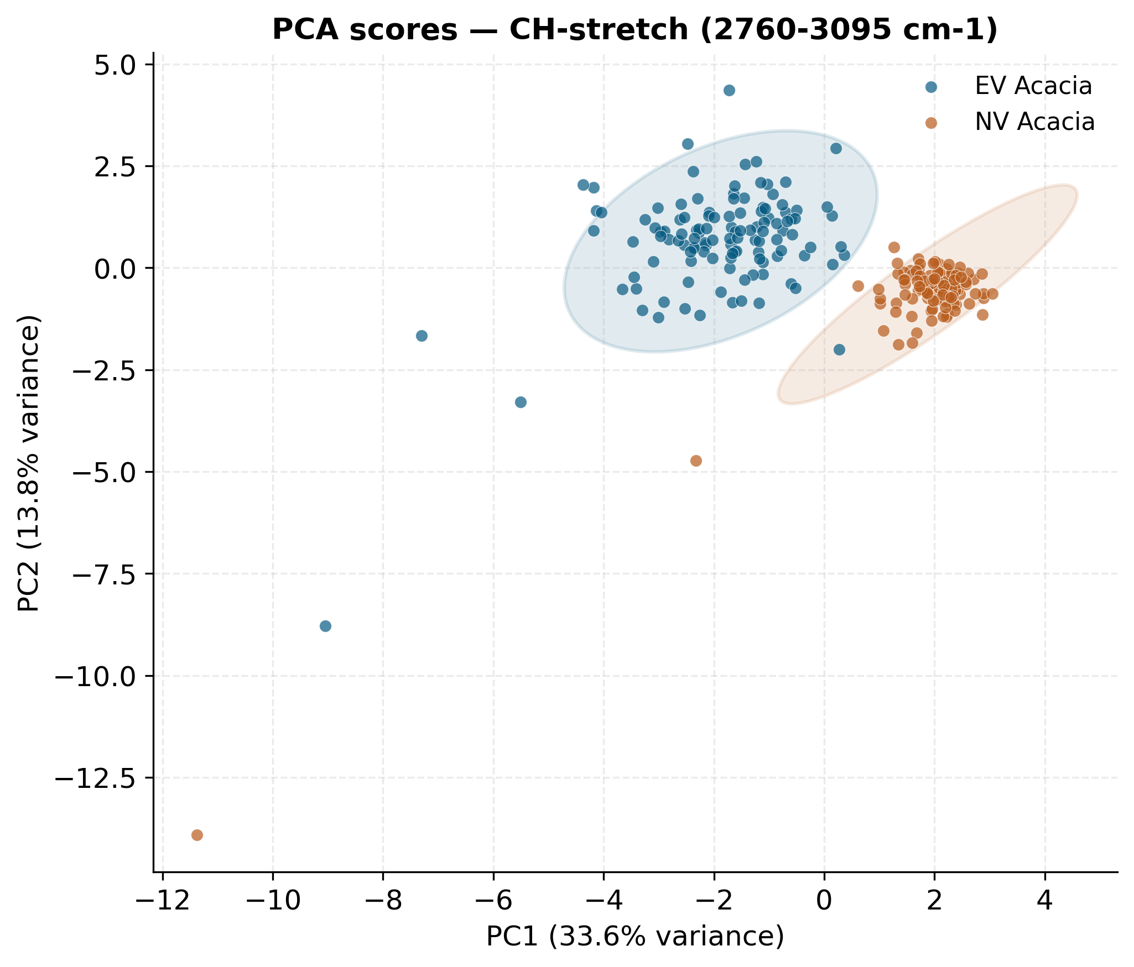



Acacia EVs vs Nanovesicles: Results
UNPUBLISHED
SERS + machine learning separates the two vesicle types without labels
Two distinct clusters
Key bands differ
Label-free
EV and NV Acacia separate clearly in PCA
Main spectral differences in the ~1380 and ~1600 cm⁻¹ bands
SERS + ML separates vesicle types without any labels
Hira Aman · Activity of Research and Training 2025–2026
Notes:
The mean spectra show differences mainly in the 1380 and 1600 bands, and in the PCA of the C-H stretching region (2760–3095 cm-1) the two vesicle types form clearly separated clusters. This shows that SERS combined with machine learning can distinguish the vesicle types without labels.

Slide 9
Training Activities
02
Mini-courses, seminars & an international conference

Slide 10
Mini-courses & Seminars
PhD Programme in Information Engineering – 41st Cycle · DIIES
1
Mini-courses
8 h each · 10 CFU
2
Seminars
5 CFU
Edge Machine Learning for Data Analysis on Low Computational Capacity Devices
Seminar | Instructor(s) | Hours
Some Results for Electromagnetic Design and Retrieval Problems | Prof. Mats Gustafsson | 1.5 h
Connected and Automated Mobility (MOST Spoke 6 dissemination activities) | M. Segata, I. Turcanu | 3 h
Factors Affecting the Port Times of Container Ships | — | 4 h
Resonances in Geometrically Finite Graphs | Dr Carsten Peterson | 2 h
Networking Solutions for Cooperative, Connected and Automated Mobility | Profs. C. Campolo, A. Bazzi, S. Sargento; Drs F. Brasca, G. Landi | 4 h
Digital Twins and Deep Learning: Advancing Infrastructure Sustainability and Resilience through Remote Sensing and Computer Vision | Dr Surya Sarat Chandra Congress | 3 h
Workshop – Optimization and Equilibrium Problems | DICEAM | —
Prof. Merenda
Ensuring Trustworthiness in Federated Learning
Prof. Fisichella
Digital Identity
Prof. Lax
Health Management
Prof. Romano
Foundations of Quantum Mechanics and Applications
Profs. Messina and Faggio
Hira Aman · Activity of Research and Training 2025–2026

Slide 11


Conference & Publications
Disseminating the first-year results
10
5
1
2
CFU · mini-courses
CFU · seminars
oral presentation
journal articles submitted
International Conference
Publications from this work
NanoInnovation 2026 · Rome · 14–18 Sept 2026
Outcome: 2 journal articles submitted
Oral presentation
1
[Paper 1 title] – submitted to [Journal], 2026
UNDER REVIEW
“Machine Learning Raman Classification of Chromonic Liquid Crystal Self-Organisation on Different Substrates”
2
[Paper 2 title] – submitted to [Journal], 2026
UNDER REVIEW
Hira Aman · Activity of Research and Training 2025–2026

Slide 12
Thank you
Questions & discussion
Hira Aman · PhD in Information Engineering, 41st Cycle · DIIES

