Slide 1
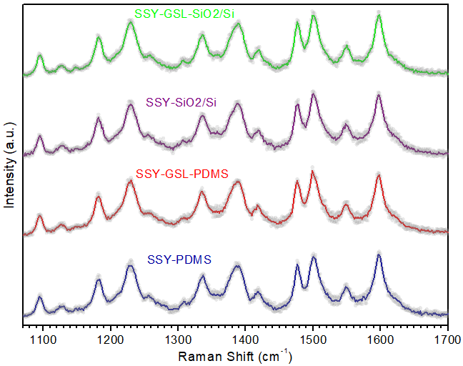
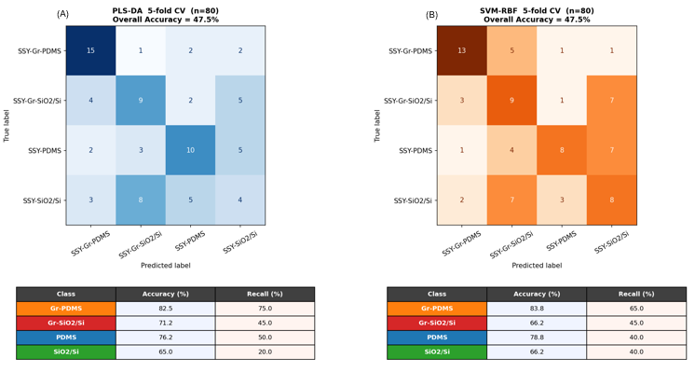
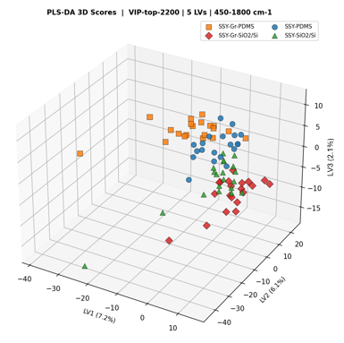
ML-Raman Classification of Chromonic Liquid Crystals on Different Substrates
Sunset Yellow (SSY) on PDMS, Gr-PDMS, SiO₂/Si and Gr-SiO₂/Si · 80 Raman spectra (20/class) · λ = 473 nm · Python (scikit-learn)
1 Raw spectra 450–1800 cm⁻¹
2 Savitzky–Golay + scaling
3 VIP feature selection
4 PLS-DA & SVM-RBF
5 CV · external · permutation test
Raman spectra: visually indistinguishable
4-class confusion matrices: PLS-DA (A), SVM-RBF (B)
PLS-DA 3D scores: PDMS vs SiO₂/Si split
47.5%
75%
90%
p = 0.001
4-class CV accuracy (both models)
Binary, mixed external test (SVM)
Graphene-only external test (PLS-DA)
Permutation test (999 permutations)
Conclusion: ML reveals substrate- and graphene-dependent SSY self-organisation invisible by eye. The main discriminating axis is the substrate (PDMS vs SiO₂/Si); SVM-RBF suits mixed sets, PLS-DA graphene-coated sets.

