Slide 1
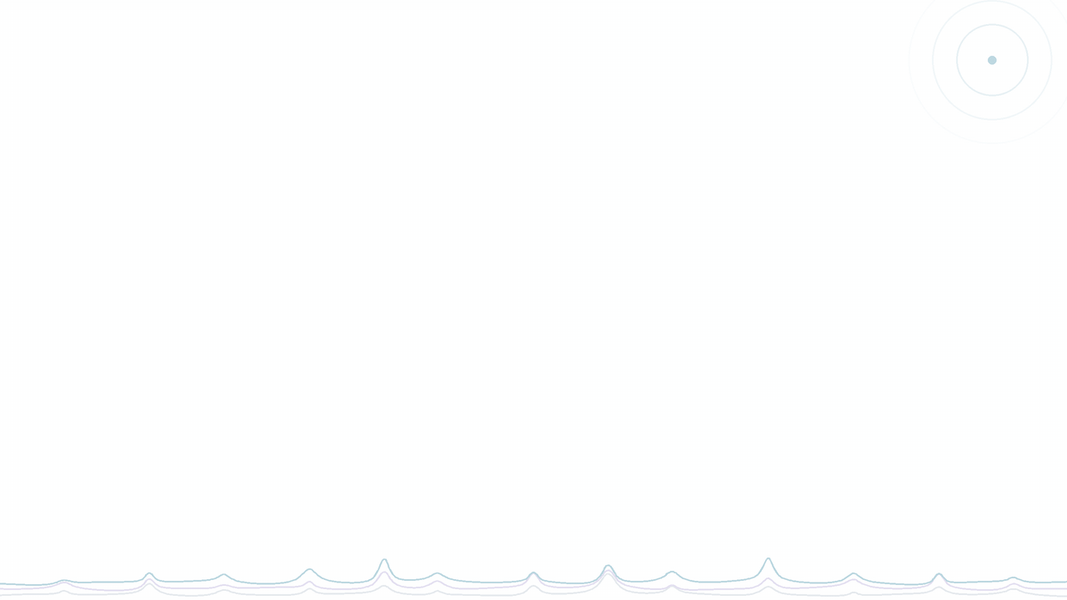

PhD Programme in “Information Engineering” – 41st Cycle
Department of Information Engineering, Infrastructure and Sustainable Energy (DIIES)
Activity of Research and Training
2025 – 2026
PhD Student: Hira Aman
Mentor: Prof. Giuliana Faggio

Slide 2
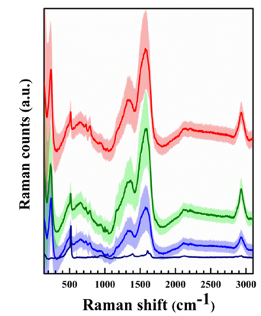
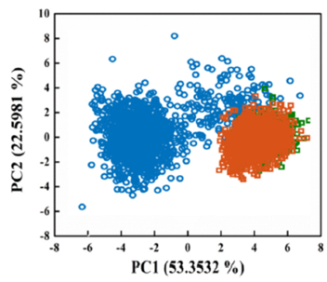
Research Activity – First Year: Motivation
Advanced characterization and AI-based analysis of biological molecules and nanostructured materials
Label-free DNA discrimination
Motivation:
Raman spectra
PCA of the spectra
2016
Au-coated SiNW arrays for SERS biosensing with electrochemical detection
Convertino et al., Sci. Rep. 6, 25099
2018
Au-coated SiNW for NIR photothermal treatment of cancer cells, monitored by Raman
Convertino et al., Nanotechnology 29, 415102
2020
Ag-coated SiNW for label-free detection of glycated albumin
Paria et al., Adv. Healthcare Mater., 2001110
2021
Raman mapping of single DNA bases on disordered nanostructured surfaces
Mussi et al., Micromachines 12, 264
HaCaT · normal
SK-Mel-28 · melanoma
A375 · melanoma
Genomic DNA drops from normal (HaCaT) and melanoma cells (SK-Mel-28, A375) on Ag-coated SiNW are separated by Raman spectroscopy and PCA, with no labels.
This PhD: Raman mapping + machine learning to analyse thousands of spectra automatically
V. Mussi, M. Ledda, D. Polese, L. Maiolo, D. Paria, I. Barman, M. G. Lolli, A. Lisi, A. Convertino, Mater. Sci. Eng. C 2021, 122, 111951.
Notes:
Full references:
1. A. Convertino, V. Mussi, L. Maiolo, "Disordered array of Au covered silicon nanowires for SERS biosensing combined with electrochemical detection," Sci. Rep. 2016, 6, 25099.
2. A. Convertino, V. Mussi, L. Maiolo, M. Ledda, M. G. Lolli, F. A. Bovino, G. Fortunato, M. Rocchia, A. Lisi, "Array of disordered silicon nanowires coated by a gold film for combined NIR photothermal treatment of cancer cells and Raman monitoring of the process evolution," Nanotechnology 2018, 29, 415102.
3. D. Paria, A. Convertino, V. Mussi, L. Maiolo, I. Barman, "Silver-Coated Disordered Silicon Nanowires Provide Highly Sensitive Label-Free Glycated Albumin Detection through Molecular Trapping and Plasmonic Hotspot Formation," Adv. Healthcare Mater. 2020, 2001110.
4. V. Mussi, M. Ledda, A. Convertino, A. Lisi, "Raman Mapping of Biological Systems Interacting with a Disordered Nanostructured Surface: A Simple and Powerful Approach to the Label-Free Analysis of Single DNA Bases," Micromachines 2021, 12, 264.

Slide 3
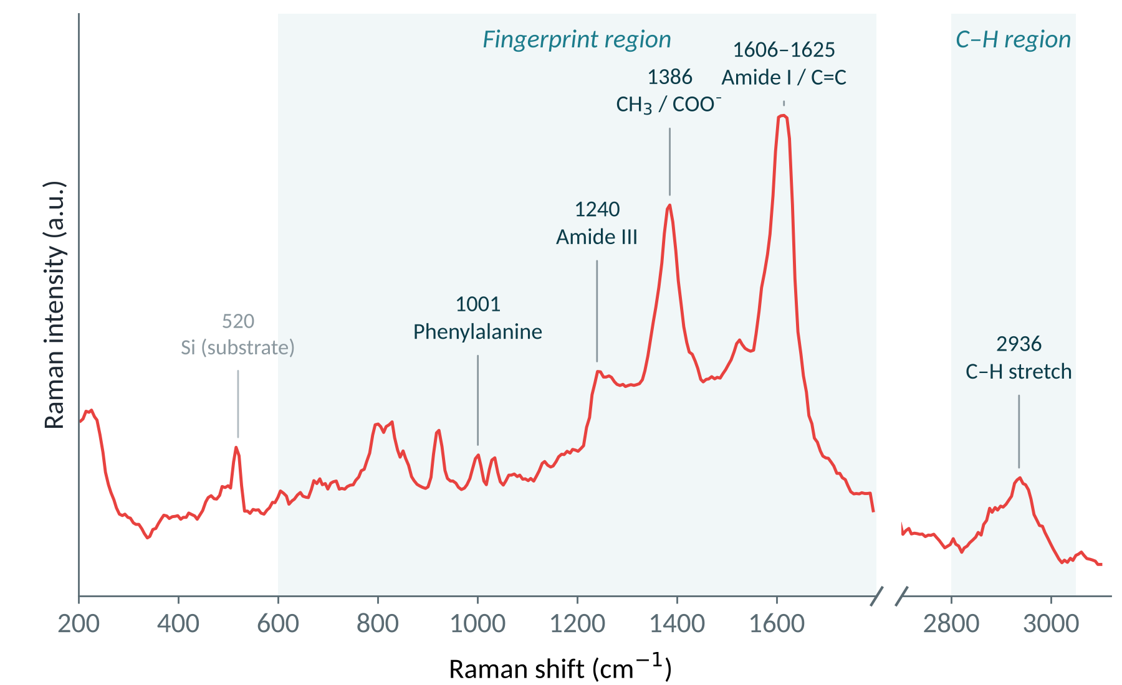
Raman Mapping: A Chemical Fingerprint at Every Pixel
Instead of checking single spectra by hand, we map the whole sample
Each pixel = one full spectrum
100s
spectra per map
Fingerprints of proteins and lipids
Where each biomolecule sits in the sample
Example spectrum: Acacia extracellular vesicles
Notes:
In our lab we don't look at single spectra one by one. We use Raman mapping: the laser scans across the sample and records a full spectrum at every pixel, so one map gives us hundreds to thousands of spectra. Each spectrum is a chemical fingerprint. Here you can see bands for proteins, such as phenylalanine at 1001, amide III at 1240 and amide I around 1600, and C-H stretching around 2936 from lipids and proteins. From the map we learn not only what biomolecules are present but where they are.

Slide 4
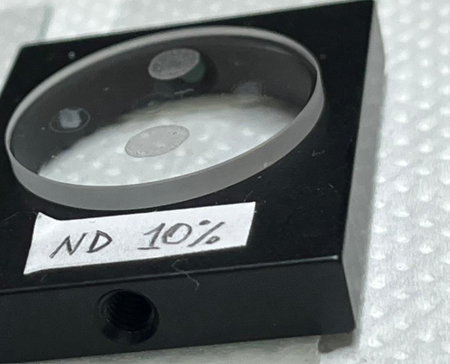
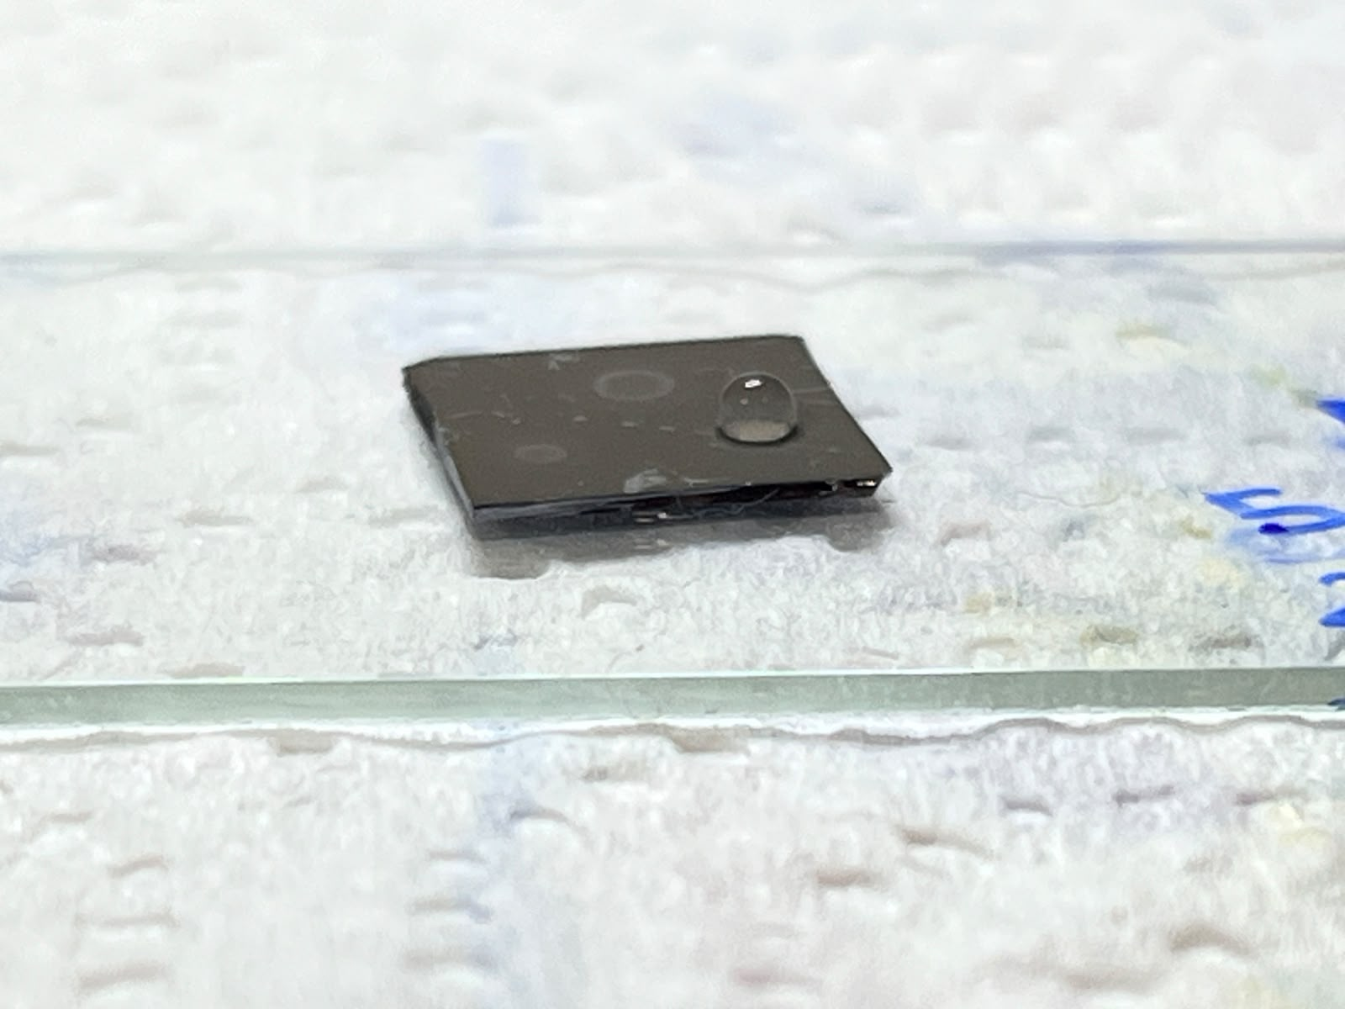
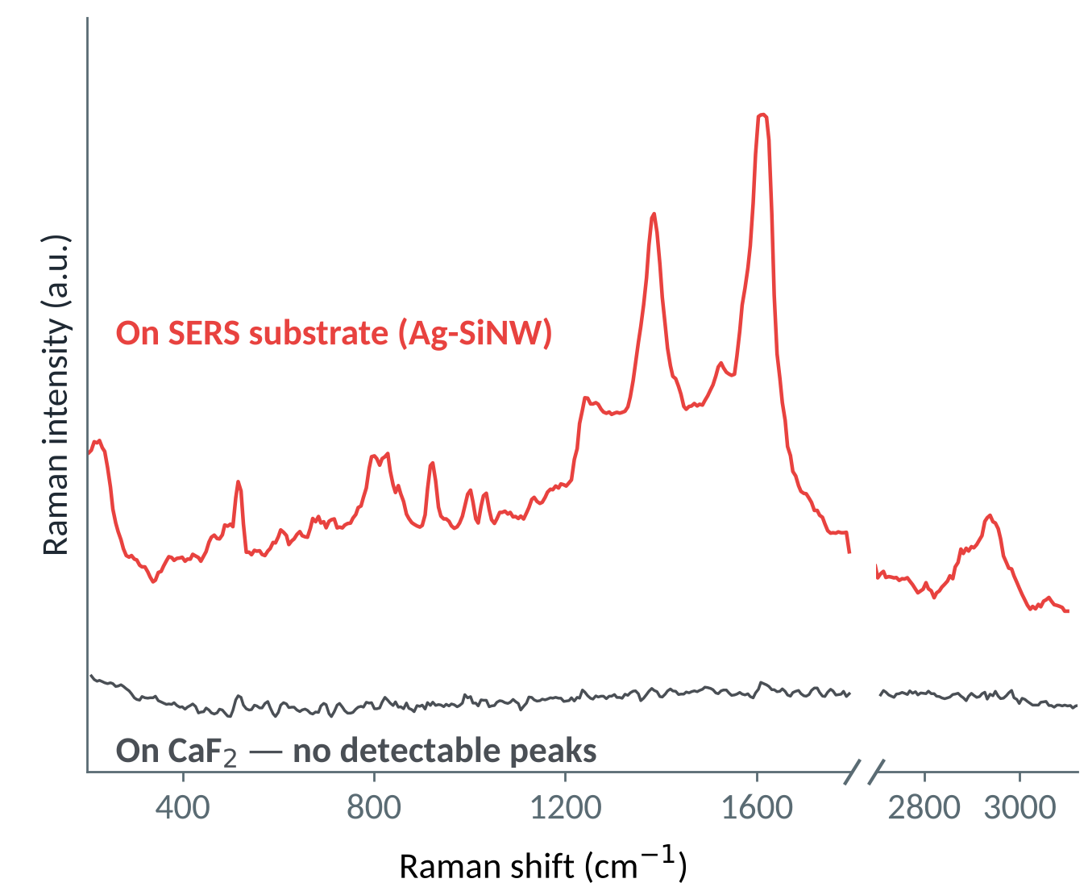
Weak Signal? SERS Makes It Visible
Surface-enhanced Raman scattering on our nanowire substrate
Laser
Strong Raman signal
Hot spot
Biomolecule
Ag/Au on Si nanowire
Some biomolecules scatter too little light to detect on a normal substrate
Laser excites surface plasmons in the metal, creating intense fields in the gaps (hot spots)
Molecules in hot spots give a much stronger Raman signal, typically 10⁴–10⁸× enhanced
Same Acacia EV sample: peaks appear only on the SERS substrate
Notes:
A problem with Raman mapping is that some biomolecules have a very weak Raman signal. To solve this we use SERS, surface-enhanced Raman scattering. Our substrate is silicon nanowires coated with metal. When the laser hits the metal, it excites surface plasmons, which create very strong electromagnetic fields in the small gaps between the wires, the so-called hot spots. Molecules sitting there give a Raman signal that is typically enhanced by ten thousand to a hundred million times. You can see it here: the bottom grey line is the same Acacia EV sample on a standard CaF2 substrate, with no detectable peaks. The red line is on our SERS substrate, where the protein and lipid bands appear clearly.

Slide 5

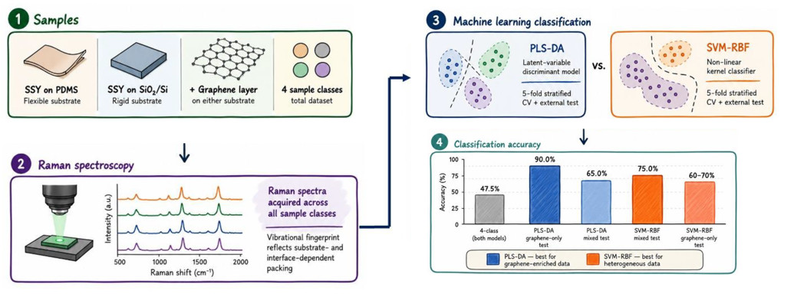
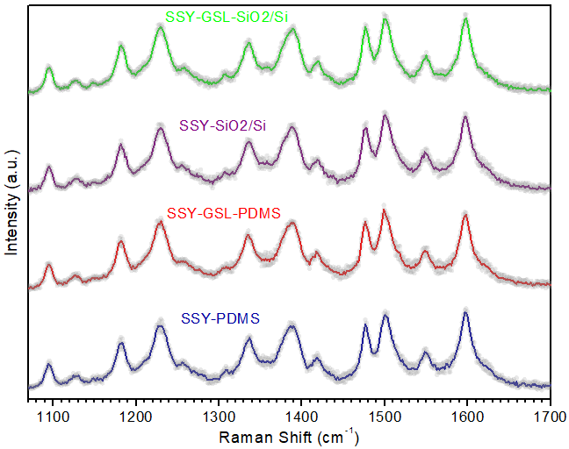
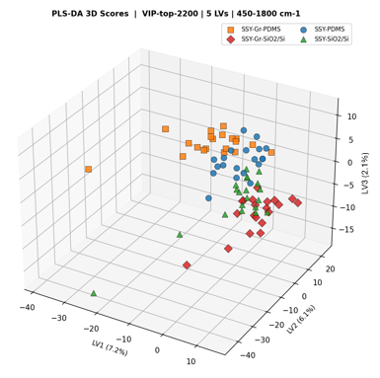
ML-Raman Classification of Chromonic Liquid Crystals on Different Substrates
Sunset Yellow (SSY) on PDMS, Gr-PDMS, SiO₂/Si and Gr-SiO₂/Si · 80 Raman spectra (20/class) · λ = 473 nm · Python (scikit-learn)
1 Raw spectra 450–1800 cm⁻¹
2 Savitzky–Golay + scaling
3 VIP feature selection
4 PLS-DA & SVM-RBF
5 CV · external · permutation test
Raman spectra: visually indistinguishable
PLS-DA 3D scores: PDMS vs SiO₂/Si split
75%
90%
p = 0.001
Binary, mixed external test (SVM)
Graphene-only external test (PLS-DA)
Permutation test (999 permutations)
Conclusion: ML reveals substrate- and graphene-dependent SSY self-organisation invisible by eye. The main discriminating axis is the substrate (PDMS vs SiO₂/Si); SVM-RBF suits mixed sets, PLS-DA graphene-coated sets.

Slide 6

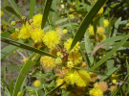
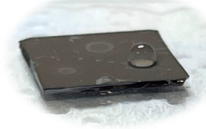
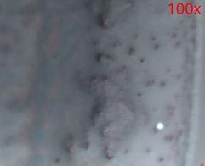
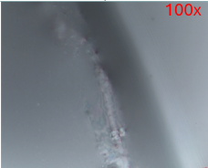
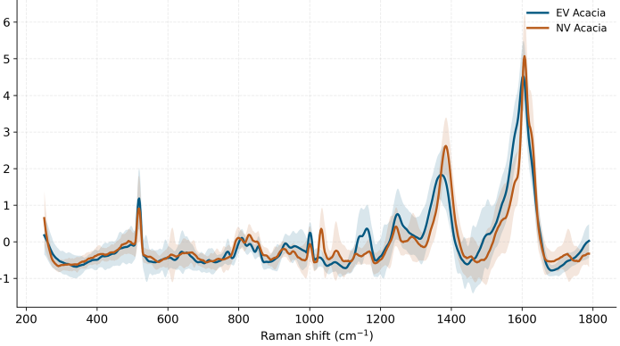
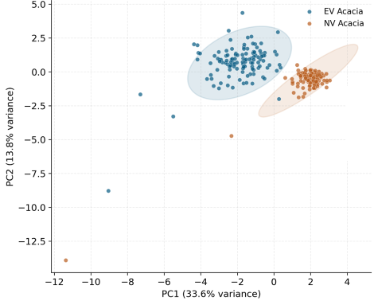
Ag/SiNW SERS: Acacia EVs vs Nanovesicles
From plant sample to machine-learning classification
1
Sample
2
Raman mapping
3
Preprocessing
4
Machine learning
Python pipeline
Crop the informative spectral region
Smoothing
SNV normalisation
PCA for dimensionality reduction
PCA-LDA classification
Cross-checked with PLS-DA
Site-grouped 5-fold cross-validation
Acacia vesicles dropped on the Ag/SiNW SERS substrate
EV Acacia
NV Acacia
100× optical images of mapped areas
Mean ± SD spectra · fingerprint region (250–1790 cm⁻¹)
PCA scores · C–H stretch region (2760–3095 cm⁻¹)
Key findings
EV and NV Acacia form two distinct clusters in PCA
Main spectral differences in the ~1380 and ~1600 cm⁻¹ bands
SERS + ML separates vesicle types without labels
SNV intensity (a.u.)
Notes:
We extract extracellular vesicles (EV) and nanovesicles (NV) from Acacia and drop them on our Ag/SiNW SERS substrate. We record Raman maps on the dried drops. The spectra are preprocessed in Python: we crop the informative region, smooth, and normalise with SNV. Then we use PCA for dimensionality reduction, followed by PCA-LDA classification, cross-checked with PLS-DA, using site-grouped 5-fold cross-validation so that spectra from the same spot never appear in both training and test sets. The mean spectra show differences mainly in the 1380 and 1600 bands, and in the PCA of the C-H region the two vesicle types form clearly separated clusters.

Slide 7
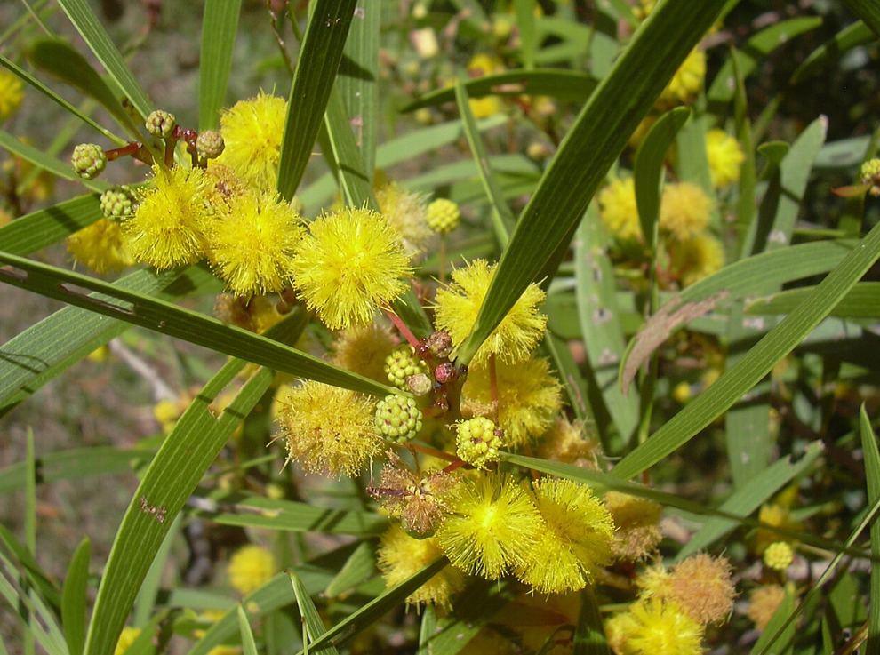
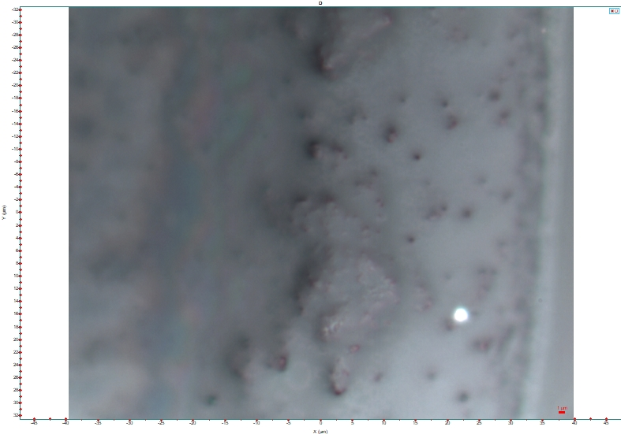
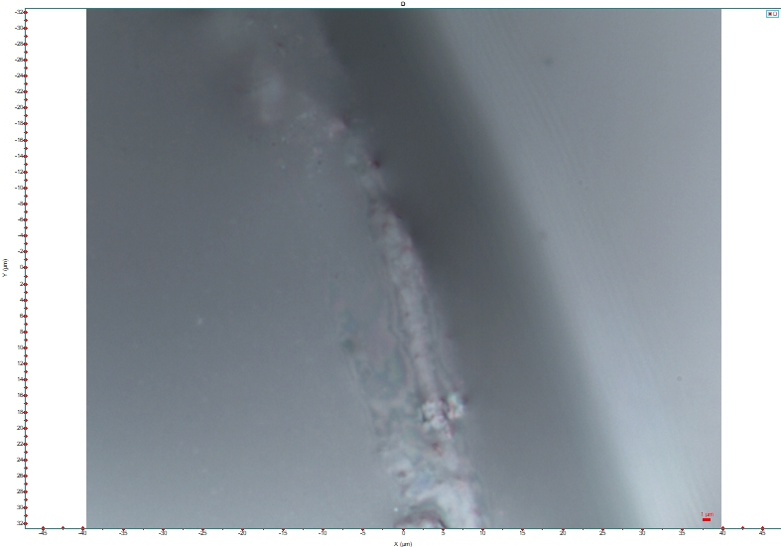
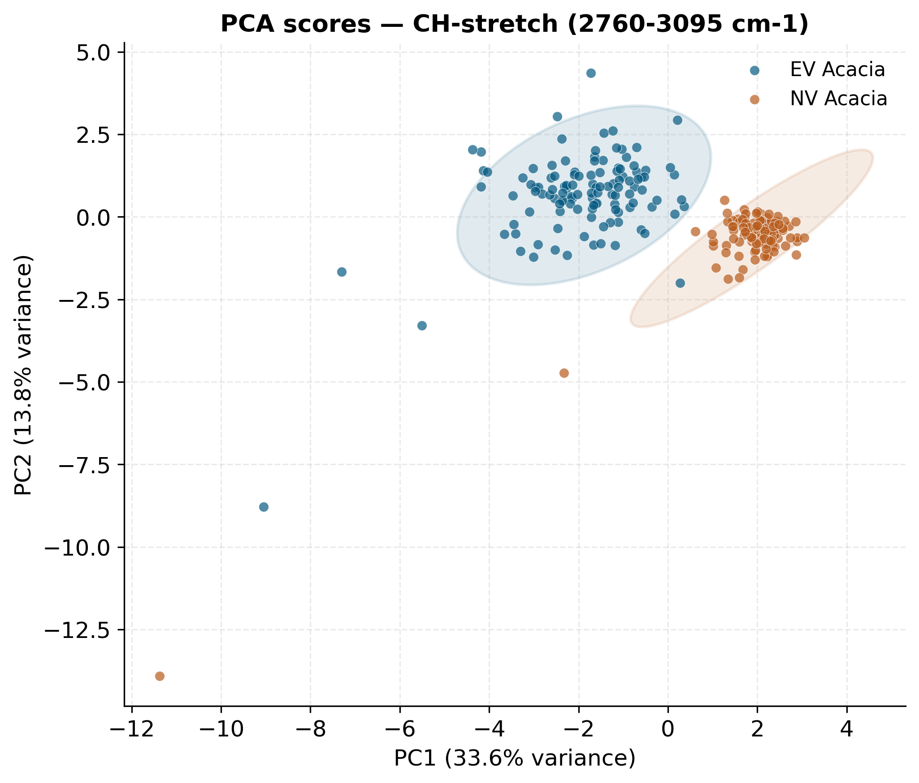
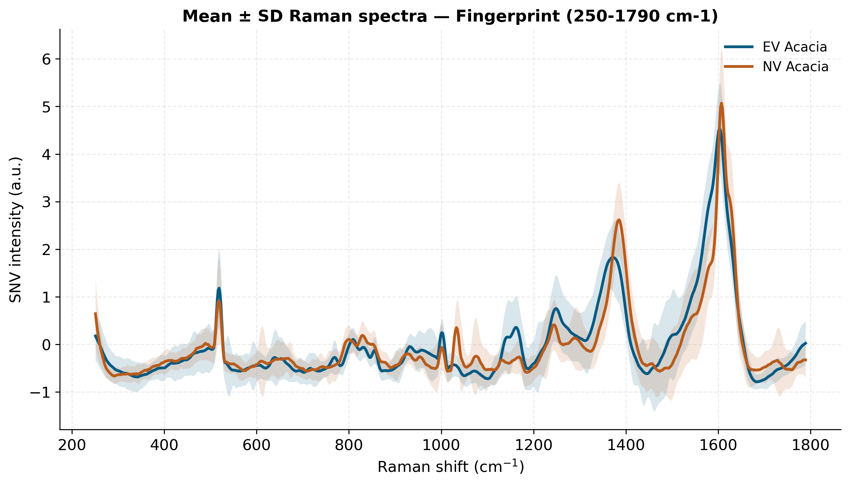
Ag/SiNW SERS Substrate :
EV Acacia
Nano vesicles Acacia
100x
100x
Python-Preprocessing –Croping
Informative region- Smoothing-
PCA for dimensionality reduction,
followed by LDA classification (PCA-LDA)
and cross-validated with PLS-DA,
using site-grouped 5-fold cross-validation

Slide 8
Training Activities: Mini-courses, Seminars & Conferences
PhD Programme in Information Engineering – 41st Cycle · DIIES
2
Seminars= 5 CFU
1
Mini-courses (8 h each= 10 CFU)
Seminar | Instructor(s) | Hours
Some Results for Electromagnetic Design and Retrieval Problems | Prof. Mats Gustafsson | 1.5 h
Connected and Automated Mobility (MOST Spoke 6 dissemination activities) | M. Segata, I. Turcanu | 3 h
Factors Affecting the Port Times of Container Ships | — | 4 h
Resonances in Geometrically Finite Graphs | Dr Carsten Peterson | 2 h
Networking Solutions for Cooperative, Connected and Automated Mobility | Profs. C. Campolo, A. Bazzi, S. Sargento; Drs F. Brasca, G. Landi | 4 h
Digital Twins and Deep Learning: Advancing Infrastructure Sustainability and Resilience through Remote Sensing and Computer Vision | Dr Surya Sarat Chandra Congress | 3 h
Workshop | DICEAM | —
Edge Machine Learning for Data Analysis on Low Computational Capacity Devices
Prof. Merenda
Ensuring Trustworthiness in Federated Learning
Prof. Fisichella
Digital Identity
Prof. Lax
Health Management
Prof. Romano
Foundations of Quantum Mechanics and Applications
Profs. Messina and Faggio
3
International Conference
NanoInnovation 2026 · Rome · 14–18 Sept 2026
Oral presentation: "Machine Learning Raman Classification of Chromonic Liquid Crystal Self-Organisation on Different Substrates"

Slide 9
Training Activities: Mini-courses, Seminars & Conferences
PhD Programme in Information Engineering – 41st Cycle · DIIES
2
Seminars (5 CFU)
1
Mini-courses (8 h each = 10 CFU)
Edge Machine Learning for Data Analysis on Low Computational Capacity Devices
Prof. Merenda
Ensuring Trustworthiness in Federated Learning
Prof. Fisichella
Digital Identity
Prof. Lax
Health Management
Prof. Romano
Foundations of Quantum Mechanics and Applications
Profs. Messina and Faggio
Seminar | Instructor(s) | Hours
Some Results for Electromagnetic Design and Retrieval Problems | Prof. Mats Gustafsson | 1.5 h
Connected and Automated Mobility (MOST Spoke 6 dissemination activities) | M. Segata, I. Turcanu | 3 h
Factors Affecting the Port Times of Container Ships | — | 4 h
Resonances in Geometrically Finite Graphs | Dr Carsten Peterson | 2 h
Networking Solutions for Cooperative, Connected and Automated Mobility | Profs. C. Campolo, A. Bazzi, S. Sargento; Drs F. Brasca, G. Landi | 4 h
Digital Twins and Deep Learning: Advancing Infrastructure Sustainability and Resilience through Remote Sensing and Computer Vision | Dr Surya Sarat Chandra Congress | 3 h
Workshop-Optimization and Equilibrium Problems | DICEAM | —
3
International Conference
4
Publications from this work
NanoInnovation 2026 · Rome · 14–18 Sept 2026
Oral presentation: “Machine Learning Raman Classification of Chromonic Liquid Crystal Self-Organisation on Different Substrates”
→ Outcome: 2 journal articles submitted (under review)
1. [Paper 1 title] – submitted to [Journal], 2026
Under review
2. [Paper 2 title] – submitted to [Journal], 2026
Under review

Slide 10
Thankyou !

