Slide 1
Performance analysis and optimization
Aditya Kumar
ACM Distinguished Speaker
Twitter: @_hiraditya_
Notes:
Look at the copy from hotmail cloud drive as well.

Slide 2
System Performance
Code:
Compiler: GCC, LLVM, ICC, MSVC
RT-libs and system: libstdc++, glibc, libgcc, compiler-rt
Hardware: AArch64, Intel, RISC-V

Slide 3
Ways to improve performance
Improve runtime of algorithms
Change algorithms
Using right data structures
Removing recursion, redundancies
Bubble sort to quick sort
list to vector, map to hash_map
Switching to recent compiler versions
GCC 12
Using improved language features, or optimize existing language semantics
C++17/20 (RVO, compile time evaluations, noexcept)
Changing the programming language
Java to C++
Micro optimizations tend to become less relevant with new compilers/runtime/hardware
Encoding data intelligently
Hand optimization, AutoFDO, PGO
Profile based optimization
Customizing the compiler to modify semantics of the language within certain constraints

Slide 4
Improve runtime of algorithms

Slide 5
Suboptimal basic_streambuf::xsgetn (libc++)
template <class _CharT, class _Traits>
streamsize
xsgetn(char_type* __s, streamsize __n) {
streamsize __i = 0;
for (; __i < __n; ++__i, ++__s) {
if (__ninp_ < __einp_)
*__s = *__ninp_++;
else
break;
}
return __i;
}
Notes:
basic_istream<_CharT, _Traits>::read(char_type* __s, streamsize __n) calls sgetn which calls xsgetn

Slide 6
Optimized basic_streambuf::xsgetn
// After
template <class _CharT, class _Traits>
streamsize xsgetn(char_type* __s, streamsize __n)
{
streamsize __i = 0;
while (__i < __n) {
if (__ninp_ < __einp_) {
const streamsize __len = std::min(__einp_ - __ninp_, __n - __i);
traits_type::copy(__s, __ninp_, __len);
__s += __len;
__i += __len;
this->gbump(__len);
}
else
break;
}
return __i;
}
// Before
template <class _CharT, class _Traits>
streamsize
xsgetn(char_type* __s, streamsize __n) {
streamsize __i = 0;
for (; __i < __n; ++__i, ++__s) {
if (__ninp_ < __einp_)
*__s = *__ninp_++;
else
break;
}
return __i;
}

Slide 7
Suboptimal string::find algorithm
// b1, e1 iterators to the haystack string​
// b2, e2 iterators to the needle string​
__search(b1, e1, b2, e2) {
while (true) {
while (true) {
if (__first1 == __s) return make_pair(__last1, __last1);
if (__pred(*__first1, *__first2)) break;
++__first1;
}
_RandomAccessIterator1 __m1 = __first1;
_RandomAccessIterator2 __m2 = __first2;
while (true) {
if (++__m2 == __last2)
return make_pair(__first1, __first1 + __len2);
++__m1;
if (!__pred(*__m1, *__m2)) {
++__first1;
break;
}
} // End While
} // End While
}
Find the first matching character
Match rest of the string

Slide 8
Optimized string::find algorithm
const _CharT *
__search_substring(const _CharT *__first1, const _CharT *__last1, const _CharT *__first2, const _CharT *__last2)
{
// First element of __first2 is loop invariant.
_CharT __f2 = *__first2;
while (true) {
__len1 = __last1 - __first1;
// Check whether __first1 still has at least __len2 bytes.
if (__len1 < __len2)
return __last1;
// Find __f2 the first byte matching in __first1.
__first1 = _Traits::find(__first1, __len1 - __len2 + 1, __f2);
if (__first1 == 0)
return __last1;
if (_Traits::compare(__first1, __first2, __len2) == 0)
return __first1;
++__first1; // TODO: Boyer-Moore can be used.
} // End While
}
Find the first matching character
Match rest of the string

Slide 9
Performance improvements
Benchmark | Without patch | With patch | Gain
Test1/32768 | 28157 ns | 2203 ns | 12.8x
Test2/32768 | 28161 ns | 2204 ns | 12.8x

Slide 10
Missing inlining opportunities in basic_string (libc++)
Important functions not inlined
basic_string::__init(const value_type* __s, size_type __sz)
basic_string::~basic_string()
Solution
Mark functions as inline

Slide 11
Missing function attributes (libc++)
Missing __attribute__((__noreturn__)) in important functions.
Prevents important compiler optimizations
Results in false positives in static analysis results
__throw.* functions in __locale, deque, future, regex, system_error, vector
Example:
class __vector_base_common {
protected:
__vector_base_common() {}
__attribute__((__noreturn__)) void __throw_length_error() const;
__attribute__((__noreturn__)) void __throw_out_of_range() const;
};

Slide 12
Issues with number parsing in locale (libc++)
Uses std::string to store the parsed numbers
Results in (unnecessary) calls to memset
Possible characters for all kinds of numbers (octal, hex, decimal) stored in one string
__atoms = “0123456789abcdefABCDEFxX+-pPiInN”
Makes unnecessary copies of ‘__atoms’ string which are not modified in common case

Slide 13
compiler vs. programmer vs. hand-optimized
Relative performance w.r.t. g++ (Lower is better)
Data: 32KB | programmer | compiler | C-memcpy
MSVC | 11 | 11 | 1.04
clang++ | 1 | 1 | 1.3
g++ | 1 | 1.3 | 1.3
// Programmer
const char*
assign(const char *beg,
const char *end, char *dest)
{
while (beg != end)
*dest++ = *beg++;
return beg;
}
// Helping compiler with user annotation
const char*
assign_res(const char * __restrict beg,
const char * __restrict end,
char *__restrict dest)
{
while (beg != end)
*dest++ = *beg++;
return beg;
}

Slide 14
Change algorithms

Slide 15
Bernstein Hash
uint32_t ComputeHash(const ZipString& name)
{
uint32_t hash = 0;
uint16_t len = name.name_length;
const uint8_t* str = name.name;
while (len--) {
hash = hash * 31 + *str++;
}
return hash;
}

Slide 16
Improved Bernstein Hash
// After uint32_t ComputeHash(const ZipString& name)
{
uint32_t hash = 0;
uint16_t len = name.name_length;
const uint8_t* str = name.name;
unsigned chunk;
const unsigned sz = sizeof(chunk);
// Hash sz bytes at a time.
while (len > sz) {
// Why not plain typecast??
__builtin_memcpy(&chunk, str, sz);
hash = hash * 31 + chunk;
len -= sz;
str += sz;
}
// Hash the left-over bytes.
while (len--) {
hash = hash * 31 + *str++;
}
return hash;
}
// Before
uint32_t ComputeHash(const ZipString& name)
{
uint32_t hash = 0;
uint16_t len = name.name_length;
const uint8_t* str = name.name;
while (len--) {
hash = hash * 31 + *str++;
}
return hash;
}

Slide 17
Comment: standard library algorithms
Iterator based algorithms can lose information and hence, can result in suboptimal performance
No optimized algorithms for non-char arrays
std::rotate on doubly linked list. Same algorithms can be writtren optimally for ranges
Copying an array of pairs
std::find may not always be the right choice
substr

Slide 18
Changing the data structure

Slide 19
vector vs. deque (push_back)
* [push_back N elements]
* Lower is better.

Slide 20
vector vs. deque (access)
* [access N elements in sequence]
* Lower is better.

Slide 21
vector vs. deque (push_back + access)
* [push_back N elements + access N elements in sequence]
* Lower is better

Slide 22
Associative vs Hashed Associative (Finding random integers)
* Lower is better

Slide 23
Comment: standard library containers
Consider total cost
Take ratio of reads/writes to decide
vector causes memory fragmentation (~2N allocations for N elements)
if reads < writes, deque can be a better choice
‘resize’ initializes the memory

Slide 24
Encoding data intelligently Find two numbers such that sum is zero
#include<algorithm>
#include<array>
#include<iostream>
template<typename T>
// Returns the positions in [b, e) which sum to zero.
std::pair<T, T> find_complement(T b, T e) {
T p1 = b;
T p2 = e;
--p2; // Point to the last element of the range.​
while (p1 != p2) {
int sum = *p1 + *p2;
if (sum == 0)
return {p1, p2}; // Preserve the information computed
else if (sum < 0)
++p1;
else // sum > 0​
--p2;
}
return {nullptr, nullptr};
}
int main() {
std::array<int, 9> a{ -4, -4, -1, 0, 1, 2, 3, 4, 4 };
std::pair<int*, int*> v = find_complement(a.begin(), a.end());
if (v.first != nullptr) {
std::cout << "\nFound: " << *v.first << ", " << *v.second;
}
return 0;
}

Slide 25
Encoding data intelligently Find all pairs such that sum is zero
#include<algorithm>
#include<array>
#include<iostream>
template<typename T>
// Returns the positions in [b, e) which sum to zero.
std::pair<T, T> find_complement(T b, T e) {
T p1 = b;
T p2 = e;
--p2; // Point to the last element of the range.​
while (p1 != p2) {
int sum = *p1 + *p2;
if (sum == 0)
return {p1, p2}; // Preserve the information computed
else if (sum < 0)
++p1;
else // sum > 0​
--p2;
}
return {nullptr, nullptr};
}
int main() {
std::array<int, 9> a{ -4, -4, -1, 0, 1, 2, 3, 4, 4 };
std::pair<int*, int*> v = find_complement(a.begin(), a.end());
while (v.first != nullptr) {
std::cout << "\nFound: " << *v.first << ", " << *v.second;
v = find_complement(++v.first, v.second);
}
return 0;
}

Slide 26
Switching to new compiler/language versions
#include<string>
int main() {
std::string s("a");
s+='a';
return 0;
}
$ g++ -O3 t.cpp -S –fno-exceptions –std=c++20 -o - | grep _ZdlPv
# Optimized away!
$ clang++ -O3 t.cpp -S –fno-exceptions –std=c++20 -o - | grep _ZdlPv
# Optimized away!
#include<string>
void foo();
int main() {
const std::string s("a");
foo();
return 0;
}
$ g++ -O3 t.cpp -S –fno-exceptions –std=c++20 -o - | grep _ZdlPv
call _ZdlPvm
$ clang++ -O3 t.cpp -S –fno-exceptions –std=c++20 -o - | grep _ZdlPv
call _ZdlPv@PLT
https://godbolt.org/z/9o1co74Kz

Slide 27
Comment: C++ programming language
The constructor and destructor cannot be const qualified
http://www.open-std.org/jtc1/sc22/wg21/docs/papers/1995/N0798.htm
Using unsigned int as induction variable is okay
www.gcc.gnu.org/PR48052

Slide 28
Size (in bytes) of empty containers 64 bit
Container | libstdc++ | libc++ | MSVC
vector<int> | 24 | 24 | 24
list<int> | 24 | 24 | 16
deque<int> | 80 | 48 | 40
set<int> | 48 | 24 | 16
unordered_set<int> | 56 | 40 | 64
map<int, int> | 48 | 24 | 16
unordered_map<int, int> | 56 | 40 | 64

Slide 29
Optimize for latency
Memory | Latency (cycles)
L1 | 4
L2 | 12
L3 | 36
RAM | 36+57ns
Intel i7-4770 3.4GHz (Turbo Boost off) 22 nm. RAM: 32 GB (PC3-12800 cl11 cr2).
Source: http://www.7-cpu.com/cpu/Haswell.html

Slide 30
Performance analysis tools
Valgrind
Linux Perf
Intel Vtune
XCode Instruments
Visual studio performance tools

Slide 31
Performance Analysis with Valgrind
valgrind [--tool=memcheck]
valgrind mostly known for its memory leak checker
valgrind --tool=cachegrind
cache and branch simulator
count read, write, and branch instructions
valgrind --tool=callgrind
execution call graph
visualization tool kcachegrind

Slide 32
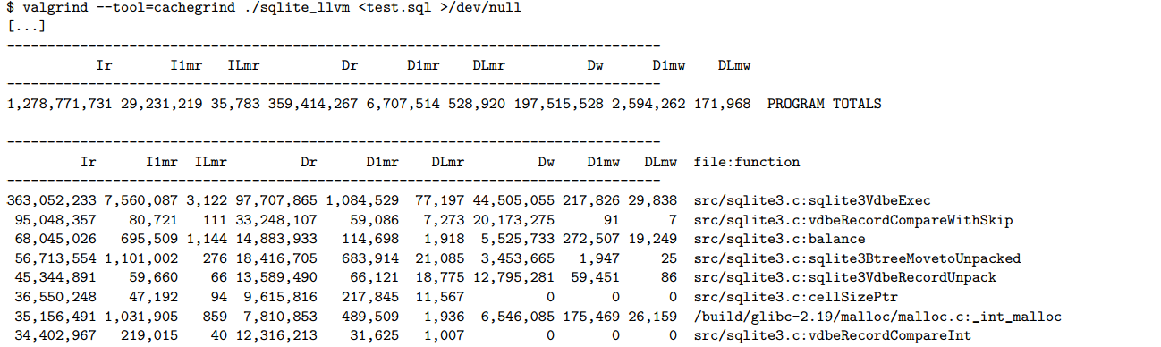
Valgrind: Example – SQLite

Slide 33
Performance Analysis with Linux Perf
perf stat
sum up all counters
perf record
record events
perf report
Shows the profile collected using `perf record`

Slide 34
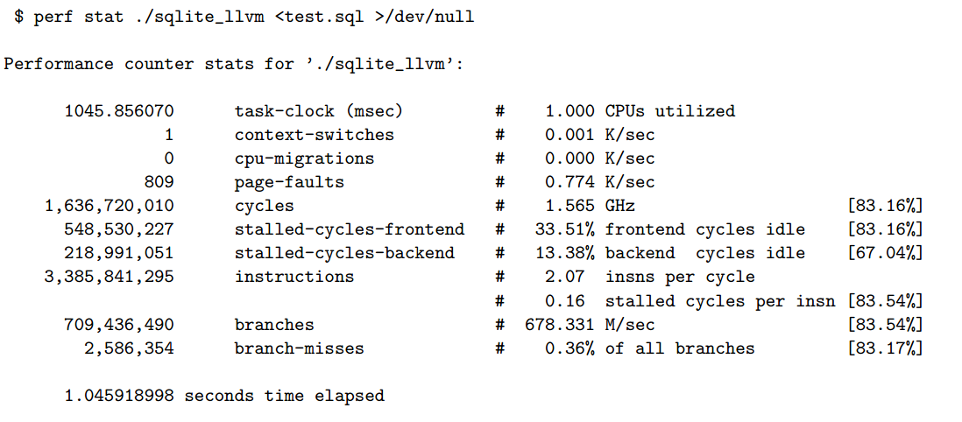
Perf stat: Example – SQLite

Slide 35
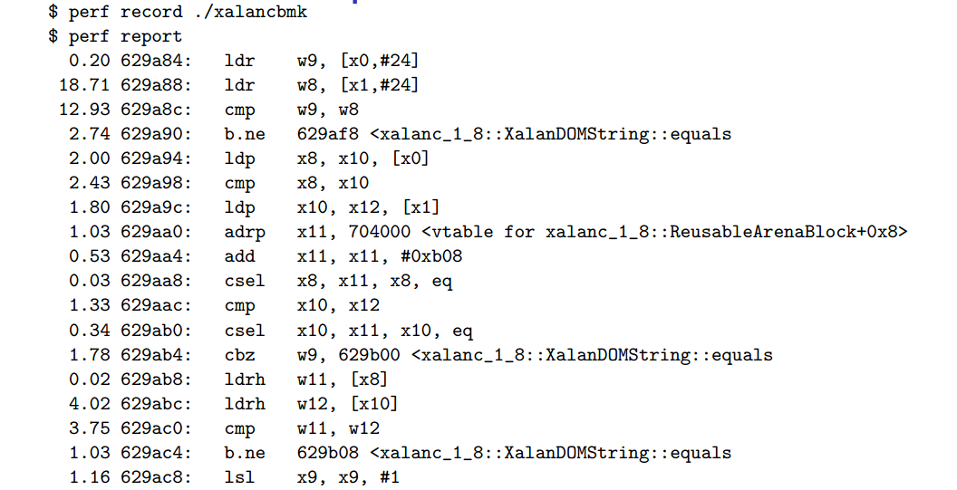
Perf record: Example – xalancbmk

Slide 36
AutoFDO: Feedback Directed Optimization
Linux-perf extracts profiles of running systems
little overhead
coverage (basic block frequencies) from dynamic profiles
continuous profiling and tuning of optimizations

Slide 37
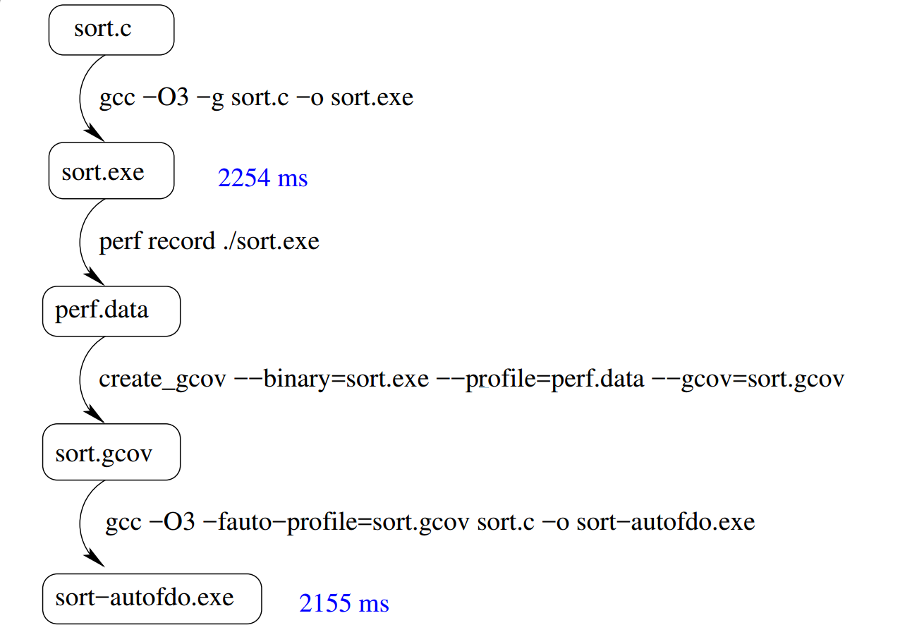
AutoFDO: Example

Slide 38
Analyzing System Performance
Vary one Component of the System at a time
Measure impact of one component on the System
Disable frequency scaling
Dynamic profiles, compiler logs
Monitor performance regression over time
Time series: track performance of system over time
Git bisect performance changes
Performance metrics
cpufrequtils
Systematic performance analysis
Run multiple times
Performance analysis pitfalls
Central tendency: the median instead of the mean
Use the quantile values instead of a single median value.
Outlier detection
Weighted samples for combining historical data

Slide 39
Performance analysis pitfalls
Central tendencies
Use the quantile values instead of a single median value
Outlier detection
Weighted samples for combining historical data
Recent data more important than the previous data.
Filter outliers
Helps with prioritization
The median instead of the mean

Slide 40
std-benchmark
https://github.com/hiraditya/std-benchmark
WIP
Builds on Linux, Windows (thanks to cmake)
Performance numbers are very stable (based on google-benchmark)
https://github.com/hiraditya/hiraditya/tree/master/_posts
https://github.com/google/benchmark
https://github.com/hiraditya/std-benchmark

Slide 41
References and Acknowledgements
Acknowledgements:
Initial version in collaboration with Sebastian Pop (Samsung Austin R&D Center)
Measurement Pitfalls:
https://stats.stackexchange.com/a/156787
https://www.longevitas.co.uk/site/informationmatrix/quantilesandpercentiles.html
https://aakinshin.net/posts/statistics-for-performance/
Linux perf: http://www.brendangregg.com/perf.html
Performance Analysis: https://github.com/AndreyAkinshin/perfolizer
Microbenchmarking: https://www.bfilipek.com/2016/01/micro-benchmarking-libraries-for-c.html
C++ benchmark tool: https://github.com/ivafanas/sltbench
AutoFDO Resources
https://gcc.gnu.org/wiki/AutoFDO/Tutorial
https://github.com/google/autofdo
https://gcc.gnu.org/lists.html

