Slide 1

Presentation title
Presenter Name

Slide 2
Agenda
Introduction
Timeline
Areas of growth
Summary
Primary goals
Presentation Title

Slide 3

Introduction
At Contoso, we empower organizations to foster collaborative thinking to further drive workplace innovation. By closing the loop and leveraging agile frameworks, we help business grow organically and foster a consumer-first mindset.

Slide 4


Primary goals
ANNUAL REVENUE GROWTH

Slide 5
Areas of growth
Time period | B2B | Supply chain | ROI | E-commerce
Q1 | 4.5 | 2.3 | 1.7 | 5.0
Q2 | 3.2 | 5.1 | 4.4 | 3.0
Q3 | 2.1 | 1.7 | 2.5 | 2.8
Q4 | 4.5 | 2.2 | 1.7 | 70

Slide 6
“Business opportunities are like buses. There’s always another one coming.”
Richard Branson

Slide 7


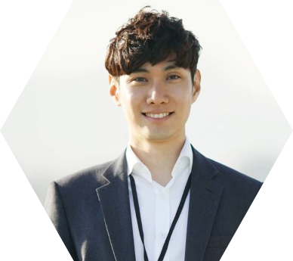

Meet our team
Mirjam Nilsson
Rajesh Santoshi
Chief Executive Officer
VP Marketing
Takuma Hayashi
Flora Berggren
President
Chief Operations Officer

Slide 8
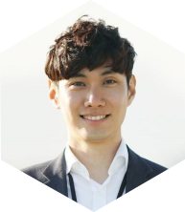







Meet our extended team
Takuma Hayashi
Graham Barnes
President
VP Product
Mirjam Nilsson
Rowan Murphy
Chief Executive Officer
SEO Strategist
Flora Berggren
Elizabeth Moore
Chief Operations Officer
Product Designer
Rajesh Santoshi
Robin Kline
VP Marketing
Content Developer

Slide 9





Plan for product launch
Planning
Marketing
Design
Strategy
Launch
Synergize scalable e-commerce
Disseminate standardized
metrics
Coordinate
e-business applications
Foster holistically superior methodologies
Deploy strategic networks with compelling
e-business needs

Slide 10
Plan for product launch
Planning
Marketing
Design
Strategy
Launch
Synergize scalable
e-commerce
Disseminate standardized metrics
Coordinate
e-business applications
Foster holistically superior methodologies
Deploy strategic networks with compelling
e-business needs

Slide 11
Timeline
Nov 20XX
May 20XX
Disseminate standardized metrics
Deploy strategy networks with compelling e-business needs
Sep 20XX
Synergize scalable
e-commerce
Jan 20XX
Mar 20XX
Coordinate e-business applications
Foster holistically superior methodologies

Slide 12

Areas of focus
B2B market scenarios
Cloud-based opportunities
Develop winning strategies to keep ahead of the competition
Capitalize on low-hanging fruit to identify a ballpark value
Visualize customer directed convergence
Iterative approaches to corporate strategy
Establish a management framework from the inside

Slide 13
How we get there
ROI
Envision multimedia-based expertise and cross-media growth strategies
Visualize quality intellectual capital
Engage worldwide methodologies with web-enabled technologies
Niche markets
Pursue scalable customer service through sustainable strategies
Engage top-line web services with cutting-edge deliverables
Supply chains
Cultivate one-to-one customer service with robust ideas
Maximize timely deliverables for real-time schemas

Slide 14


Summary
At Contoso, we believe in giving 110%. By using our next-generation data architecture, we help organizations virtually manage agile workflows. We thrive because of our market knowledge and great team behind our product. As our CEO says, “Efficiencies will come from proactively transforming how we do business.”

Slide 15




Thank you
Mirjam Nilsson
mirjam@contoso.com
www.contoso.com

