Slide 1

Operation Data
Operations & SLA Performance Analysis | Jan–Jun 2026

Slide 2
Business Problem & Objective
Business Problem
Management needed visibility into order-processing performance, SLA compliance, delays, errors, and operational bottlenecks.
Objective
Analyze order-processing data to identify SLA performance patterns, areas requiring operational investigation, and data-quality issues.
Tools:
Excel | SQL | Python | Power BI

Slide 3
Data Preparation & Quality Checks
25,012 Raw records
Key cleaning decisions
Standardized inconsistent Region values
Converted 4 negative processing times to missing
Missing processing times excluded from SLA calculations
Retained extreme processing times for investigation
Retained zero shipping days because they were not proven invalid
Remove 12 Duplicates
25,000 unique orders
Standardize and validate fields
Analysis-ready dataset

Slide 4
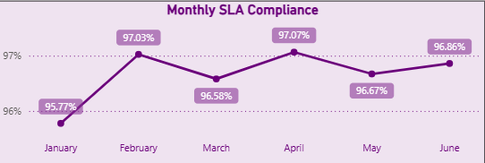
Overall Operational Performance
25,000
Orders
96.65%
SLA Compliance
10.35 Hours
Avg Processing
4.60%
Error Rate
24,132 orders met SLA out of 24,968 orders with valid processing times.

Slide 5
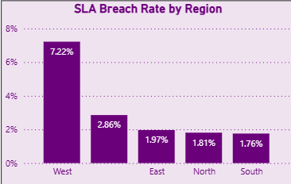
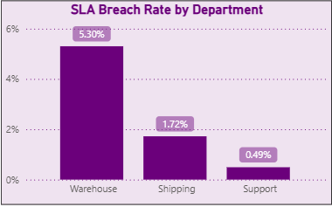
Where Are SLA Breaches Concentrated?
West recorded a 7.22% observed SLA breach rate, compared with 1.76%–1.97% across the other named regions. Warehouse recorded a 5.30% breach rate compared with Shipping at 1.72% and Support at 0.49%.

Slide 6
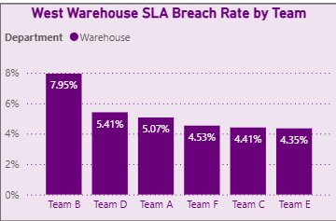
West Warehouse -Team-Level Analysis
3.35%
Overall
7.22%
West
10.66%
West Warehouse
Team B recorded the highest observed breach rate within West Warehouse at 20.86%.

Slide 7
Recommendations & Next Steps
Investigate West Warehouse
Review workflow, queue times, handoffs, capacity, and workload distribution.
2.
Investigate Team B
Compare workload, priority mix, order complexity, and processing-time distribution with other teams.
3.
Monitor SLA Performance
Continue monthly monitoring to identify changes in compliance and emerging bottlenecks.
4.
Improve Data Quality
Address missing Region, Team, Processing Hours, and Order Value fields at the source.
1.
Next analytical step: investigate whether the West Warehouse pattern persists after controlling for order priority, workload, and time period.

