Slide 1
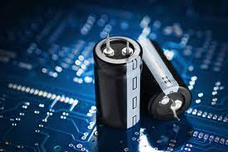
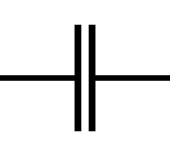
CAPACITOR
AN ELECTRONIC STORAGE DEVICE:
(PAST,PRESENT AND FUTURE)

Slide 2

introduction
What is capacitor?
Capacitor is a temporary storage device.
A capacitor is an electronic device that is used to store electrical energy.
Charging and Discharging.
Unit: Farad
Capacitor has Polarity
Example: LED in Adapter

Slide 3
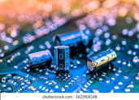
Capacitance:
Capacitance is the ability of a material to store electric charge. It is measured in farads(F).
The larger the capacitance value, the more charge material can store.
It is defined as the ratio of the charge store on a conductor to the potential difference between the conductors.
C = Q/V
C :- capacitance(F)
Q :- charge(C)
V :- potential difference(V)

Slide 4
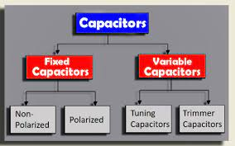
Types of capacitors
1. FIXED CAPACITOR :- A fixed capacitor is a capacitor which
has a fixed capacitance value . This means that the amount
of charge that the capacitor can store is not adjustable.
Types of fixed capacitor:-
Polar capacitor
Non-polar capacitor
2. VARIABLE CAPACITOR:- A variable capacitor is a capacitor
that allows you to adjust capacitance value . which means
capacitance value is not fixed.
Types of variable capacitor:-
Tunning capacitors
Trimmer capacitors

Slide 5
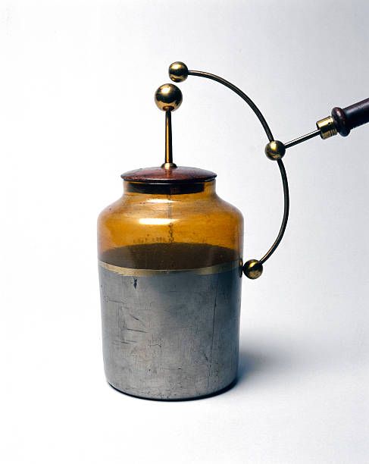
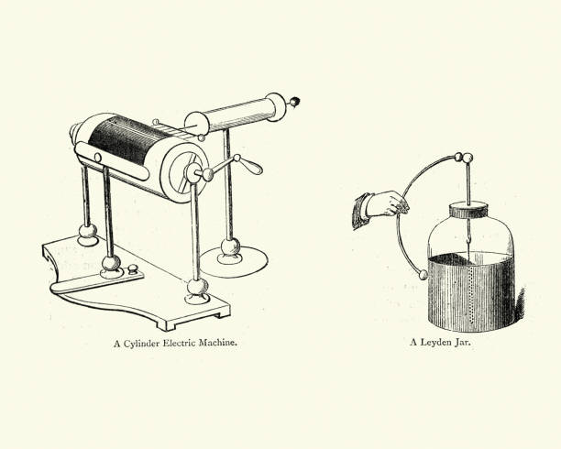
PAST: EARLY CAPACITORS
The early development of capacitors, also known as Leyden jar,
dates back to the 18th century. It was independently invented
by multiple scientists, including Ewald Georg von Kleist in 1745
and Pieter van in 1746.
It is the basic form of capacitor that stores electrical energy in
the form of electric charge on two conductive plates separated
by an insulator.

Slide 6
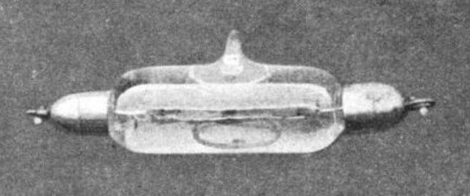
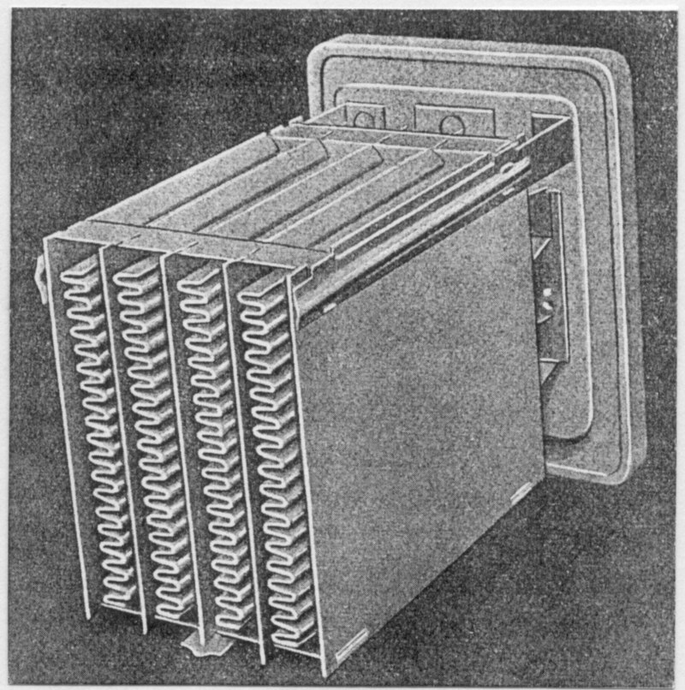
PAST: ELECTROLYTIC capacitors
Early Development: The concept of the electrolytic capacitor dates back to the late 19th century, Charles Pollak, in 1896.
Quality and Reliability: Quality control and reliability testing have become critical in the development of electrolytic capacitors to ensure longevity and performance, especially in demanding applications.

Slide 7
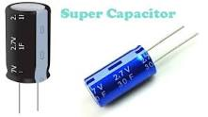
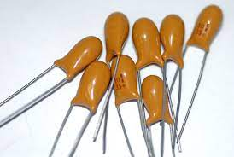
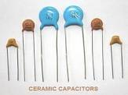
PRESENT: TYPES OF CAPACITORS
SUPERCAPACITORS :- A supercapacitor is a high-capacity electrical energy storage device that can store and release energy quickly, making it suitable for applications requiring rapid bursts of power.
CERAMIC CAPACITORS :- A ceramic capacitor is an electronic component that stores and releases electrical energy in the form of electric fields and is made of ceramic materials.

Slide 8
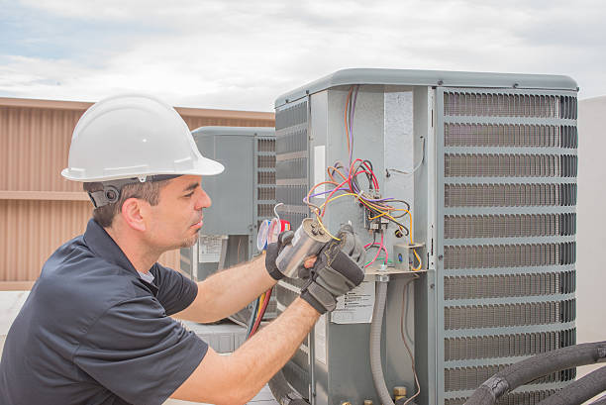
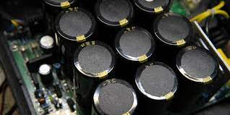
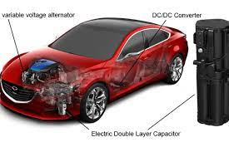
Present: Capacitor application
ELECTRONICS :- Capacitors are widely used in electronics to store and release electrical energy. They help stabilize voltage levels, and store energy for quick discharge .
ELECTRIC VEHICLES :- Capacitors play a significant role in electric vehicles (EVs). They are used in regenerative braking systems to capture and store energy during braking.

Slide 9
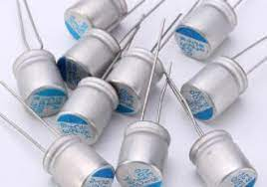
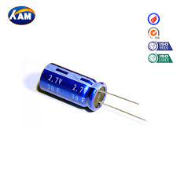
FUTURE- EMERGING TECHNOLOGIES
Here are some potential future emerging technologies in
capacitors:
Solid-State Capacitors: Solid-state capacitors could replace traditional electrolytic capacitors. They are more reliable, have longer lifespans, and are less prone to leakage. Future developments may improve their energy storage capacity.
High-Temperature Capacitors: Capacitors that can operate at higher temperatures without significant degradation are essential for demanding applications .

Slide 10


FUTURE- CHALLENGES AND SOLUTIONS
Challenges:
Energy Density: One of the primary challenges with capacitors is their relatively low energy density compared to batteries.
Self-Discharge: Capacitors tend to self-discharge over time, which limits their long-term energy storage capabilities.
Solutions:
Superconducting Capacitors: Superconducting materials, when used in capacitors, can significantly increase energy storage capabilities and reduce self-discharge.
Innovative Designs: Redesigning capacitors with innovative structures and geometries can lead to improvements in energy storage, reliability, and other performance parameters.

Slide 11


ENVIRONMENTAL IMPACT
Their environmental impact can be assessed in several ways:
Transportation: The transportation of capacitors and electronic devices can contribute to carbon emissions if not done efficiently.
Recycling and Disposal: The disposal of electronic devices containing capacitors, especially if not properly recycled or treated, can lead to environmental contamination and health risks.

Slide 12

CONCLUSION
capacitors have played a vital role in the past as essential components in electrical circuits, enabling energy storage and signal filtering.
In the present, they continue to be indispensable in various electronic devices and systems, facilitating energy management and signal processing.
Their past, present, and future contributions underscore their enduring importance in the field of electronics and energy management.

Slide 13


