Slide 1

CHATGENIX | 3001 | Chat-bot
Date: 28-05-2025
Team Members
Samreen Fatima (23bd1a1256)
Vedasree Ramaram (23bd1a1265)
Hiral Jain (23bd1a1222)
Manasa Jalluri(23bd1a1223)
Ch.sri Charan Sai (23bd1a12c4)
Mentors
Chatan Tulasi
Harismitha Eity

Slide 2
CONTENTS
Title Slide
Introduction
Requirement
Process Flow
Design
Development
Expected Outcome
Thank you!

Slide 3
INTRODUCTION
Project Scope: The College Chat-bot is an AI-powered virtual assistant designed to provide instant and accurate information related to college activities. It aims to automate query handling, reduce administrative workload, and enhance the overall communication experience for students and faculty.
Abstract: The project involves scraping data from the college website (https://kmit.in/) to build a custom knowledge base. Using LLM (Large Language Model), the chat-bot processes natural language queries and responds with relevant information. The chat-bot will be deployed on the college website or student portal for easy access.
Target Technology Domain:
Artificial Intelligence (AI): Natural language processing (NLP) using LLMs.
Web Development: Full-stack development with typescript , vite for frontend and supabase for backend
Data Engineering: Web scraping and data storage.
Cloud Storage:Supabase Authentication for access control.
Authentication & Security: Supabase Auth + RLS (Row-Level Security)
Backend : RESTful API call directly to Supabase using the Supabase JS client.

Slide 4
REQUIREMENT
📌 Stakeholders (End Users):
Students:
Access information about courses, faculty, events, and schedules.
Get updates on exam notifications, results, and announcements.
Ask general college-related queries.
Faculty/Admin:
Retrieve faculty details, events, and schedules.
Use the chat-bot for administrative inquiries.
Admin-level access to scrape and update the knowledge base.
College Management:
Monitor chat-bot performance and logs.
Ensure data accuracy and reliability.
📌 Their Needs (Use Cases):
Students' Use Cases:
Query about admissions, courses, and schedules.
Ask about exam dates, results, and deadlines.
Retrieve event details (seminars, workshops, fests).
Inquire about faculty contact information.
Faculty/Admin Use Cases:
Search for student-related details (exam schedules, attendance policies).
Access staff meeting schedules and college events.
Use admin panel to trigger data scraping.
┌───────────────────────┐
│ College Website |
└───────────────────────┘
│
│
┌──────────────▼───────────────┐
│ College Chatbot │
│ (LLM-powered Virtual Assistant) │
└──────────────────────────────┘
│
┌───────────────┼───────────────┐
│ │ │
┌─────▼─────┐ ┌─────▼─────┐ ┌─────▼─────┐
│ Students │ Faculty | │ Admin │
└─────────── ┘ └─────────── ┘ └───────────┘
│ | |
┌──────▼──────┐ ┌────▼─────┐ ┌─────▼─────┐
│ Queries for Admin Data
│ courses, Queries Scraping
│ events, etc & Updates Trigger
└─────────────┘ └────────── ┘ └───────┘

Slide 5
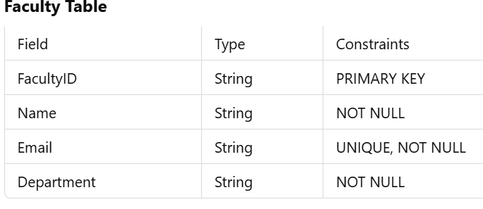
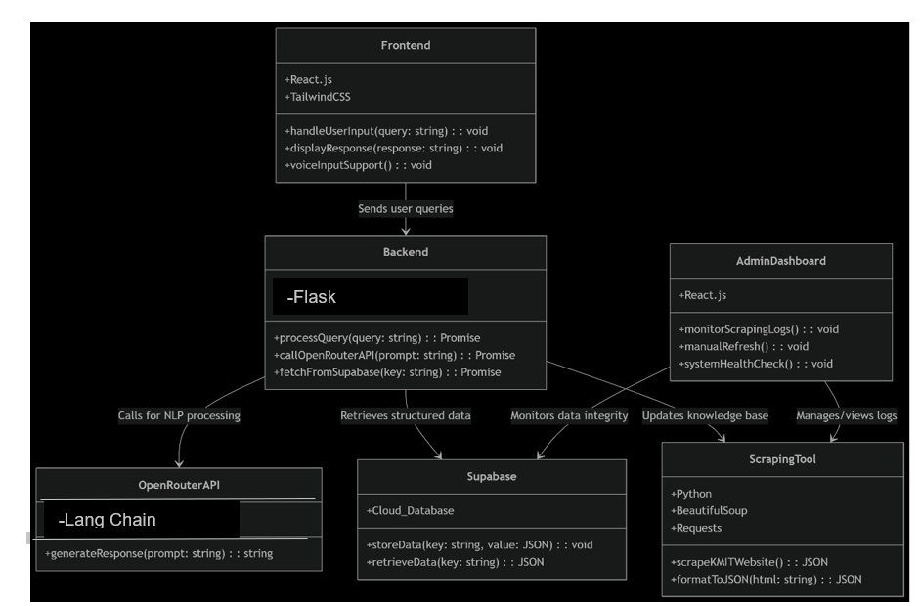
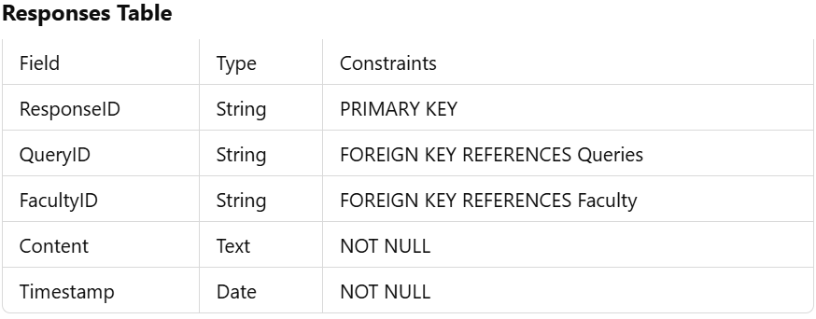
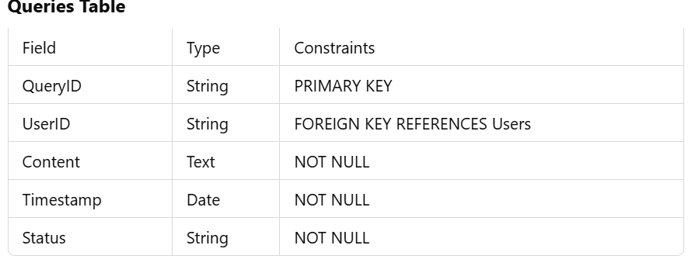
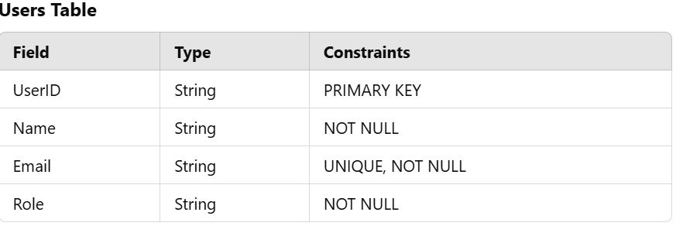
DESIGN
Database design (tables):
Class diagram

Slide 6
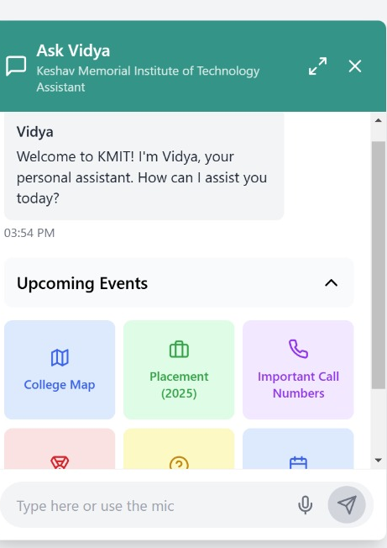
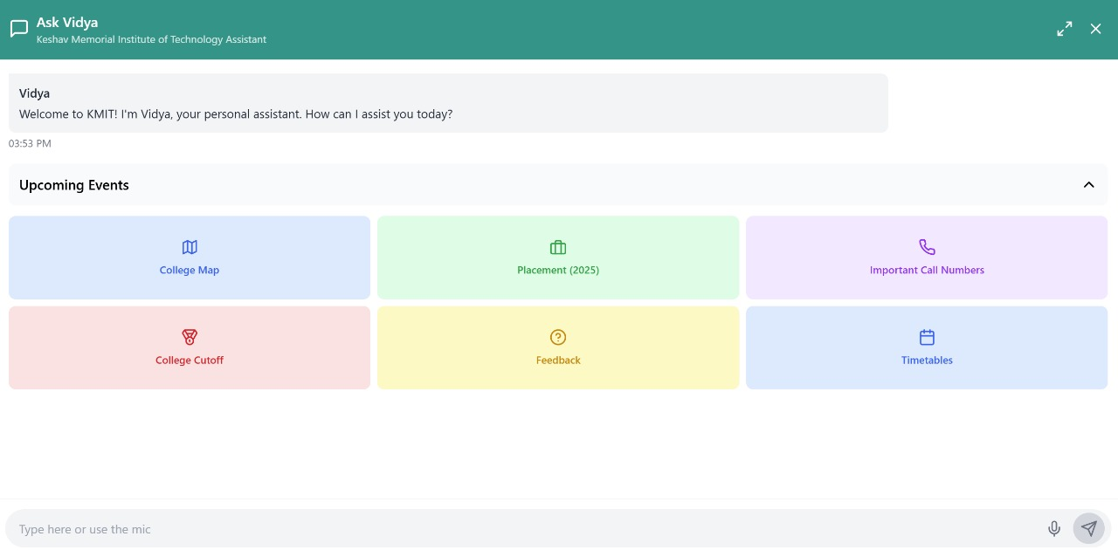
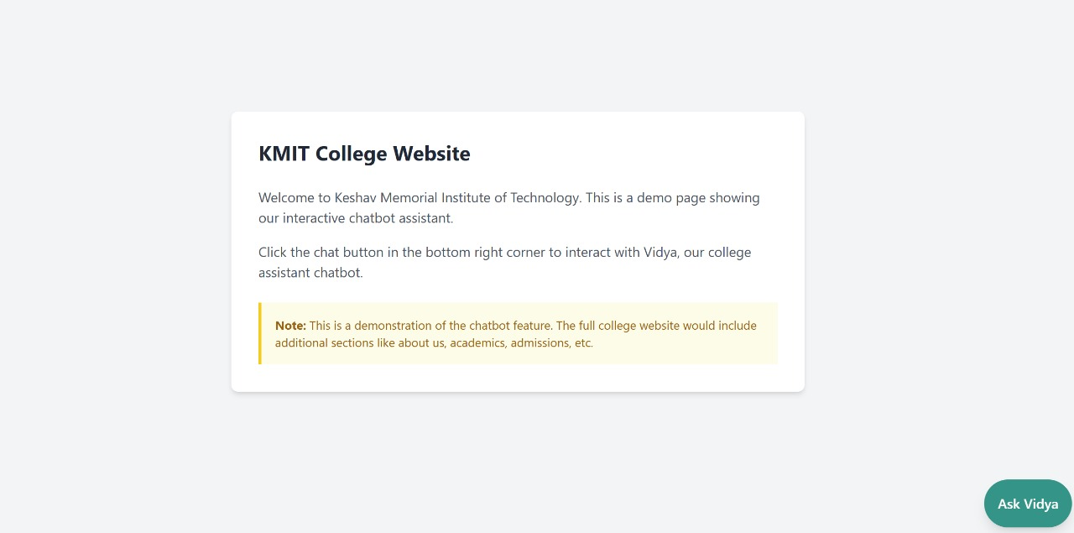
DEVELOPMENT

Slide 7
EXPECTED OUTCOME
Features | Status
Upcoming events | ✅completed
Detailed information of clubs with social media handles | ✅completed
Location Assistance | ✅completed
Website Directing | ✅completed
Using NLP for user-friendly convo | ✅completed
Realtime syncing of user data using cloud | ✅completed
Fetching and Sumarizing key information like placement | ✅completed
Voice assistance(speech-to-text) | ✅completed

Slide 8
Thank you!

Slide 9
Frontend
(User Input)
Scraped DATA
(Beautiful Soup)
Backend
(Flask)
Data Base
(Supabase)
Query Processing
(Keyword Search)
FAISS
(Vector Search+Embeddings)
Gemini API
(LLM model)
Generated Response

