Slide 1

Final Project :Data Analysis Process New York City Airbnb Open Data dataset from Kaggle Hiral Dasadia hiral.dasadia@students.williscollege.com
Introduction of Dataset and project
This project is based on the New York City Airbnb Open Data dataset, which provides detailed information about Airbnb listings in New York City. The dataset includes important features such as price, location, room type, availability, number of reviews, and host-related details, allowing for a comprehensive analysis of listing patterns and customer behavior.

Slide 2
The central research question for this project is: How does the number of reviews relate to the price, availability, and other features of Airbnb listings?
This question aims to explore whether listings with a higher number of reviews are associated with specific patterns in pricing, availability throughout the year, room types, and location. Understanding these relationships can provide insights into what factors influence the popularity and demand of Airbnb listings.
To answer this question, the project follows a structured data analysis process, including data cleaning, exploratory data analysis (EDA), application of analytical techniques, and effective communication and interpretation of results. The insights derived from this analysis can help in understanding market trends and support data-driven decision-making.

Slide 3
Data Analysis: Coding and Interpretation The coding and analysis process begins with accessing and loading the dataset into the Python environment for further analysis.
Coding: 1. Access the Dataset
import pandas as pd
import numpy as np
df = pd.read_csv('AB_NYC_2019.csv')
Interpretation: The dataset was accessed by importing the required libraries and loading the CSV file into a panda DataFrame for analysis.

Slide 4
2. Data Cleaning 1) Analyze your dataset's structure using descriptive functions. Coding: print(df.head()), print(df.info()), print(df.shape), print(df.dtypes), print(df.describe()) Interpretation: The head() function provides a quick view of the dataset, showing that it contains multiple features related to Airbnb listings such as price, location, room type, and number of reviews. The info() function reveals the total number of entries (48,895) and highlights the presence of some missing values in specific columns. The dataset consists of a mix of numerical and categorical variables, as confirmed by dtypes. Additionally, the shape of the dataset indicates that it contains 16 columns, making it suitable for detailed analysis. Overall, this step helps in understanding the data structure and prepares the dataset for further cleaning and analysis.

Slide 5
2) Identify and handle missing values, possibly using DataFrame's dropna() or fillna() methods.
Coding: print(df.isnull().sum())
df = df.dropna(subset=['price', 'number_of_reviews', 'availability_365'])
df['reviews_per_month'] = df['reviews_per_month'].fillna(0)
df = df.drop(columns=['last_review’]), df['name'] = df['name'].fillna('Unknown')
df['host_name'] = df['host_name'].fillna('Unknown')
# Verify again, print(df.isnull().sum())
Interpretation: The dataset contains missing values in columns such as reviews_per_month, last_review, name, and host_name, while key numerical variables are complete. Since the analysis focuses on reviews, price, and availability, missing values were handled strategically to preserve relevant data. The reviews_per_month column was filled with 0 to represent listings with no reviews, and the last_review column was removed as it was not essential. Minor missing values in text fields were replaced with “Unknown,” resulting in a clean and consistent dataset ready for further analysis.

Slide 6
3) Detect and treat outliers using techniques such as the IQR score.
Coding: Q1 = df['price'].quantile(0.25), Q3 = df['price'].quantile(0.75)
IQR = Q3 - Q1
lower_bound = Q1 - 1.5 * IQR, upper_bound = Q3 + 1.5 * IQR
# Identify outliers
outliers = df[(df['price'] < lower_bound) | (df['price'] > upper_bound)]
print("Number of outliers:", outliers.shape[0])
Interpretation: The summary statistics indicate a wide variation in listing prices, suggesting the presence of extreme values. Using the IQR method, the upper bound was identified as 334, and listings priced above this value were considered outliers. A total of 2,972 such listings were detected, indicating a significant number of high-priced properties. These outliers reflect premium or luxury listings and may influence overall analysis results.

Slide 7
3. Exploratory Data Analysis (EDA) 1) Use visualizations libraries such as matplotlib and seaborn to explore data. Coding: import matplotlib.pyplot as plt import seaborn as sns Interpretation: The dataset is prepared for exploratory data analysis by importing visualization libraries and reviewing the cleaned data for further analysis.
2) Generate Descriptive Statistics
Coding: print(df.describe())
Interpretation: Descriptive statistics were generated to summarize the distribution, central tendency, and variability of both numerical and categorical variables in the dataset. The descriptive statistics show that the average price is around the dataset mean (with values ranging from very low to a maximum above 300), indicating high variability in listing prices. Similarly, availability ranges from 0 to 365 days, showing that while many listings have limited availability, some are available throughout the year.

Slide 8
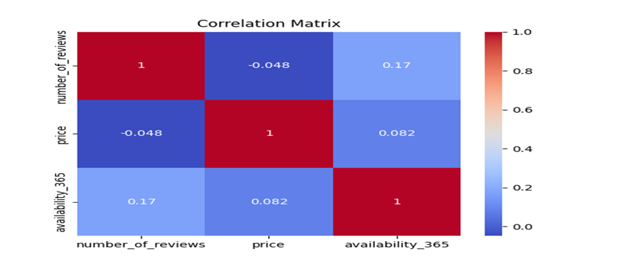
3) Analyze correlations between 'number_of_reviews', 'price', and 'availability_365'.
Coding: corr = df[['number_of_reviews', 'price', 'availability_365']].corr(), print(corr)
Interpretation: The correlation matrix and heatmap indicate that there is no strong relationship among the variables. The correlation between number_of_reviews and price is slightly negative (-0.047), suggesting that the number of reviews has almost no impact on listing price. Similarly, a weak positive correlation (0.172) exists between number_of_reviews and availability_365, indicating that listings with more reviews tend to have slightly higher availability, but the relationship is minimal. The heatmap visually confirms these weak relationships, as all correlation values are close to zero, showing that these variables are largely independent of each other.

Slide 9
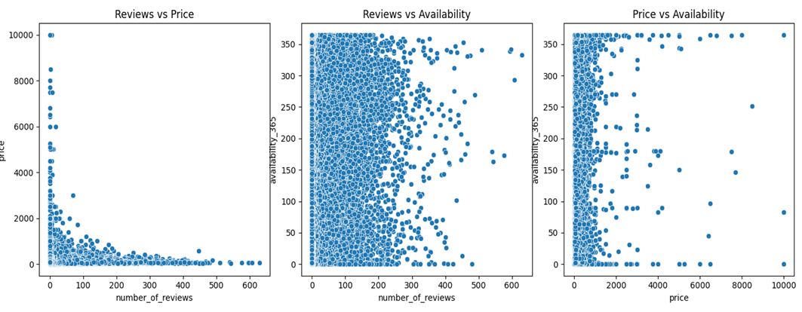
4) Visualize the Data Create scatter plots for 'number_of_reviews', 'price', and 'availability_365'.
Interpretation: The scatter plots indicate that there is no clear or strong relationship between the variables. The relationship between number of reviews and availability appears slightly positive, but the points are widely scattered, showing a weak association. Similarly, price and availability do not exhibit any strong pattern, suggesting that price does not significantly influence availability. Overall, the visualizations confirm that the relationships among these variables are weak and not strongly linear.

Slide 10
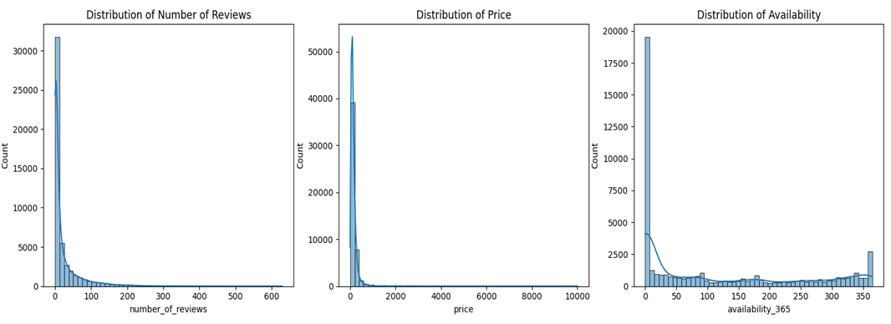
Build histograms for 'number_of_reviews', 'price', and 'availability_365'.
Interpretation: The histograms indicate that both number_of_reviews and price are right-skewed, meaning most listings have lower review counts and moderate prices, while a few listings have very high values. This suggests the presence of outliers or highly popular and premium listings. The distribution of availability_365 is more spread out, showing that listings vary widely in terms of availability throughout the year. Overall, the data is not normally distributed and shows significant variability across key variables.

Slide 11
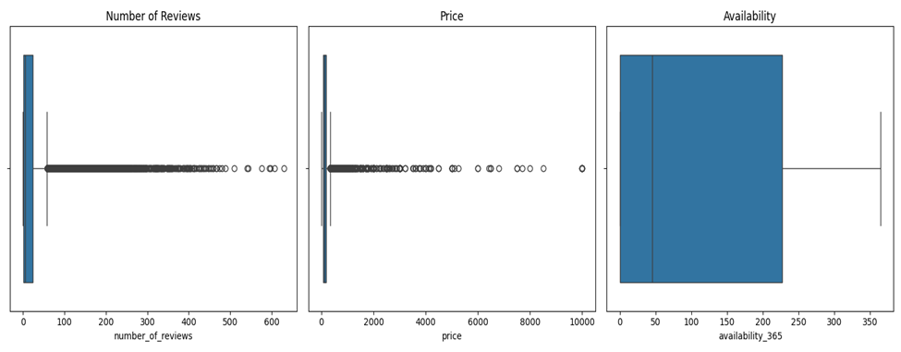
boxplots for 'number_of_reviews', 'price', and 'availability_365'
Interpretation: The boxplots reveal that the dataset contains several outliers, particularly in price and number_of_reviews, where a few listings have significantly higher values than the majority. Most listings are concentrated in the lower range, indicating that typical listings have moderate prices and fewer reviews. The wide spread and extreme points suggest high variability in the dataset. These outliers likely represent premium or highly popular listings and can influence the overall analysis.

Slide 12
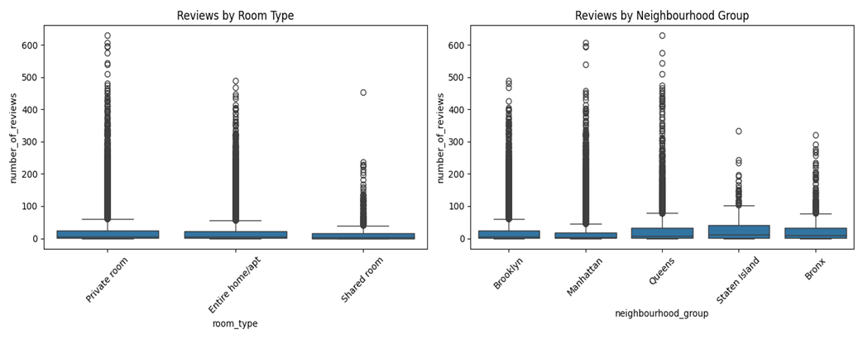
Explore number of reviews with respect to 'room_type' and 'neighbourhood_group'.
Interpretation: The boxplots show that the number of reviews varies across different room types and neighbourhood groups. Certain room types have higher median review counts, indicating greater popularity among guests. Similarly, some neighbourhoods exhibit a wider spread and higher number of reviews, suggesting higher demand in those areas. Overall, location and room type appear to influence the number of reviews, though variability exists within each category.

Slide 13
4. Advanced Data Analysis Techniques
To further analyze the dataset, a Linear Regression model was applied to predict the number_of_reviews based on key listing features such as price, availability, room type, and neighbourhood group. Categorical variables were converted into numerical format using encoding techniques, and the dataset was split into training and testing sets to validate the model performance.
The model was evaluated using standard performance metrics, including Mean Absolute Error (MAE), Mean Squared Error (MSE), Root Mean Squared Error (RMSE), and R-squared.
Interpretation of Results
The model produced a Mean Absolute Error (MAE) of approximately 26.6, indicating that, on average, the predicted number of reviews differs from the actual value by about 26 reviews. The Root Mean Squared Error (RMSE) of approximately 44.05 suggests that larger prediction errors are present in the model.
Most importantly, the R-squared value of 0.03 indicates that only about 3% of the variation in the number of reviews is explained by the model. This is a very low value, suggesting that the selected features—price, availability, room type, and neighbourhood group—have very limited predictive power for determining the number of reviews.
Conclusion from Advanced Analysis
The results confirm the findings from the exploratory data analysis, which showed weak relationships between the variables. This suggests that the number of reviews is influenced by other factors not included in the model, such as customer experience, listing quality, host responsiveness, or external factors.
Overall, the predictive model demonstrates that while basic listing features provide some insight, they are not sufficient to accurately predict review counts, highlighting the complexity of customer behavior in the Airbnb market.

Slide 14
5. Interpret and Communicate the Results
The analysis of the Airbnb dataset provides valuable insights into the relationship between the number of reviews and key listing features such as price, availability, room type, and neighbourhood group.
The findings from the exploratory data analysis indicate that there is no strong relationship between number of reviews and price, as both correlation analysis and scatter plots show weak or minimal association. This suggests that highly reviewed listings are not necessarily more expensive. Similarly, a weak positive relationship between number of reviews and availability was observed, indicating that listings with more reviews may have slightly higher availability, but the impact is not significant.
The distribution analysis revealed that both price and number of reviews are highly right-skewed, meaning that most listings fall within lower ranges, while a small number of listings have extremely high values. These outliers, identified through boxplots and IQR analysis, represent premium or highly popular listings and contribute to the variability in the dataset.
Further analysis showed that room type and neighbourhood group influence the number of reviews, with certain categories showing higher median review counts. This indicates that location and type of listing play a more important role in determining listing popularity compared to price or availability alone.
The advanced analysis using a Linear Regression model further confirmed these findings. The model showed a very low R-squared value (0.03), meaning that only a small portion of the variation in review count can be explained by the selected features. This highlights that the number of reviews is influenced by other factors such as customer experience, listing quality, and host performance.
Conclusion
In conclusion, the number of reviews is not strongly related to price or availability but is moderately influenced by listing characteristics such as room type and location. These findings suggest that customer preferences and experiences play a significant role in determining listing popularity. The results of this analysis can help hosts and platforms better understand demand patterns and improve decision-making strategies in the Airbnb market.

Slide 15
Reflection
This project provided valuable hands-on experience in applying the complete data analysis process, from data cleaning to exploratory data analysis and advanced analytical techniques. It helped me develop a deeper understanding of how to work with real-world datasets, identify patterns, and interpret results effectively. The use of visualizations also enhanced my ability to communicate insights clearly to a target audience or management.
As I come from a finance background and have experience as a financial analyst, this project was particularly useful in showing how data analysis and machine learning techniques can be applied in the finance domain. It has given me confidence that I can use these skills to automate repetitive tasks, analyze financial data more efficiently, and support better decision-making.
If I were to approach this project again, I would explore additional variables and more advanced models to improve prediction accuracy. I would also focus more on feature selection and model optimization to gain deeper insights.
Going forward, I would like to improve my skills in tools such as Power BI and Tableau to create more interactive and visually appealing dashboards. I also aim to strengthen my knowledge in data analysis and machine learning techniques to build more robust models and deliver high-quality analytical work with greater confidence.

