Slide 1
Training Project ——Synnex Training System
Reporter：Jennifer Tian, Davis Zhang, Hiram Huang
2015.1.9

Slide 2
Content
System Requirements Analysis
System Framework Design
System Testing
System Implementation
System Demo
System Database Design

Slide 3
System Requirements Analysis

Slide 4
Why do we choose this training project?
The current training system cannot satisfy our uses.
The complexity of training system can be controlled by us.

Slide 5
What will we want to do?
Synnex Training System
Management of User Infos
Create
Search
Training Course Management
Training Term Management
Create
Delete
Create Training Course
Modify Training Course
Practice Management
Create
Submit
Review
Progress of Training
View the Progress of Course
View the Progress of Practice
Modify
User Group Management
Create

Slide 6
What will we do in Management of User Infos?
Manager
Trainee
Create info of trainer/trainee
Modify password
Search the info of user by name
Modify password
Search the info of user by name
Modify password
Trainer
Search the info of user by name
User group Management
Create

Slide 7
What will we do in course management?
Manager
Delete
Create training course
Trainer
Modify training course
Modify training course
Set up Email as the notice
Term of Training Management
Create
Set up Email as the notice
Set up Email as the notice

Slide 8
What will we do in practice management?
Trainer
Review Practice
Trainee
Create practice
Have 2 ways to create practice content
The textarea
Attachmenet
Set up Email as the notice
Graded
To mark the practice as finished
Submit practice
Have 2 ways to create practice content
The textarea
Attachmenet
Set up Email as the notice

Slide 9
What will we do in progress of training?
Training Manager
Trainer
View the progress of training course
Trainee
View the progress of training course
View the progress of one trainee’s courses
View the progress of training course
All courses in a term whether is finished
Search the trainee by his name
View the progress of trainee’s courses
All courses of one trainee whether is attended by himself
All courses in a term whether is finished
View the progress of one trainer’s courses
All courses in a term whether is finished

Slide 10
System Framework Design

Slide 11
开发运行环境
IDE：Eclipse
Web服务器：Tomcat6
数据库：MySQL
版本控制：Github
项目构建及管理：Maven
运行环境：IE 9及以上版本；Chrome；FireFox等

Slide 12
框架设计

Slide 13
框架设计
UI Layer
Spring MVC
Dispatcher Servlet & Handler Mapping & View Resolver & Model And View
Business Layer
Spring
Transaction & Hibernate Session Management
Persistence
Hibernate
ORM
Business Service Classes
HQL & DAO Classes
Controller Classes

Slide 14
System Database Design

Slide 15
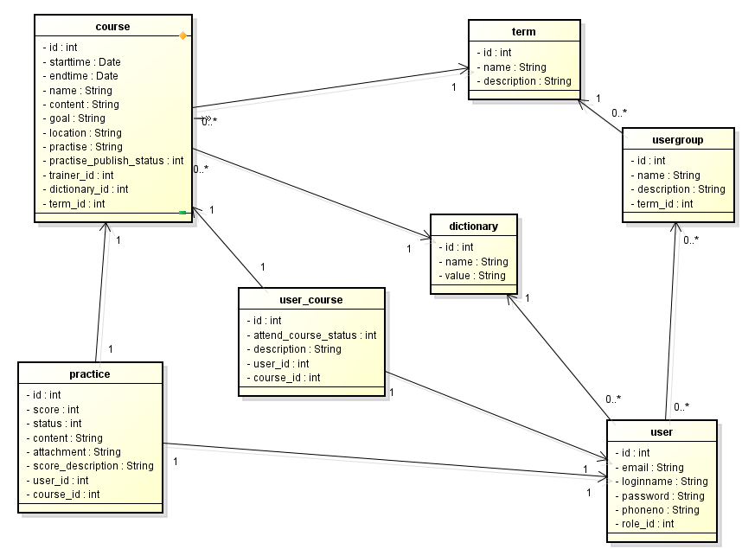

Slide 16
System Implementation

Slide 17
How do we divide the work?

Slide 18
System Testing

Slide 19
System Demo

Slide 20
Thank YOU!

