Slide 1
Contact Manager

Slide 2
Members
Guensly Louis
Katherine Rosenfeld
Kaycee Peeples
Alvin Kangoo
Philip Leong
Sasuke Hirano
Ot Gabaldon Torrents

Slide 3
What is the project?
The project is essentially a software, known as a contact manager ,that enables a system to store and retrieve basic contact information including names, addresses, and phone numbers.
Every feature and component including the front-end, API, database is being hosted via Amazon Web Services cloud.
The front-end of the contact manager allows for either user log-in or user sign up.
Landing page displays basic user info along with the current contacts stored under the active account.
The application gives the user the capability to add, edit, search, and delete contacts. It also provides the user the ability to assign pre-installed icons or upload pictures for each contact.

Slide 4
How was it developed?
The project was developed using the agile method of software development
LAMP stack was used for application
Apache was used for website hosting
PHP used for both the front and back end to connect them
CSS used in the front end development of application while SQL was used for the database

Slide 5
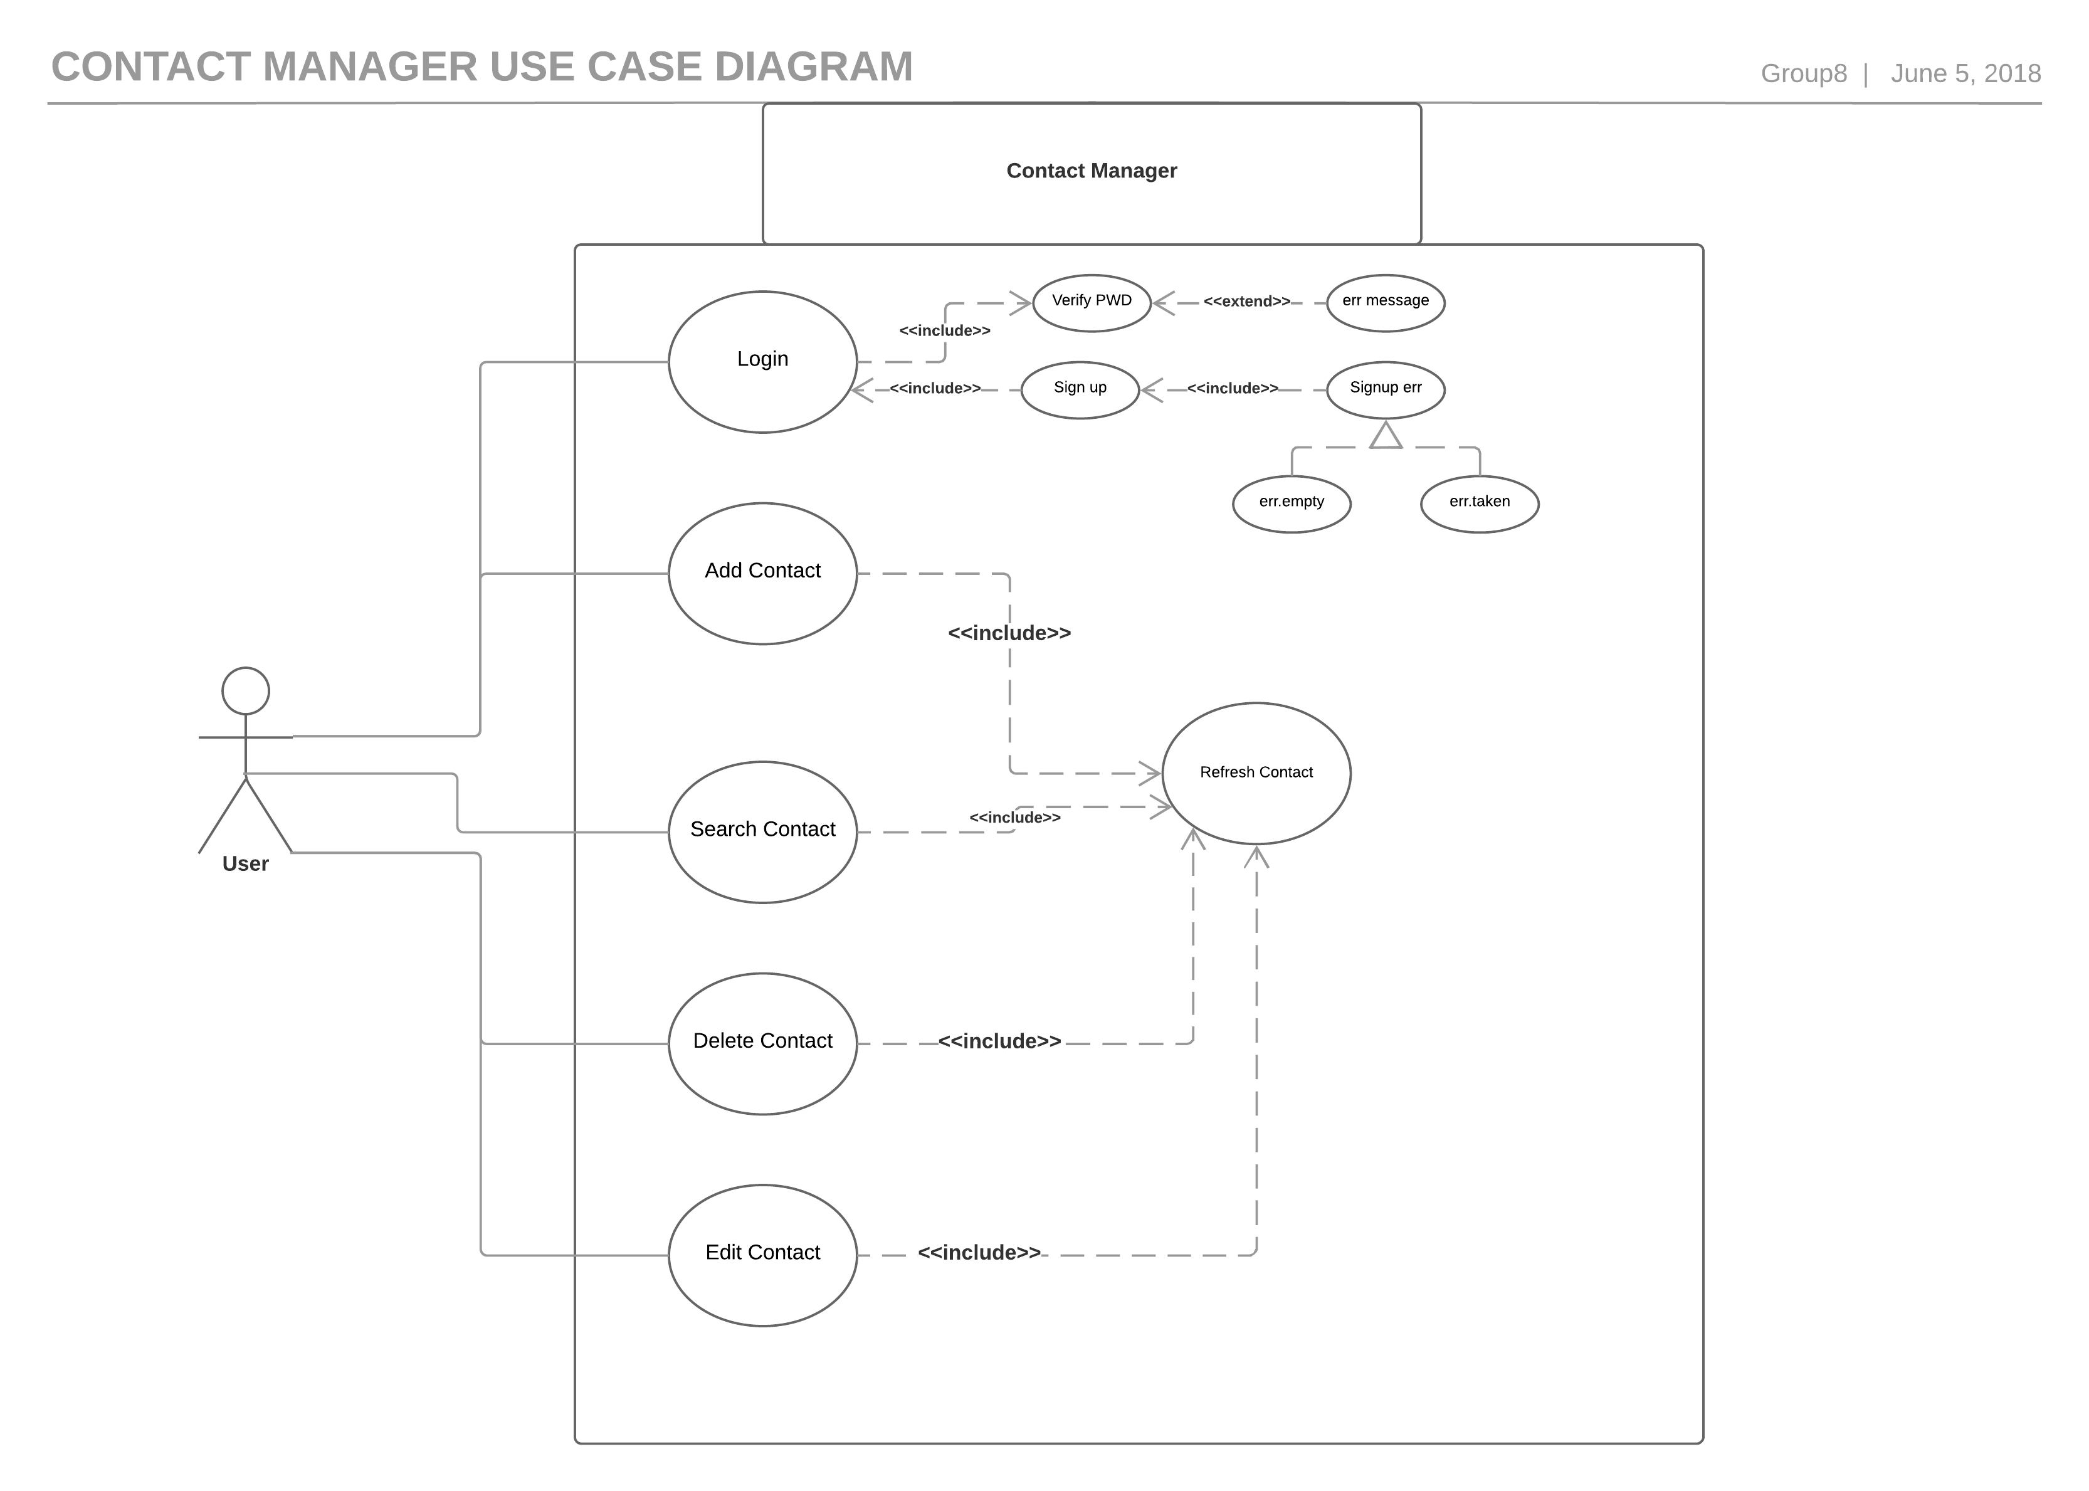

Slide 6
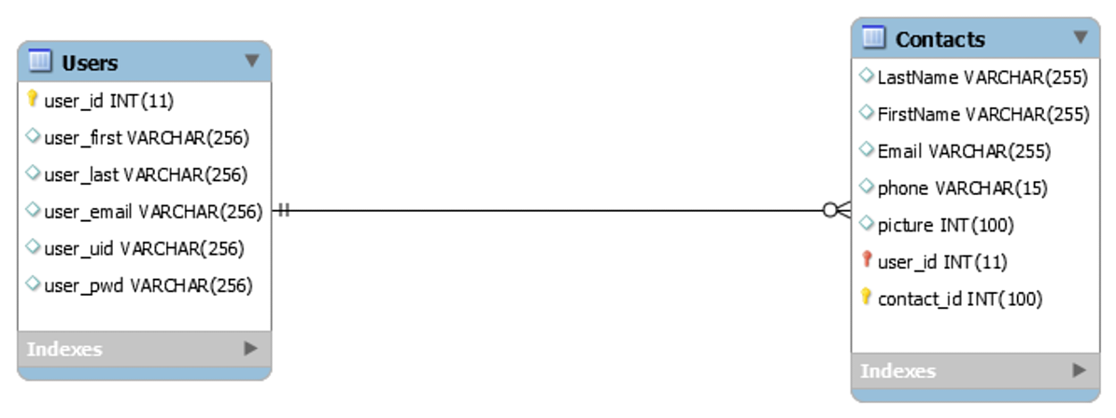
Entity Relationship Diagram(ERD)

Slide 7


