Slide 1



Slide 2
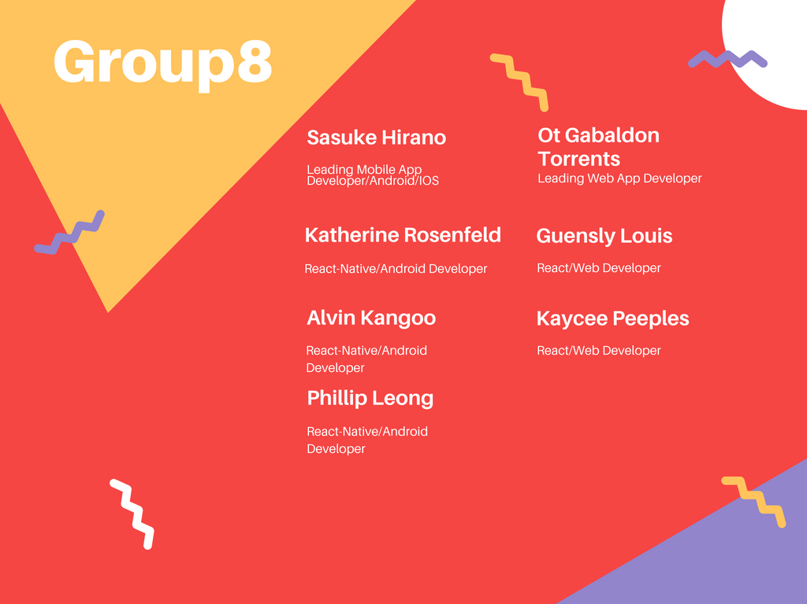

Slide 3
Introduction and Synopsis
Open-environment for studying
No confinement by the restraints of Facebook or GroupMe for a single course, you are now open to an entire community of people for an unlimited amount of courses and topics.
Develop communities for similar interest of studies
Coordinate face-face meetup in local area

Slide 4
What is the project?
The project is a meet up app, named Studbud.
Social Networking app, with authentication, profiles, dashboard, posts, groups, etc.
Give users the ability to search for study groups using keywords as well as hash tags.
Can use geolocation or zip code to find study groups locally.
Moderator privileges within study groups.
In-app user communication, ability to notify all users of a specific group by push, email, or SMS.
Using MongoDB, Express, Redux, and Node.js (MERN) stack development.

Slide 5
Features
Privacy and Security
Notifications of user activity within joined groups
Customizable individual profiles
Ability to create public and private groups
Add relevant hash tags to groups
Users can communicate privately with one another within the app

Slide 6
Frameworks and Software
Web application and Mobile application will be implemented with MERN(MongoDB Express Redux Node.js) stack development
Front-end development will be done with react(Web) and react-native(mobile app)
Database for both react and react- native will be situated and maintained through MongoDB which stores data as JSON documents.
Redux is a JavaScript library which will be utilized for state management.
Node.js(with Express) will support routing of requests and access to the backend API.

Slide 7
Stretch Goals
Constantly needing to improve the end product for quality assurance.
Whether it is a UI or UX component, many tweaks have to be made for the app to be fully functional and complete.
Debugging and testing numerous times to routinely remove bugs, errors, or abnormalities.
Support page for users to give us their input to improve the app.

Slide 8
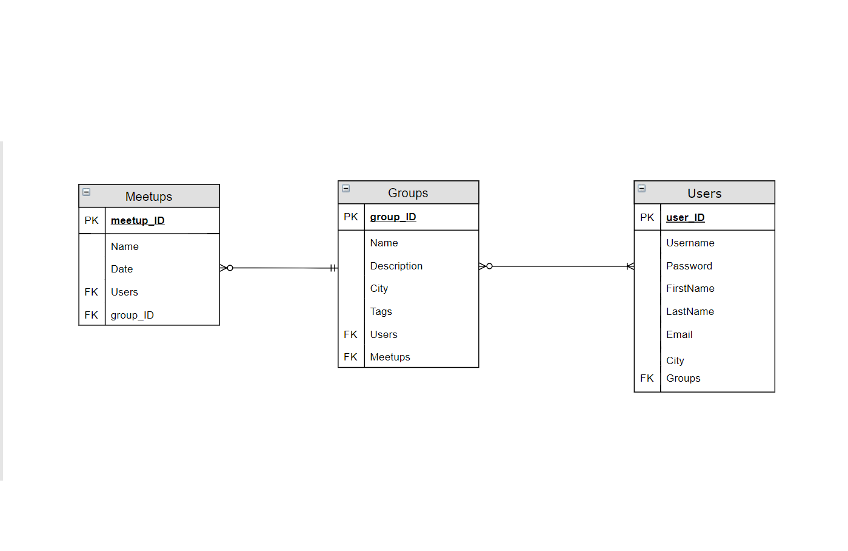
Entity Relationship Diagram(ERD)

Slide 9
Expected challenges/delays
Learning curve for cross-platform development is a hurdle for all developers involved.
Setting up development environment was a tricky and time-consuming task.
Accomplishing goals within allotted deadline.
Planning user-designed interactions
Using a document-oriented Database

Slide 10


