Slide 1
Real-time e-Learning Platform

Slide 2
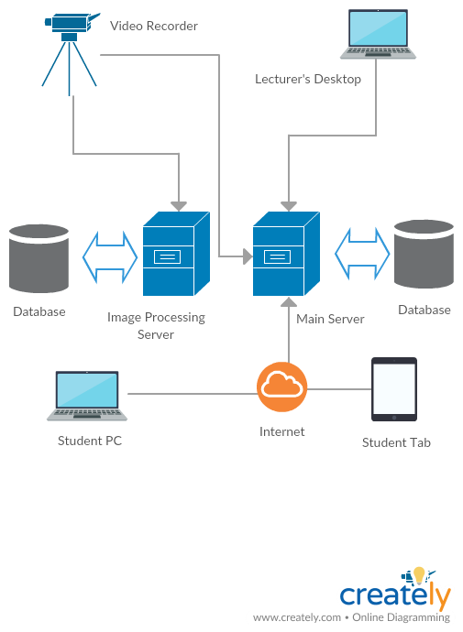
Overview

Slide 3
Areas to Focus
Face Recognition and Tracking
Video Player / Data Analytics
1
3
2
Real-time Audio / Video Transcoding
4
Real-time Questioning Facility and Virtual Whiteboard

Slide 4
Face Recognition and Tracking

Slide 5
Face Recognition and Tracking
Computer Vision
Computer vision is concerned with the automatic extraction, analysis and understanding of useful information from a single image or a sequence of images.

Slide 6
Application of Computer Vision
Biometric verification of lecturers
Face Registering
Face Detection
Lecturer Motion Tracking
Using PTZ(Pan,Tilt,Zoom) Camera

Slide 7
How It all fits in

Slide 8
Technology
Why use Python/OpenCV ?
Performance Matters!
Open Source
More functions for computer vision
Continuous updates
Large Community

Slide 9
Market Value
Narrow the experience gap between on campus and off site student
Minimal user involvement
Automatic tracking
Cost effective
Single PTZ camera

Slide 10
Real-Time Audio / Video Transcoding

Slide 11
Real-time Audio / Video Transcoding
Converting one form of coded representation to another.
Multiple Outputs
Different Bitrates
Different resolutions

Slide 12
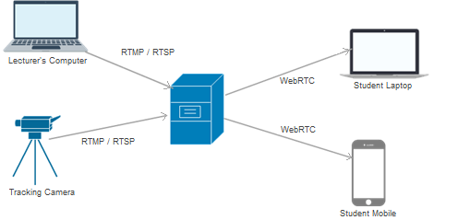
Technology
H.264 encoded RTMP stream
WebRTC stream

Slide 13



Major Challenges:
Processing Delay
Network Delay

Slide 14
Solution
Processing Delay :
CPU Processing + GPU Processing
Optimized Resource Allocation
Network Delay :
Adaptive Bitrate feature

Slide 15
Market Value
Higher Performance
Low Cost on Resources

Slide 16
Video Player / Data Analytics

Slide 17


Video Player
Multiple independent feeds
Camera feed
Projector feed
Whiteboard
Chat
Student question feed
Dynamic layout

Slide 18
Market Value - for student
Reducing bandwidth requirement (optional image processing)
Protecting Video Contents (streaming on request)
Smooth experience (adaptive bitrate)

Slide 19
Data Analytics
Data
Analyzed
Statistics

Slide 20
Market Value - (Analytics)
A valuable feedback for future improvements

Slide 21
Student Questioning Facility and Virtual Whiteboard

Slide 22
Student Questioning facility and Virtual Whiteboard
Content sharing, access to learning materials only.
Further widening to video stream.
Real-time questioning facility with video & audio feeds.
Interactive whiteboard.

Slide 23
Technology
Chat box - HTML5 WebSockets
Establish a solid connection between server and the browser.
Fast and persistence communication.
Low latency
Whiteboard - HTML5 canvas

Slide 24
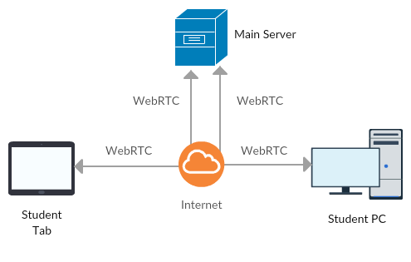
Architect Diagram

Slide 25
Comparison with eduscope
Questioning facilities
Whiteboard interaction

Slide 26
Market Value
Student gets a real class room experience.
Questioning facility.

Slide 27
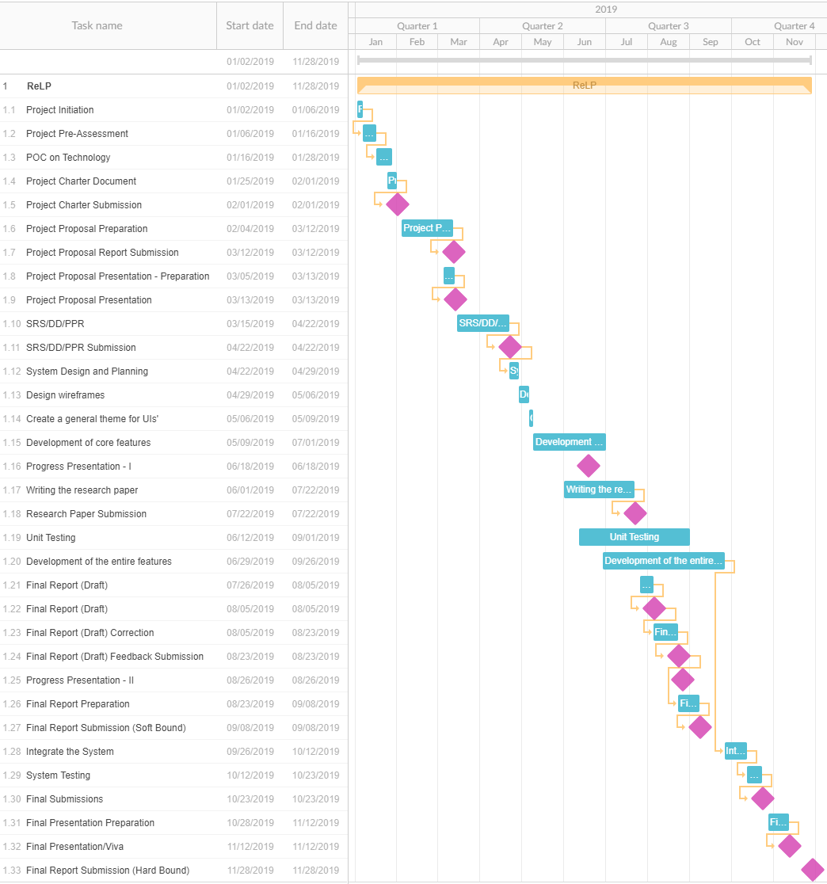

Slide 28
Thank you.

