Slide 1

Elderly Patient Monitoring System
PROJECT PROTOTYPE

Slide 2
ELDERLY PATIENT MONITORING SYSTEM…..
GROUP NUMBER : 17-105
SUPERVISOR : MR. YASHAS MALLAWAARACHCHI
STUDENT NAME | STUDENT REGISTRATION NUMBER
ABEYRATHNE H.V.L.K. | IT14073656
SUDHASINGHE S.P.L.P. | IT14054532
CHATHURANGI W.A.S. | IT14069482
RANATHUNGA R.M.K.V. | IT14044632

Slide 3
BACKGROUND…….
With the ageing, older people are restricted to bed due to various kinds of diseases and eventually they are becoming bedridden patients.
Due to industrialization and the globalization, most of the people are affected by respiratory problems and the majority of them are elderly people.
Since the respiratory disorder for elderly people are common, they have been untreated to some extent.
Therefore they require special caring with continuous human monitoring.

Slide 4
SYSTEM OVERVIEW

Slide 5
Respiratory Sound Analysis & Drug Reminder
Sensor Configuration & Anomaly Detection via Sensor Inputs
ELDERLY PATIENT MONITORING SYSTEM
Abnormality Detection in Behaviors
Abnormality Detection in Emotions

Slide 6
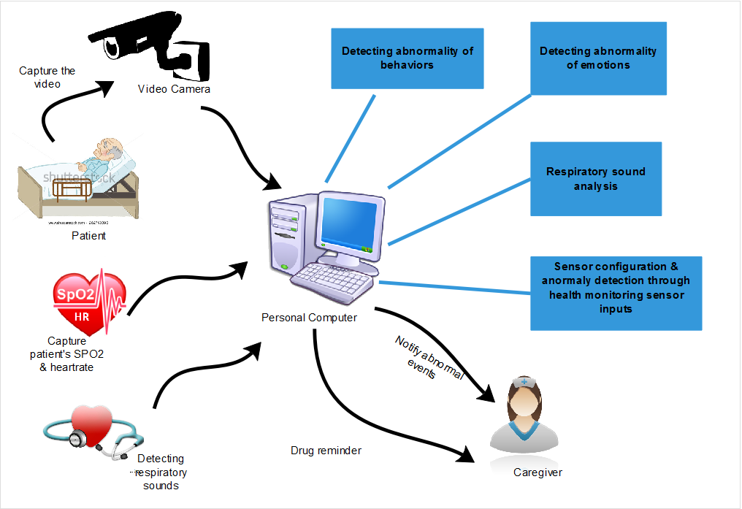

Slide 7
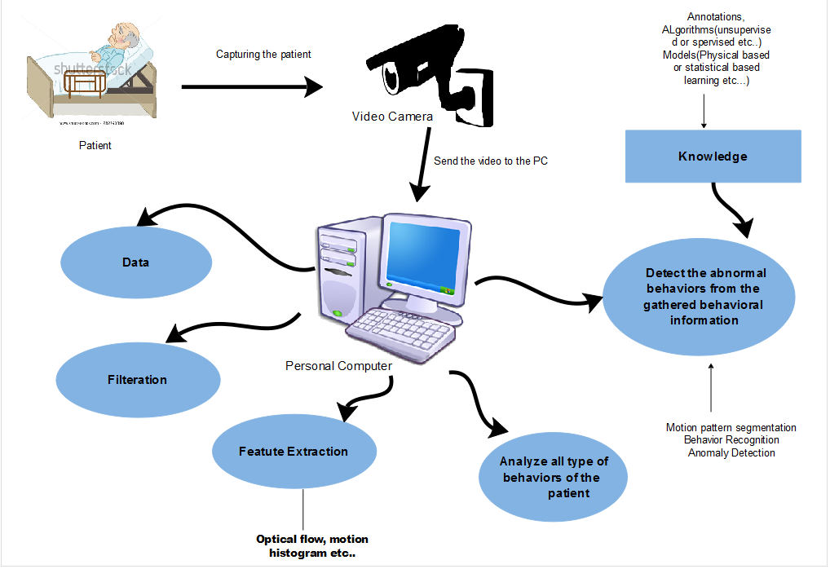
ABNORMALITY DETECTION OF BEHAVIOURS
Chathurangi W.A.S. – IT14069482

Slide 8
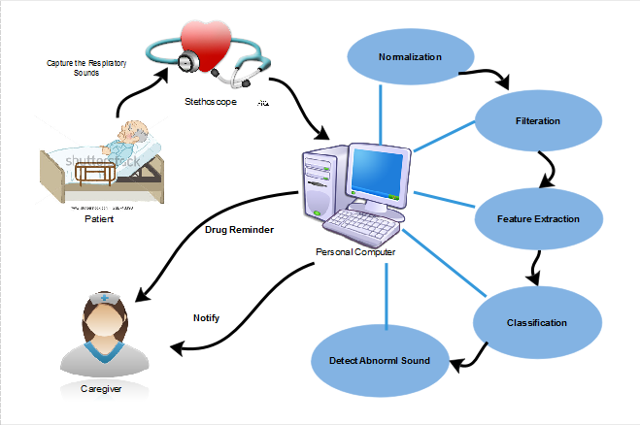
RESPIRATORY SOUND ANALYSIS & DRUG REMINDER

Slide 9
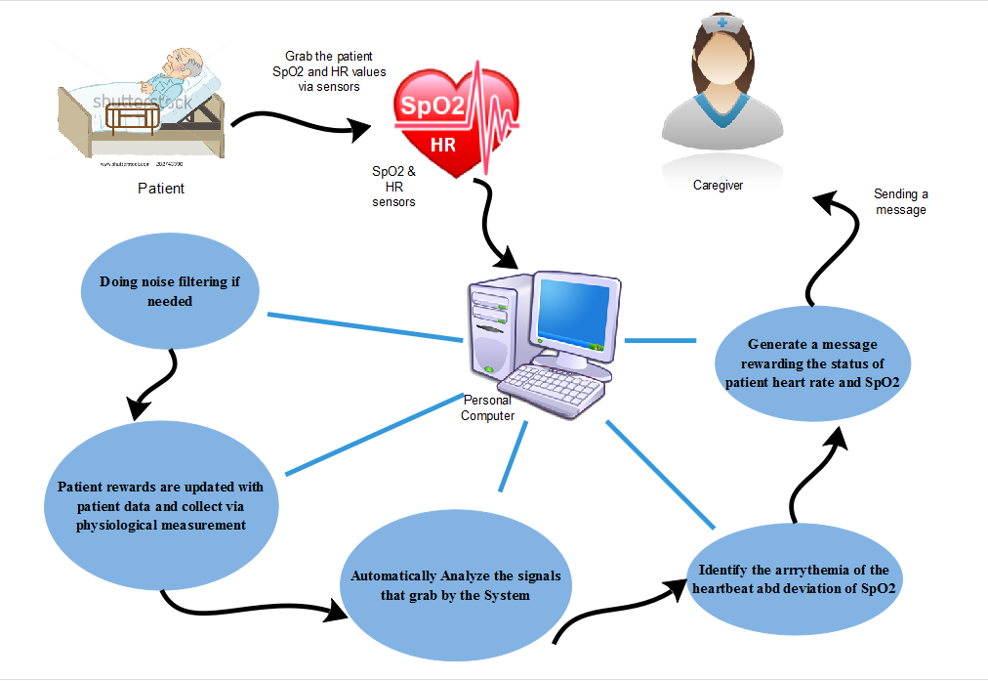
SENSOR CONFIGURATION & ANOMALY DETECTION VIA SENSOR INPUTS
Sudasinghe S.P.L.P. – IT14054532

Slide 10
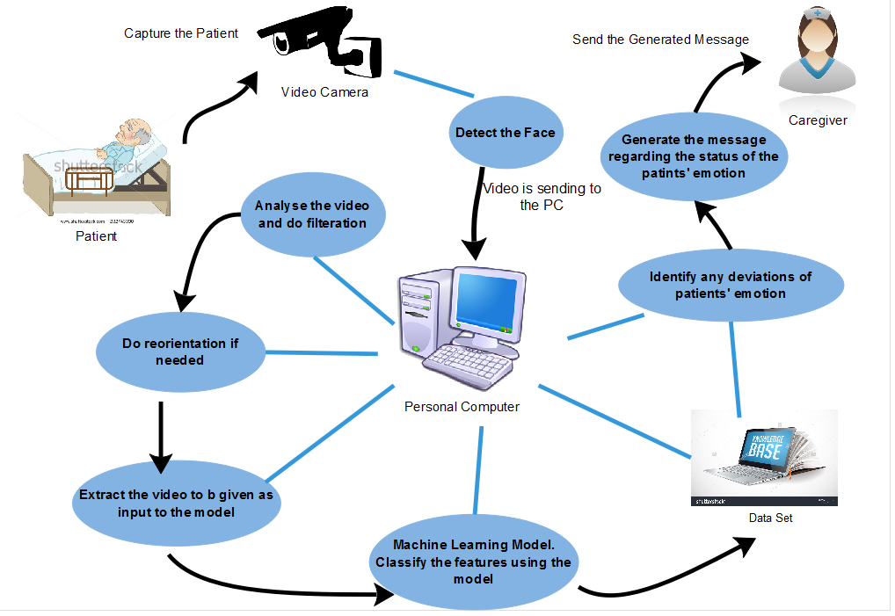
ABNORMALITY DETECTION IN EMOTIONS
Ranathunga R.M.K.V. – IT14044632

Slide 11
WORK ALLOCATION
Student ID | Student Name | Work Allocation
IT14073656 | ABEYRATHNE H.V.L.K. | RESPIRATORY SOUND ANALYSIS & DRUG REMINDER
IT14054532 | SUDASINGHE S.P.L.P. | SENSOR CONFIGURATION & ANOMALY DETECTION VIA SENSOR INPUTS
IT14069482 | CHATHURANGI W.A.S. | ABNORMALITY DETECTION OF BEHAVIOURS
IT14044632 | RANATHUNGA R.M.K.V. | ABNORMALITY DETECTION IN EMOTIONS

Slide 12
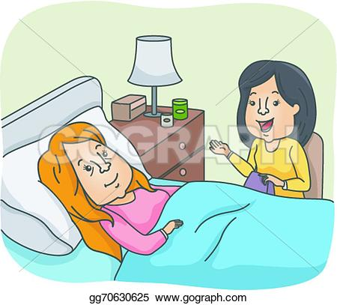
THANK YOU….

