Slide 1
AN AUTOMATED SYSTEM FOR THE MONITORING OF PATIENTS WITH RESPIRATORY DISORDERS

Slide 2
Group Members
AEBEYRATHNE H.V.L.K. - IT14073656
SUDASINGHE S.P.L.P. - IT14054532
CHATHURANGI W.A.S. - IT14069482
RANATHUNGA R.M.K.V. - IT14044632

Slide 3
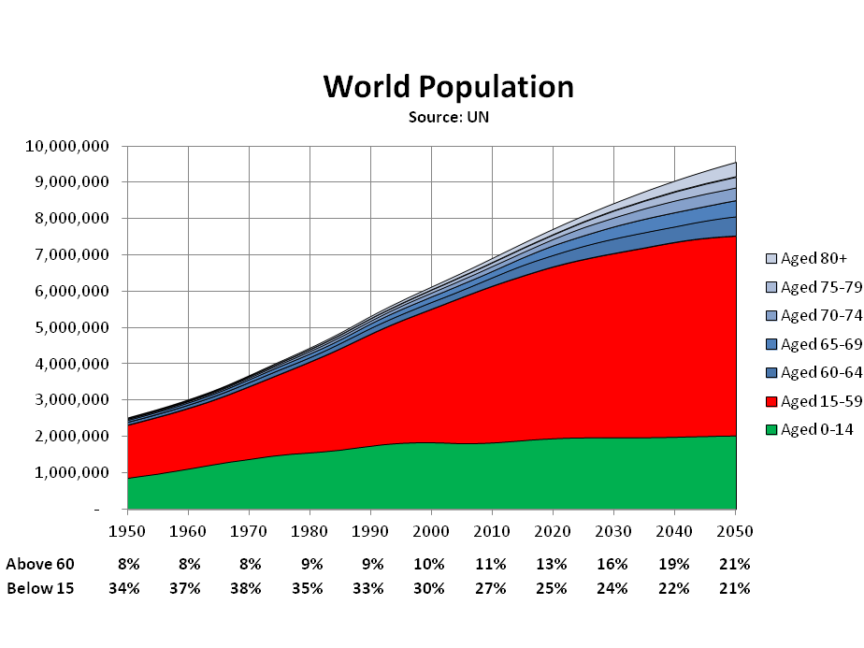
Background
THE WORLD IS AGEING RAPIDLY. PEOPLE AGED 60 AND OLDER MAKE UP 12.3 PER CENT OF THE GLOBAL POPULATION, AND BY 2050, THAT NUMBER WILL RISE TO ALMOST 22PER CENT”
-United Nation Population Fund-

Slide 4
RESEARCH PROBLEM

Slide 5
RESEARCH PROBLEM
Finding well qualified caregivers / private nurses is not an easy task!
People are busy with their tough life styles!
High concentration level is needed even for well trained and qualified caregivers to monitor the patient in every single second!
Several computerized monitoring systems available up to date which are lack of many mandatory worth to their extreme cost!

Slide 6
SOLUTION

Slide 7
Solution
Came up with inexpensive, efficient and a reliable system which can effectively monitor multiple necessary facts of the patients especially who are having respiratory problems and detect anomalies in order to minimize adverse events.

Slide 8
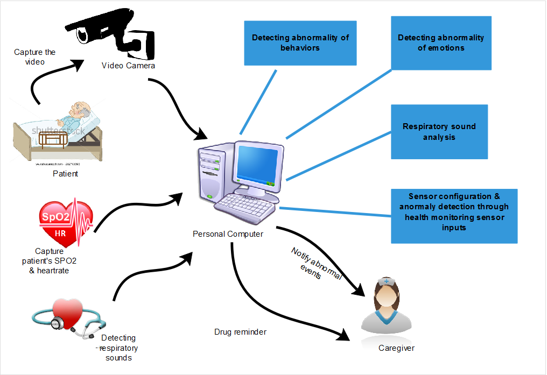
Overall system

Slide 9
Patient Monitoring System
Respiratory Sound Analysis
Sensor Configuration & Anomaly Detection via Sensor Inputs
Abnormality Detection in Behaviors
Abnormality Detection in Emotions

Slide 10
This is how our system works!!!!

Slide 11
DEMO

Slide 12
Let’s go through with each components furthermore!!!

Slide 13
Abnormality Detection in Behaviours

Slide 14
Abnormality Detection in Emotions

Slide 15
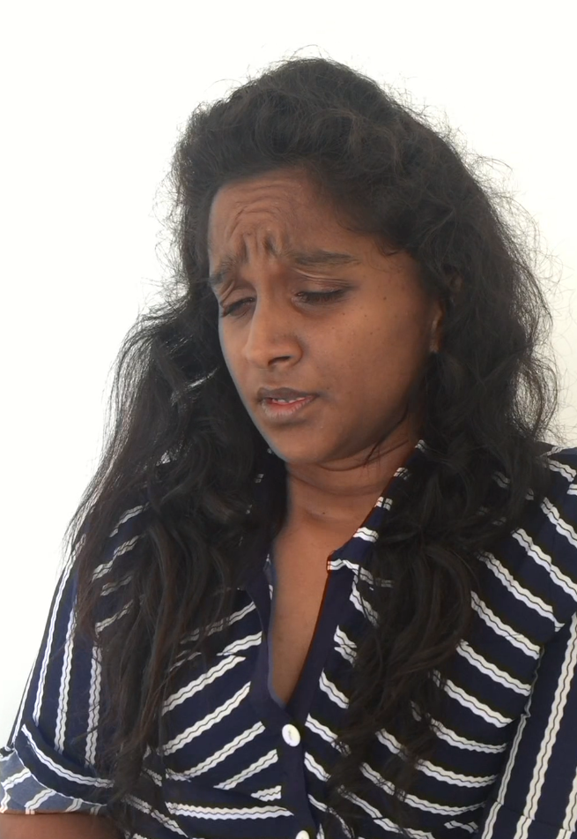
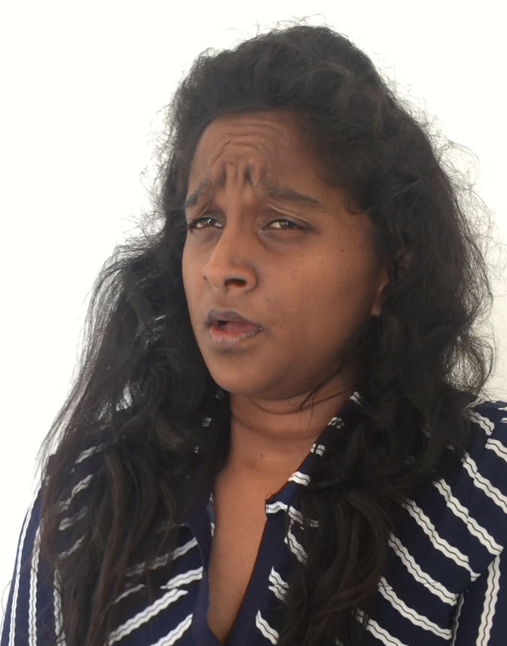
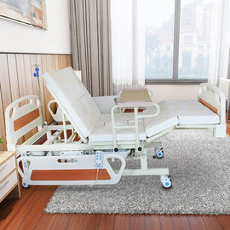
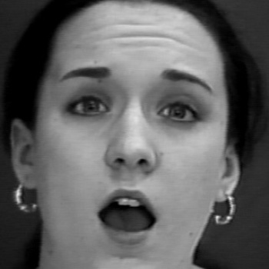
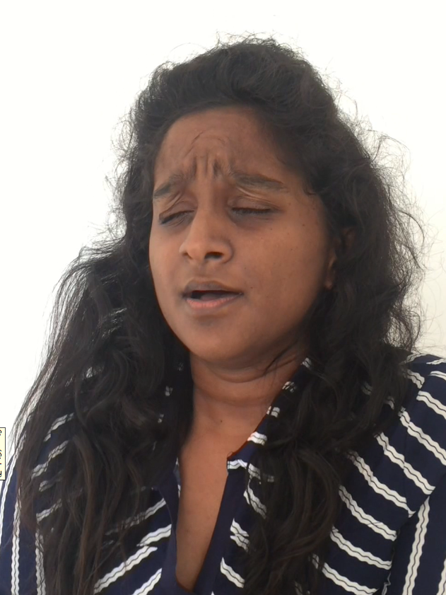

Slide 16
Sensor Configuration & Anomaly Detection via Sensor Inputs

Slide 17
Respiratory Sound Analysis

Slide 18
Normal Lung Sound
Bronchial
VesiculoBronchial
VESICULAR
TRACHEAL
Abnormal Lung Sound
Wheezes
RHONCHI
CRACKLE

Slide 19

Associations between abnormal lung sounds
Relevant Disease | Crackles | Wheezes | Rhonchi
Pneumonia
Obstructive pulmonary disease
Asthma

Slide 20
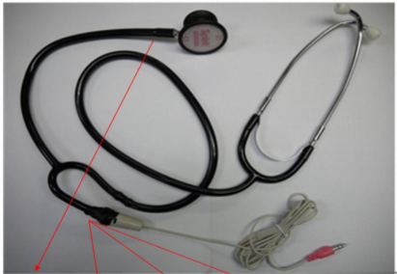
Implementation of stethoscope

Slide 21
Preparation of dataset
RALE REPOSITORY
A GITHUB REPOSITORY
Https://github.com/ntutebd308/lab308 (accessed on 29 May 2017).

Slide 22
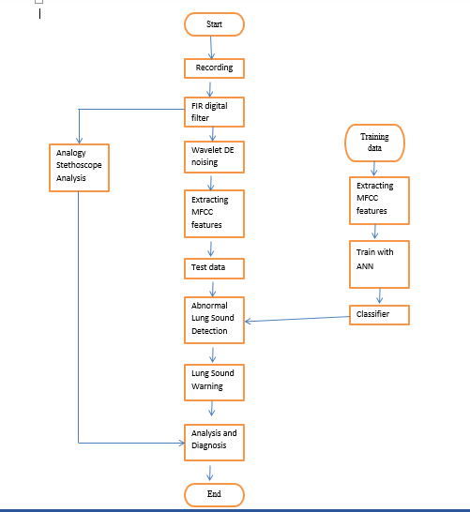
Respiratory sound analysis process

Slide 23
ACCURACY OF THE COMPONENT
WITH TRAINING DATA – 100%
WITH TESTING DATA – 88.33 %

Slide 24
NON-FUNCTIONAL REQUIREMENTS

Slide 25
Non-Functional Requirements
Reliability
Availability
Security
Maintainability

Slide 26
BUSINESS PLAN

Slide 27
Uses and Benefits
Family member can become a caregiver.
Save the cost requires for an external caregiver or a nurse.
Eases up duties of the caregiver.

Slide 28
The elderly population in Sri Lanka has grown rapidly in the past several decades. They were an unprecedented 2.5 million in 2012, and this is still increasing. One in eight Sri Lankans is 60 years or over.
Almost 55% of elderly population suffers from at least one chronic illness -> 1,375,000
Chronic Respiratory Diseases account for 8.5% of the All chronic diseases -> 116,875
116,8750* 0.25 = 29 219
Target Market - Homecare settings
Elder Homes
Elder care agencies

Slide 29
Expected Outcome
Minimize the health care cost.
Caregiver can make better decisions.
Reduced adverse events.
Patients return home events.

Slide 30
Thank you!!

