Slide 1

Elderly Patient Monitoring System
PROJECT PROPOSAL

Slide 2
ELDERLY PATIENT MONITORING SYSTEM…..
GROUP NUMBER : 17-105
SUPERVISOR : MR. YASHAS MALLAWAARACHCHI
STUDENT NAME | STUDENT REGISTRATION NUMBER
ABEYRATHNE H.V.L.K. | IT14073656
SUDHASINGHE S.P.L.P. | IT14054532
CHATHURANGI W.A.S. | IT14069482
RANATHUNGA R.M.K.V. | IT14044632

Slide 3
BACKGROUND

Slide 4
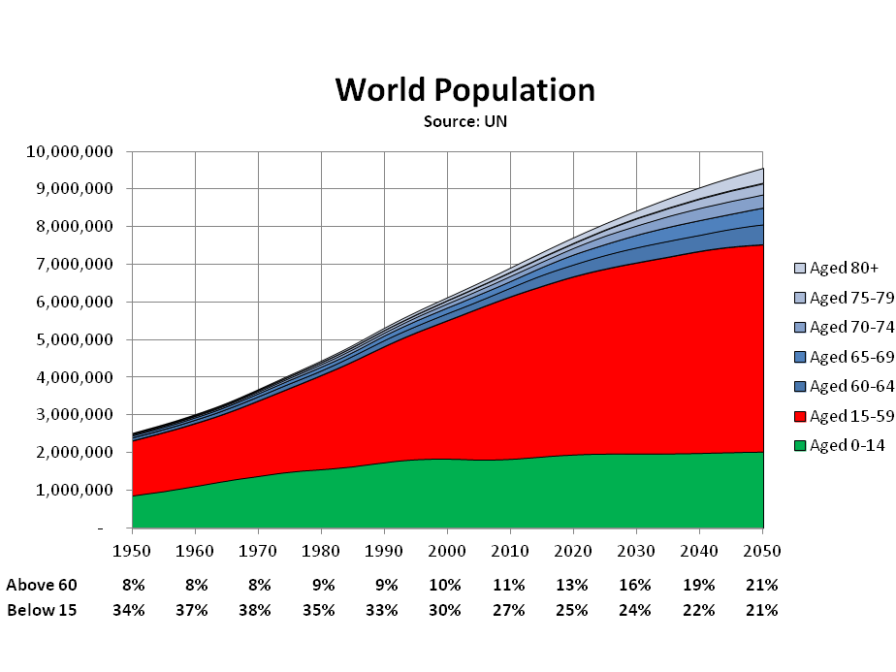
BACKGROUND
“THE WORLD IS AGEING RAPIDLY. PEOPLE AGED 60 AND OLDER MAKE UP 12.3 PER CENT OF THE GLOBAL POPULATION, AND BY 2050, THAT NUMBER WILL RISE TO ALMOST 22PER CENT”
United Nation Population Fund
Abeyrathne H.V.L.K. – IT14073656

Slide 5
BACKGROUND contd….
With the ageing, older people are restricted to bed due to various kinds of diseases and eventually they are becoming bedridden patients.
Due to industrialization and the globalization, most of the people are affected by respiratory problems and the majority of them are elderly people.
Since the respiratory disorder for elderly people are common, they have been untreated to some extent.
Therefore they require special caring with continuous human monitoring.
Abeyrathne H.V.L.K. – IT14073656

Slide 6
What is PATIENT MONITORING ????
Patient Monitoring
Is the OBSERVATION of a DISEASE, CONDITION or ONE or SEVERAL MEDICAL PARAMETERS over time.
Abeyrathne H.V.L.K. – IT14073656

Slide 7
RESEARCH PROBLEM

Slide 8
RESEARCH PROBLEM
Human monitoring requires well trained caregiver with sound knowledge and skills to keep eye on the patient all the time.
Finding well qualified caregivers/private nurses is not an easy task while they are limited and already assigned for particular jobs.
High concentration level is needed even for well trained and qualified caregivers to monitor the patient in every single second.
Several computerized monitoring systems available up to date which are lack of many mandatory features worth to their extreme cost.
Abeyrathne H.V.L.K. – IT14073656

Slide 9
SYSTEM OVERVIEW

Slide 10
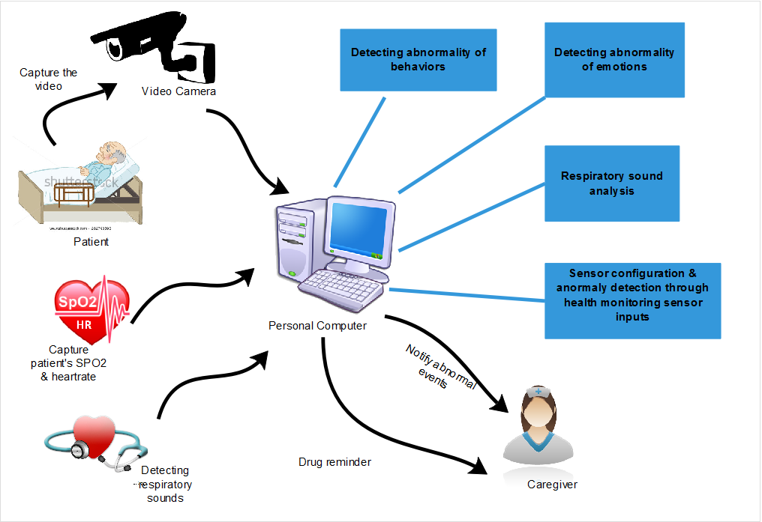
Abeyrathne H.V.L.K. – IT14073656

Slide 11
Respiratory Sound Analysis & Drug Reminder
Sensor Configuration & Anomaly Detection via Sensor Inputs
ELDERLY PATIENT MONITORING SYSTEM
Abnormality Detection in Behaviors
Abnormality Detection in Emotions
Abeyrathne H.V.L.K. – IT14073656

Slide 12
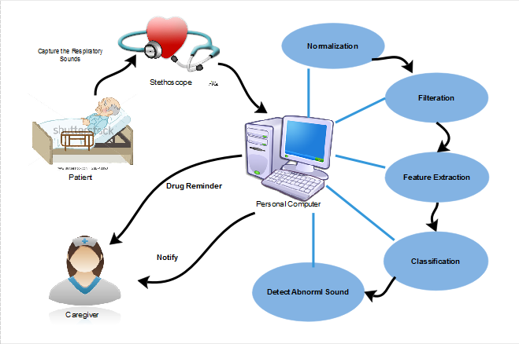
RESPIRATORY SOUND ANALYSIS & DRUG REMINDER
Abeyrathne H.V.L.K. – IT14073656

Slide 13
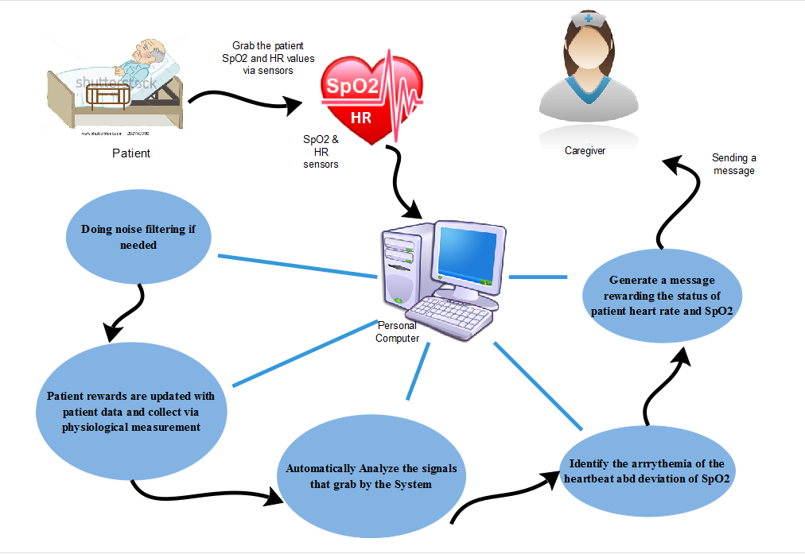
SENSOR CONFIGURATION & ANOMALY DETECTION VIA SENSOR INPUTS
Sudasinghe S.P.L.P. – IT14054532

Slide 14
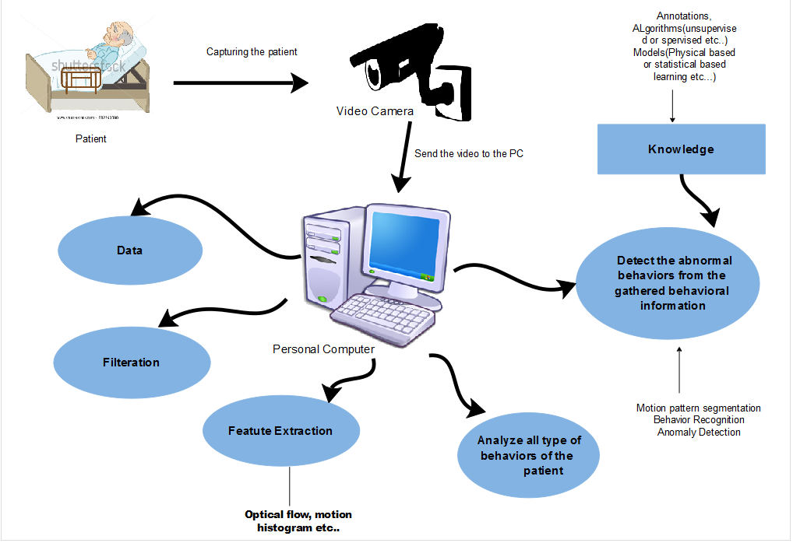
ABNORMALITY DETECTION OF BEHAVIOURS
Chathurangi W.A.S. – IT14069482

Slide 15
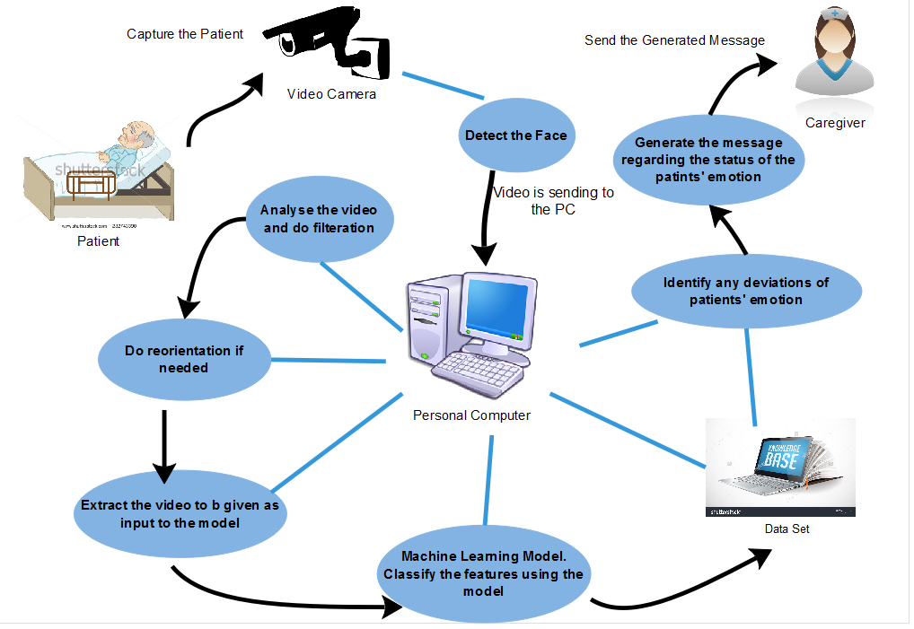
ABNORMALITY DETECTION IN EMOTIONS
Ranathunga R.M.K.V. – IT14044632

Slide 16
OBJECTIVES

Slide 17
MAIN OBJECTIVE
To implement an inexpensive, efficient and a reliable system which can effectively monitor elderly patients who are having respiratory problems and detect anomalies in order to minimize adverse events.
Ranathunga R.M.K.V. – IT14044632

Slide 18
SPECIFIC OBJECTIVES
Provide continuous monitoring of the primary health parameters.
Reduce cost and time which requires to attend at hospitals and clinics.
Provide an alerting mechanism in case of an abnormality detection.
Provide a mechanism to alert the caregiver about the drug taking.
Ranathunga R.M.K.V. – IT14044632

Slide 19
FINAL OUTPUTS

Slide 20
USES AND BENEFITS
Family member can become a caregiver.
Save the cost requires for an external caregiver or a nurse.
Eases up duties of the caregiver.
Ranathunga R.M.K.V. – IT14044632

Slide 21
Expected Outcome
Caregiver can make better decisions.
Minimize health care costs.
Patients return home sooner.
Reduced adverse events.
Ranathunga R.M.K.V. – IT14044632

Slide 22
SIMILAR SYSTEMS

Slide 23




SIMILAR SYSTEMS
This unique health and fitness tracker, available to individual consumers, combines a wristband monitor that tracks movement and sleep details with a user-friendly mobile app that enables logging of exercise, food and hydration.
This is developed by comprehensive technology to help monitor chronic or at-risk patients with wearable sensors that collect real-time health data.
It is a cellphone designed to be simple, user-friendly for seniors and provide Urgent Care them. This uses GPS and wireless cellular technology to connect users with emergency contacts
Using discreet wireless sensors throughout the client’s living area, Wellness tracks activity and wellness indicators, giving caregivers real-time insight into each client’s current conditions as well as potential emergent problems.
Chathurangi W.A.S. – IT14069482

Slide 24


FEATURES OF THE SYSTEM
SYSTEM | RESPIRATORY SOUND ANALYSIS | SENSOR CONFIGURATION & ANOMALY DETECTION VIA SENSOR INPUTS | ABNORMALITY DETECTION OF BEHAVIOURS | ABNORMALITY DETECTION IN EMOTIONS | ALERTING CAREGIVER
PROPOSED SYSTEM
Chathurangi W.A.S. – IT14069482

Slide 25
MARKETING STRATERGY

Slide 26
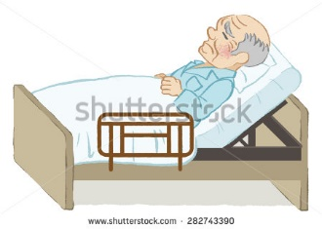
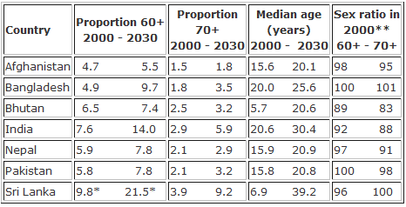
MARKETING POTENTIAL
Target Market --- Homecare settings
Elder Homes
Elder care agencies
Ageing in Sri Lanka in South Asian perspective
Chathurangi W.A.S. – IT14069482

Slide 27

MARKETING STRATEGY
Increased technological improvement, rise in the incidence, globalization and prevalence of some diseases along with increase in aging population, enhanced demand for monitoring in private sectors. Hence the global market for patient monitoring system market is expected to have a healthy growth rate in the forecast period !!
Chathurangi W.A.S. – IT14069482

Slide 28
WORK ALLOCATION
Student ID | Student Name | Work Allocation
IT14073656 | ABEYRATHNE H.V.L.K. | RESPIRATORY SOUND ANALYSIS & DRUG REMINDER
IT14054532 | SUDASINGHE S.P.L.P. | SENSOR CONFIGURATION & ANOMALY DETECTION VIA SENSOR INPUTS
IT14069482 | CHATHURANGI W.A.S. | ABNORMALITY DETECTION OF BEHAVIOURS
IT14044632 | RANATHUNGA R.M.K.V. | ABNORMALITY DETECTION IN EMOTIONS

Slide 29
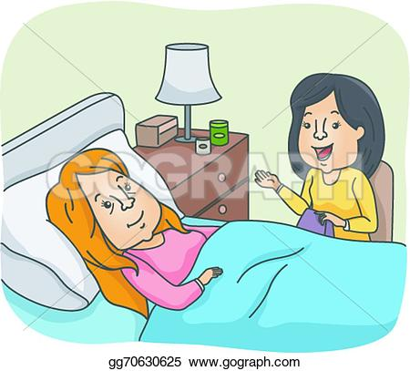
THANK YOU….

