Slide 1
Executing MPI Programs Over Hadoop Using BSP
CS240A Winter 2013
Hiranya Jayathilaka
Michael Agun

Slide 2
The Paradigm Shift
Parallel computing is undergoing a paradigm shift from large scale super computers to simple clusters of commodity machines.
Computing power is becoming an inexpensive utility – Cloud computing is the order of the day.
Need to rethink existing parallel programming models – Or better yet need to adapt old programming models to new ones.

Slide 3
Why Adapt?
Nobody wants to rewrite existing programs that are known to work.
But new cloud/parallel computing offerings hardly support old/legacy parallel programming code.
Violates the write once, run anywhere principle of modern programming.
Both old and new programming models share the same core principles of parallel computing – But the implementations are often not compatible.

Slide 4
Project Goals
Build a framework that enables executing existing MPI code over a modern parallel computing platform such as Hadoop.
Shouldn’t require any changes to MPI code.
MPI developers shouldn’t have to be aware of Hadoop or any other underlying adapters.
Reasonable performance depending on the underlying physical resources.

Slide 5
MPI Over MapReduce?
Already attempted by a research group at Emory University.
“Adapting MPI to MapReduce PaaS Clouds: An Experiment in Cross-Paradigm Execution” – UCC `12
Could only support collective communication operations of MPI.
Very high overhead.
A simple PI calculation program (10000 iters) took more than 200 seconds to finish.

Slide 6
Proposal: MPI Over BSP
Bulk Synchronous Parallel – A high-level programming model for parallel applications.
Simple superstep model.
Local Computation → Process Communication → Barrier Synchronization
Deadlock free execution with predictable performance.
More compatible with MPI than plain MapReduce.
Already in widespread use in the industry (eg: Google Pregel)

Slide 7


Hadoop Integration
Apache Hama – BSP support for Hadoop.
http://hama.apache.org
Based on core Hadoop APIs and HDFS.
Easy to setup on existing Hadoop clusters.

Slide 8
Architecture
BSP job for Hama/Hadoop
Launches MPI jobs.
Handles addressing, communication, scheduling and job I/O (with HDFS).
MPI2BSP C library (mpi.h/mpi.c)
Our implementation of the MPI standard that bridges MPI code with BSP.
Developers only need to link their existing MPI code with our MPI library.
Uses sockets to communicate with the parent BSP job.
Tools
mpicc,mpirun

Slide 9

Workflow
MPI_Comm_rank();
BSP Job
BSP Task 0
MPI
0
$ mpicc foo.c
$ mpirun a.out –np 3
BSP Task 1
MPI
a.out
1
a.out
HDFS
Hama
BSP Task 2
MPI
2

Slide 10
Supported MPI Functions
MPI_Init
MPI_Comm_rank
MPI_Comm_size
MPI_Send
MPI_Recv
MPI_Bcast
MPI_Reduce
MPI_Finalize
MPI_Wtime

Slide 11
Performance Testing
Lab Setup with 6 physical machines
Machine configuration
Intel® Xeon® X3363 CPU @ 2.83 GHz (Quad core) with 6MB cache
8GB main memory
Broadcom NetXtreme BCM5722 Gigabit Ethernet card on PCI express
Ubuntu Linux 10.04 (Lucid) operating system
Oracle JDK 1.7.0_09
Hadoop 1.1.1 + Hama 0.6 (used default settings)

Slide 12
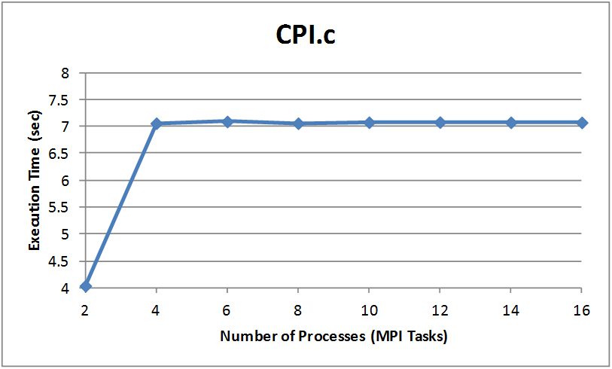
PI Calculation (cpi.c - MPICH)

Slide 13
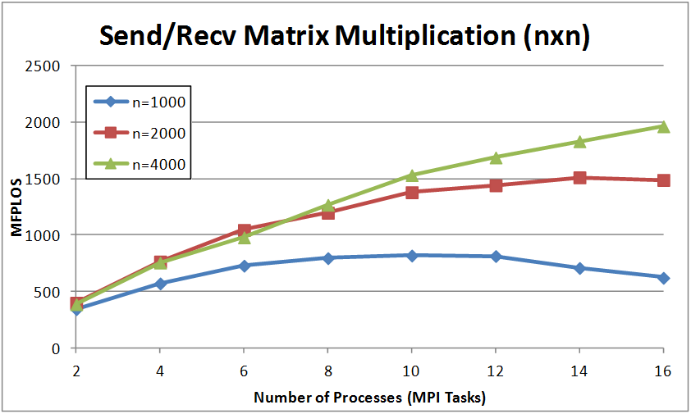
Matrix Multiplication (Send/Recv)

Slide 14
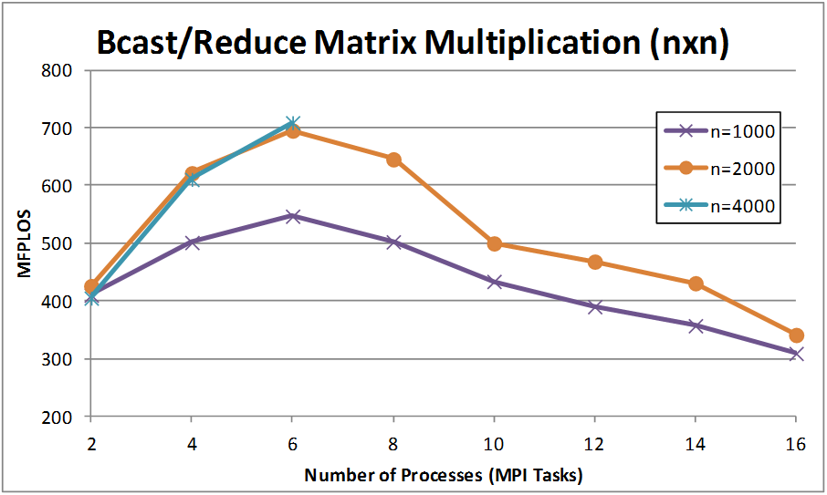
Matrix Multiplication (Broadcast/Reduce)

Slide 15
Testing on Triton
Managed to get everything up and running
Used Hadoop 1.1.1
Reasonable performance
But as expected not as good as native MPI performance on the supercomputing environment
System more suitable for running computations on commodity machines

Slide 16
Key Observations
Supports virtually any MPI program (unmodified)
Reasonable job execution time and speedup
Send/Receive performance is better and scales well compared to Broadcast/Reduce
Need more memory (Can be potentially alleviated by using a different algorithm )
Barrier synchronization overhead

Slide 17
Future Work
Improved collective communication performance
Using Hama pipes for more native integration with MPI
Fault tolerance with process checkpointing (DMTCP)
Supporting more MPI function – Standardization - Benchmarking

Slide 18
Questions?

