Slide 1

Apache JClouds
Cloud interfaces, simplified
Hiranya Jayathilaka
Dept. of Computer Science, UCSB

Slide 2
Roadmap
Cloud computing
Challenges
Apache JClouds
Demo
Pros and cons
Summary and conclusion

Slide 3
The Cloud Revolution
Cloud computing is revolutionizing the way software is developed and delivered.
Software-as-a-Service (SaaS)
Platform-as-a-Service (PaaS)
Infrastructure-as-a-Service (IaaS)

Slide 4
Many Benefits
Cost effective
Reduced maintenance overhead
Easy and fast provisioning – Improved time-to-market
Autoscaling and elasticity
Fault tolerance

Slide 5

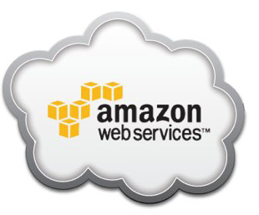


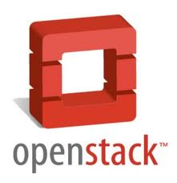
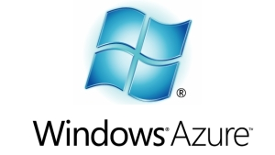








The Other Side of the Coin

Slide 6
Challenges
How do you select the cloud provider that’s right for you?
How do you port your application from one cloud provider to another?
How to develop multi-cloud applications?

Slide 7


Enter, JClouds
An open source library that facilitates developing applications for a wide range of cloud providers.
Implement your application using JClouds, and run it on your favorite cloud without any code changes.
Simple, intuitive APIs.
Java and Clojure support.

Slide 8
History
Started in March 2009 by Adrian Cole as an open source project.
Initially based in London, developed mostly by European Java community.
Contributed to Apache in April 2013.
http://wiki.apache.org/incubator/jcloudsProposal
Already popular in the industry – Used by the likes of Adobe, CloudBees, RedHat, Twitter and SalesForce.
http://jclouds.incubator.apache.org/documentation/reference/apps-that-use-jclouds/

Slide 9
Getting Started
No binary download ☺
The documentation provides the necessary configurations for popular project management tools, so JClouds can be included in your project as a dependency.
Maven
ANT
Leiningen

Slide 10
JClouds APIs
Compute Service API
For managing compute nodes (VMs) in the cloud
Blobstore API
For storing data in the cloud

Slide 11
Compute Service API
Key abstractions
Hardware
Operating system
Template
Supported providers
AWS (EC2), Bluelock, CloudSigma, ElasticHosts, Go2Cloud, GoGrid, Green House Data, HP, Ninefold, OpenHosting, Rackspace, ServerLove, SkaliCloud, SoftLayer, Stratogen, TRMK, TryStack

Slide 12
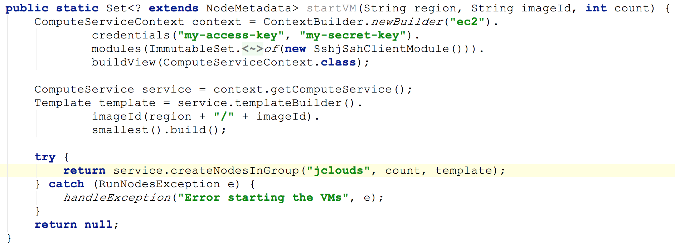
Starting a VM from an Image

Slide 13
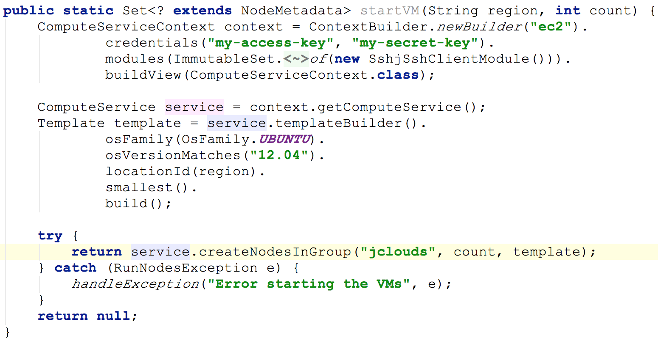
If You Don’t Have an Image?

Slide 14
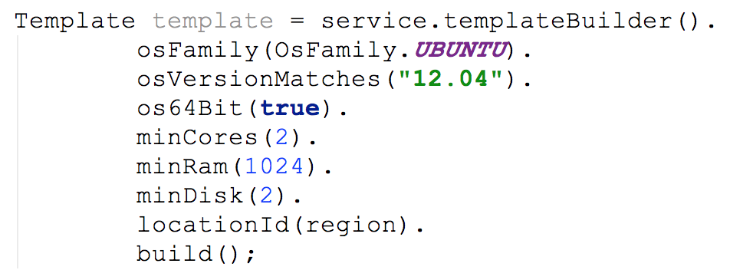
More Control Over Templates

Slide 15
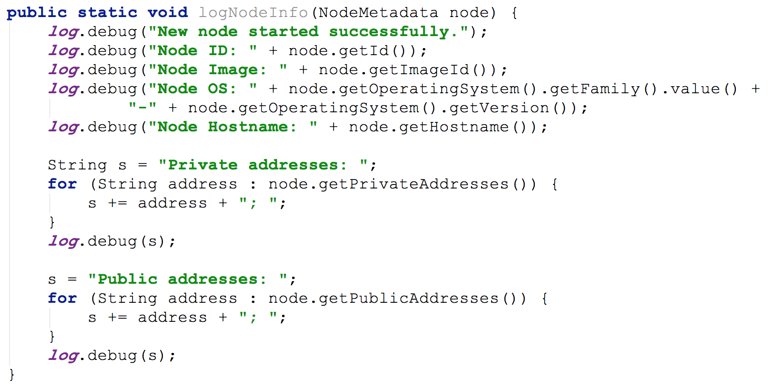
Access VM Metadata

Slide 16
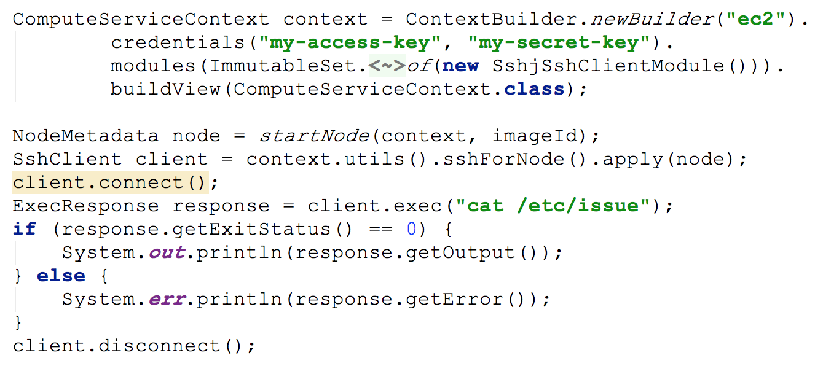
SSH to Remote VM

Slide 17
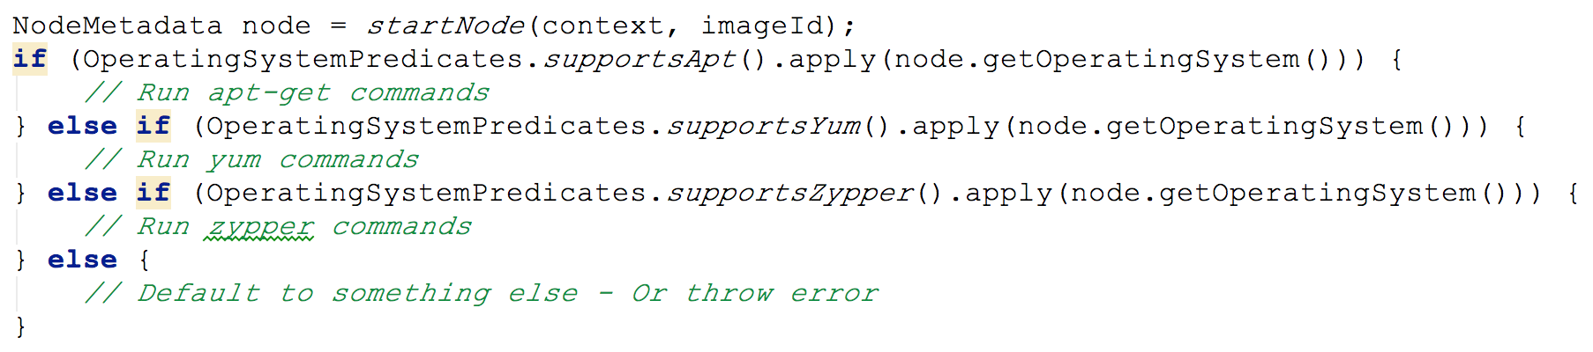
Dealing with Package Managers

Slide 18
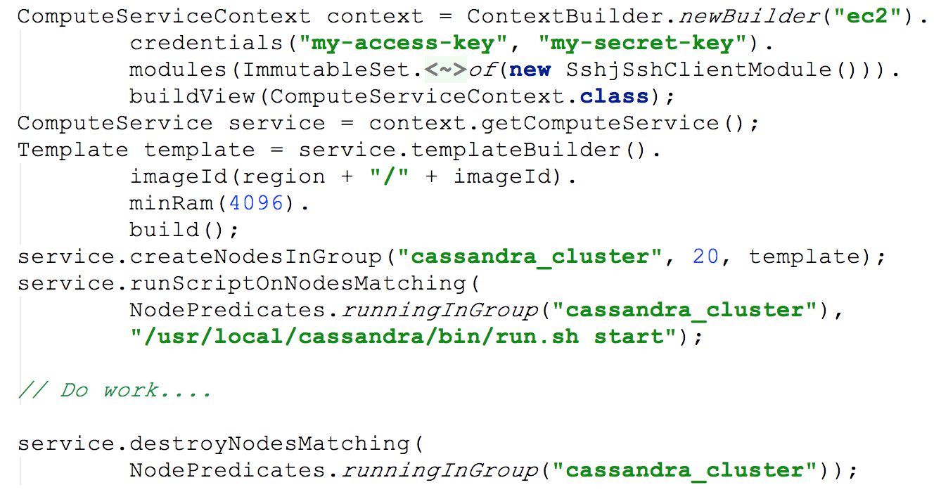
Managing Clusters

Slide 19
Blobstore API
Key abstractions
Container
Folder
Blob
Supported providers
AWS (S3), CloudOne, HP, Azure, Ninefold, Rackspace, Synaptic

Slide 20
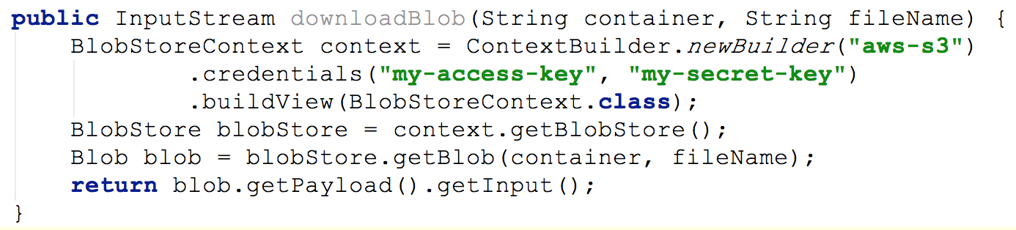
Downloading a Blob

Slide 21
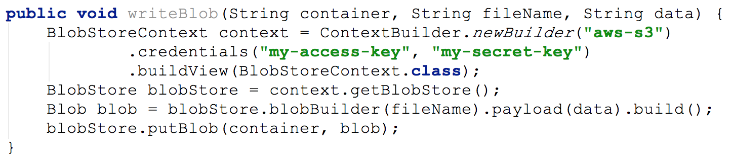
Write Blob

Slide 22
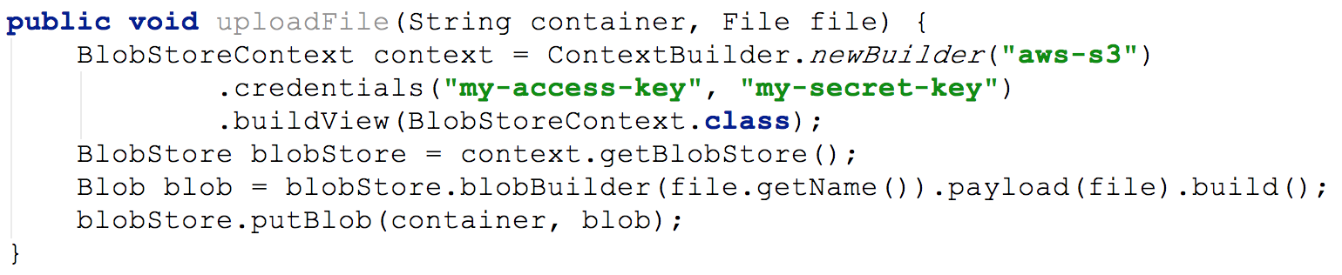
Upload File

Slide 23
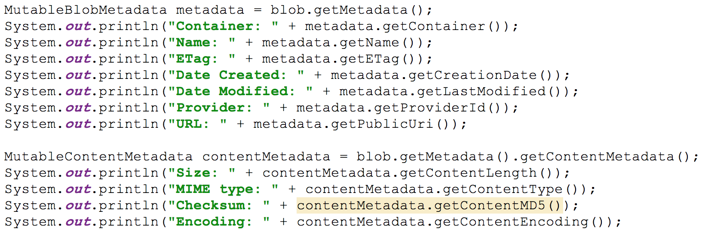
Access Blob Metadata

Slide 24
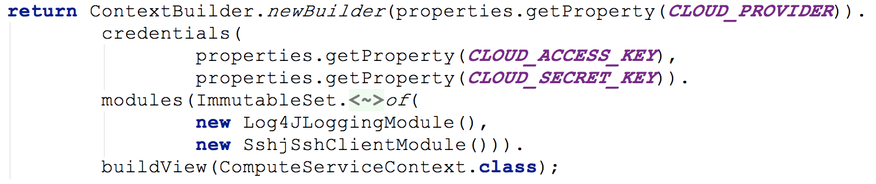
Logging Support

Slide 25
Demonstration
Scenario
Start an Ubuntu VM in EC2
Upload a Python script and a Java application to the VM (Java application also based on JClouds)
Install Python and JRE on the VM using apt-get
Run the Java application on the VM to download a data file from S3
Run the Python script on the data file
Upload the output to S3

Slide 26
Pros
Powerful abstractions: Simple + High-level + Convention over configuration
Location awareness baked into the API
Easily manage clusters of nodes
Excellent portability
Unit testable
Free and open source (ASL 2.0)
“It just works” (YMMV)

Slide 27
Cons
Still in the Apache Incubator
Limited documentation
Potential “Jar hell”

Slide 28
Summary
Cloud computing brings a horde of benefits – But the diversity can be overwhelming.
Several challenges with respect to evaluating cloud vendors and porting application across cloud platforms.
Apache JClouds provides a simple and feature-rich approach for developing cloud applications that are easily portable across multiple vendors.

Slide 29
Thank You & Questions

Slide 30
References
Project website: http://jclouds.incubator.apache.org
Apache Incubator proposal: http://wiki.apache.org/incubator/jcloudsProposal
Getting started: http://jclouds.incubator.apache.org/documentation/gettingstarted/
Demo code: https://github.com/hiranya911/jclouds-demo

