Slide 1
Networking Hall of Shame
Featuring Sun Microsystems, Linksys, Apple, OpenSSL consortium, and Microsoft

Slide 2
Morris Worm (1988)
First exploit was by Robert Morris in the Internet Worm.
Exploited finger daemon (remote root)
int main(argc, argv)
char *argv[];
{
register char *sp;
char line[512];
…
gets(line);
…
return(0);
}

Slide 3
Linksys ping bug revisited (2004)
Ping utility on linksys wireless router.
Can enter:
127.0.0.1|ls>/tmp//ping.log
Runs shell command and returns results.
if(strchr(ip, ' ') || strchr(ip, '`') ||
|| strstr(ip, “/tmp/ping.log”))
// Fix Ping.asp bug, user can execute
// command ping in Ping.asp
Input sanity check (added after previous exploit):

Slide 4


Slide 5
Apple SSL goto fail (Feb 2014)
static OSStatus
SSLVerifySignedServerKeyExchange(SSLContext *ctx, bool isRsa, SSLBuffer signedParams,
uint8_t *signature, UInt16 signatureLen)
{
OSStatus err;
...
if ((err = SSLHashSHA1.update(&hashCtx, &serverRandom)) != 0)
goto fail;
if ((err = SSLHashSHA1.update(&hashCtx, &signedParams)) != 0)
goto fail;
goto fail;
if ((err = SSLHashSHA1.final(&hashCtx, &hashOut)) != 0)
goto fail;
...
err = sslRawVerify(...);
fail:
SSLFreeBuffer(&signedHashes);
SSLFreeBuffer(&hashCtx);
return err;
}

Slide 6
Heartbleed OpenSSL Vulnerability (2014)
/* Parsing heartbeat request message*/
hbtype = *p++; /* Extract type */
n2s(p, payload); /* Extract length into payload */
pl = p; /* Set pl to start of payload data*/
…
/* To send response */
*bp++ = TLS1_HB_RESPONSE; /* Set response type */
s2n(payload, bp); /* set payload len in answer */
memcpy(bp, pl, payload); /* copy “payload” bytes to
output buffer */

Slide 7
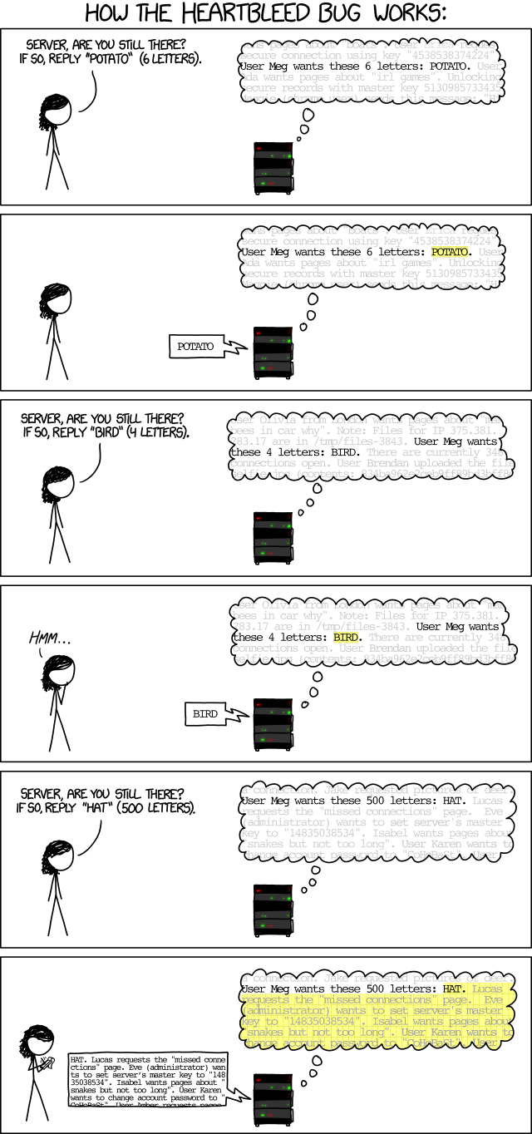

Slide 8
Microsoft network fileshare password
In all versions of Windows up to ME, supplying the correct first byte of a password allowed access to a network share.
if (*correct_password == *supplied_password) {
/* allow connection */
…
}

Slide 9
Lessons
Code layout matters.
Buffer overflows bugs are common in C. Avoid unsafe functions such as gets(), strcpy() that don’t range check.
Understand the language.
Use all compiler warnings.
Tools like valgrind are a huge win for analyzing your code, especially for memory allocation bugs in C.
http://valgrind.org/

