Slide 1
Big Bang Nucleosynthesis [Supplement to Lecture VII]

Slide 2
⁷Be
(³He,γ)
(n,p)
(³H,n)
(³He,p)
(D, γ)
⁶Li
⁷Li
(D,p)
(³H,γ)
³He
⁴He
(p,γ)
(D,n)
(D,n)
(n,p)
¹H
(n,γ)
²H
(D,p)
³H
Stable isotope
Radioactive isotope
(p,γ)
Reaction
n
Radioactive decay

Slide 3
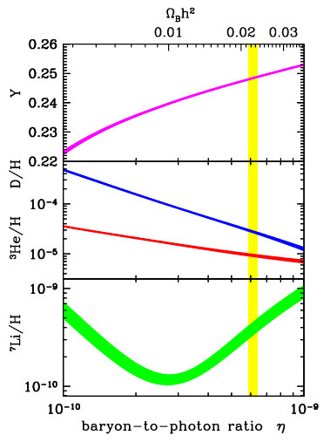
BBN Yield Predictions
Cyburt, Fields & Olive 2003
Phys Lett B 567,227
⁴He fraction by mass
Abundance relative
to H by number

Slide 4
⁴He
Prediction: Y = 0.2482±0.0003±0.0006
Usually estimate He abundance from H II region spectra (H I and He I recombination lines).
Determine temperature (self-consistent or using [O III]).
Model collisional excitation, fluorescence.
Optical depth effects. He I 2³S₁ is metastable.
Model reddening.
Model stellar He I absorption.
Ionization correction factors (H II and He I can coexist).
Extrapolate to zero metallicity to get primordial value.
Major recent development is NIR spectroscopy to get 1.08 µm line as a density diagnostic.

Slide 5
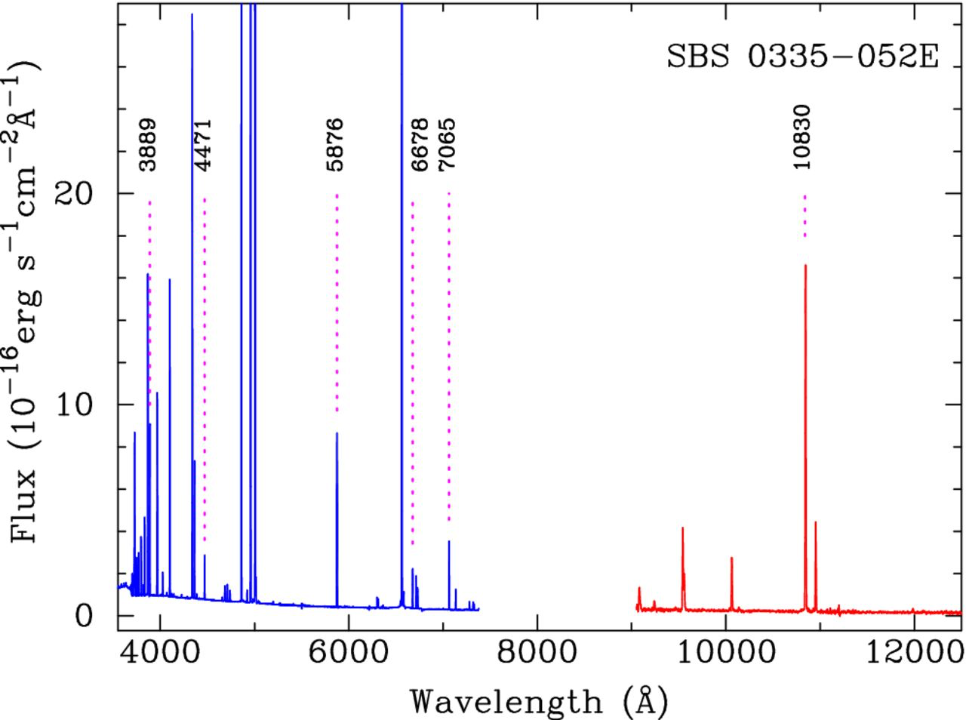
Spectrum Of Extragalctic H II Region Showing Helium Lines [LBT (optical) + VLT (NIR)]
Izotov et al. (2014)

Slide 6
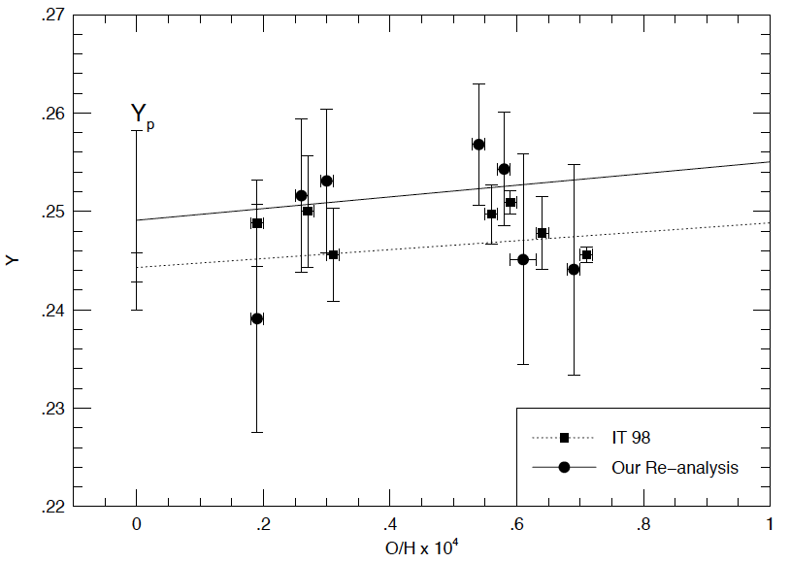
Helium
Prediction: Y = 0.2482±0.0003±0.0006
Usually estimate He abundance from H II region spectra (He I recombination lines). Extrapolate to zero metallicity to get primordial value.
predicted
0.232 < Y_{p} < 0.258
Olive & Skillman 2004 ApJ 617,29

Slide 7
He Abundances
✔*
Measured from H II Regions
0.2551 ± 0.0022 Izotov et al. (2014)
0.2449 ± 0.0040 Aver et al. (2015)
0.2446 ± 0.0029 Peimbert et al. (2016)
Measured from recombination (CMB anisotropies)
0.2410 ± 0.025 Planck 2018 VI
0.2460 ± 0.035 Planck 2018 VI (allowing N_{ν} free)
Theory
0.2470 ± 0.0002 (with Planck Ω_{b}h²)
* Determinations are only marginally consistent with each other.

Slide 8
Examples of Deuterium Measurements
Location | D/H (ppm) | Method
Earth | 150
Venus | 16000±2000 | Mass spec. Donahue et al 1982
Mars | 900±400 | IR lines (HDO/H₂O) Owen et al 1988
Jupiter | 22—50 50±20 | IR lines (CH₃D/CH₄) Kunde et al 1982 Mass spec. Niemann et al 1996
Saturn | 4—29 | IR lines (CH₃D/CH₄) Courtin et al 1984
Local ISM | ~ 7 – 20 | Absorption lines in stellar spectra. Depends on line of sight; see tabulation by Linsky et al 2006
Lyman-α absorbers | 25.3±0.4 | H vs D Lyman absorption lines in QSO spectra, Cooke et al. 2014

Slide 9
Warnings on D/H
Not all D/H is the primordial value, or even that at the formation of the solar system.
Problems:
Astration: burning of D to ³He etc. in stars.
Chemical fractionation: At low temperatures D binds more tightly to molecules than H due to vibrational zero point energy.
Fractionation due to depth of planetary gravity well. (This is why Jupiter was once used for BBN D/H.)
XH⁺ + D → XD⁺ + H

Slide 10
Intergalactic D/H
✔
Probably most reliable method is low-metallicity quasar absorption line systems.
Little processing by stars
Less opportunity to hide deuterium in molecules or dust grains
Reduced mass of e⁻D⁺ is greater than e⁻p⁺ by 1 part in 3600, rescaling all hydrogenic energy levels. Equivalent to velocity shift of c/3600 = 80 km/s.
Absorber value 25.3±0.4 ppm agrees with predicted 25.8±0.4 ppm.

Slide 11
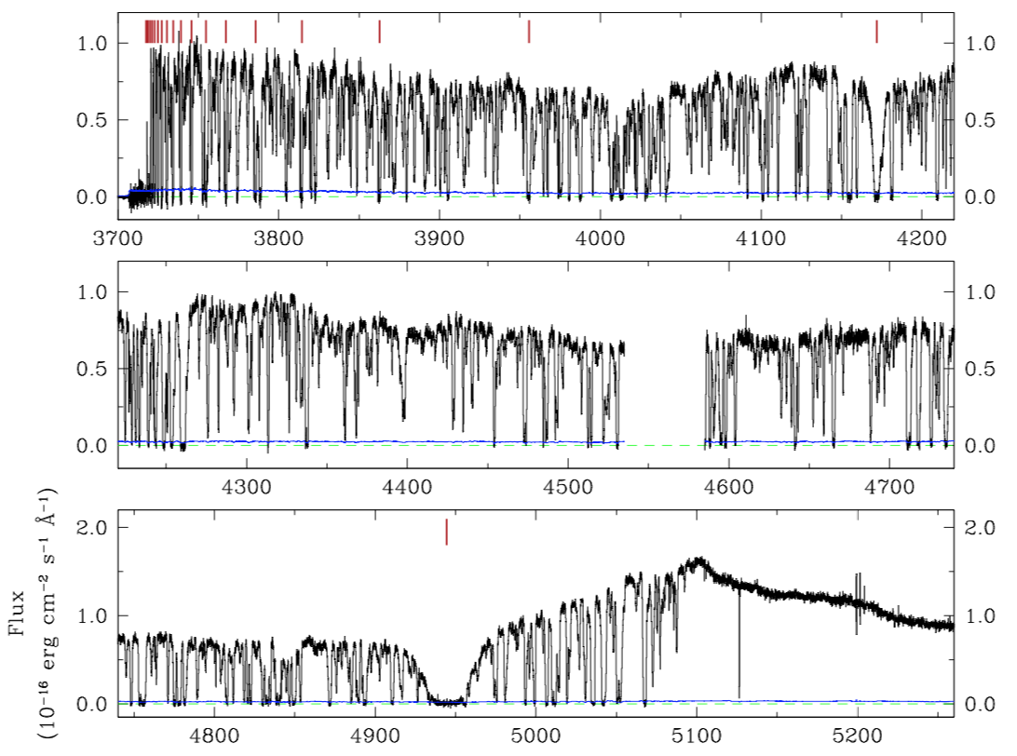
Spectrum of SDSS J1358+6522 [z_{Quasar} = 3.17, z_{abs} = 3.07]
abs Lyβ
Chip
gap
Quasar Lyα
abs Lyα
Cooke et al. (2014)

Slide 12
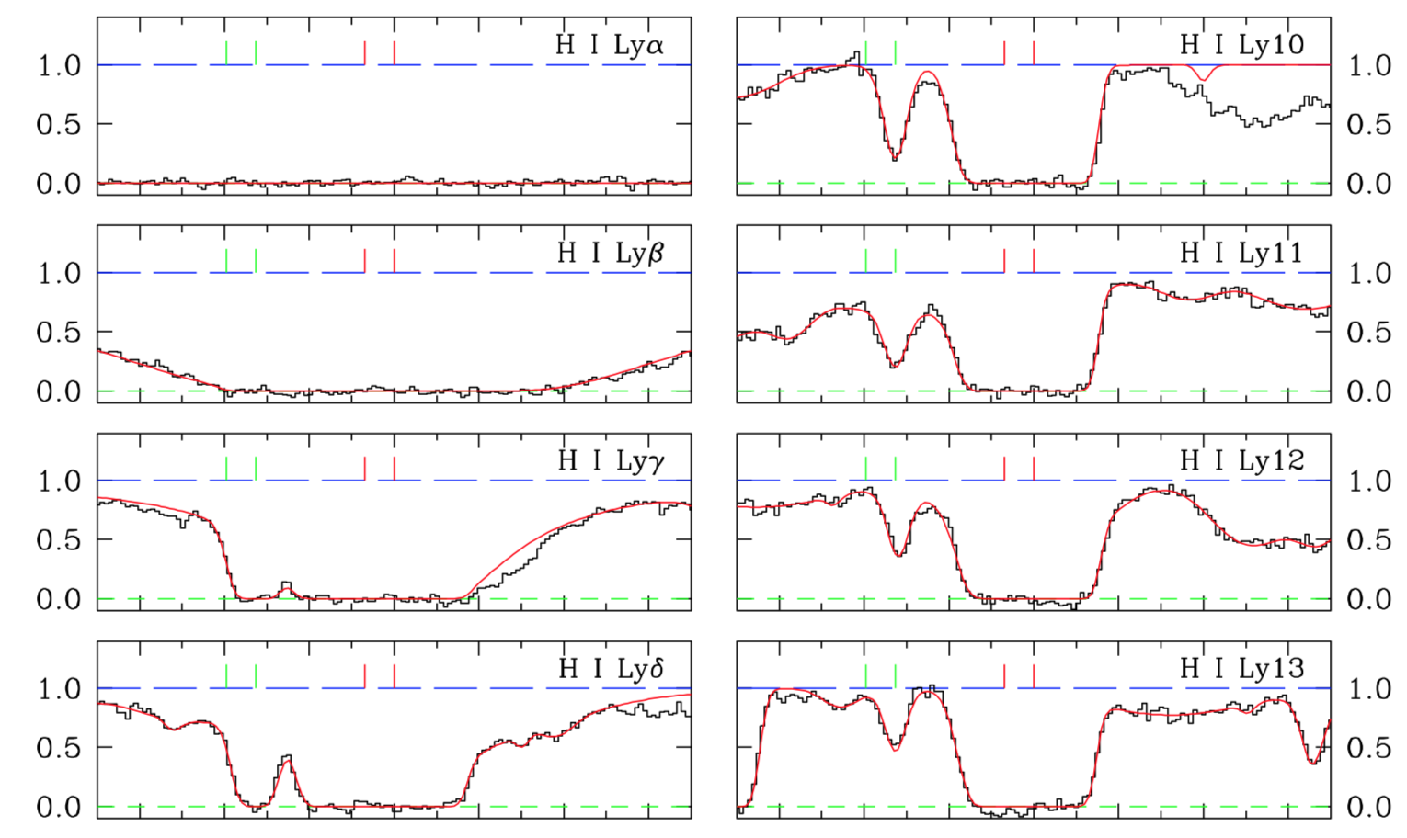
H vs. D Lines in the absorber
D
H
Cooke et al. (2014)

Slide 13
³He
Difficulties:
Can be both produced and destroyed in stars.
No IGM measurement.
Most(?) accepted measurement is ³He⁺ hyperfine line (λ=3.46cm) low-metallicity H II regions. Bania et al (2002) find ³He/H < 15 ppm.
Directly observed 11±2 ppm, argue that stars would lead to net increase in ³He.
Predicted from WMAP baryon abundance: ³He/H = 10.5±0.3±0.3 ppm.
Aside: Jupiter atmosphere ratio ³He:⁴He = (1.1±0.2)×10⁻⁴ [Niemann et al 1996].
✔?

Slide 14
Lithium
Can be measured in low-metallicity stars.
Two multiplets available for Li I: 6708Å (2s—2p) and 6104Å (2p—3d).
⁷Li destroyed at high T, ⁷Li + p → 2⁴He. Avoid low-mass stars due to deep convective zone.
Slight isotope shift of ⁶Li vs. ⁷Li.
Li can also be produced via cosmic rays:
Spallation of CNO elements (also gives Be, B)
⁴He + ⁴He collisions at low energies.

Slide 15
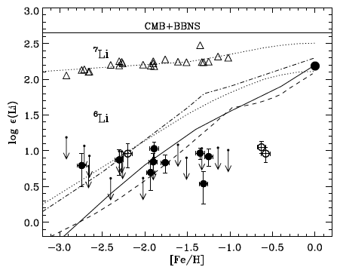
Li abundance evolution
12 + log₁₀ X_{Li}
Asplund et al (2006) ApJ 644, 229

Slide 16
The Lithium Problem(s)
⁷Li: Predicted (4.7±0.7)×10⁻¹⁰.
See update from Cyburt et al. 2016.
Observations give lower values
e.g. (1.1—1.5) ×10⁻¹⁰ from Asplund et al. 2006.
Other determinations are typically ~(1—2)×10⁻¹⁰.
⁶Li: there have been reports of a plateau at ~6×10⁻¹², although now mostly interpreted as due to line asymmetry from convection.
Unclear whether ⁷Li problem indicates new physics, versus our understanding of stellar evolution.
✗
?

