Slide 1
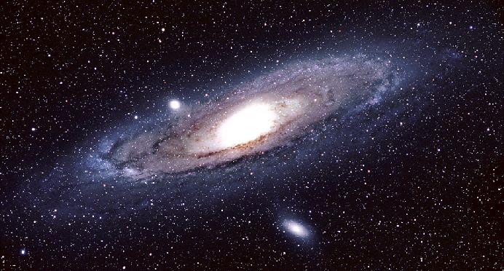
Milky Way Galaxy

Slide 2
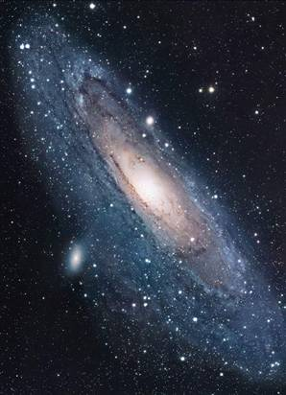
Are stars distributed uniformly through space, or do they clump together?
Astronomers now know that stars are in clumps called “galaxies”. The Sun is part of the Milky Way Galaxy.

Slide 3
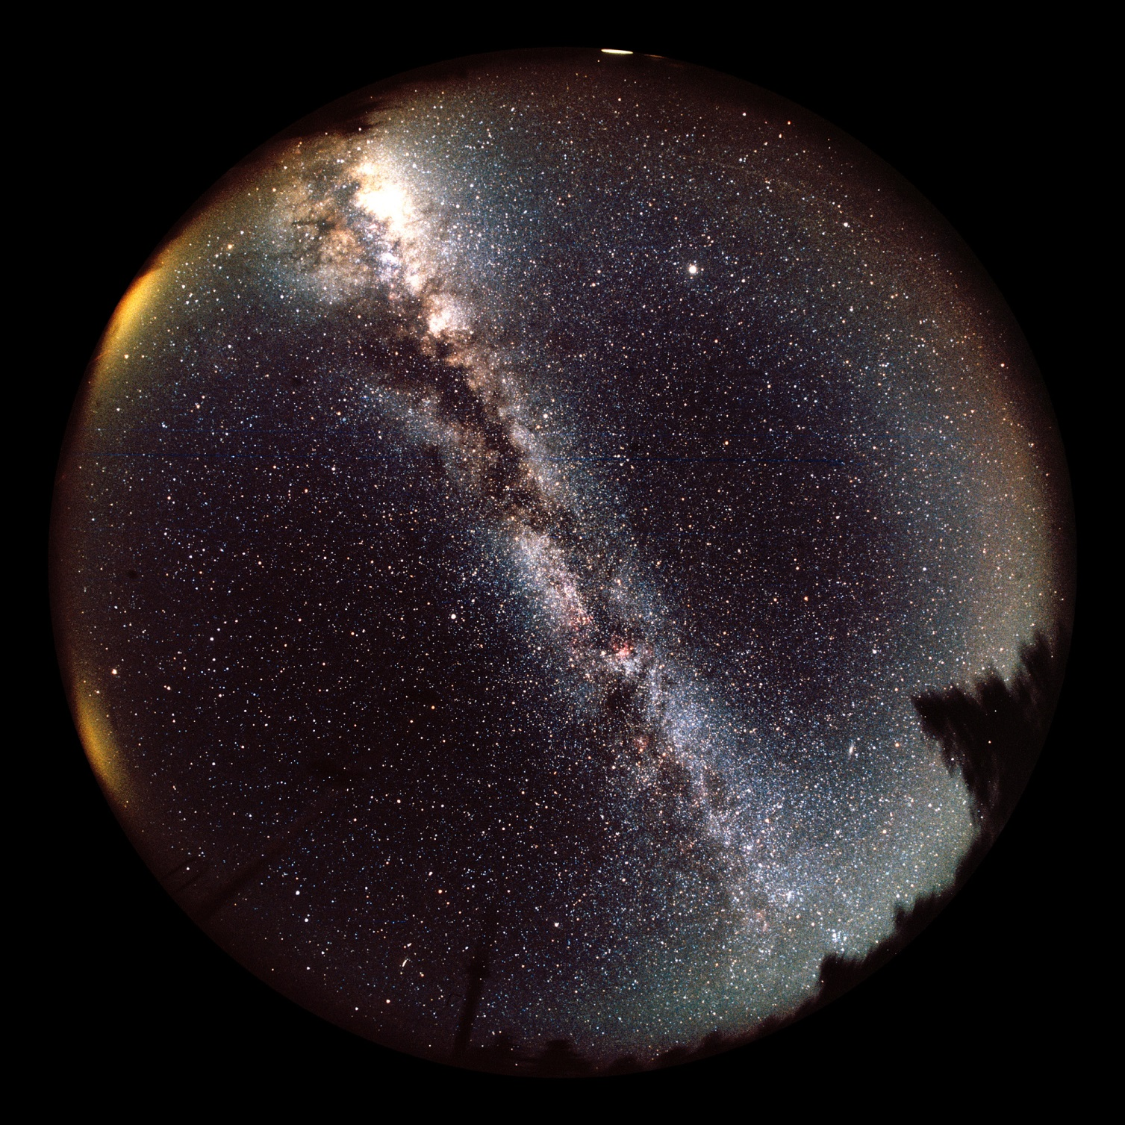
In the dark night sky, we see a luminous path called the Milky Way.

Slide 4
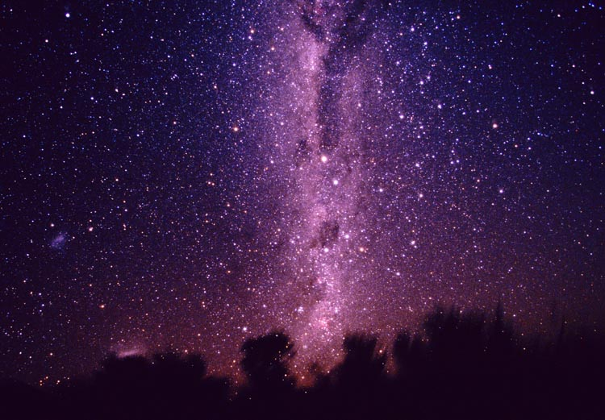
Greek astronomers called the Milky Way galaktikos kuklos, or “milky circle”; Romans called it via lactea, or “milky way”.
Aristotle thought the Milky Way was a fiery cloud in the Earth’s upper atmosphere.

Slide 5
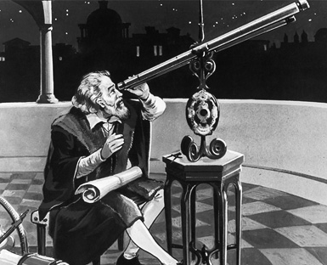
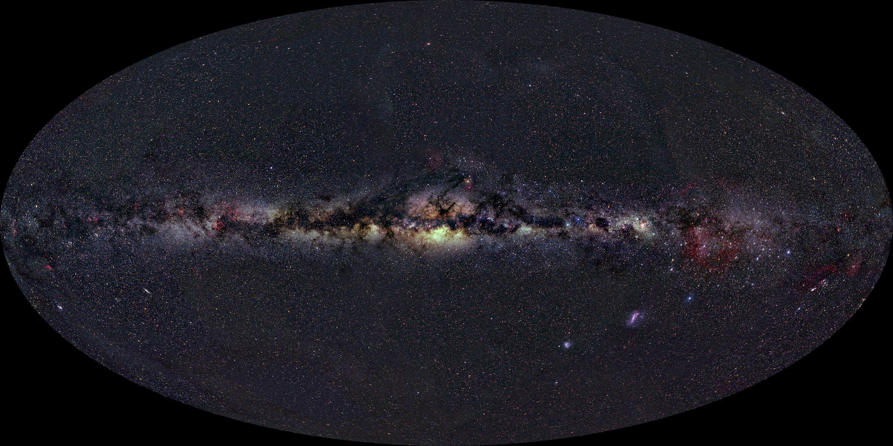
Galileo looked at the Milky Way with his telescope: he found it was made of an “immense number” of faint stars.

Slide 6


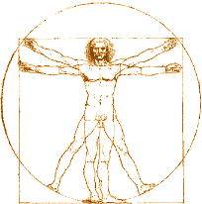
Consider a disk of stars:
few stars this way
many stars this way
We see the “Milky Way” when we look the long way through the disk.

Slide 7
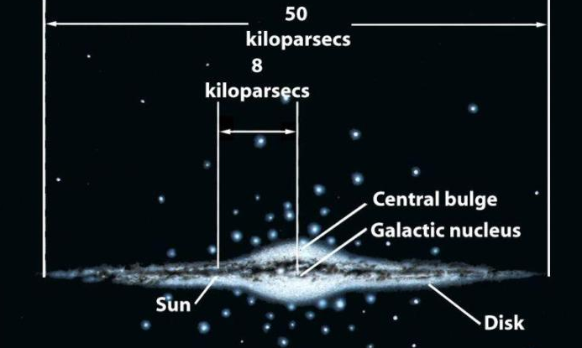
If we saw the Milky Way galaxy edge-on from outside:
= 8000 parsecs = 26,000 light-years =1.7 billion AU

Slide 8
The Milky Way is BIG!
  A flattened disk of stars with a central bulge plus a halo
  ~50 kpc in diameter and ~1 kpc thick
  Sun is ~8 kpc from the center in Sagittarius
  Galactic Center and much of the disk is obscured by dust in the plane of the Galaxy

Slide 9
The Herschels’ Star Gauges
William & Caroline Herschel (1785):
Counted stars along 683 lines of sight using their 48-inch telescope.
Assumed all stars are the same luminosity, and that they could see to the edges of the system.
Model:
  Flattened Milky Way (“grindstone”)
  Sun very near the center.

Slide 10
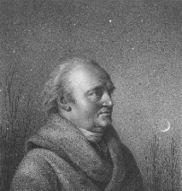
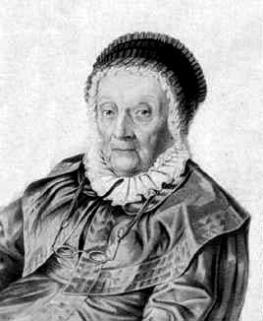
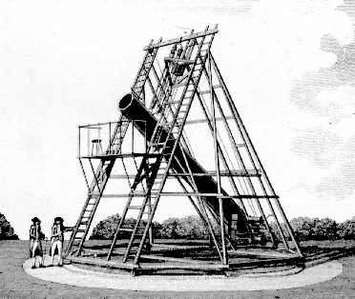

Slide 11
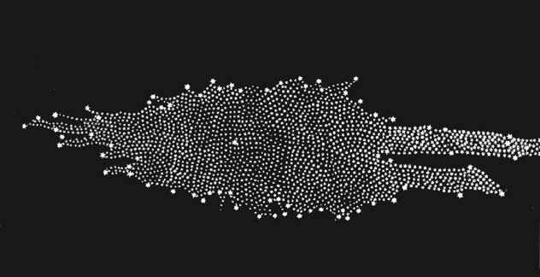
How big is our Home?

Slide 12
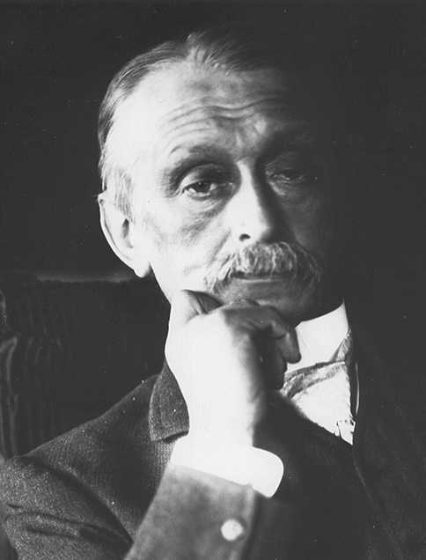
The Kapteyn Universe
Jacobus Kapteyn (1901 thru 1922):
Used photographic star counts
Estimated distances statistically based on parallaxes & proper motions of nearby stars.
Neglected interstellar absorption of starlight.
Model:
  Flattened disk 15 kpc across & 3 kpc thick with the Sun slightly off center.

Slide 13
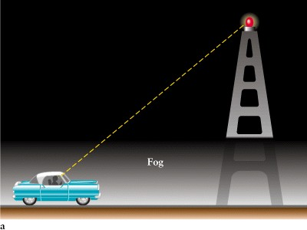

Slide 14
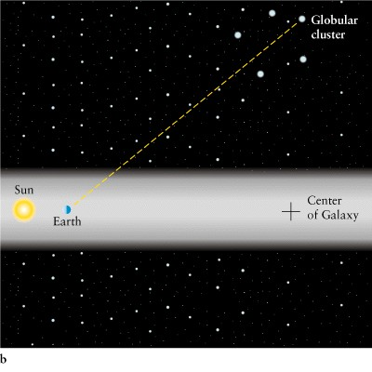
Dust obstructed the full view of the MW

Slide 15
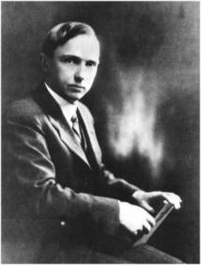
Harlow Shapley (1915 thru 1921)
Harvard Astronomer
Noticed two facts about Globular Clusters:
  Uniformly above & below the Milky Way.
  Concentrated on the sky toward Sagittarius
Observations:
  Globular Cluster distances from RR Lyrae stars
  Mapped the cluster distribution in space.

Slide 16
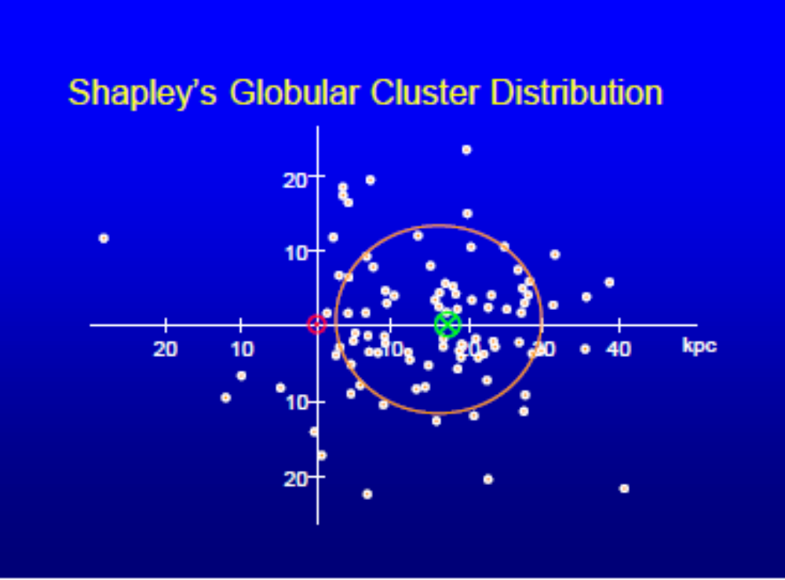

Slide 17
The Greater Milky Way
Shapley’s Results (1921):
  Globular clusters form a subsystem centered on the Milky Way.
  The Sun is NOT at the MW center
  MW is a flattened disk.
Right basic result, it’s but size too big:
  Shapley ignored interstellar absorption
  Caused him to overestimate the distances.

Slide 18
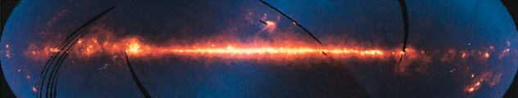
Far-IR map of the Galaxy shows that the dust lies mostly in the plane of the Galaxy

Slide 19
The Present Picture
Largely Shapley’s model, corrected for the effects of interstellar absorption.
  A flattened disk of stars with a central bulge plus a halo
  ~50 kpc in diameter and ~1 kpc thick
  Sun is ~8 kpc from the center in Sagittarius
  Galactic Center and much of the disk is obscured by dust in the plane of the Galaxy

Slide 20
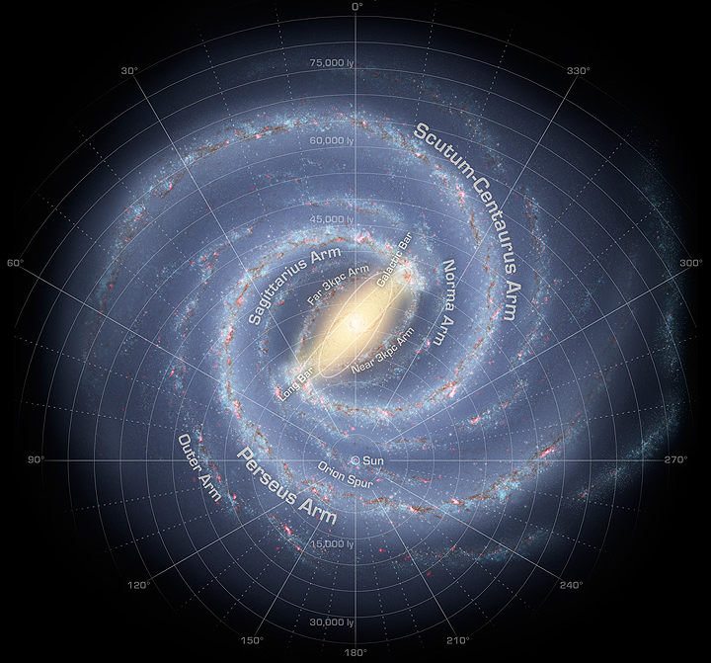
If we saw the Milky Way galaxy face-on from outside:

