Slide 1
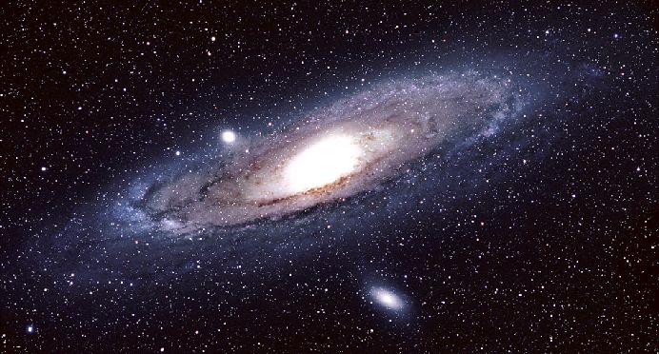
Galaxies

Slide 2
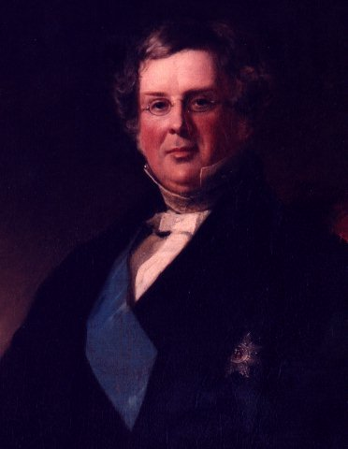
Spiral Nebulae
William Parsons, 3rd Earl of Rosse
Built a 72-inch telescope known as the “Parsonstown Leviathan” (c. 1845)
Discovered the “Spiral Nebulae”
  Disks with a spiral pattern
  Some edge-on disks with dark bands
  Did not resolve them into stars.

Slide 3
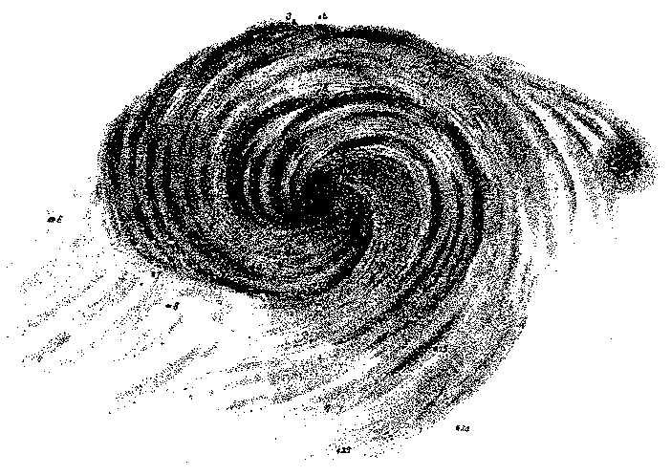
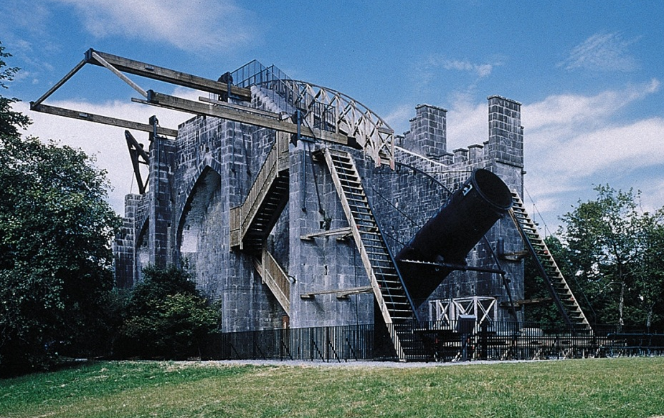
Rosse’s sketch of M51
72-inch Telescope at Birr Castle

Slide 4
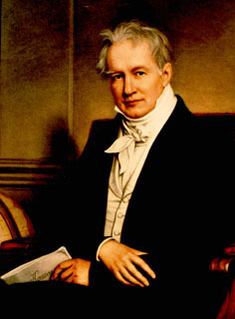
Island Universe Hypothesis
Kant’s idea (1755) revived by Alexander von Humboldt (1845):
  Spiral Nebulae are other Milky Ways (or galaxies) made of stars.
  Very distant and external to our Galaxy.
Big Picture:
The Milky Way is one of many galaxies in a vast Universe.

Slide 5
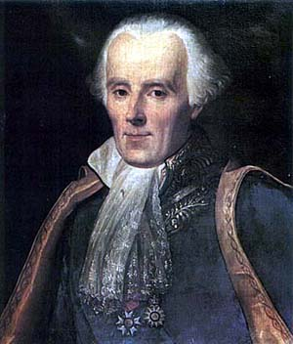
Nebular Hypothesis
Revival of a Solar System model of Pierre Simone Laplace (1798):
  Spiral Nebulae are swirling gas clouds
  Nearby and internal to our Milky Way
  Might be forming solar systems
Big Picture:
The Milky Way is the Universe.

Slide 6
The Great Debate
Problem hinges on the finding distances:
  How big is the Milky Way?
  How distant are the Spiral Nebulae?
Island Universe Hypothesis:
  Nebulae more distant than our Galaxy is big
Nebular Hypothesis:
  Nebulae fit comfortably within the Galaxy.

Slide 7
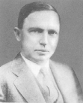
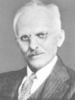
The Shapley-Curtis Debate
1920 Debate on The Scale of the Universe
Sponsor: National Academy of the Sciences
Harlow Shapley: (Harvard)
  Defended his model for the Galaxy and the “conventional” Nebular Hypothesis.
Heber Curtis: (Lick Observatory)
  Defended the Kapteyn Model and the “radical” Island Universe Hypothesis.

Slide 8
Andromeda Nebula

Slide 9
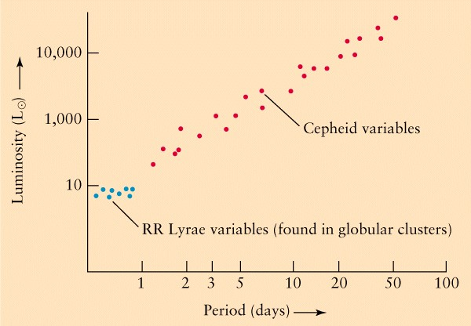

Slide 10
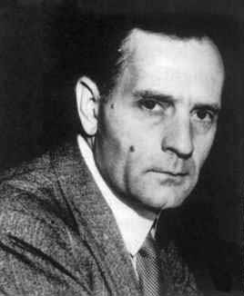
Hubble Ends the Debate
Edwin Hubble (1923):
  Using the new Mt. Wilson 100-inch telescope
  Found a Cepheid in Andromeda
  Shapley’s P-L relationship gave 300 kpc
By 1925:
  Hubble had measured 10 Cepheids

Slide 11
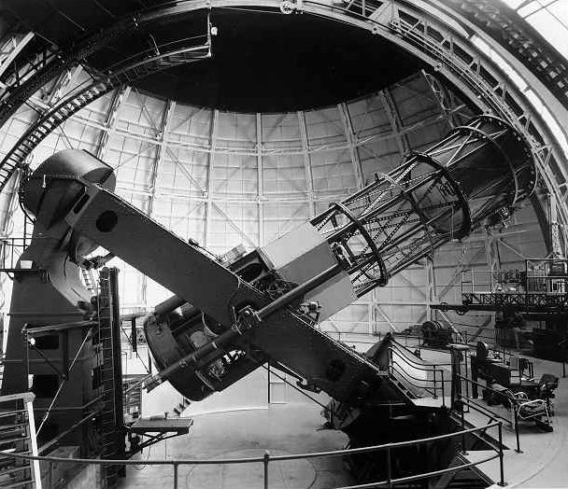
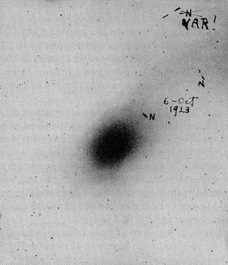
Hubble’s Cepheid in Andromeda
100-inch Telescope
(Mt. Wilson)

Slide 12
The Realm of the Galaxies
We call the Milky Way “The Galaxy”
Spiral “Nebulae” now called Spiral Galaxies:
  Stellar systems like the Milky Way
  Typical sizes are 10s of kpc
  Typical distances are in Mega-parsecs (Mpc)
The Universe suddenly became a much bigger place.

Slide 13
Hubble Classification of Galaxies
All bright galaxies fall into one of three broad classes according to their shape:
  Spiral Galaxies (~75%)
  Elliptical Galaxies (20%)
  Irregular Galaxies (5%)
Basic classification system developed by Hubble (1936).

Slide 14
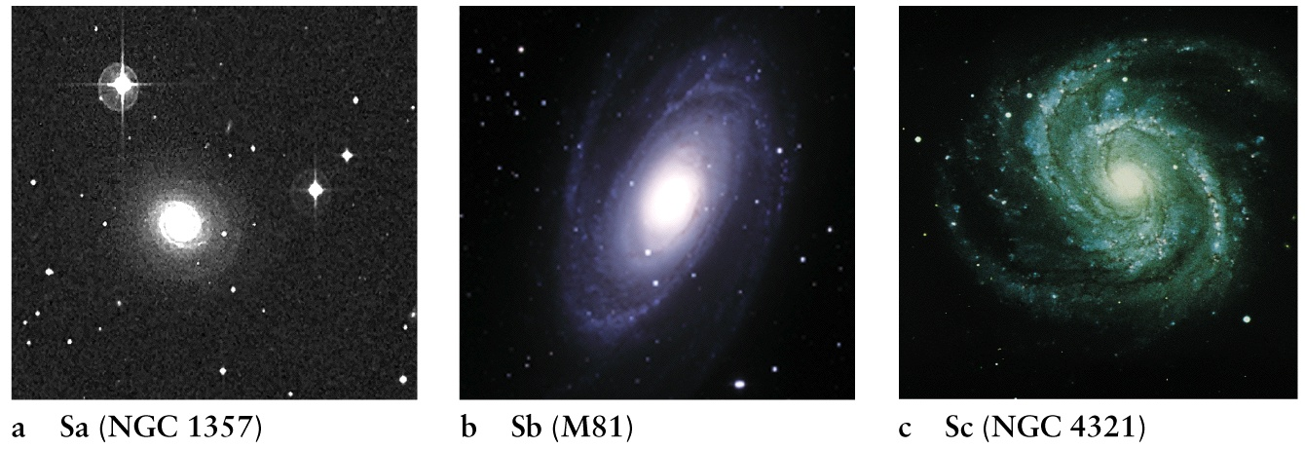

Slide 15
Type S: Ordinary Spirals
Classified by relative strength of the central bulge & tightness of the spiral arms
Types: Sa, Sb, and Sc
  Sa: strong bulge & tight, indistinct arms
  Sb: intermediate type
  Sc: small bulge & loose, well-defined arms
The Milky Way is probably type Sb.

Slide 16
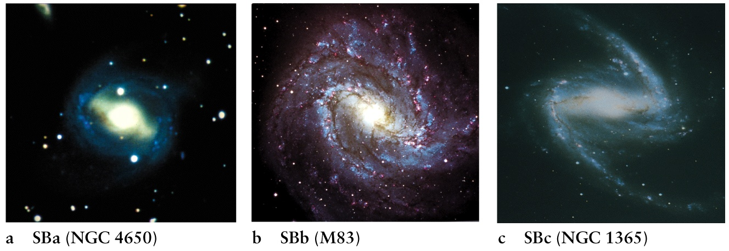

Slide 17
Type SB: Barred Spirals
Parallel group to the ordinary spirals:
  About as many barred as ordinary spirals.
Feature a strong central stellar bar:
  Bar rotates as a unit (solid body rotation)
  Spiral arms emerge from the ends of the bar
Same subclasses:
  SBa, SBb, and SBc

Slide 18
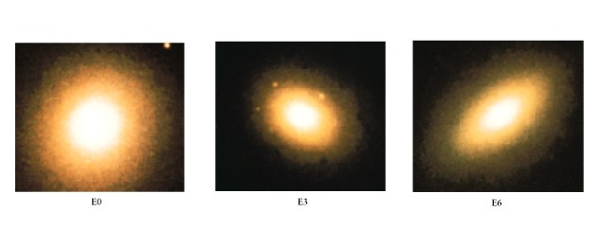

Slide 19
Type E: Ellipticals
Show little internal structure:
  Elliptical in shape
  No disks, spiral arms, or dust lanes
  Brightest stars are red---Old Stars
Classified by the degree of apparent flatness:
  E0 is circular
  E7 is flattest

Slide 20
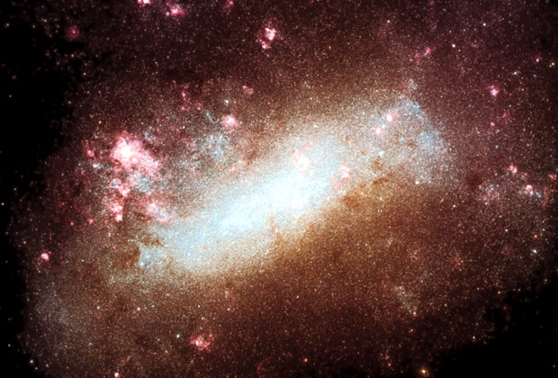

Slide 21
Type I: Irregulars
Show an irregular, often chaotic structure.
Little evidence of systematic rotation.
Catch-all class:
  Proposed systematic subclasses, but many irregulars defy classification.

Slide 22
Relative Stellar & Gas Content
Spirals:
  Range is ~10-20% gas
  On-going star formation in the disks
Ellipticals:
  Very little or no gas or dust
  Star formation ended billions of years ago

Slide 23
Stellar motions
Spirals: supported by rotation of stars around centers of galaxies
Ellipticals: supported by random motions of stars

