Slide 1

Workplace Discrimination in the US
Project Final Report, Team 10

Slide 2
Introduction, Problem Statement and Objectives
Introduction
Objectives
Team 10 is a group of data science consultants specializing in law practice across the United States.
Identifying the most attractive region or state to open up an office, both in the current and near term. This could be based on the level of disproportionate claims being filed in one state.
Identifying any states or regions in which discriminatory lawsuits are abnormally low as targets for secondary office openings.
Identifying what specific discrimination law will be the primary focus of this office.
(If possible) Quantifying the impact of the implemented state legislature to identify proactive opportunities for secondary office openings.
Problem Statement
We have been hired by a discrimination law firm that is looking to open up an office in a specific region or state within the US, but is unsure how to determine where the best location would be for its offices.
Notes:
Team 10 has been hired by a national law firm looking to expand upon its practice by opening up a regional or state-specific office with the primary focus on workplace discrimination lawsuit resolution. The firm has enough capital and resources to open up a law firm of any size, anywhere within the country but lacks an understanding of where would be the best location. They want to open up a location that will have the opportunity to have an outsized impact on the community that it serves, not necessarily just a location that handles the most cases.
The problem statement for the firm is that they lack a fundamental understanding of the current landscape of discriminatory practices throughout the nation and do not know where would be the best location to open up their first discrimination practice office. The firm may have the right business acumen and talent when it comes to actually running a law firm, but they need team 10 to help guide them in terms of identifying where an outsized market opportunity exists for them.
Objectives
They have multiple competitors within the nation already with established discrimination practices and want to make sure that the first office that they open up is in the optimal location. From an economic standpoint, the office should be opened in a location that has a large volume of discriminatory lawsuits being filed in order to support the firm financially. This does not mean that the firm wants to open up a location that handles the most volume, but rather that there is enough volume to support their venture. From a talent standpoint, the law firm would also like to understand whether or not they should be hiring lawyers with a specific law specialty to support their office opening. From a corporate social responsibility standpoint, leadership at the firm is suspicious that there may be certain regions and states within the country that have suppressed volumes of discrimination being filed & would like to understand whether or not opening up an office in that region or state would make sense for a secondary opening. Additionally, as noted above, the firm would be interested in making an outsized social impact with its first opening. Put a different way, leadership has shared with us that one of its objectives is to make sure that the community that it initially serves has an outsized volume of discriminatory lawsuits.
To expand upon the talent question - there are multiple different discrimination laws within the United States. The firm is keenly aware of this and wants to make sure that its talent hiring for the new location is appropriately tailored to the volumes they anticipate working on. They also would love to understand what states have abnormally high proportions of certain discriminatory laws being filed - to understand whether or not they should instead focus on specific subsections of discriminatory law in the United States.
To summarize the team 10’s objectives as they relate to the law firm:
To identify the most attractive region or state to open up an office, both in the current and near term. This could be based on the level of disproportionate claims being filed in one state.
To identify what specific discrimination law will be the primary focus of this office.
To identify any states or regions in which discriminatory lawsuits are abnormally low as targets for secondary office openings.
(If possible) Quantify the impact of the implemented state legislature to identify proactive opportunities for secondary office openings.
As trusted consultants to the national law firm in question, team 10 has been given quite a large amount of autonomy in determining the best way to answer the questions. We will approach the question from multiple different avenues, to account for the broad scope of the question that we have been hired to solve.

Slide 3
Objectives & Approach
Solved by
Objectives
Statistical Tools and Models
Identifying the most attractive region or state to open up an office, both in the current and near term. This could be based on the level of disproportionate claims being filed in one state.
Identifying any states or regions in which discriminatory lawsuits are abnormally low as targets for secondary office openings.
Identifying what specific discrimination law will be the primary focus of this office.
(If possible) Quantifying the impact of the implemented state legislature to identify proactive opportunities for secondary office openings.
Regression Model -> state used as a categorical predictor variable
Also look into other factors to understand the trend like major political party and state per capita income
Exploratory Data Analysis (How many cases of each discrimination type split out by per capita in each state?)
Difference-in-Difference Estimator for charges before/after legislation

Slide 4

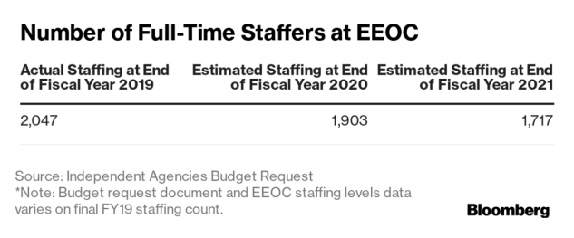
Articles / Research
Articles/studies with identical or very similar problem statement couldn’t be located
There’re a few articles showing that EEOC claims could be influenced by variety of factors, such as:
US economic conditions (Rusty Juban and Laura Gardner, 2020) (economy improves → number of discrimination cases filed decrease)
Movements and social contagions (“Me Too” movement → increase in sex related discriminations charges)
States specific laws (existence of state non-discrimination laws → more charges for sexual orientation and and gender identity discriminations, Amanda K. Baumle, M.V. Lee Badgett, and Steven Boutcherr, 2020)
Priorities set by president, congress and the courts (emphasis of presidents on hiring people with disabilities → spike in disabilities cases, Alan H. Kennedy, Sebawit G. Bishu, 2022)
Research of various publications also show that internal conditions in EEOC could have impact too:
Budget and staffing of EEOC fluctuates
EEOC responsibilities grow
All of this is important to consider for future models enhancement
Notes:
We have researched available literature and articles, using Georgia Tech Library and couldn’t locate studies or papers that would cover similar problem statement or research. However, we did find a few interesting articles which showed that EEOC claims could be influenced by many different factors. For example, article from 2020 states that US economic conditions do affect number of discrimination cases filed (if people don’t that the market has sufficient job opportunities, then they are less likely to file a case). Social movements, like “me too”, also could result into more cases being filed. According to another article, states specific laws also have influence over volume of charges being filed, especially ones for sexual orientation and gender identity. Priorities set by government have impact as well, for example emphasis on hiring people with disabilities by certain presidents led to spike in disabilities cases being files. Finally, EEOC condition itself could be another factor, budget and staffing of EEOC does fluctuate, sometimes unfavorably, and its responsibilities grow from year to year. All of these are important factors that could be used further for our models enhancements.

Slide 5
Description of datasets
U.S. Equal Opportunity Commission (EEOC)
Charge Receipts (yearly, 2009 - 2021)
Centers for Disease Control and Prevention (CDC) population estimates (yearly, 2010 - 2020)
For each state:
Number of total charges
Number of charges by type of discrimination (10 types listed - race, sex, national origin, religion etc.)
% of US and state charges
For each state:
Population in 10 Race and Sex categories (e.g. white male/female, black male/female etc.)
Population in Hispanic and Non-Hispanic categories
Bureau of Economic Analysis
(yearly, 2009 - 2021)
National Governors Association
(yearly, 2009 - 2021)
United States Census Bureau
(yearly, 2009 - 2021)
Per capita income for each state
Political party of incumbent governor for each state
Population numbers for each state

Slide 6
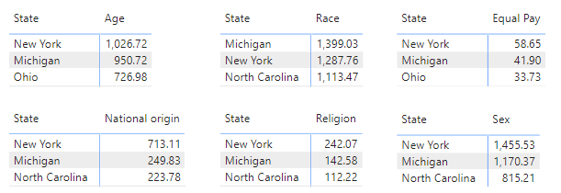
Approach / Methodology: Data Exploration
Top 3 states with the most discrimination complaints filed by category per 100k people (2009-2021)
New York, Michigan, Ohio, North Carolina most frequently appear in the “top” list
Notes:
Model 1: The first model we developed, regressed Total_Charges (total number of dicrimination charges filed with the EEOC for a given year) on State, Year, State_Population, Gov_Party (political party affiliation of the state governor for each year) and population estimates of White, Black, Native American, Asian and Hispanic male and female residents for a given year.
The summary of the model showed that the population estimates of White, Native American, Asian and Hispanic residents of a state are statistically significant in explaining the number of complaints filed with the EEOC. However, the state governor's party affiliation does not seem to add any value in terms of explaining the response.
Model 2: We kept the demographic factors in order to explain our response and explored other variables which may have an impact on the number of complaints filed. From the US Bureau of Economic Analysis, we pulled each state's per capita income for a given year and combined it with our dataset. This enabled us to introduce an additional explanatory State_Per_Capita_Income to our linear regression model.
The new factor (State_Per_Capita_Income) did not seem to add any significant explanatory value to our model. We intend to explore more socio-economic and political factors to further refine this model and work on how we can make it better by handling common problems (if present) in fitting linear regression models taught in Module 1 Lesson 8 & 9.

Slide 7
Approach / Methodology: Data Exploration
Notes:
Before building out any models we wanted to do some more exploratory data analysis. Here we're visualizing number of cases reported for each state normalized for 100,000 people. It's interesting to note that New York, Michigan are consistently the top reported states. While states like North Carolina and Ohio seem to change.

Slide 8
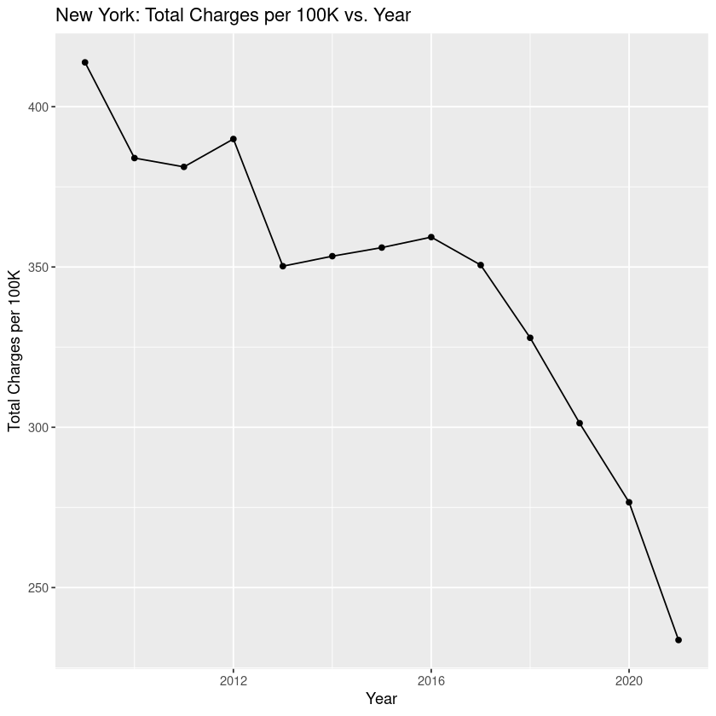
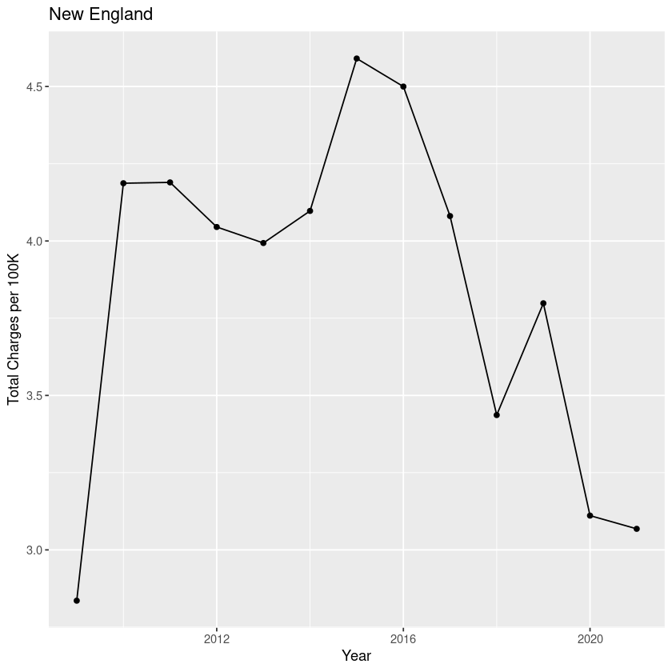
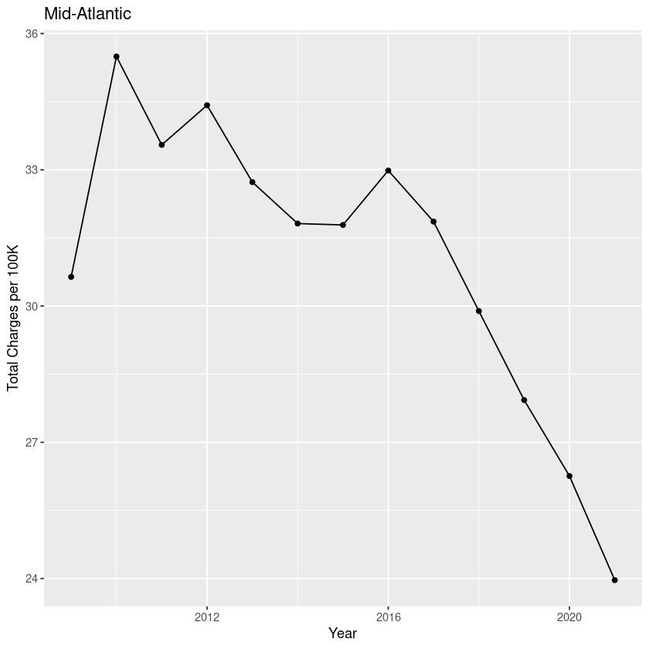
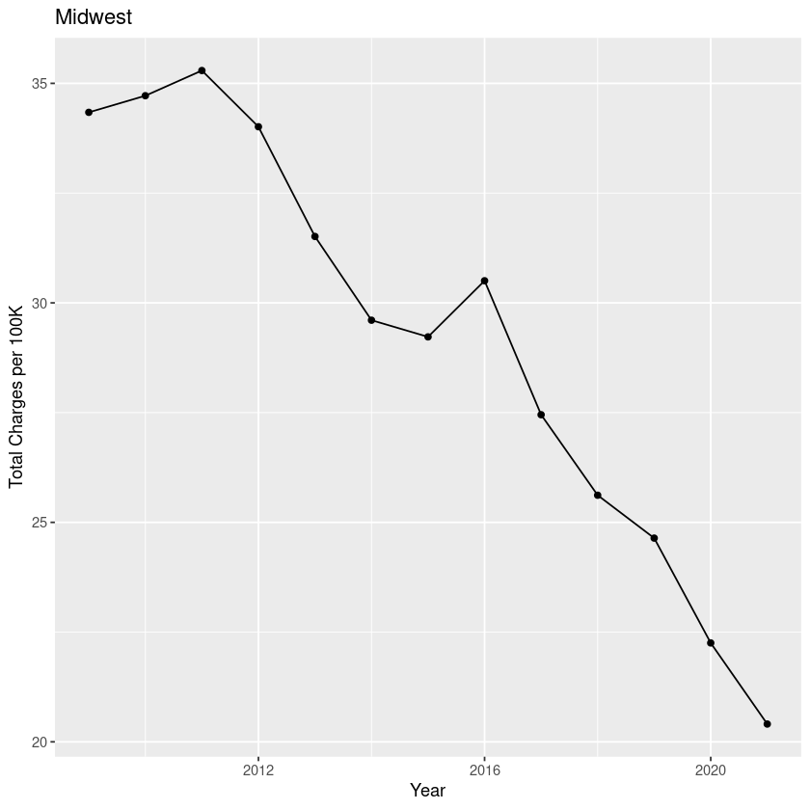
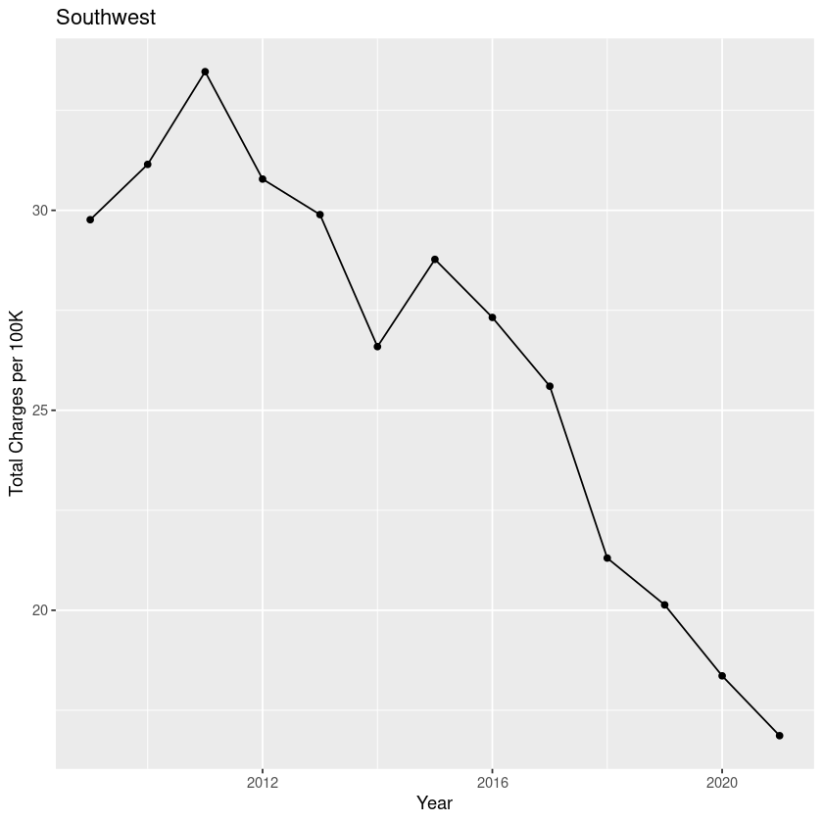
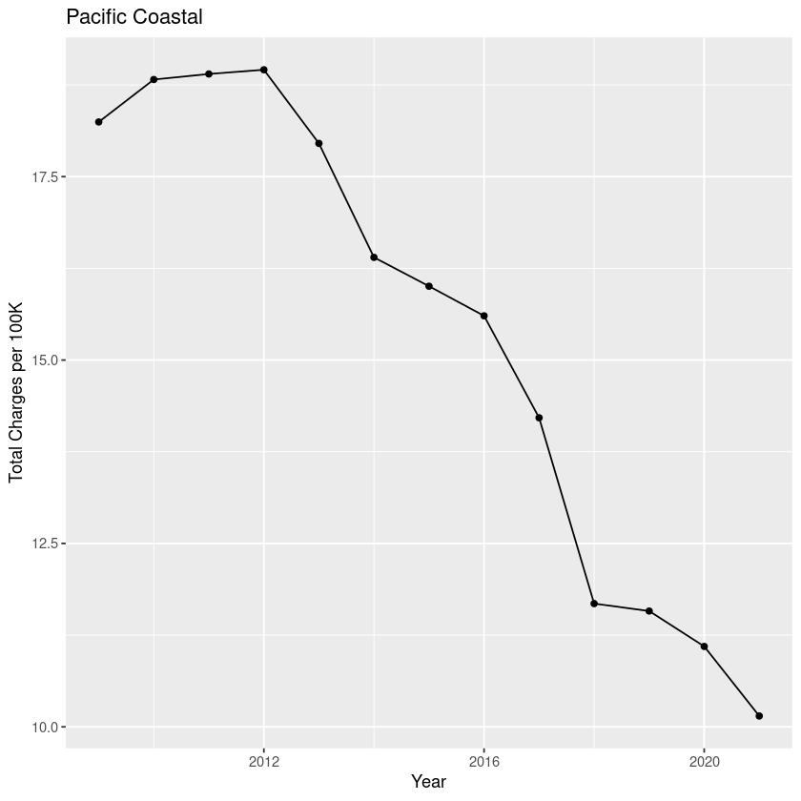
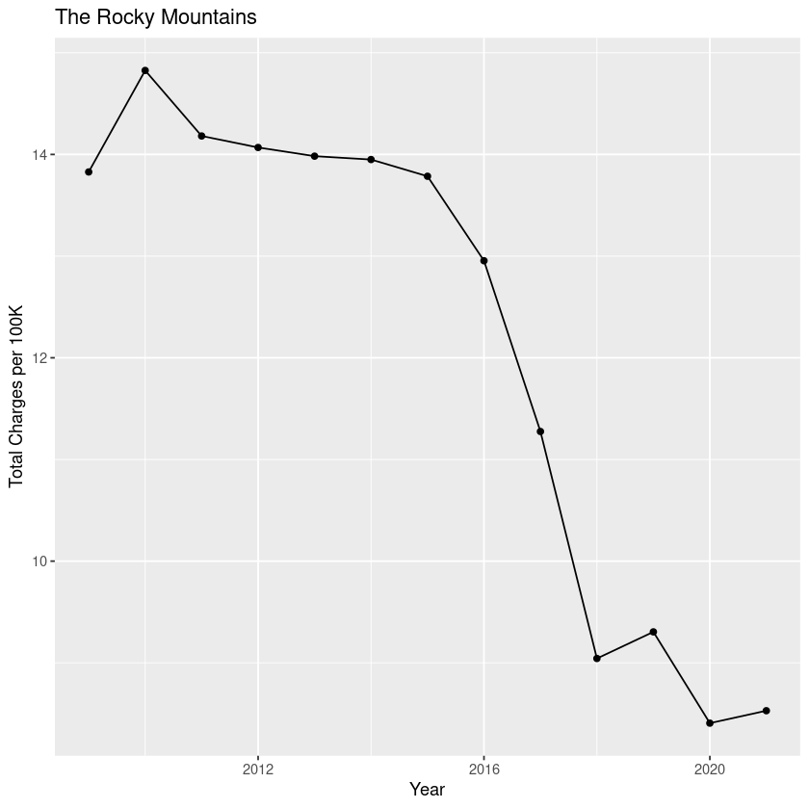
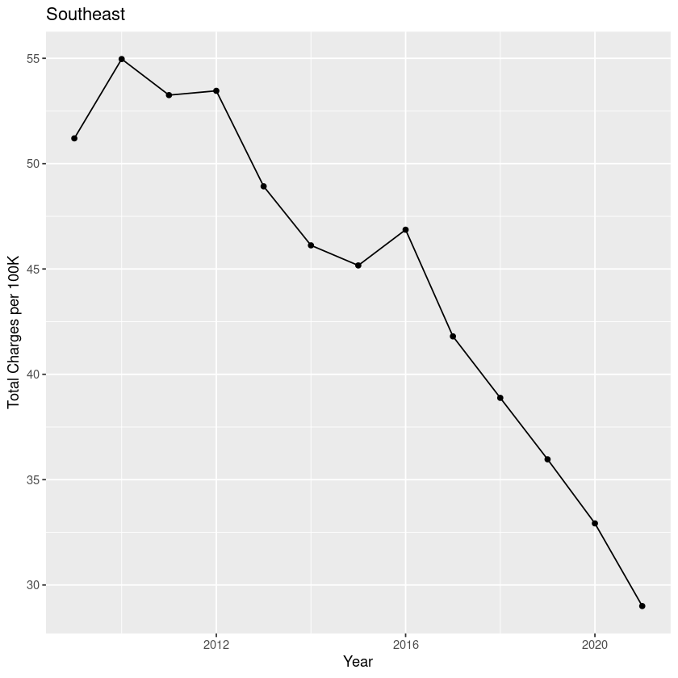
Approach / Methodology: Data Exploration
Notes:
We wanted to see why New York was considered an outlier and so we plotted total cases vs. year from the last decade. It turns out there's a sharp decline around 2016 for New York. We wanted to see if other states followed this strend. So grouping by region, we plotted the same charts. Here you can see, while the trend line differs from region to region, all regions seem to have a declining rate in reporting.

Slide 9
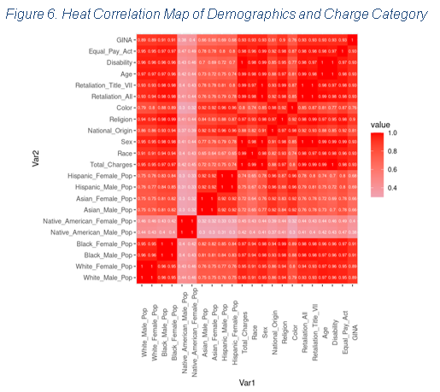
Approach / Methodology: Data Exploration
Correlation Heatmap
Leveraged to enhance our understanding of the broad landscape of factors impacting different discrimination reporting buckets
Notes:
After looking at time and geographical location, we would like to see if any demographic factors such as race or gender correlate to the number of cases reported. Some things about this correlation plot are expected: races seem to be correlated regardless of gender (where there is a high white female population, there is also a high white male population.) Similarly all types of reporting seem highly correlated (where there's high reporting of one type of discrimination, others are also likely to be reported).

Slide 10
Approach / Methodology: Data Modeling
model1 <- lm(Total_Charges ~ Year + State + Gov_Party + State_Population + White_Male_Pop + White_Female_Pop + Black_Male_Pop + Black_Female_Pop + Native_American_Male_Pop + Native_American_Female_Pop + Asian_Male_Pop + Asian_Female_Pop + Hispanic_Male_Pop + Hispanic_Female_Pop, data)
model2 <- lm(Total_Charges ~ Year + State + State_Population + State_Per_Capita_Income + White_Male_Pop + White_Female_Pop + Black_Male_Pop + Black_Female_Pop + Native_American_Male_Pop + Native_American_Female_Pop + Asian_Male_Pop + Asian_Female_Pop + Hispanic_Male_Pop + Hispanic_Female_Pop, data)
model3 <- lm(Total_Charges ~ Year + State + State_Population + White_Male_Pop + White_Female_Pop + Black_Male_Pop + Black_Female_Pop + Native_American_Male_Pop + Native_American_Female_Pop + Asian_Male_Pop + Asian_Female_Pop + Hispanic_Male_Pop + Hispanic_Female_Pop, data)
Notes:
Our preliminary research indicated that socio-economic, demographic and political factors impact the number of complaints filed in each state. In order to better understand this relationship, we built 3 linear regression models.
In model1, we used Population Estimates from the NCHS and state governor’s party affiliation for a given year to get a high-level view of any possible dependencies of the number of complaints filed with the EEOC on state demographics, leading party affiliations and state population makeup.
This model indicated that state demographics are statistically significant while state governor’s party affiliations did not have any significance in explaining the response.
Since our research indicated that economic conditions may play an important role in explaining the number of complaints filed, in model2 we added the State_Per_Capita_Income explanatory variable but the regression result showed no statistical significance of this variable.
So in model3, we kept only the statistically significant features and compared its performance to that of the other models.

Slide 11
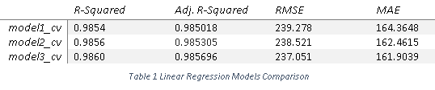
Approach / Methodology: Model Selection and Goodness of Fit
model3 gives the highest R-Squared and Adjusted R-Squared and the lowest Root Mean Square Error and Mean Absolute Error after cross-validation.
Notes:
To evaluate the performance of these models on our dataset, we measured how well the predictions made by each model matched the observed data. For this purpose, we used 10-fold cross-validation and compared their RMSE, R-Squared, Adjusted R-Squared and MAE.
The highest R-Squared and Adjusted R-Squared and the lowest RMSE and MAE justified the use of model3 in our analysis.

Slide 12
Interpretation of Results
Exploratory Data Analysis
Linear Regression
Difference in Difference
Gave us insight into various high-level trends and considerations in our conclusions including:
Overall Reporting Landscape
State Reporting Trends
Regional Reporting Trends
Yearly Reporting Trends
Leveraged to test hypotheses concerning:
Regional Reporting Impact [rejected]
State Reporting Impact [confirmed]
Government/Political climates Impact [rejected]
Demographic Population [partially confirmed]
Provided insight into:
Case study of Missouri law on reporting climate
Provided methodology for:
Testing additional laws impacts
We deprioritized logistic regression as we did not have case-level data

Slide 13
Recommendations
States to Consider
Law to Practice
Awareness of Laws
We recommend that the firm considers¹:
New York
Michigan
North Carolina
Ohio
For secondary openings, we recommend the firm considers²:
Minnesota
Mississippi
We believe that the law firm should focus primarily on retaliation and age related discrimination.³
We believe that the firm needs to be constantly aware of new legislation⁴ being passed in the state.
Legislature could inform decisions to:
Open a new office
Keep a particular office open
Close down an existing office
Use our model to test other states laws for impact.
1: These states correspond with the highest coefficients in our linear regression modeling
2: These states correspond to our lowest coefficients in our linear regression modeling
3: These are the highest per capita reports in the recommended states
4: These are based on the conclusion within the difference in difference analysis

