Slide 1
The Pochoir Stencil Compiler Overview
Charles Leiserson, Yuan Tang, Rezaul Chowdhury, Bradley Kuszmaul, CK Luk, Steven Johnson, Ekanathan Natarajan
Mar. 13, 2012

Slide 2
What’s a stencil?
A stencil updates every point in a d-dimensional spatial grid at time t as a function of nearby grid points at times t–1, t–2, …, t–k, for T time steps.
2D Heat equation
a(t,x,y) = a(t–1,x,y)
+ CX·(a(t–1,x+1,y) - 2·a(t–1,x,y) + a(t–1,x–1,y))
+ CY·(a(t–1,x,y+1) - 2·a(t–1,x,y) + a(t–1,x,y–1))
2D 5-point stencil
time
Notes:
Stencils are critical to many applications (e.g. diffusion, electromagnetics, image processing) AMR = Adaptive Mesh Refinement

Slide 3
Story
Stencils are prevailing
iterative PDE solvers such as Jacobi, multigrid, and AMR,
image processing,
geometric modeling.
Highly cache-efficient stencil algorithm is known yet hard to write from case to case.
Conventional numerical library focus on optimizing individual computation operator
How to automate the optimization of a family of computation (such as stencil) in one framework is an open question.
Library?
DSL?
EDSL?
Compiler’s pragma?
Autotuner?

Slide 4
Roadmap
Release 0.5 (Feb. 2011)
Release 1.0 (Mar. 2012)
Release 2.0 (TBD)

Slide 5
Release 0.5
Released in Feb. 2011
Published in SPAA’11 & HotPar’11
Simple, concise, declarative, and easily verifiable DSL embedded in C++, with Intel Cilk Plus extension.
Arbitrary shaped, arbitrary depth stencil on arbitrary d-dimensional space-time grid, with complex boundary condition.

Slide 6
Current List of Known Users
Oscar Barenys, Univ. Politechnica of Catalonia, Spain.
Volker Strumpen, Johannes Kepler University, Austria.
Nicolas Pinto, MIT/Harvard
Nicolas Vasilache, Reservoir Lab.
Patrick S. McCormick, Los Alamos National Lab.
Mohammed Shaheen, Max Planck Institut Informatik, Germany
Wim Vanroose, Universiteit Antwerpen, Belgium.
Tom Henretty, Ohio State Univ.
Protonu Basu, Univ. of Utah.
Shoaib Kamil, Berkeley.
Hal Finkel, Argonne National Lab.
Matthias Christen, Klingelbergstrass, Basel, Switzerland.
Vinayaka Bandishti, Indian Institute of Science, Bangalore, India.
Hans Vandierendonck, Ghent University, Belguim.

Slide 7
Benchmark Suite
Physics
Heat equation
Wave equation
Maxwell’s equation
Lattice Boltzmann Method
Computational Biology
RNA secondary structure prediction
Pairwise sequence alignment
Computational Finance
American Put Stock Option Pricing
Mechanical Engineering
Compressible Euler Flow
Others
Conway’s Game of Life
…

Slide 8
Release 0.5
Algorithm:
Performance Results:
Specification:
Boundary Conditions:
Compilation strategy:
Optimization strategies:

Slide 9
Release 0.5
Algorithm:
Performance Results:
Specification:
Boundary Conditions:
Compilation strategy:
Optimization strategies:

Slide 10
Algorithm
Parallel cache-oblivious stencil algorithm
Based on Frigo and Strumpen’s notion of trapezoidal decomposition
Improved parallelism by hyperspace cut strategy
Compared with looping implementation, reduce cache miss rate from Θ(NT/B) to Θ(NT/MB)
C++ template meta-programming library to automatically expand for different stencils
Different kernels, boundaries, dimensionality, data types, etc.
Notes:
B: cache block size, M: cache size

Slide 11
Release 0.5
Algorithm:
Performance Results:
Specification:
Boundary Conditions:
Compilation strategy:
Optimization strategies:

Slide 12
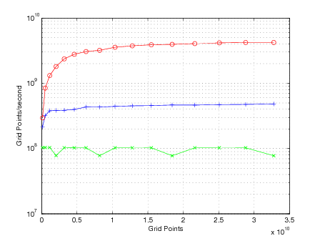
2D Heat Equation
5-point stencil on a torus
Pochoir
Parallel Loop
Serial Loop
Intel C++ compiler 12.0.0 with Cilk Plus on 12 core Intel core i7 (Nehalem)

Slide 13
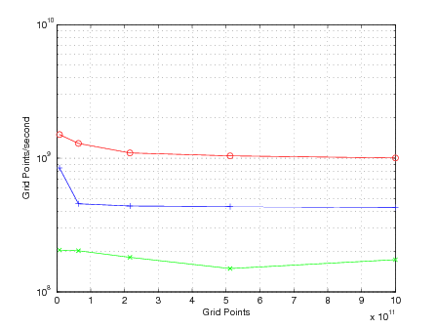
3D Wave Equation
25-point stencil on a nonperiodic domain
Pochoir
Parallel Loop
Serial Loop
Intel C++ compiler 12.0.0 with Cilk Plus on 12 core Intel core i7 (Nehalem)

Slide 14
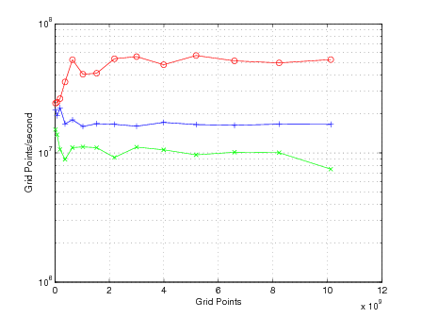
3D Lattice Boltzmann Method
19-point stencil on a nonperiodic domain
Pochoir
Parallel Loop
Serial Loop
Intel C++ compiler 12.0.0 with Cilk Plus on 12 core Intel core i7 (Nehalem)

Slide 15
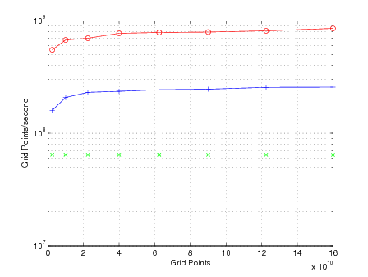
1D Pairwise Sequence Alignment
Pochoir
Parallel Loop
Serial Loop
Intel C++ compiler 12.0.0 with Cilk Plus on 12 core Intel core i7 (Nehalem)

Slide 16
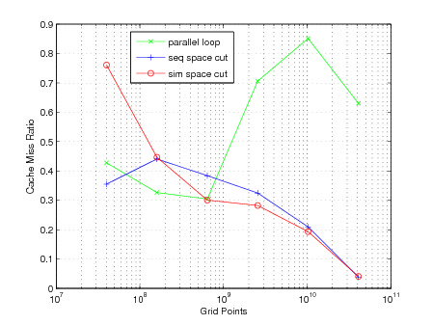
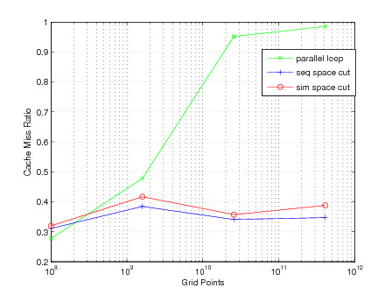
Cache miss ratio of Pochoir vs Parallel loops
Cache Miss Ratio of heat_2D_NP
Cache Miss Ratio of 3dfd

Slide 17
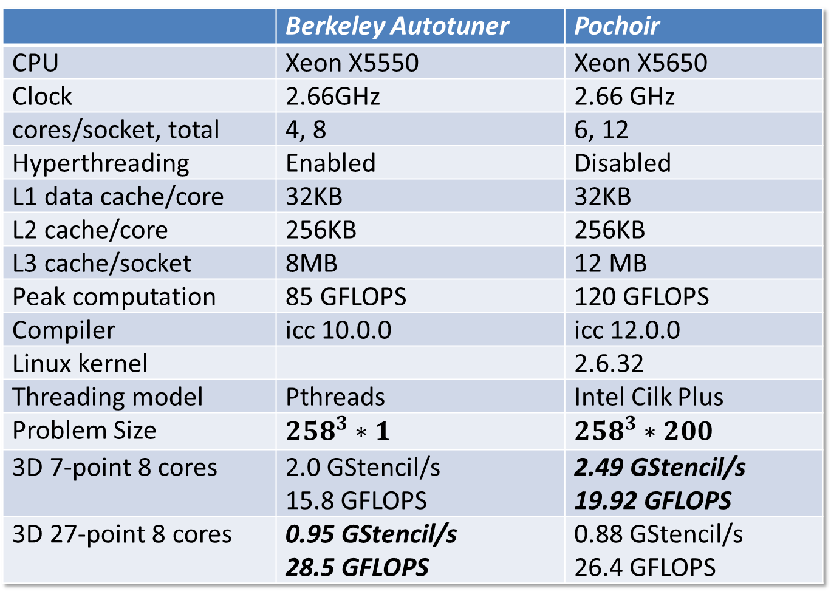
Pochoir vs Autotuner
 | Berkeley Autotuner | Pochoir
CPU | Xeon X5550 | Xeon X5650
Clock | 2.66GHz | 2.66 GHz
cores/socket, total | 4, 8 | 6, 12
Hyperthreading | Enabled | Disabled
L1 data cache/core | 32KB | 32KB
L2 cache/core | 256KB | 256KB
L3 cache/socket | 8MB | 12 MB
Peak computation | 85 GFLOPS | 120 GFLOPS
Compiler | icc 10.0.0 | icc 12.0.0
Linux kernel |  | 2.6.32
Threading model | Pthreads | Intel Cilk Plus
Problem Size | $${258}^{3}∗1$$ | $${258}^{3}∗200$$
3D 7-point 8 cores | 2.0 GStencil/s 15.8 GFLOPS | 2.49 GStencil/s 19.92 GFLOPS
3D 27-point 8 cores | 0.95 GStencil/s 28.5 GFLOPS | 0.88 GStencil/s 26.4 GFLOPS

Slide 18
Release 0.5
Algorithm:
Performance Results:
Specification:
Boundary Conditions:
Compilation strategy:
Optimization strategies:

Slide 19
Specification of 2D Heat Equation
1 Pochoir_Boundary_2D(zero_bdry, arr, t, x, y)
2 return 0;
3 Pochoir_Boundary_End
4 int main(void) {
5 Pochoir_Shape_2D 2D_five_pt[6]
= {{0,0,0}, {-1,0,0}, {-1,1,0}, {-1,-1,0}, {-1,0,-1}, {-1,0,1}};
6 Pochoir_2D heat(2D_five_pt);
7 Pochoir_Array_2D(double) a(X,Y);
8 a.Register_Boundary(zero_bdry);
9 heat.Register_Array(a);
10 Pochoir_Kernel_2D(kern, t, x, y)
11 a(t,x,y) = a(t-1,x,y)
+ 0.125*(a(t-1,x+1,y) - 2.0*a(t-1,x,y) + a(t-1,x-1,y))
+ 0.125*(a(t-1,x,y+1) - 2.0*a(t-1,x,y) + a(t-1,x,y-1));
12 Pochoir_Kernel_End
13 for (int x = 0; x < X; ++x)
for (int y = 0; y < Y; ++y)
a(0,x,y) = rand();
14 heat.Run(T, kern);
15 for (int x = 0; x < X; ++x)
16 for (int y = 0; y < Y; ++y)
17 cout << a(T,x,y);
18 return 0;
19 }
time

Slide 20
Specification of 2D Heat Equation
1 Pochoir_Boundary_2D(zero_bdry, arr, t, x, y)
2 return 0;
3 Pochoir_Boundary_End
4 int main(void) {
5 Pochoir_Shape_2D 2D_five_pt[6]
= {{0,0,0}, {-1,0,0}, {-1,1,0}, {-1,-1,0}, {-1,0,-1}, {-1,0,1}};
6 Pochoir_2D heat(2D_five_pt);
7 Pochoir_Array_2D(double) a(X,Y);
8 a.Register_Boundary(zero_bdry);
9 heat.Register_Array(a);
10 Pochoir_Kernel_2D(kern, t, x, y)
11 a(t,x,y) = a(t-1,x,y)
+ 0.125*(a(t-1,x+1,y) - 2.0*a(t-1,x,y) + a(t-1,x-1,y))
+ 0.125*(a(t-1,x,y+1) - 2.0*a(t-1,x,y) + a(t-1,x,y-1));
12 Pochoir_Kernel_End
13 for (int x = 0; x < X; ++x)
for (int y = 0; y < Y; ++y)
a(0,x,y) = rand();
14 heat.Run(T, kern);
15 for (int x = 0; x < X; ++x)
16 for (int y = 0; y < Y; ++y)
17 cout << a(T,x,y);
18 return 0;
19 }
time
Declare a kernel function kern with time parameter t and spatial parameters x and y.

Slide 21
Specification of 2D Heat Equation
1 Pochoir_Boundary_2D(zero_bdry, arr, t, x, y)
2 return 0;
3 Pochoir_Boundary_End
4 int main(void) {
5 Pochoir_Shape_2D 2D_five_pt[6]
= {{0,0,0}, {-1,0,0}, {-1,1,0}, {-1,-1,0}, {-1,0,-1}, {-1,0,1}};
6 Pochoir_2D heat(2D_five_pt);
7 Pochoir_Array_2D(double) a(X,Y);
8 a.Register_Boundary(zero_bdry);
9 heat.Register_Array(a);
10 Pochoir_Kernel_2D(kern, t, x, y)
11 a(t,x,y) = a(t-1,x,y)
+ 0.125*(a(t-1,x+1,y) - 2.0*a(t-1,x,y) + a(t-1,x-1,y))
+ 0.125*(a(t-1,x,y+1) - 2.0*a(t-1,x,y) + a(t-1,x,y-1));
12 Pochoir_Kernel_End
13 for (int x = 0; x < X; ++x)
for (int y = 0; y < Y; ++y)
a(0,x,y) = rand();
14 heat.Run(T, kern);
15 for (int x = 0; x < X; ++x)
16 for (int y = 0; y < Y; ++y)
17 cout << a(T,x,y);
18 return 0;
19 }
time
Declare the 2-dimensional Pochoir shape 2D_five_pt as a list of 6 cells. Each cell specifies the relative offset of indices used in the kernel function, e.g., for a(t,x,y), we specify the corresponding cell {0,0,0}, for a(t–1,x+1,y), we specify {–1,1,0}, and so on.

Slide 22
Specification of 2D Heat Equation
1 Pochoir_Boundary_2D(zero_bdry, arr, t, x, y)
2 return 0;
3 Pochoir_Boundary_End
4 int main(void) {
5 Pochoir_Shape_2D 2D_five_pt[6]
= {{0,0,0}, {-1,0,0}, {-1,1,0}, {-1,-1,0}, {-1,0,-1}, {-1,0,1}};
6 Pochoir_2D heat(2D_five_pt);
7 Pochoir_Array_2D(double) a(X,Y);
8 a.Register_Boundary(zero_bdry);
9 heat.Register_Array(a);
10 Pochoir_Kernel_2D(kern, t, x, y)
11 a(t,x,y) = a(t-1,x,y)
+ 0.125*(a(t-1,x+1,y) - 2.0*a(t-1,x,y) + a(t-1,x-1,y))
+ 0.125*(a(t-1,x,y+1) - 2.0*a(t-1,x,y) + a(t-1,x,y-1));
12 Pochoir_Kernel_End
13 for (int x = 0; x < X; ++x)
for (int y = 0; y < Y; ++y)
a(0,x,y) = rand();
14 heat.Run(T, kern);
15 for (int x = 0; x < X; ++x)
16 for (int y = 0; y < Y; ++y)
17 cout << a(T,x,y);
18 return 0;
19 }
time
Declare the 2-dimensional Pochoir shape 2D_five_pt as a list of 6 cells. Each cell specifies the relative offset of indices used in the kernel function, e.g., for a(t,x,y), we specify the corresponding cell {0,0,0}, for a(t–1,x+1,y), we specify {–1,1,0}, and so on.

Slide 23
Specification of 2D Heat Equation
1 Pochoir_Boundary_2D(zero_bdry, arr, t, x, y)
2 return 0;
3 Pochoir_Boundary_End
4 int main(void) {
5 Pochoir_Shape_2D 2D_five_pt[6]
= {{0,0,0}, {-1,0,0}, {-1,1,0}, {-1,-1,0}, {-1,0,-1}, {-1,0,1}};
6 Pochoir_2D heat(2D_five_pt);
7 Pochoir_Array_2D(double) a(X,Y);
8 a.Register_Boundary(zero_bdry);
9 heat.Register_Array(a);
10 Pochoir_Kernel_2D(kern, t, x, y)
11 a(t,x,y) = a(t-1,x,y)
+ 0.125*(a(t-1,x+1,y) - 2.0*a(t-1,x,y) + a(t-1,x-1,y))
+ 0.125*(a(t-1,x,y+1) - 2.0*a(t-1,x,y) + a(t-1,x,y-1));
12 Pochoir_Kernel_End
13 for (int x = 0; x < X; ++x)
for (int y = 0; y < Y; ++y)
a(0,x,y) = rand();
14 heat.Run(T, kern);
15 for (int x = 0; x < X; ++x)
16 for (int y = 0; y < Y; ++y)
17 cout << a(T,x,y);
18 return 0;
19 }
time
Declare the 2-dimensional Pochoir shape 2D_five_pt as a list of 6 cells. Each cell specifies the relative offset of indices used in the kernel function, e.g., for a(t,x,y), we specify the corresponding cell {0,0,0}, for a(t–1,x+1,y), we specify {–1,1,0}, and so on.

Slide 24
Specification of 2D Heat Equation
1 Pochoir_Boundary_2D(zero_bdry, arr, t, x, y)
2 return 0;
3 Pochoir_Boundary_End
4 int main(void) {
5 Pochoir_Shape_2D 2D_five_pt[6]
= {{0,0,0}, {-1,0,0}, {-1,1,0}, {-1,-1,0}, {-1,0,-1}, {-1,0,1}};
6 Pochoir_2D heat(2D_five_pt);
7 Pochoir_Array_2D(double) a(X,Y);
8 a.Register_Boundary(zero_bdry);
9 heat.Register_Array(a);
10 Pochoir_Kernel_2D(kern, t, x, y)
11 a(t,x,y) = a(t-1,x,y)
+ 0.125*(a(t-1,x+1,y) - 2.0*a(t-1,x,y) + a(t-1,x-1,y))
+ 0.125*(a(t-1,x,y+1) - 2.0*a(t-1,x,y) + a(t-1,x,y-1));
12 Pochoir_Kernel_End
13 for (int x = 0; x < X; ++x)
for (int y = 0; y < Y; ++y)
a(0,x,y) = rand();
14 heat.Run(T, kern);
15 for (int x = 0; x < X; ++x)
16 for (int y = 0; y < Y; ++y)
17 cout << a(T,x,y);
18 return 0;
19 }
time
Declare the 2-dimensional Pochoir shape 2D_five_pt as a list of 6 cells. Each cell specifies the relative offset of indices used in the kernel function, e.g., for a(t,x,y), we specify the corresponding cell {0,0,0}, for a(t–1,x+1,y), we specify {–1,1,0}, and so on.

Slide 25
Specification of 2D Heat Equation
1 Pochoir_Boundary_2D(zero_bdry, arr, t, x, y)
2 return 0;
3 Pochoir_Boundary_End
4 int main(void) {
5 Pochoir_Shape_2D 2D_five_pt[6]
= {{0,0,0}, {-1,0,0}, {-1,1,0}, {-1,-1,0}, {-1,0,-1}, {-1,0,1}};
6 Pochoir_2D heat(2D_five_pt);
7 Pochoir_Array_2D(double) a(X,Y);
8 a.Register_Boundary(zero_bdry);
9 heat.Register_Array(a);
10 Pochoir_Kernel_2D(kern, t, x, y)
11 a(t,x,y) = a(t-1,x,y)
+ 0.125*(a(t-1,x+1,y) - 2.0*a(t-1,x,y) + a(t-1,x-1,y))
+ 0.125*(a(t-1,x,y+1) - 2.0*a(t-1,x,y) + a(t-1,x,y-1));
12 Pochoir_Kernel_End
13 for (int x = 0; x < X; ++x)
for (int y = 0; y < Y; ++y)
a(0,x,y) = rand();
14 heat.Run(T, kern);
15 for (int x = 0; x < X; ++x)
16 for (int y = 0; y < Y; ++y)
17 cout << a(T,x,y);
18 return 0;
19 }
time
Declare a boundary function zero_bdry on the 2-dimensional Pochoir array arr indexed by time coordinate t and spatial coordinates x and y, which always returns 0.

Slide 26
Specification of 2D Heat Equation
1 Pochoir_Boundary_2D(zero_bdry, arr, t, x, y)
2 return 0;
3 Pochoir_Boundary_End
4 int main(void) {
5 Pochoir_Shape_2D 2D_five_pt[6]
= {{0,0,0}, {-1,1,0}, {-1,0,0}, {-1,-1,0}, {-1,0,-1}, {-1,0,1}};
6 Pochoir_2D heat(2D_five_pt);
7 Pochoir_Array_2D(double) a(X,Y);
8 a.Register_Boundary(zero_bdry);
9 heat.Register_Array(a);
10 Pochoir_Kernel_2D(kern, t, x, y)
11 a(t,x,y) = a(t-1,x,y)
+ 0.125*(a(t-1,x+1,y) - 2.0*a(t-1,x,y) + a(t-1,x-1,y))
+ 0.125*(a(t-1,x,y+1) - 2.0*a(t-1,x,y) + a(t-1,x,y-1));
12 Pochoir_Kernel_End
13 for (int x = 0; x < X; ++x)
for (int y = 0; y < Y; ++y)
a(0,x,y) = rand();
14 heat.Run(T, kern);
15 for (int x = 0; x < X; ++x)
16 for (int y = 0; y < Y; ++y)
17 cout << a(T,x,y);
18 return 0;
19 }
time
Initialize all points of the grid at time 0 to a random value.

Slide 27
Specification of 2D Heat Equation
1 Pochoir_Boundary_2D(zero_bdry, arr, t, x, y)
2 return 0;
3 Pochoir_Boundary_End
4 int main(void) {
5 Pochoir_Shape_2D 2D_five_pt[6]
= {{0,0,0}, {-1,1,0}, {-1,0,0}, {-1,-1,0}, {-1,0,-1}, {-1,0,1}};
6 Pochoir_2D heat(2D_five_pt);
7 Pochoir_Array_2D(double) a(X,Y);
8 a.Register_Boundary(zero_bdry);
9 heat.Register_Array(a);
10 Pochoir_Kernel_2D(kern, t, x, y)
11 a(t,x,y) = a(t-1,x,y)
+ 0.125*(a(t-1,x+1,y) - 2.0*a(t-1,x,y) + a(t-1,x-1,y))
+ 0.125*(a(t-1,x,y+1) - 2.0*a(t-1,x,y) + a(t-1,x,y-1));
12 Pochoir_Kernel_End
13 for (int x = 0; x < X; ++x)
for (int y = 0; y < Y; ++y)
a(0,x,y) = rand();
14 heat.Run(T, kern);
15 for (int x = 0; x < X; ++x)
16 for (int y = 0; y < Y; ++y)
17 cout << a(T,x,y);
18 return 0;
19 }
time
Run a stencil computation on the Pochoir object heat for T time steps using kernel function kern. The Run method can be called multiple times.

Slide 28
Release 0.5
Algorithm:
Performance Results:
Specification:
Boundary Conditions:
Compilation strategy:
Optimization strategies:

Slide 29

Various Boundary Conditions
Nonperiodic zero boundary
Pochoir_Boundary_2D(zero_bdry, arr, t, x, y)
return 0;
Pochoir_Boundary_End
Periodic (toroidal) boundary
#define mod(r,m) (((r) % (m)) + ((r)<0)?(m):0)
Pochoir_Boundary_2D(periodic, arr, t, x, y)
return arr.get( t,
mod(x, arr.size(1)),
mod(y, arr.size(0)) ); Pochoir_Boundary_End
Cylindrical boundary
#define mod(r,m) (((r) % (m)) + ((r)<0)?(m):0)
Pochoir_Boundary_2D(cylinder, arr, t, x, y)
if (x < 0) || (x >= arr.size(1))
return 0;
return arr.get( t, x, mod(y, arr.size(0)) );
Pochoir_Boundary_End

Slide 30
Various Boundary Conditions
Dirichlet boundary
Pochoir_Boundary_2D(dirichlet, arr, t, x, y)
return 100+0.2*t;
Pochoir_Boundary_End
Neumann boundary
Pochoir_Boundary_2D(neumann, arr, t, x, y)
int xx(x), yy(y);
if (x<0) xx = 0;
if (x>=arr.size(1)) xx = arr.size(1);
if (y<0) yy = 0;
if (y>=arr.size(0)) yy = arr.size(0);
return arr.get(t, xx, yy);
Pochoir_Boundary_End
Notes:
Dirichlet: Changes with time.
Neumann: Constrains derivative (in this case 0).

Slide 31
Release 0.5
Algorithm:
Performance Results:
Specification:
Boundary Conditions:
Compilation strategy:
Optimization strategies:

Slide 32
Two-Phase Compilation Strategy
Phase 1 goal: Check functional correctness
Pochoir
Spec.
Intel C++ Compiler
Serial Loops
Pochoir Template Library
Pochoir
Spec.
Pochoir
Compiler
Postsource
Cilk Code
Intel C++ Compiler
Optimized Parallel Code
Phase 2 goal: Maximize performance
Pochoir Template Library
Notes:
C++ is notoriously hard to parse.
No good open-source C++ frontend is available.
The problems of LLVM:
Not all C++ features are supported. E.g. variadic template was not supported when we started the project. So compilation of some standard C++ code by LLVM may fail.
LLVM is not good for source-to-source transformation.

Slide 33
Pochoir Guarantee
If a stencil program compiles and runs with the Pochoir template library during Phase 1,
Pochoir
Spec.
Intel C++ Compiler
Serial Loops
Pochoir Template Library
Pochoir
Spec.
Pochoir
Compiler
Postsource
Cilk Code
then no errors will occur during Phase 2 when it is compiled with the Pochoir compiler or during the subsequent running of the optimized binary.
Intel C++ Compiler
Optimized Parallel Code
Pochoir Template Library

Slide 34
Release 0.5
Algorithm:
Performance Results:
Specification:
Boundary Conditions:
Compilation strategy:
Optimization strategies:

Slide 35
Optimization Strategies
Two code clones
Unifying the handling of periodic and nonperiodic boundary conditions
Automatic selection of traversal strategy
-split-macro-shadow
-split-opt-pointer
Coarsening of base cases
Adaptive trapezoidal decomposition

Slide 36
Release 1.0
Mar. 2012
Bug Fix
User’s feedback
Variadic Template Support
Even Simpler user interface

Slide 37
Release 2.0
TBD
Inhomogeneity
Macroscopic Inhomogeneity
Microscopic Inhomogeneity
JIT compilation
Generate the computational kernels on-the-fly
Generalized Dependency
From orthogonal grid to general graph

Slide 38
Contributions
Simple, concise, declarative, and easily verifiable DSL embedded in C++, with Intel Cilk Plus extension.
Arbitrary shaped, arbitrary depth stencil on arbitrary d-dimensional space-time grid, with complex boundary condition.
Inhomogeneous regions
Macroscopic inhomogeneity
Microscopic inhomogeneity
JIT compiler for stencil
Generalized dependency
From orthogonal grid to general graph
Funded in medium scale by NSF

Slide 39
Pochoir Team
Charles E. Leiserson, Project Leader
Yuan Tang
Rezaul Alam Chowdhury
Bradley C. Kuszmaul
Chi-Keung Luk
Steven G. Johnson
Ekanathan Palamadai Natarajan

