Slide 1
The Pochoir Stencil Compiler
Yuan Tang, Rezaul Alam Chowdhury, Chi-Keung Luk, Bradley C. Kuszmaul, Charles E. Leiserson

Slide 2
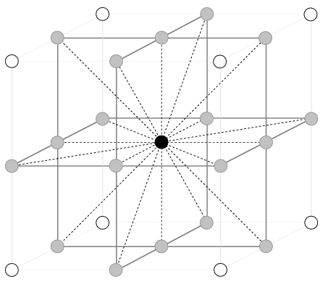
Background
For a given point, a stencil is a fixed subset of nearby neighbors.
A stencil code updates every point in an n-dimensional spatial grid at time t as a function of nearby grid points at times t–1, t-2, …, t–k.
Stencils are used in iterative PDE solvers such as Jacobi, Multi-grid, and AMR, as well as for image processing and geometric modeling.
t
x
Notes:
Stencils are critical to many applications (e.g. diffusion, electromagnetics, image processing)

Slide 3
Looping Implementation
A nested loop implementation is straightforward:
for (t = 1; t≤T, ++t) {
for (i0 = 0, i0<n0, ++i0) {
for (i1 = 0, i1<n1, ++i1) {
for (i2 = 0, i2<n2, ++i2) {
⟨⟨ update A[t%k,i0,i1,i2] according to stencil ⟩⟩
} } } }
Conventional Optimization: Loop Tiling

Slide 4
Issues in looping Implementation
N
t
B
x
Z
Issue: Looping is memory intensive, especially for parallel implementations, and it uses caches poorly. Assuming N is the data set size, Cache line size B, then cache miss will be

Slide 5
Cache-Oblivious Algorithms
t
t
x
x
Divide-and-conquer cache-oblivious techniques, based on trapazoidal decompositions, are known to be effective.
Problem: These codes are difficult to write.

Slide 6
Pochoir Stencil Compiler
Pochoir Specification: domain specific functional specification embedded in an imperative language
Directly executable and debuggable via any native C++ tool chain
No manual annotation or special compiler pragma needed
Pochoir Template library: C++ template library
Collection of different stencil computing algorithm (common across different stencils)
C++ template meta-programming for dimensionality, user’s data structure, # toggle array
Pochoir Compiler: Domain specific compiler in Haskell
Application specific optimization (base case and boundary conditions)

Slide 7
Contributions
Provides a functional specification embedded in an imperative language
Novel Two-Phase compilation strategy
First run: functional correctness, debugging aid
Second run: performance
Pochoir Guarantee
A novel way of programming complex numeric library
Input kernel and boundary function instead of value parameters (kernel is no longer hard-coded in library)
Requires coordination of both compiler and template library to achieve optimal performance

Slide 8
Contributions
Parallel cache-oblivious stencil computing algorithm for arbitrary d-dimensional grids.
Simultaneous Space Cut algorithm
Base case optimizations
Two code clones, coarsening of base case,
-split-macro-shadow, -split-pointer, -split-opt-pointer, etc.
Parallelized via Intel Cilk Plus

Slide 9
Functional Specification
Embedded in C++.
Directly executable and debuggable via any native C++ tool chain.
Supports arbitrary d-dimensional rectangular grids.
The stencil shape can be arbitrary.
A point at time t can depend on points at time t–1, t–2, …, t–k.
Both periodic and nonperiodic boundary conditions are supported.

Slide 10
2D Heat Equation in Ideal Specification
Pochoir<2> heat;
Pochoir_Shape<2> shape[6] = {{0, 0, 0}, {-1, 1, 0}, {-1, 0, 0}, {-1, -1, 0}, {-1, 0, -1}, {-1, 0, 1}};
Pochoir_Array<double, 2> a(N, M);
Pochoir_Boundary_2D(bdry, arr, t, i, j)
return 0;
Pochoir_Boundary_end
Pochoir_kernel_2D(kern, t, i, j)
a(t, i, j) = 0.125 * (a(t-1, i+1, j) - 2.0 * a(t-1, i, j) + a(t-1, i-1, j)) + 0.125 * (a(t-1, i, j+1) - 2.0 * a(t-1, i, j) + a(t-1, i, j-1)) + a(t-1, i, j);
Pochoir_kernel_end
for (int i = 0; i < N; ++i) {
for (int j = 0; j < N; ++j) {
a(0, i, j) = rand();
}}
heat.registerBoundaryFn(a, bdry);
heat.registerShape(shape);
heat.run(T, kern);
Define
Initialize
Register
Run
Notes:
We need either registerBondaryFn() (so we can NOT associate boundary function directly in Pochoir_Array’s constructor) or registerArray() because
We need to check the consistency in shape of each engaged Pochoir_Array
We need to extract the computing domain out of this array of Pochoir_Array – because we don’t have registerDomain() now
We need to know all the info about participated Pochoir_Array to optimize the base case
How to deal with function template, which parametrize the types of input Pochoir_Array and Pochoir object. Then we will have no idea of <type, rank, toggle> pair of Pochoir_Array, then we can NOT optimize it by using the pointer/zero-pointer. In this case we will have to switch to macro tricks instead, which also relies on the use of registerBoundaryFn(), registerArray() to know which is engaged. But even macro tricks need to know the rank of engaged Pochoir_Array. So, at least, Pochoir object can NOT be templated. – so the question is, in such situation, shall we print out some error message, and ask the user to change his program, or still compile but without any performance improv
The only thing that can be further compacted is directly associate shape and kernel with Pochoir object. But
First, it puts a strict order between definition of shape, kernel and Pochoir object
It eliminates the flexibility of associate different shape with the same Pochoir object, and re-run it with different kernel
Current Pochoir object is very flexible and can be freely plugged in any stencil computation parameters and run it as long as it’s a 2D stencil.
By using a class, instead of plugging in the necessary parameters of a stencil and run it, it’s the same difference as asking the user to finish the construction of an automobile and/or just asking them to input the routing information and just drive it.

Slide 11
Declare a Stencil Computation
Pochoir<2> heat;
Pochoir_Shape<2> shape[6] = {{0, 0, 0}, {-1, 1, 0}, {-1, 0, 0}, {-1, -1, 0}, {-1, 0, -1}, {-1, 0, 1}};
Pochoir_Array<double, 2> a(N, M);
Pochoir_Boundary_2D(bdry, arr, t, i, j)
return 0;
Pochoir_Boundary_end
Pochoir_kernel_2D(kern, t, i, j)
a(t, i, j) = 0.125 * (a(t-1, i+1, j) - 2.0 * a(t-1, i, j) + a(t-1, i-1, j)) + 0.125 * (a(t-1, i, j+1) - 2.0 * a(t-1, i, j) + a(t-1, i, j-1)) + a(t-1, i, j);
Pochoir_kernel_end
for (int i = 0; i < N; ++i) {
for (int j = 0; j < N; ++j) {
a(0, i, j) = rand();
}}
heat.registerBoundaryFn(a, bdry);
heat.registerShape(shape);
heat.run(T, kern);
Pochoir < dim> name;
dim is the number of spatial dimensions.
name is the name of the stencil object.
Declare a Pochoir Stencil object heat, which is of rank 2

Slide 12
Stencil Declaration
Pochoir<2> heat;
Pochoir_Shape<2> shape[6] = {{0, 0, 0}, {-1, 1, 0}, {-1, 0, 0}, {-1, -1, 0}, {-1, 0, -1}, {-1, 0, 1}};
Pochoir_Array<double, 2> a(N, M);
Pochoir_Boundary_2D(bdry, arr, t, i, j)
return 0;
Pochoir_Boundary_end
Pochoir_kernel_2D(kern, t, i, j)
a(t, i, j) = 0.125 * (a(t-1, i+1, j) - 2.0 * a(t-1, i, j) + a(t-1, i-1, j)) + 0.125 * (a(t-1, i, j+1) - 2.0 * a(t-1, i, j) + a(t-1, i, j-1)) + a(t-1, i, j);
Pochoir_kernel_end
for (int i = 0; i < N; ++i) {
for (int j = 0; j < N; ++j) {
a(0, i, j) = rand();
}}
heat.registerBoundaryFn(a, bdry);
heat.registerShape(shape);
heat.run(T, kern);
Pochoir_Shape<dim> name[cell_count] = {cells};
dim is the number of dimensions
cell_count is the number of cells specified in cells
cells is a list of the cells in the stencil
Declare the shape of the dim-dimensional stencil as a list of cell_count cells, where each cell specifies the offset of indices in the Pochoir_Array, e.g., for a(t+1, i, j), we specify the corresponding cell {1, 0, 0}, for a(t, i+1, j), we specify {0, 1, 0}, and so on

Slide 13
Array Declaration
Pochoir<2> heat;
Pochoir_Shape<2> shape[6] = {{0, 0, 0}, {-1, 1, 0}, {-1, 0, 0}, {-1, -1, 0}, {-1, 0, -1}, {-1, 0, 1}};
Pochoir_Array<double, 2> a(N, M);
Pochoir_Boundary_2D(bdry, arr, t, i, j)
return 0;
Pochoir_Boundary_end
Pochoir_kernel_2D(kern, t, i, j)
a(t, i, j) = 0.125 * (a(t-1, i+1, j) - 2.0 * a(t-1, i, j) + a(t-1, i-1, j)) + 0.125 * (a(t-1, i, j+1) - 2.0 * a(t-1, i, j) + a(t-1, i, j-1)) + a(t-1, i, j);
Pochoir_kernel_end
for (int i = 0; i < N; ++i) {
for (int j = 0; j < N; ++j) {
a(0, i, j) = rand();
}}
heat.registerBoundaryFn(a, bdry);
heat.registerShape(shape);
heat.run(T, kern);
Pochoir_Array< type, dim> name(size_{dim–1}, …, size₁, size₀, shape);
type is the type of the stencil array
dim is the number of dimensions
toggle is the number of internal toggle array. By default, the value of toggle is 2.
name is the name of array
size_{dim–1}, …, size₁, size₀ , are the sizes of each spatial dimension
shape, is the shape of stencil, which is going to be computed on the Pochoir_Array name
Declare a Pochoir_Array object a, which is of type double ,rank 2, and default toggle 2, all the spatial dimensions are N unit long.
Class Pochoir_Array contains both underlying storage and corresponding operating methods.

Slide 14
Declaration of Boundary Function
Pochoir<2> heat;
Pochoir_Shape<2> shape[6] = {{0, 0, 0}, {-1, 1, 0}, {-1, 0, 0}, {-1, -1, 0}, {-1, 0, -1}, {-1, 0, 1}};
Pochoir_Array<double, 2> a(N, M);
Pochoir_Boundary_2D(bdry, arr, t, i, j)
return 0;
Pochoir_Boundary_end
Pochoir_kernel_2D(kern, t, i, j)
a(t, i, j) = 0.125 * (a(t-1, i+1, j) - 2.0 * a(t-1, i, j) + a(t-1, i-1, j)) + 0.125 * (a(t-1, i, j+1) - 2.0 * a(t-1, i, j) + a(t-1, i, j-1)) + a(t-1, i, j);
Pochoir_kernel_end
for (int i = 0; i < N; ++i) {
for (int j = 0; j < N; ++j) {
a(0, i, j) = rand();
}}
heat.registerBoundaryFn(a, bdry);
heat.registerShape(shape);
heat.run(T, kern);
Pochoir_Boundary_2D(name, array, idx_{t}, idx_{dim–1}, …, idx₁, idx₀)
<definition>
Pochoir_Boundary_end
array is the corresponding Pochoir_Array
Idx_{t} is the index of time dimension
idx_{dim–1}, …, idx₁, idx₀ are the indices of each spatial dimension
<definition> is C++ code that defines the behavior of Pochoir_Array on boundary
Declare a boundary function, which has a name bdry, and input parameters arr, idx_{t}, idx_{dim–1}, …, idx₁, idx₀

Slide 15
Declaration of Stencil Function
Pochoir<2> heat;
Pochoir_Shape<2> shape[6] = {{0, 0, 0}, {-1, 1, 0}, {-1, 0, 0}, {-1, -1, 0}, {-1, 0, -1}, {-1, 0, 1}};
Pochoir_Array<double, 2> a(N, M, shape);
Pochoir_Boundary_2D(bdry, arr, t, i, j)
return 0;
Pochoir_Boundary_end
Pochoir_kernel_2D(kern, t, i, j)
a(t, i, j) = 0.125 * (a(t-1, i+1, j) - 2.0 * a(t-1, i, j) + a(t-1, i-1, j)) + 0.125 * (a(t-1, i, j+1) - 2.0 * a(t-1, i, j) + a(t-1, i, j-1)) + a(t-1, i, j);
Pochoir_kernel_end
for (int i = 0; i < N; ++i) {
for (int j = 0; j < N; ++j) {
a(0, i, j) = rand();
}}
heat.registerBoundaryFn(a, bdry);
heat.registerShape(shape);
heat.run(T, kern);
Pochoir_kernel_2D(name, idx_{t}, idx_{dim–1}, …, idx₁, idx₀)
<definition>
Pochoir_kernel_end
Idx_{t} is the index of time dimension
idx_{dim–1}, …, idx₁, idx₀ are the indices of each spatial dimension
<definition> is a C++ code to define the stencil computing kernel/formula
Declare a computing kernel function, which has a name kern, and input parameters idx_{t}, idx_{dim–1}, …, idx₁, idx₀

Slide 16
Initialization of Pochoir_Array
Pochoir<2> heat;
Pochoir_Shape<2> shape[6] = {{0, 0, 0}, {-1, 1, 0}, {-1, 0, 0}, {-1, -1, 0}, {-1, 0, -1}, {-1, 0, 1}};
Pochoir_Array<double, 2> a(N, M, shape);
Pochoir_Boundary_2D(bdry, arr, t, i, j)
return 0;
Pochoir_Boundary_end
Pochoir_kernel_2D(kern, t, i, j)
a(t, i, j) = 0.125 * (a(t-1, i+1, j) - 2.0 * a(t-1, i, j) + a(t-1, i-1, j)) + 0.125 * (a(t-1, i, j+1) - 2.0 * a(t-1, i, j) + a(t-1, i, j-1)) + a(t-1, i, j);
Pochoir_kernel_end
for (int i = 0; i < N; ++i) {
for (int j = 0; j < N; ++j) {
a(0, i, j) = rand();
}}
heat.registerBoundaryFn(a, bdry);
heat.registerShape(shape);
heat.run(T, kern);
Elements of Pochoir_Array can be initialized in a nested loop

Slide 17
Register Boundary Function
Pochoir<2> heat;
Pochoir_Shape<2> shape[6] = {{0, 0, 0}, {-1, 1, 0}, {-1, 0, 0}, {-1, -1, 0}, {-1, 0, -1}, {-1, 0, 1}};
Pochoir_Array<double, 2> a(N, M, shape);
Pochoir_Boundary_2D(bdry, arr, t, i, j)
return 0;
Pochoir_Boundary_end
Pochoir_kernel_2D(kern, t, i, j)
a(t, i, j) = 0.125 * (a(t-1, i+1, j) - 2.0 * a(t-1, i, j) + a(t-1, i-1, j)) + 0.125 * (a(t-1, i, j+1) - 2.0 * a(t-1, i, j) + a(t-1, i, j-1)) + a(t-1, i, j);
Pochoir_kernel_end
for (int i = 0; i < N; ++i) {
for (int j = 0; j < N; ++j) {
a(0, i, j) = rand();
}}
heat.registerBoundaryFn(a, bdry);
heat.registerShape(shape);
heat.run(T, kern);
name.registerBoundaryFn(array, bdry)
name is the name of a stencil object
array is the Pochoir_Array which is going to be registered the boundary function
bdry is the name of boundary function
register the previously defined boundary function bdry with Pochoir_Array a

Slide 18
Register Array
Pochoir<2> heat;
Pochoir_Shape<2> shape[6] = {{0, 0, 0}, {-1, 1, 0}, {-1, 0, 0}, {-1, -1, 0}, {-1, 0, -1}, {-1, 0, 1}};
Pochoir_Array<double, 2> a(N, M, shape);
Pochoir_Boundary_2D(bdry, arr, t, i, j)
return 0;
Pochoir_Boundary_end
Pochoir_kernel_2D(kern, t, i, j)
a(t, i, j) = 0.125 * (a(t-1, i+1, j) - 2.0 * a(t-1, i, j) + a(t-1, i-1, j)) + 0.125 * (a(t-1, i, j+1) - 2.0 * a(t-1, i, j) + a(t-1, i, j-1)) + a(t-1, i, j);
Pochoir_kernel_end
for (int i = 0; i < N; ++i) {
for (int j = 0; j < N; ++j) {
a(0, i, j) = rand();
}}
heat.registerArray(a);
heat.registerShape(shape);
heat.run(T, kern);
name.registerArray(array)
name is the name of a stencil object
array is a Pochoir_Array which is going to be involved in the stencil computation of name
Register Pochoir_Array a with Pochoir object heat
If the user doesn’t register a boundary function, system will automatically use zero-padding algorithm to compute the kernel, which will further boost the performance.
A lot more arguments in later slides

Slide 19
Register Shape
Pochoir<2> heat;
Pochoir_Shape<2> shape[6] = {{0, 0, 0}, {-1, 1, 0}, {-1, 0, 0}, {-1, -1, 0}, {-1, 0, -1}, {-1, 0, 1}};
Pochoir_Array<double, 2> a(N, M, shape);
Pochoir_Boundary_2D(bdry, arr, t, i, j)
return 0;
Pochoir_Boundary_end
Pochoir_kernel_2D(kern, t, i, j)
a(t, i, j) = 0.125 * (a(t-1, i+1, j) - 2.0 * a(t-1, i, j) + a(t-1, i-1, j)) + 0.125 * (a(t-1, i, j+1) - 2.0 * a(t-1, i, j) + a(t-1, i, j-1)) + a(t-1, i, j);
Pochoir_kernel_end
for (int i = 0; i < N; ++i) {
for (int j = 0; j < N; ++j) {
a(0, i, j) = rand();
}}
heat.registerArray(a);
heat.registerShape(shape);
heat.run(T, kern);
name.registerShape(shape) : register
the shape info previously declared for
a specific stencil object
name is the name of stencil object
shape is the desired shape info correlated with a specific stencil equation
register the previously defined shape with Pochoir object heat

Slide 20
Run the Stencil
Pochoir<2> heat;
Pochoir_Shape<2> shape[6] = {{0, 0, 0}, {-1, 1, 0}, {-1, 0, 0}, {-1, -1, 0}, {-1, 0, -1}, {-1, 0, 1}};
Pochoir_Array<double, 2> a(N, M, shape);
Pochoir_Boundary_2D(bdry, arr, t, i, j)
return 0;
Pochoir_Boundary_end
Pochoir_kernel_2D(kern, t, i, j)
a(t, i, j) = 0.125 * (a(t-1, i+1, j) - 2.0 * a(t-1, i, j) + a(t-1, i-1, j)) + 0.125 * (a(t-1, i, j+1) - 2.0 * a(t-1, i, j) + a(t-1, i, j-1)) + a(t-1, i, j);
Pochoir_kernel_end
for (int i = 0; i < N; ++i) {
for (int j = 0; j < N; ++j) {
a(0, i, j) = rand();
}}
heat.registerArray(a);
heat.registerShape(shape);
heat.run(T, kern);
name.run(T, stencil_func) : run the
specific stencil kernel function for specific time steps.
name is the name of stencil object
T is the number of time steps to run
stencil_func is the previously defined stencil function
run the Pochoir object heat with time step T, and computing kernel kern

Slide 21
Periodic/Non-Periodic 2D Heat Equation
Pochoir<2> heat;
Pochoir_Shape<2> shape[6] = {{0, 0, 0}, {-1, 1, 0}, {-1, 0, 0}, {-1, -1, 0}, {-1, 0, -1}, {-1, 0, 1}};
Pochoir_Array<double, 2> a(N, M, shape);
Pochoir_Boundary_2D(bdry, arr, t, i, j)
return 0;
Pochoir_Boundary_end
Pochoir_kernel_2D(kern, t, i, j)
a(t, i, j) = 0.125 * (a(t-1, i+1, j) - 2.0 * a(t-1, i, j) + a(t-1, i-1, j)) + 0.125 * (a(t-1, i, j+1) - 2.0 * a(t-1, i, j) + a(t-1, i, j-1)) + a(t-1, i, j);
Pochoir_kernel_end
for (int i = 0; i < N; ++i) {
for (int j = 0; j < N; ++j) {
a(0, i, j) = rand();
}}
heat.registerBoundaryFn(a, bdry);
heat.registerShape(shape);
heat.run(T, kern);
Pochoir<2> heat;
Pochoir_Shape<2> shape[6] ={{0, 0, 0}, {-1, -1, 0}, {-1, 0, 0}, {-1, 1, 0}, {-1, 0, -1}, {-1, 0, 1}};
Pochoir_Array<double, 2> a(N, M, shape);
Pochoir_Boundary_2D(bdry, arr, t, i, j)
int new_i = i, new_j = j;
if (new_i < 0)
new_i += arr.size(1);
else if (new_i >= arr.size(1))
new_i -= arr.size(1);
if (new_j < 0)
new_j += arr.size(0);
else if (new_j >= arr.size(0))
new_j -= arr.size(0);
return arr.get(t, new_i, new_j);
Pochoir_Boundary_end
Pochoir_kernel_2D(kern, t, i, j)
a(t, i, j) = 0.125 * (a(t-1, i-1, j) - 2.0 * a(t-1, i, j) + a(t-1, i+1, j)) + 0.125 * (a(t-1, i, j-1) - 2 * a(t-1, i, j) + a(t-1, i, j+1)) + a(t-1, i, j);
Pochoir_kernel_end
for (int i = 0; i < N; ++i) {
for (int j = 0; j < N; ++j) {
a(0, i, j) = rand();
}}
heat.registerBoundaryFn(a, bdry);
heat.registerShape(shape);
heat.run(T, kern);
Notes:
As Jim pointed out, we should include the shift in time dimension to figure out the correct slope, in case there’re multiple time steps involved in stencil computation!

Slide 22
Periodic/Non-Periodic 2D Heat Equation
Pochoir<2> heat;
Pochoir_Shape<2> shape[6] = {{0, 0, 0}, {-1, 1, 0}, {-1, 0, 0}, {-1, -1, 0}, {-1, 0, -1}, {-1, 0, 1}}; Pochoir_Array<double, 2> a(N, M, shape);
Pochoir_Boundary_2D(bdry, arr, t, i, j)
return 0;
Pochoir_Boundary_end
Pochoir_kernel_2D(kern, t, i, j)
a(t, i, j) = 0.125 * (a(t-1, i+1, j) - 2.0 * a(t-1, i, j) + a(t-1, i-1, j)) + 0.125 * (a(t-1, i, j+1) - 2.0 * a(t-1, i, j) + a(t-1, i, j-1)) + a(t-1, i, j);
Pochoir_kernel_end
for (int i = 0; i < N; ++i) {
for (int j = 0; j < N; ++j) {
a(0, i, j) = rand();
}}
heat.registerBoundaryFn(a, bdry);
heat.registerShape(shape);
heat.run(T, kern);
Pochoir<2> heat;
Pochoir_Shape<2> shape[6] ={{0, 0, 0}, {-1, -1, 0}, {-1, 0, 0}, {-1, 1, 0}, {-1, 0, -1}, {-1, 0, 1}}; Pochoir_Array<double, 2> a(N, M, shape);
Pochoir_Boundary_2D(bdry, arr, t, i, j)
int new_i = i, new_j = j;
if (new_i < 0)
new_i += arr.size(1);
else if (new_i >= arr.size(1))
new_i -= arr.size(1);
if (new_j < 0)
new_j += arr.size(0);
else if (new_j >= arr.size(0))
new_j -= arr.size(0);
return arr.get(t, new_i, new_j);
Pochoir_Boundary_end
Pochoir_kernel_2D(kern, t, i, j)
a(t, i, j) = 0.125 * (a(t-1, i-1, j) - 2.0 * a(t-1, i, j) + a(t-1, i+1, j)) + 0.125 * (a(t-1, i, j-1) - 2 * a(t-1, i, j) + a(t-1, i, j+1)) + a(t-1, i, j);
Pochoir_kernel_end
for (int i = 0; i < N; ++i) {
for (int j = 0; j < N; ++j) {
a(0, i, j) = rand();
}}
heat.registerBoundaryFn(a, bdry);
heat.registerShape(shape);
heat.run(T, kern);
Notes:
As Jim pointed out, we should include the shift in time dimension to figure out the correct slope, in case there’re multiple time steps involved in stencil computation!

Slide 23
Two-Phase Compilation Strategy
Pochoir
Spec.
Normal C++ Compiler
Serial Loops
Pochoir Template Library
First Phase:
With any native C++ tool chain
With Pochoir Template library or any third-party library which implements the Pochoir linguistic constructs
Serial loops
Debugging assistance provided in Pochoir library
Checking functional correctness

Slide 24
Two-Phase Compilation Strategy
Pochoir
Spec.
Pochoir
Compiler
Postsource
Spec.
Normal C++ Compiler
Optimized code
Pochoir Template Library
Second Phase:
Automatically select best optimizing strategy via Pochoir compiler
Automatically select optimal parameter values with ISAT autotuning tool
Optimal run for maximum performance

Slide 25
Pochior Guarantee
If the stencil program compiles and runs with the Pochoir template library, no errors will occur when it is compiled with the Pochoir compiler or during the subsequent running of the optimized binary.

Slide 26
Cache-Oblivious Stencil Algorithms
t
t
x
x

Slide 27
Parallel Cache-Oblivious Stencil Algorithms
t
Parallel Space Cut
x

Slide 28
Parallel cache-oblivious stencil algorithm for multi-dimensional grids
void co_walk(u;t0,t1;x0,x1,dx0,dx1;y0,y1,dy0,dy1;z0,z1,dz0,dz1) {
int dt = t1 – t0;
if (dx >= dx_thres && dx >= dy && dx >= dz && dt >= 1 && dx >= 2 *slope_x * dt * r) {
int chunk = dx/r; int i;
/* spawn all black trapezoids */
for (i = 0; i < r-1; ++i)
cilk_spawn co_walk(u;t0,t1;x0+i*chunk, x0+(i+1)*chunk,slope_x,-slope_x; y0,y1,dy0,dy1;z0,z1,dz0,dz1);
co_walk(u;t0,t1;x0+i*chunk,x1,slope_x,-slope_x; y0,y1,dy0,dy1;z0,z1,dz0,dz1);
cilk_sync;
/* spawn all gray trapezoids */
…….
} else if (…/* cut into y dimension */) {
…….
} else if (…/* cut into z dimension */) {
……..
} else if (…/* cut into t dimension */) {
……..
} else { /* call the base case */
baseCase(u;t0,t1;x0,x1,dx0,dx1;y0,y1,dy0,dy1;z0,z1,dz0,dz1);
}
}

Slide 29
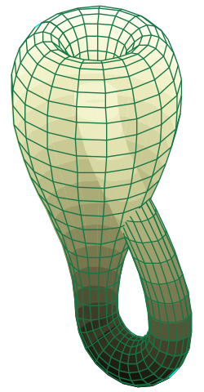
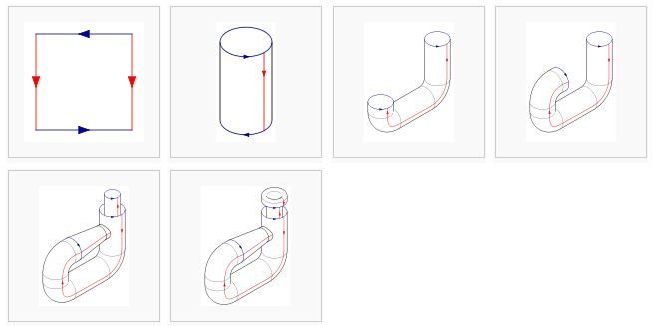
Game of Life on Klein Bottle
Pictures adapted from wikipedia
Notes:
Potential operations on Dim variable
Non-Periodic: return value, return func /* assuming func is NOT an alias of any Pochoir_Array */
Periodic: normal modulo operation, change_direction /* array_size – i */.
Switch some dim variables, such as arr.get(j, i);

Slide 30
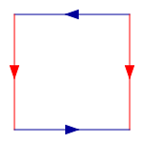
Game of Life on Klein Bottle
Pictures adapted from wikipedia
Notes:
Potential operations on Dim variable
Non-Periodic: return value, return func /* assuming func is NOT an alias of any Pochoir_Array */
Periodic: normal modulo operation, change_direction /* array_size – i */.
Switch some dim variables, such as arr.get(j, i);

Slide 31
Game of Life on Klein Bottle
Pochoir_Boundary_2D(klein_bottle_2D, arr, t, i, j)
int new_i = i, new_j = j;
const int l_arr_size_1 = arr.size(1), l_arr_size_0 = arr.size(0);
if (new_i < 0)
new_i += l_arr_size_1;
else if (new_i >= l_arr_size_1)
new_i -= l_arr_size_1;
if (new_j < 0) {
new_j += l_arr_size_0;
new_i = l_arr_size_1 - 1 - new_i;
} else if (new_j >= l_arr_size_0) {
new_j -= l_arr_size_0;
new_i = l_arr_size_1 - 1 - new_i;
}
return arr.get(t, new_i, new_j);
Pochoir_Boundary_end
Notes:
Potential operations on Dim variable
Non-Periodic: return value, return func /* assuming func is NOT an alias of any Pochoir_Array */
Periodic: normal modulo operation, change_direction /* array_size – i */.
Switch some dim variables, such as arr.get(j, i);

Slide 32
Basics of Cache-oblivious stencil algorithm – 1D
t
t
NP
P
x
x

Slide 33
Basics of Cache-oblivious stencil algorithm – 1D
t
t
NP
P
x
x
t
P=NP
x

Slide 34
Basics of cache-oblivious stencil algorithm – 2D
y
t
x

Slide 35
Basics of cache-oblivious stencil algorithm – 2D
y
1
2
3
4
5
t
x

Slide 36
Basics of cache-oblivious stencil algorithm – 2D
y
1
2
3
4
5
t
x
root
Spawn 2
Spawn 4
Sync
Spawn 1
Spawn 3
Spawn 5

Slide 37
Basics of cache-oblivious stencil algorithm – 2D
y
11
21
31
41
51
12
22
32
42
52
13
23
33
43
53
14
24
34
44
54
15
25
35
45
55
t
x
root
Spawn 2
Spawn 4
Sync
Spawn 1
Spawn 3
Spawn 5

Slide 38
Basics of cache-oblivious stencil algorithm – 2D
y
11
21
31
41
51
12
22
32
42
52
13
23
33
43
53
14
24
34
44
54
15
25
35
45
55
t
x
root
Spawn 2
Spawn 4
Sync
Spawn 1
Spawn 3
Spawn 5
22
24
sync
21
23
25
42
44
sync
41
43
45
12
14
sync
11
13
15
32
34
sync
31
33
35
52
54
sync
51
53
55

Slide 39
Basics of cache-oblivious stencil algorithm – 2D
y
11
21
31
41
51
12
22
32
42
52
13
23
33
43
53
14
24
34
44
54
15
25
35
45
55
t
x
root
Spawn 2
Spawn 4
Sync
Spawn 1
Spawn 3
Spawn 5
22
24
sync
21
23
25
42
44
sync
41
43
45
12
14
sync
11
13
15
32
34
sync
31
33
35
52
54
sync
51
53
55

Slide 40
Basics of cache-oblivious stencil algorithm – 2D
y
11
21
31
41
51
12
22
32
42
52
13
23
33
43
53
14
24
34
44
54
15
25
35
45
55
t
x
root
Spawn 2
Spawn 4
Sync
Spawn 1
Spawn 3
Spawn 5
22
24
sync
21
23
25
42
44
sync
41
43
45
12
14
sync
11
13
15
32
34
sync
31
33
35
52
54
sync
51
53
55

Slide 41
Basics of cache-oblivious stencil algorithm – 2D
y
11
21
31
41
51
12
22
32
42
52
13
23
33
43
53
14
24
34
44
54
15
25
35
45
55
t
x
root
Spawn 2
Spawn 4
Sync
Spawn 1
Spawn 3
Spawn 5
22
24
sync
23
25
42
44
sync
41
43
45+21
12
14
sync
11
13
15
32
34
sync
31
33
35
52
54
sync
51
53
55

Slide 42
Basics of cache-oblivious stencil algorithm – 2D
y
11
21
31
41
51
12
22
32
42
52
13
23
33
43
53
14
24
34
44
54
15
25
35
45
55
t
x
root
Spawn 2
Spawn 4
Sync
Spawn 1
Spawn 3
Spawn 5
22
24
sync
23
25+41
42
44
sync
43
45+21
12
14
sync
11
13
15
32
34
sync
31
33
35
52
54
sync
51
53
55

Slide 43
Parallelism of cache-oblivious stencil algorithm – 2D
y
1
2
3
4
5
t
x
Spawn 2, 4
Sync
Spawn 1, 3, 5

Slide 44
Parallelism of cache-oblivious stencil algorithm – 2D
y
y
1
2
3
4
5
11
21
31
41
51
12
22
32
42
52
13
23
33
43
53
14
24
34
44
54
15
25
35
45
55
t
x
t
x
Spawn 2, 4
Sync
Spawn 1, 3, 5
Spawn 22, 24, 42, 44
Sync
Spawn 21, 23, 25, 41, 43, 45
Sync
Spawn 12, 14, 32, 34, 52, 54
Sync
Spawn 11, 13, 15, 31, 33, 35,
51, 53, 55

Slide 45
Parallelism of cache-oblivious stencil algorithm – 2D
y
y
11
21
31
41
51
11
21
31
41
51
12
22
32
42
52
12
22
32
42
52
13
23
33
43
53
13
23
33
43
53
14
24
34
44
54
14
24
34
44
54
15
25
35
45
55
15
25
35
45
55
t
x
t
x
1st, cutting ‘x’, 2nd, cutting ‘y’
1st, cutting ‘y’, 2nd, cutting ‘x’
Spawn 22, 24, 42, 44
Sync
Spawn 21, 23, 25, 41, 43, 45
Sync
Spawn 12, 14, 32, 34, 52, 54
Sync
Spawn 11, 13, 15, 31, 33, 35,
51, 53, 55
Spawn 22, 24, 42, 44
Sync
Spawn 12, 14, 32, 34, 52, 54
Sync
Spawn 21, 23, 25, 41, 43, 45
Sync
Spawn 11, 13, 15, 31, 33, 35,
51, 53, 55

Slide 46
Parallelism of cache-oblivious stencil algorithm – 2D
y
y
11
21
31
41
51
11
21
31
41
51
12
22
32
42
52
12
22
32
42
52
13
23
33
43
53
13
23
33
43
53
14
24
34
44
54
14
24
34
44
54
15
25
35
45
55
15
25
35
45
55
t
x
t
x
1st, cutting ‘x’, 2nd, cutting ‘y’
1st, cutting ‘y’, 2nd, cutting ‘x’
Spawn 22, 24, 42, 44
Sync
Spawn 21, 23, 25, 41, 43, 45
Sync
Spawn 12, 14, 32, 34, 52, 54
Sync
Spawn 11, 13, 15, 31, 33, 35,
51, 53, 55
Spawn 22, 24, 42, 44
Sync
Spawn 12, 14, 32, 34, 52, 54
Sync
Spawn 21, 23, 25, 41, 43, 45
Sync
Spawn 11, 13, 15, 31, 33, 35,
51, 53, 55

Slide 47
Simultaneous Space Cut
Space Cut: evaluate and assign dependency level to as many spatial dimension as possible. Spawn and sync sub-trapezoids according dependency levels
Time Cut: The same as Sequential Space Cut
Base Case: The same as Sequential Space Cut
3
2
1
2
2
1
0
1
1
2
1
2
1
2
3

Slide 48
Simultaneous Space Cut
y
g
11
21
31
41
51
b
12
22
32
42
52
g
13
23
33
43
53
b
14
24
34
44
54
g
15
25
35
45
55
t
g
b
g
b
g
x
root
Spawn 22, 24, 42, 44
Sync
Spawn 12, 14, 32, 34, 52, 54
21, 23, 25, 41, 43, 45
Sync
Spawn 11, 13, 15, 31, 33, 35,
51, 53, 55
Spawn
22, 24
42, 44
sync
Spawn
12, 14
21, 23, 25
32, 34,
41, 43, 45
52, 54
sync
Spawn
11, 13, 15
31, 33, 35
51, 53, 55

Slide 49
Simultaneous Space Cut
Lemma 1: All subtrapezoids created by a simultaneous space cut on k>=1 of the d >= k spatial dimensions of a (d+1)-dimensional trapezoids can be evaluated in k+1 parallel steps.

Slide 50
Simultaneous Space Cut
Lemma 1: All subtrapezoids created by a simultaneous space cut on k>=1 of the d >= k spatial dimensions of a (d+1)-dimensional trapezoids can be evaluated in k+1 parallel steps.
Lemma 2: All subtrapezoids created by sequential space cut on k>=1 of the d >= k spatial dimensions of a (d+1)-dimensional trapezoids can be evaluated in parallel steps.

Slide 51
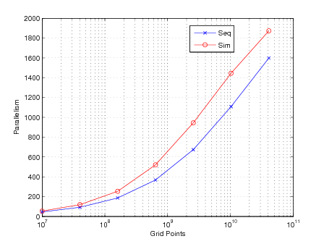
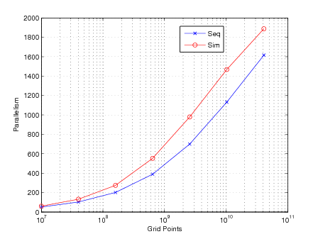
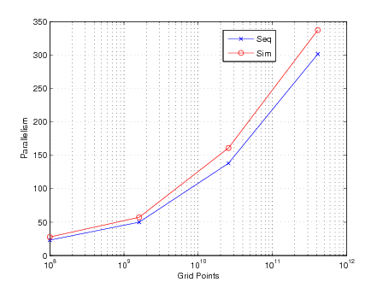
Parallelism of heat_2D_P
Parallelism of heat_2D_NP
Parallelism of 3dfd

Slide 52
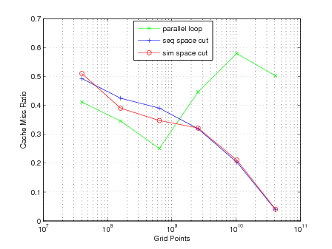
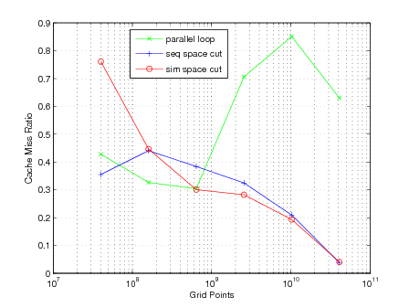
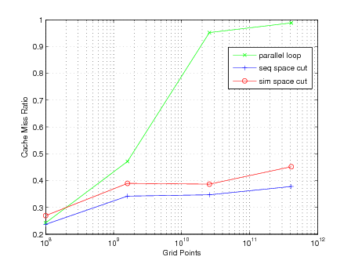
Cache Miss Ratio of heat_2D_P
Cache Miss Ratio of heat_2D_NP
Cache Miss Ratio of 3dfd

Slide 53
Conclusion of Simultaneous Space Cut Algorithm
Solve the data dependency issue on Klein Bottle, Mobius Strip, (hopefully, all geometrically continuous grid)
Improve the parallelism/span asymptotically over sequential space cut algorithm
Without any loss in cache efficiency

Slide 54
Can we do better?

Slide 55
Parallel Cache-Oblivious Stencil Algorithms
t
x

Slide 56
Parallel Cache-Oblivious Stencil Algorithms
t
t
x
x
Increase the parallelism at
the cost of redundant storage
and computation

Slide 57
Parallel Cache-Oblivious Stencil Algorithms
t
t
x
x
Increase the parallelism at
the cost of redundant storage
and computation
Sync?

Slide 58
Parallel Cache-Oblivious Stencil Algorithms
t
t
∆x
x
∆x
x

Slide 59
Parallel Cache-Oblivious Stencil Algorithms
t
t
∆x
x
∆x
x
Increase the parallelism at
the cost of redundant storage
, redundant computation. And
Still have synchronization
overhead

Slide 60
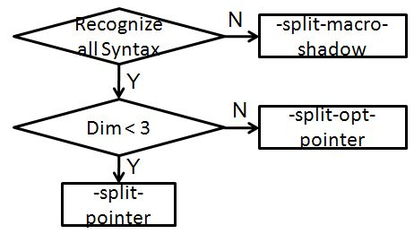
Base-case optimization
Two code clones
Coarsening of base-case
-split-macro-shadow, -split-pointer, -split-opt-pointer, etc.

Slide 61
-split-macro-shadow
Pochoir<2> heat;
Pochoir_Shape<2> shape[6] = {{1, 0, 0}, {0, 1, 0}, {0, -1, 0}, {0, 0, 0}, {0, 0, -1}, {0, 0, 1}};
Pochoir_Array<double, 2> a(N, M, shape);
Pochoir_Boundary_2D(bdry, arr, t, i, j)
if (i <= 0 || i >= arr.size(1)-1 || j < =0 || j >= arr.size(0)-1)
return 0;
else
return arr.get(t, i, j);
Pochoir_Boundary_end
Pochoir_kernel_2D(kern, t, i, j)
a(t, i, j) = 0.125 * (a(t-1, i+1, j) - 2.0 * a(t-1, i, j) + a(t-1, i-1, j)) + 0.125 * (a(t-1, i, j+1) - 2.0 * a(t-1, i, j) + a(t-1, i, j-1)) + a(t-1, i, j);
Pochoir_kernel_end
heat.registerBoundaryFn(a, bdry);
heat.registerArray(a);
heat.registerShape(shape);
heat.run(T, kern);
Pochoir<2> heat;
Pochoir_Shape<2> shape[6] = {{0, 0, 0}, {-1, 1, 0}, {-1, 0, 0}, {-1, -1, 0}, {-1, 0, -1}, {-1, 0, 1}};
Pochoir_Array<double, 2> a(N, M, shape);
Pochoir_Boundary_2D(bdry, arr, t, i, j)
if (i <= 0 || i >= arr.size(1)-1 || j < =0 || j >= arr.size(0)-1)
return 0;
else
return arr.get(t, i, j);
Pochoir_Boundary_end
Pochoir_kernel_2D(kern, t, i, j)
a(t, i, j) = 0.125 * (a(t-1, i+1, j) - 2.0 * a(t-1, i, j) + a(t-1, i-1, j)) + 0.125 * (a(t-1, i, j+1) - 2.0 * a(t-1, i, j) + a(t-1, i, j-1)) + a(t-1, i, j);
Pochoir_kernel_end
heat.registerBoundaryFn(a, bdry);
heat.registerShape(shape);
{
#define a(t, i, j) a.interior(t, i, j)
Pochoir_kernel_2D(interior_kern, t, i, j)
a(t, i, j) = 0.125 * (a(t-1, i+1, j) - 2.0 * a(t-1, i, j) + a(t-1, i-1, j)) + 0.125 * (a(t-1, i, j+1) - 2.0 * a(t-1, i, j) + a(t-1, i, j-1)) + a(t-1, i, j);
Pochoir_kernel_end
#undef a(t, i, j)
heat.run(T, interior_kern, kern);
}

Slide 62
indexing issue
Pochoir<2> heat;
Pochoir_Shape<2> shape[6] = {{0, 0, 0}, {-1, 1, 0}, {-1, 0, 0}, {-1, -1, 0}, {-1, 0, -1}, {-1, 0, 1}};
Pochoir_Array<double, 2> a(N, M, shape);
Pochoir_Boundary_2D(bdry, arr, t, i, j)
if (i <= 0 || i >= arr.size(1)-1 || j < =0 || j >= arr.size(0)-1)
return 0;
else
return arr.get(t, i_dom, j);
Pochoir_Boundary_end
Pochoir_kernel_2D(kern, t, i, j)
a(t, i, j) = 0.125 * (a(t-1, i+1, j) - 2.0 * a(t-1, i, j) + a(t-1, i-1, j)) + 0.125 * (a(t-1, i, j+1) - 2.0 * a(t-1, i, j) + a(t-1, i, j-1)) + a(t-1, i, j);
Pochoir_kernel_end
heat.registerBoundaryFn(a, bdry);
heat.registerShape(shape);
{
#define a(t, i, j) a.interior(t, i, j)
Pochoir_kernel_2D(interior_kern, t, i, j)
a(t, i, j) = 0.125 * (a(t-1, i+1, j) - 2.0 * a(t-1, i, j) + a(t-1, i-1, j)) + 0.125 * (a(t-1, i, j+1) - 2.0 * a(t-1, i, j) + a(t-1, i, j-1)) + a(t-1, i, j);
Pochoir_kernel_end
#undef a(t, i, j)
heat.run(T, interior_kern, kern);
}

Slide 63
indexing issue
Pochoir<2> heat;
Pochoir_Shape<2> shape[6] = {{0, 0, 0}, {-1, 1, 0}, {-1, 0, 0}, {-1, -1, 0}, {-1, 0, -1}, {-1, 0, 1}};
Pochoir_Array<double, 2> a(N, M, shape);
Pochoir_Boundary_2D(bdry, arr, t, i, j)
if (i <= 0 || i >= arr.size(1)-1 || j < =0 || j >= arr.size(0)-1)
return 0;
else
return arr.get(t, i, j);
Pochoir_Boundary_end
Pochoir_kernel_2D(kern, t, i, j)
a(t, i, j) = 0.125 * (a(t-1, i+1, j) - 2.0 * a(t-1, i, j) + a(t-1, i-1, j)) + 0.125 * (a(t-1, i, j+1) - 2.0 * a(t-1, i, j) + a(t-1, i, j-1)) + a(t-1, i, j);
Pochoir_kernel_end
heat.registerBoundaryFn(a, bdry);
heat.registerShape(shape);
{
#define a(t, i, j) a.interior(t, i, j)
Pochoir_kernel_2D(interior_kern, t, i, j)
a(t, i, j) = 0.125 * (a(t-1, i+1, j) - 2.0 * a(t-1, i, j) + a(t-1, i-1, j)) + 0.125 * (a(t-1, i, j+1) - 2.0 * a(t-1, i, j) + a(t-1, i, j-1)) + a(t-1, i, j);
Pochoir_kernel_end
#undef a(t, i, j)
heat.run(T, interior_kern, kern);
}
for (int t = 0; t < T_SIZE; ++t) {
for (int i= 0; i < N; ++i) {
for (int j = 0; j < N; ++j) {
a[(t&1)*total_size + i * stride_i +
j*stride_j] = ….
}
}
}

Slide 64
indexing issue
Pochoir<2> heat;
Pochoir_Shape<2> shape[6] = {{0, 0, 0}, {-1, 1, 0}, {-1, 0, 0}, {-1, -1, 0}, {-1, 0, -1}, {-1, 0, 1}};
Pochoir_Array<double, 2> a(N, M, shape);
Pochoir_Boundary_2D(bdry, arr, t, i, j)
if (i <= 0 || i >= arr.size(1)-1 || j < =0 || j >= arr.size(0)-1)
return 0;
else
return arr.get(t, i, j);
Pochoir_Boundary_end
Pochoir_kernel_2D(kern, t, i, j)
a(t, i, j) = 0.125 * (a(t-1, i+1, j) - 2.0 * a(t-1, i, j) + a(t-1, i-1, j)) + 0.125 * (a(t-1, i, j+1) - 2.0 * a(t-1, i, j) + a(t-1, i, j-1)) + a(t-1, i, j);
Pochoir_kernel_end
heat.registerBoundaryFn(a, bdry);
heat.registerShape(shape);
{
#define a(t, i, j) a.interior(t, i, j)
Pochoir_kernel_2D(interior_kern, t, i, j)
a(t, i, j) = 0.125 * (a(t-1, i+1, j) - 2.0 * a(t-1, i, j) + a(t-1, i-1, j)) + 0.125 * (a(t-1, i, j+1) - 2.0 * a(t-1, i, j) + a(t-1, i, j-1)) + a(t-1, i, j);
Pochoir_kernel_end
#undef a(t, i, j)
heat.run(T, interior_kern, kern);
}
for (int t = 0; t < T_SIZE; ++t) {
for (int i = 0; i < N; ++i) {
for (int j = 0; j < N; ++j) {
a[(t&1)*total_size + i * stride_i +
j*stride_j] = ….
}
}
}
for (int t = 0; t < T_SIZE; ++t) {
_t = (t&1) * total_size;
for (int i = 0; i < N; ++i) {
_i = i * stride_i;
for (int j = 0; j < N; ++j) {
_j = j * stride_j;
a[_t + _i + _j] = ….
}
}
}

Slide 65
Using Iterator to traverse internal sub-trapezoid
Use STL style iterators to traverse sub-trapezoid
t
x

Slide 66
-split-pointer
Pochoir<2> heat;
Pochoir_Shape<2> shape[6] = {{0, 0, 0}, {-1, 1, 0}, {-1, 0, 0}, {-1, -1, 0}, {-1, 0, -1}, {-1, 0, 1}};
Pochoir_Array<double, 2> a(N, M, shape);
Pochoir_Boundary_2D(bdry, arr, t, i, j)
if (i <= 0 || i >= arr.size(1)-1 || j < =0 || j >= arr.size(0)-1)
return 0;
else
return arr.get(t, i, j);
Pochoir_Boundary_end
Pochoir_kernel_2D(kern, t, i, j)
a(t, i, j) = 0.125 * (a(t-1, i+1, j) - 2.0 * a(t-1, i, j) + a(t-1, i-1, j)) + 0.125 * (a(t-1, i, j+1) - 2.0 * a(t-1, i, j) + a(t-1, i, j-1)) + a(t-1, i, j);
Pochoir_kernel_end
heat.registerBoundaryFn(a, bdry);
heat.registerShape(shape);
{
#define a(t, i, j) a.interior(t, i, j)
Pochoir_kernel_2D(interior_kern, t, i, j)
a(t, i, j) = 0.125 * (a(t-1, i+1, j) - 2.0 * a(t-1, i, j) + a(t-1, i-1, j)) + 0.125 * (a(t-1, i, j+1) - 2.0 * a(t-1, i, j) + a(t-1, i, j-1)) + a(t-1, i, j);
Pochoir_kernel_end
#undef a(t, i, j)
heat.run(T, interior_kern, kern);
}
Pochoir_kernel_2D(iter_kern, t, i, j)
grid_info<2> l_grid = grid;
double * iter5, *iter4, *iter3, *iter2, *iter1, *iter0;
double * a_base = a.data();
const int l_a_total_size = a.total_size();
int gap_a_1, gap_a_0;
const int l_stride_a_1 = a.stride(1), l_stride_a_0 = a.stride(0);
for (int t = t0; t < t1; ++t) {
double * baseIter_1, *baseIter_0;
baseIter_0 = a_base + ((t + 1) & 0x1) * l_a_total_size + (l_grid.x0[1]) * l_stride_a_1 + (l_grid.x0[0]) * l_stride_a_0;
baseIter_1 = a_base + ((t) & 0x1) * l_a_total_size + (l_grid.x0[1]) * l_stride_a_1 + (l_grid.x0[0]) * l_stride_a_0;
iter0 = baseIter_0 + (0) * l_stride_a_1 + (0) * l_stride_a_0;
iter1 = baseIter_1 + (1) * l_stride_a_1 + (0) * l_stride_a_0;
iter2 = baseIter_1 + (0) * l_stride_a_1 + (0) * l_stride_a_0;
iter3 = baseIter_1 + (-1) * l_stride_a_1 + (0) * l_stride_a_0;
iter4 = baseIter_1 + (0) * l_stride_a_1 + (1) * l_stride_a_0;
iter5 = baseIter_1 + (0) * l_stride_a_1 + (-1) * l_stride_a_0;
gap_a_1 = l_stride_a_1 + (l_grid.x0[0] - l_grid.x1[0]) * l_stride_a_0;
for (int i = l_grid.x0[1]; i < l_grid.x1[1]; ++i, iter0 += gap_a_1, iter1 += gap_a_1, iter2 += gap_a_1, iter3 += gap_a_1, iter4 += gap_a_1, iter5 += gap_a_1) {
for (int j = l_grid.x0[0]; j < l_grid.x1[0]; ++j, ++iter0, ++iter1, ++iter2, ++iter3, ++iter4, ++iter5) {
(*iter0) = 0.125 * ((*iter1) - 2.0 * (*iter2) + (*iter3)) + 0.125 * ((*iter4) - 2.0 * (*iter2) + (*iter5)) + (*iter2);
} } /* end for (sub-trapezoid) */
/* Adjust sub-trapezoid! */
for (int i = 0; i < 2; ++i) {
l_grid.x0[i] += l_grid.dx0[i]; l_grid.x1[i] += l_grid.dx1[i];
}} /* end for t */Pochoir_kernel_end
Pochoir_Kernel_End
One iterator for one shape term

Slide 67
-split-opt-pointer
Pochoir_kernel_2D(iter_kern, t, i, j)
grid_info<2> l_grid = grid;
double * iter5, *iter4, *iter3, *iter2, *iter1, *iter0;
double * a_base = a.data();
const int l_a_total_size = a.total_size();
int gap_a_1, gap_a_0;
const int l_stride_a_1 = a.stride(1), l_stride_a_0 = a.stride(0);
for (int t = t0; t < t1; ++t) {
double * baseIter_1, *baseIter_0;
baseIter_0 = a_base + ((t + 1) & 0x1) * l_a_total_size + (l_grid.x0[1]) * l_stride_a_1 + (l_grid.x0[0]) * l_stride_a_0;
baseIter_1 = a_base + ((t) & 0x1) * l_a_total_size + (l_grid.x0[1]) * l_stride_a_1 + (l_grid.x0[0]) * l_stride_a_0;
iter0 = baseIter_0 + (0) * l_stride_a_1 + (0) * l_stride_a_0;
iter1 = baseIter_1 + (1) * l_stride_a_1 + (0) * l_stride_a_0;
iter2 = baseIter_1 + (0) * l_stride_a_1 + (0) * l_stride_a_0;
iter3 = baseIter_1 + (-1) * l_stride_a_1 + (0) * l_stride_a_0;
iter4 = baseIter_1 + (0) * l_stride_a_1 + (1) * l_stride_a_0;
iter5 = baseIter_1 + (0) * l_stride_a_1 + (-1) * l_stride_a_0;
gap_a_1 = l_stride_a_1 + (l_grid.x0[0] - l_grid.x1[0]) * l_stride_a_0;
for (int i = l_grid.x0[1]; i < l_grid.x1[1]; ++i, iter0 += gap_a_1, iter1 += gap_a_1, iter2 += gap_a_1, iter3 += gap_a_1, iter4 += gap_a_1, iter5 += gap_a_1) {
for (int j = l_grid.x0[0]; j < l_grid.x1[0]; ++j, ++iter0, ++iter1, ++iter2, ++iter3, ++iter4, ++iter5) {
(*iter0) = 0.125 * ((*iter1) - 2.0 * (*iter2) + (*iter3)) + 0.125 * ((*iter4) - 2.0 * (*iter2) + (*iter5)) + (*iter2);
} } /* end for (sub-trapezoid) */
/* Adjust sub-trapezoid! */
for (int i = 0; i < 2; ++i) {
l_grid.x0[i] += l_grid.dx0[i]; l_grid.x1[i] += l_grid.dx1[i];
}} /* end for t */Pochoir_kernel_end
Pochoir_Kernel_End
Too many pointers in inner most loop
Reduce the number of iterators in inner-most loop

Slide 68
-split-opt-pointer
Pochoir_kernel_2D(iter_kern, t, i, j)
grid_info<2> l_grid = grid;
double * iter5, *iter4, *iter3, *iter2, *iter1, *iter0;
double * a_base = a.data();
const int l_a_total_size = a.total_size();
int gap_a_1, gap_a_0;
const int l_stride_a_1 = a.stride(1), l_stride_a_0 = a.stride(0);
for (int t = t0; t < t1; ++t) {
double * baseIter_1, *baseIter_0;
baseIter_0 = a_base + ((t + 1) & 0x1) * l_a_total_size + (l_grid.x0[1]) * l_stride_a_1 + (l_grid.x0[0]) * l_stride_a_0;
baseIter_1 = a_base + ((t) & 0x1) * l_a_total_size + (l_grid.x0[1]) * l_stride_a_1 + (l_grid.x0[0]) * l_stride_a_0;
iter0 = baseIter_0 + (0) * l_stride_a_1 + (0) * l_stride_a_0;
iter1 = baseIter_1 + (1) * l_stride_a_1 + (0) * l_stride_a_0;
iter2 = baseIter_1 + (0) * l_stride_a_1 + (0) * l_stride_a_0;
iter3 = baseIter_1 + (-1) * l_stride_a_1 + (0) * l_stride_a_0;
iter4 = baseIter_1 + (0) * l_stride_a_1 + (1) * l_stride_a_0;
iter5 = baseIter_1 + (0) * l_stride_a_1 + (-1) * l_stride_a_0;
gap_a_1 = l_stride_a_1 + (l_grid.x0[0] - l_grid.x1[0]) * l_stride_a_0;
for (int i = l_grid.x0[1]; i < l_grid.x1[1]; ++i, iter0 += gap_a_1, iter1 += gap_a_1, iter2 += gap_a_1, iter3 += gap_a_1, iter4 += gap_a_1, iter5 += gap_a_1) {
for (int j = l_grid.x0[0]; j < l_grid.x1[0]; ++j, ++iter0, ++iter1, ++iter2, ++iter3, ++iter4, ++iter5) {
(*iter0) = 0.125 * ((*iter1) - 2.0 * (*iter2) + (*iter3)) + 0.125 * ((*iter4) - 2.0 * (*iter2) + (*iter5)) + (*iter2);
} } /* end for (sub-trapezoid) */
/* Adjust sub-trapezoid! */
for (int i = 0; i < 2; ++i) {
l_grid.x0[i] += l_grid.dx0[i]; l_grid.x1[i] += l_grid.dx1[i];
}} /* end for t */Pochoir_kernel_end
Pochoir_Kernel_End
Pochoir_kernel_2D(iter_kern, t, i, j)
grid_info<2> l_grid = grid;
double * pt_a_1, *pt_a_0;
double * a_base = a.data();
const int l_a_total_size = a.total_size();
int gap_a_1, gap_a_0;
const int l_stride_a_1 = a.stride(1), l_stride_a_0 = a.stride(0);
for (int t = t0; t < t1; ++t) {
pt_a_0 = a_base + ((t + 1) & 0x1) * l_a_total_size + (l_grid.x0[1]) * l_stride_a_1 + (l_grid.x0[0]) * l_stride_a_0;
pt_a_1 = a_base + ((t) & 0x1) * l_a_total_size + (l_grid.x0[1]) * l_stride_a_1 + (l_grid.x0[0]) * l_stride_a_0;
gap_a_1 = l_stride_a_1 + (l_grid.x0[0] - l_grid.x1[0]) * l_stride_a_0;
for (int i = l_grid.x0[1]; i < l_grid.x1[1]; ++i, pt_a_0 += gap_a_1, pt_a_1 += gap_a_1) {
for (int j = l_grid.x0[0]; j < l_grid.x1[0]; ++j, ++pt_a_0, ++pt_a_1) {
pt_a_0[0] = 0.125 * (pt_a_1[l_stride_a_1 * (1)] - 2.0 * pt_a_1[0] + pt_a_1[l_stride_a_1 * (-1)]) + 0.125 * (pt_a_1[l_stride_a_0 * (1)] - 2.0 * pt_a_1[0] + pt_a_1[l_stride_a_0 * (-1)]) + pt_a_1[0];
} } /* end for (sub-trapezoid) */
/* Adjust sub-trapezoid! */
for (int i = 0; i < 2; ++i) {
l_grid.x0[i] += l_grid.dx0[i]; l_grid.x1[i] += l_grid.dx1[i];
}} /* end for t */ Pochoir_Kernel_End
Pochoir_Kernel_End
Reduce the number of iterators in inner-most loop

Slide 69
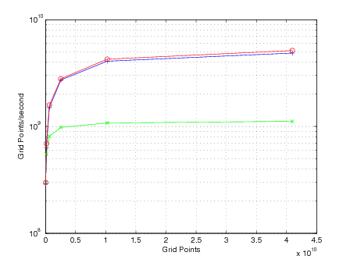
Comparison of three optimizing options
Heat_2D_P on Nehalem

Slide 70
Can we do better?

Slide 71
Can we do better?
t
N
x
Data set size = N;
Cache size = Z;
N >> Z;
Cache line size = B;

Slide 72
Can we do better?
t
t
N
x
x
N
Data set size = N;
Cache size = Z;
N > Z;
Cache line size = B;

Slide 73
Can we do better?

Slide 74
Cache Miss Ratio of heat_2D_P
Cache Miss Ratio of heat_2D_NP
Cache Miss Ratio of 3dfd

Slide 75
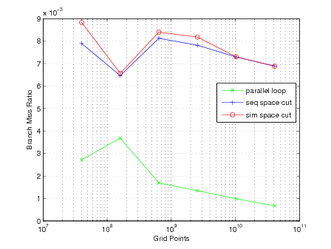
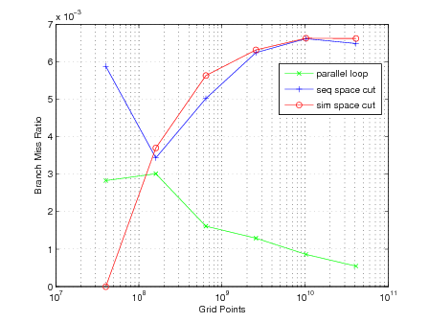
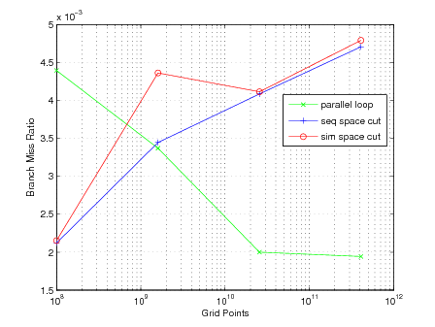
Branch miss ratio of heat_2D_P
Branch miss ratio of heat_2D_NP
Branch miss ratio of 3dfd

Slide 76
Benchmark | Dim | Grid size | Time step | Pochoir 1 core | Pochoir 12 core | Speedup | Loops 12 core | Loops/Pochoir 12 core
2D Heat NP | 2 | 16000^3 | 500 | 277 | 24 | 11.54 | 149 | 6.20
2D Heat P | 2 | 16000^3 | 500 | 281 | 24 | 11.70 | 248 | 10.33
Game of Life P | 2 | 16000^3 | 500 | 931 | 77 | 12.09 | 410 | 5.32
3dfd NP | 3 | 1000^3 | 500 | 3082 | 447 | 6.89 | 1071 | 2.39
LBM NP | 3 | 100x100x130 | 3000 | 345 | 68 | 5.07 | 220 | 3.24
Longest common subsequence NP | 1 | 100000 | 200000 | 68 | 9 | 7.55 | 25 | 2.60

Slide 77
Benchmark | Dim | Grid size | Time step | Pochoir 1 core | Pochoir 12 core | Speedup | Loops 12 core | Loops/Pochoir 12 core
2D Heat NP | 2 | 16000^3 | 500 | 277 | 24 | 11.54 | 149 | 6.20
2D Heat P | 2 | 16000^3 | 500 | 281 | 24 | 11.70 | 248 | 10.33
Game of Life P | 2 | 16000^3 | 500 | 931 | 77 | 12.09 | 410 | 5.32
3dfd NP | 3 | 1000^3 | 500 | 3082 | 447 | 6.89 | 1071 | 2.39
LBM NP | 3 | 100x100x130 | 3000 | 345 | 68 | 5.07 | 220 | 3.24
Longest common subsequence NP | 1 | 100000 | 200000 | 68 | 9 | 7.55 | 25 | 2.60

Slide 78
Benchmark | Dim | Grid size | Time step | Pochoir 1 core | Pochoir 12 core | Speedup | Loops 12 core | Loops/Pochoir 12 core
2D Heat NP | 2 | 16000^3 | 500 | 277 | 24 | 11.54 | 149 | 6.20
2D Heat P | 2 | 16000^3 | 500 | 281 | 24 | 11.70 | 248 | 10.33
Game of Life P | 2 | 16000^3 | 500 | 931 | 77 | 12.09 | 410 | 5.32
Game of Life P (bit trick) | 2 | 16000^3 | 500 | 345 | 28 | 12.32 | 332 | 11.85
3dfd NP | 3 | 1000^3 | 500 | 3082 | 447 | 6.89 | 1071 | 2.39
LBM NP | 3 | 100x100x130 | 3000 | 345 | 68 | 5.07 | 220 | 3.24
Longest common subsequence NP | 1 | 100000 | 200000 | 68 | 9 | 7.55 | 25 | 2.60

Slide 79
Can we do better?
Branchless cache-oblivious algorithm
Remove un-predictable branches
Traverse the points in recursive order without recursion
Recursion unrolling

Slide 80
Can we do better?
Branchless cache-oblivious algorithm
Remove un-predictable branches
Traverse the points in recursive order without recursion
Recursion unrolling
Measuring algorithm’s performance in terms of
Computation complexity
Caching complexity
Branching complexity
# branch? # un-predictable branch?
Design principle: bit trick, recursion unrolling, …

Slide 81
Can we do better?
Branchless cache-oblivious algorithm
Remove un-predictable branches
Traverse the points in recursive order without recursion
Recursion unrolling
Measuring algorithm’s performance in terms of
Computing complexity
Caching complexity
Branching complexity
# un-predictable branch (conditional branches, recursive function calls)?
Design principle: bit trick, recursion unrolling, …

Slide 82
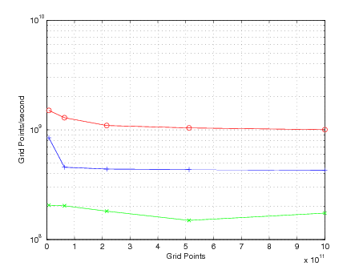
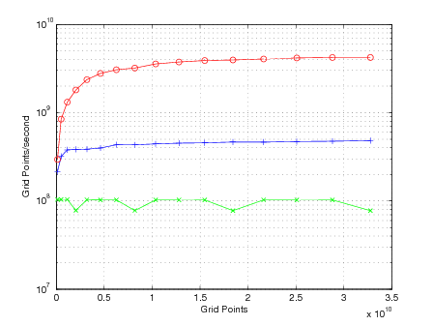
Overall Performance
3dfd
Heat_2D_P
Pochoir vs Parallel Loop vs Serial Loop

Slide 83
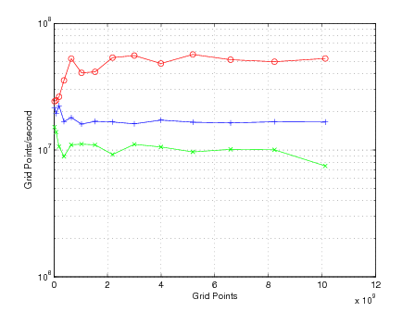
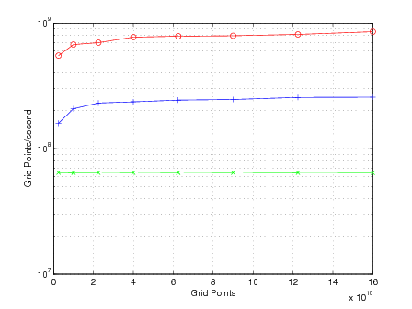
Overall Performance
LBM
PSA
Pochoir vs Parallel Loop vs Serial Loop

Slide 84
Conclusion
Pochoir version 1.0 ready to go
Simultaneous space cut algorithm solve the data dependency of Klein bottle, Mobius strip
Simultaneous space cut algorithm improves parallelism over sequential space cut algorithm asymptotically without loss in cache efficiency
Different optimization options automatically optimize the user’s stencil specification

Slide 85
Future Work
Explore more algorithmic variants
Overlapped trapezoidal decomposition
Automatic zero-padding
Irregular computing domain
Heuristic auto-tuning

Slide 86
Future work
Branchless cache-oblivious algorithm
Measuring the algorithm performance in terms of
Computing complexity (# major arithmetic ops)
Ideal computing model
Caching complexity
cache miss rate? Cache miss ratio?
Design principle: Divide-and-Conquer
Ideal cache model
Branching complexity
# un-predictable branches (conditional branches, recursive function calls)? mis-predicted ratio?
Design principle: bit-trick, recursion unrolling, …
Ideal branching model

