Slide 1
The Pochoir Stencil Compiler
Status Update

Slide 2
Story
Stencils are prevailing
Conventional numerical library focus on optimizing individual computation operator
Highly cache-efficient stencil algorithm is known yet hard to write from case to case.
How to automate the optimization of a family of computation (such as stencil) in one framework is yet open question.
Library?
Compiler’s pragma?
Autotuner?
DSL?
EDSL? (Pochoir’s approach)

Slide 3
Summary
What we have done:
Simple, concise, declarative, and easily verifiable DSL embedded in C++, with Intel Cilk Plus extension.
Arbitrary shaped, arbitrary depth stencil on arbitrary d-dimensional space-time grid, with complex boundary condition.
What we plan to do:
Further improve the performance for complex stencil kernels
Multiple inhomogeneous kernels (possibly overlapping)
Macroscopic inhomogeneity
Microscopic inhomogeneity
Generalized dependency
From orthogonal grid to general graph
Recurrence solver, dynamic programming
JIT compiler for stencil
Platform portability

Slide 4
How Intel Can Help (market plan)
Embed Pochoir technology in the ICC compiler
Optimizing techniques for a family of computation
Bind EDSL with compiler and runtime system
Extending Pochoir technology to new architectures such as GPU, MIC, etc.
JIT interface to ICC (call icc as a standalone library)
Collaborating with Intel Exascale Computing lab on complex stencil kernels
Apply Pochoir technology to non-HPC applications, such as video processing, recurrence solver, dynamic programming
Help with Intel Cilk Plus and related tools, such as cilkprof
Incorporate ISAT with heuristic autotuning
Research support for Yuan Tang
Open source like FFTW?

Slide 5
Roadmap
Release 0.5 (Feb. 2011)
Release 1.0 (Aug. 2012)
Release 2.0 (TBD)

Slide 6
Release 0.5
Released in Feb. 2011
Published in SPAA’11 & HotPar’11
Simple, concise, declarative, and easily verifiable DSL embedded in C++, with Intel Cilk Plus extension.
Arbitrary shaped, arbitrary depth stencil on arbitrary d-dimensional space-time grid, with complex boundary condition.

Slide 7

2D Heat Equation
1 Pochoir_Boundary_2D(zero_bdry, arr, t, x, y)
2 return 0;
3 Pochoir_Boundary_End
4 int main(void) {
5 Pochoir_Shape_2D 2D_five_pt[6]
= {{0,0,0}, {-1,0,0}, {-1,1,0}, {-1,-1,0}, {-1,0,-1}, {-1,0,1}};
6 Pochoir_2D heat(2D_five_pt);
7 Pochoir_Array_2D(double) a(X,Y);
8 a.Register_Boundary(zero_bdry);
9 heat.Register_Array(a);
10 Pochoir_Kernel_2D(kern, t, x, y)
11 a(t,x,y) = a(t-1,x,y)
+ 0.125*(a(t-1,x+1,y) - 2.0*a(t-1,x,y) + a(t-1,x-1,y))
+ 0.125*(a(t-1,x,y+1) - 2.0*a(t-1,x,y) + a(t-1,x,y-1));
12 Pochoir_Kernel_End
13 for (int x = 0; x < X; ++x)
for (int y = 0; y < Y; ++y)
a(0,x,y) = rand();
14 heat.Run(T, kern);
15 for (int x = 0; x < X; ++x)
16 for (int y = 0; y < Y; ++y)
17 cout << a(T,x,y);
18 return 0;
19 }
time

Slide 8
2D Heat Equation
1 Pochoir_Boundary_2D(zero_bdry, arr, t, x, y)
2 return 0;
3 Pochoir_Boundary_End
4 int main(void) {
5 Pochoir_Shape_2D 2D_five_pt[6]
= {{0,0,0}, {-1,0,0}, {-1,1,0}, {-1,-1,0}, {-1,0,-1}, {-1,0,1}};
6 Pochoir_2D heat(2D_five_pt);
7 Pochoir_Array_2D(double) a(X,Y);
8 a.Register_Boundary(zero_bdry);
9 heat.Register_Array(a);
10 Pochoir_Kernel_2D(kern, t, x, y)
11 a(t,x,y) = a(t-1,x,y)
+ 0.125*(a(t-1,x+1,y) - 2.0*a(t-1,x,y) + a(t-1,x-1,y))
+ 0.125*(a(t-1,x,y+1) - 2.0*a(t-1,x,y) + a(t-1,x,y-1));
12 Pochoir_Kernel_End
13 for (int x = 0; x < X; ++x)
for (int y = 0; y < Y; ++y)
a(0,x,y) = rand();
14 heat.Run(T, kern);
15 for (int x = 0; x < X; ++x)
16 for (int y = 0; y < Y; ++y)
17 cout << a(T,x,y);
18 return 0;
19 }
time
Declare a kernel function kern with time parameter t and spatial parameters x and y.

Slide 9
2D Heat Equation
1 Pochoir_Boundary_2D(zero_bdry, arr, t, x, y)
2 return 0;
3 Pochoir_Boundary_End
4 int main(void) {
5 Pochoir_Shape_2D 2D_five_pt[6]
= {{0,0,0}, {-1,0,0}, {-1,1,0}, {-1,-1,0}, {-1,0,-1}, {-1,0,1}};
6 Pochoir_2D heat(2D_five_pt);
7 Pochoir_Array_2D(double) a(X,Y);
8 a.Register_Boundary(zero_bdry);
9 heat.Register_Array(a);
10 Pochoir_Kernel_2D(kern, t, x, y)
11 a(t,x,y) = a(t-1,x,y)
+ 0.125*(a(t-1,x+1,y) - 2.0*a(t-1,x,y) + a(t-1,x-1,y))
+ 0.125*(a(t-1,x,y+1) - 2.0*a(t-1,x,y) + a(t-1,x,y-1));
12 Pochoir_Kernel_End
13 for (int x = 0; x < X; ++x)
for (int y = 0; y < Y; ++y)
a(0,x,y) = rand();
14 heat.Run(T, kern);
15 for (int x = 0; x < X; ++x)
16 for (int y = 0; y < Y; ++y)
17 cout << a(T,x,y);
18 return 0;
19 }
time
Declare the 2-dimensional Pochoir shape 2D_five_pt as a list of 6 cells. Each cell specifies the relative offset of indices used in the kernel function, e.g., for a(t,x,y), we specify the corresponding cell {0,0,0}, for a(t–1,x+1,y), we specify {–1,1,0}, and so on.

Slide 10
2D Heat Equation
1 Pochoir_Boundary_2D(zero_bdry, arr, t, x, y)
2 return 0;
3 Pochoir_Boundary_End
4 int main(void) {
5 Pochoir_Shape_2D 2D_five_pt[6]
= {{0,0,0}, {-1,0,0}, {-1,1,0}, {-1,-1,0}, {-1,0,-1}, {-1,0,1}};
6 Pochoir_2D heat(2D_five_pt);
7 Pochoir_Array_2D(double) a(X,Y);
8 a.Register_Boundary(zero_bdry);
9 heat.Register_Array(a);
10 Pochoir_Kernel_2D(kern, t, x, y)
11 a(t,x,y) = a(t-1,x,y)
+ 0.125*(a(t-1,x+1,y) - 2.0*a(t-1,x,y) + a(t-1,x-1,y))
+ 0.125*(a(t-1,x,y+1) - 2.0*a(t-1,x,y) + a(t-1,x,y-1));
12 Pochoir_Kernel_End
13 for (int x = 0; x < X; ++x)
for (int y = 0; y < Y; ++y)
a(0,x,y) = rand();
14 heat.Run(T, kern);
15 for (int x = 0; x < X; ++x)
16 for (int y = 0; y < Y; ++y)
17 cout << a(T,x,y);
18 return 0;
19 }
time
Declare the 2-dimensional Pochoir shape 2D_five_pt as a list of 6 cells. Each cell specifies the relative offset of indices used in the kernel function, e.g., for a(t,x,y), we specify the corresponding cell {0,0,0}, for a(t–1,x+1,y), we specify {–1,1,0}, and so on.

Slide 11
2D Heat Equation
1 Pochoir_Boundary_2D(zero_bdry, arr, t, x, y)
2 return 0;
3 Pochoir_Boundary_End
4 int main(void) {
5 Pochoir_Shape_2D 2D_five_pt[6]
= {{0,0,0}, {-1,0,0}, {-1,1,0}, {-1,-1,0}, {-1,0,-1}, {-1,0,1}};
6 Pochoir_2D heat(2D_five_pt);
7 Pochoir_Array_2D(double) a(X,Y);
8 a.Register_Boundary(zero_bdry);
9 heat.Register_Array(a);
10 Pochoir_Kernel_2D(kern, t, x, y)
11 a(t,x,y) = a(t-1,x,y)
+ 0.125*(a(t-1,x+1,y) - 2.0*a(t-1,x,y) + a(t-1,x-1,y))
+ 0.125*(a(t-1,x,y+1) - 2.0*a(t-1,x,y) + a(t-1,x,y-1));
12 Pochoir_Kernel_End
13 for (int x = 0; x < X; ++x)
for (int y = 0; y < Y; ++y)
a(0,x,y) = rand();
14 heat.Run(T, kern);
15 for (int x = 0; x < X; ++x)
16 for (int y = 0; y < Y; ++y)
17 cout << a(T,x,y);
18 return 0;
19 }
time
Declare the 2-dimensional Pochoir shape 2D_five_pt as a list of 6 cells. Each cell specifies the relative offset of indices used in the kernel function, e.g., for a(t,x,y), we specify the corresponding cell {0,0,0}, for a(t–1,x+1,y), we specify {–1,1,0}, and so on.

Slide 12
2D Heat Equation
1 Pochoir_Boundary_2D(zero_bdry, arr, t, x, y)
2 return 0;
3 Pochoir_Boundary_End
4 int main(void) {
5 Pochoir_Shape_2D 2D_five_pt[6]
= {{0,0,0}, {-1,0,0}, {-1,1,0}, {-1,-1,0}, {-1,0,-1}, {-1,0,1}};
6 Pochoir_2D heat(2D_five_pt);
7 Pochoir_Array_2D(double) a(X,Y);
8 a.Register_Boundary(zero_bdry);
9 heat.Register_Array(a);
10 Pochoir_Kernel_2D(kern, t, x, y)
11 a(t,x,y) = a(t-1,x,y)
+ 0.125*(a(t-1,x+1,y) - 2.0*a(t-1,x,y) + a(t-1,x-1,y))
+ 0.125*(a(t-1,x,y+1) - 2.0*a(t-1,x,y) + a(t-1,x,y-1));
12 Pochoir_Kernel_End
13 for (int x = 0; x < X; ++x)
for (int y = 0; y < Y; ++y)
a(0,x,y) = rand();
14 heat.Run(T, kern);
15 for (int x = 0; x < X; ++x)
16 for (int y = 0; y < Y; ++y)
17 cout << a(T,x,y);
18 return 0;
19 }
time
Declare the 2-dimensional Pochoir shape 2D_five_pt as a list of 6 cells. Each cell specifies the relative offset of indices used in the kernel function, e.g., for a(t,x,y), we specify the corresponding cell {0,0,0}, for a(t–1,x+1,y), we specify {–1,1,0}, and so on.

Slide 13
2D Heat Equation
1 Pochoir_Boundary_2D(zero_bdry, arr, t, x, y)
2 return 0;
3 Pochoir_Boundary_End
4 int main(void) {
5 Pochoir_Shape_2D 2D_five_pt[6]
= {{0,0,0}, {-1,0,0}, {-1,1,0}, {-1,-1,0}, {-1,0,-1}, {-1,0,1}};
6 Pochoir_2D heat(2D_five_pt);
7 Pochoir_Array_2D(double) a(X,Y);
8 a.Register_Boundary(zero_bdry);
9 heat.Register_Array(a);
10 Pochoir_Kernel_2D(kern, t, x, y)
11 a(t,x,y) = a(t-1,x,y)
+ 0.125*(a(t-1,x+1,y) - 2.0*a(t-1,x,y) + a(t-1,x-1,y))
+ 0.125*(a(t-1,x,y+1) - 2.0*a(t-1,x,y) + a(t-1,x,y-1));
12 Pochoir_Kernel_End
13 for (int x = 0; x < X; ++x)
for (int y = 0; y < Y; ++y)
a(0,x,y) = rand();
14 heat.Run(T, kern);
15 for (int x = 0; x < X; ++x)
16 for (int y = 0; y < Y; ++y)
17 cout << a(T,x,y);
18 return 0;
19 }
time
Declare a boundary function zero_bdry on the 2-dimensional Pochoir array arr indexed by time coordinate t and spatial coordinates x and y, which always returns 0.

Slide 14
Boundary Conditions
Nonperiodic zero boundary
Pochoir_Boundary_2D(zero_bdry, arr, t, x, y)
return 0;
Pochoir_Boundary_End
Periodic (toroidal) boundary
#define mod(r,m) (((r) % (m)) + ((r)<0)?(m):0)
Pochoir_Boundary_2D(periodic, arr, t, x, y)
return arr.get( t,
mod(x, arr.size(1)),
mod(y, arr.size(0)) ); Pochoir_Boundary_End
Cylindrical boundary
#define mod(r,m) (((r) % (m)) + ((r)<0)?(m):0)
Pochoir_Boundary_2D(cylinder, arr, t, x, y)
if (x < 0) || (x >= arr.size(1))
return 0;
return arr.get( t, x, mod(y, arr.size(0)) );
Pochoir_Boundary_End

Slide 15
Boundary Conditions
Dirichlet boundary
Pochoir_Boundary_2D(dirichlet, arr, t, x, y)
return 100+0.2*t;
Pochoir_Boundary_End
Neumann boundary
Pochoir_Boundary_2D(neumann, arr, t, x, y)
int xx(x), yy(y);
if (x<0) xx = 0;
if (x>=arr.size(1)) xx = arr.size(1);
if (y<0) yy = 0;
if (y>=arr.size(0)) yy = arr.size(0);
return arr.get(t, xx, yy);
Pochoir_Boundary_End
Notes:
Dirichlet: Changes with time.
Neumann: Constrains derivative (in this case 0).

Slide 16
2D Heat Equation
1 Pochoir_Boundary_2D(zero_bdry, arr, t, x, y)
2 return 0;
3 Pochoir_Boundary_End
4 int main(void) {
5 Pochoir_Shape_2D 2D_five_pt[6]
= {{0,0,0}, {-1,1,0}, {-1,0,0}, {-1,-1,0}, {-1,0,-1}, {-1,0,1}};
6 Pochoir_2D heat(2D_five_pt);
7 Pochoir_Array_2D(double) a(X,Y);
8 a.Register_Boundary(zero_bdry);
9 heat.Register_Array(a);
10 Pochoir_Kernel_2D(kern, t, x, y)
11 a(t,x,y) = a(t-1,x,y)
+ 0.125*(a(t-1,x+1,y) - 2.0*a(t-1,x,y) + a(t-1,x-1,y))
+ 0.125*(a(t-1,x,y+1) - 2.0*a(t-1,x,y) + a(t-1,x,y-1));
12 Pochoir_Kernel_End
13 for (int x = 0; x < X; ++x)
for (int y = 0; y < Y; ++y)
a(0,x,y) = rand();
14 heat.Run(T, kern);
15 for (int x = 0; x < X; ++x)
16 for (int y = 0; y < Y; ++y)
17 cout << a(T,x,y);
18 return 0;
19 }
Initialize all points of the grid at time 0 to a random value.

Slide 17
2D Heat Equation
1 Pochoir_Boundary_2D(zero_bdry, arr, t, x, y)
2 return 0;
3 Pochoir_Boundary_End
4 int main(void) {
5 Pochoir_Shape_2D 2D_five_pt[6]
= {{0,0,0}, {-1,1,0}, {-1,0,0}, {-1,-1,0}, {-1,0,-1}, {-1,0,1}};
6 Pochoir_2D heat(2D_five_pt);
7 Pochoir_Array_2D(double) a(X,Y);
8 a.Register_Boundary(zero_bdry);
9 heat.Register_Array(a);
10 Pochoir_Kernel_2D(kern, t, x, y)
11 a(t,x,y) = a(t-1,x,y)
+ 0.125*(a(t-1,x+1,y) - 2.0*a(t-1,x,y) + a(t-1,x-1,y))
+ 0.125*(a(t-1,x,y+1) - 2.0*a(t-1,x,y) + a(t-1,x,y-1));
12 Pochoir_Kernel_End
13 for (int x = 0; x < X; ++x)
for (int y = 0; y < Y; ++y)
a(0,x,y) = rand();
14 heat.Run(T, kern);
15 for (int x = 0; x < X; ++x)
16 for (int y = 0; y < Y; ++y)
17 cout << a(T,x,y);
18 return 0;
19 }
Run a stencil computation on the Pochoir object heat for T time steps using kernel function kern. The Run method can be called multiple times.

Slide 18
Two-Phase Compilation Strategy
Phase 1 goal: Check functional correctness
Pochoir
Spec.
Intel C++ Compiler
Serial Loops
Pochoir Template Library
Pochoir
Spec.
Pochoir
Compiler
Postsource
Cilk Code
Intel C++ Compiler
Optimized Parallel Code
Phase 2 goal: Maximize performance
Pochoir Template Library

Slide 19
Pochoir Guarantee
If a stencil program compiles and runs with the Pochoir template library during Phase 1,
Pochoir
Spec.
Intel C++ Compiler
Serial Loops
Pochoir Template Library
Pochoir
Spec.
Pochoir
Compiler
Postsource
Cilk Code
then no errors will occur during Phase 2 when it is compiled with the Pochoir compiler or during the subsequent running of the optimized binary.
Intel C++ Compiler
Optimized Parallel Code
Pochoir Template Library

Slide 20
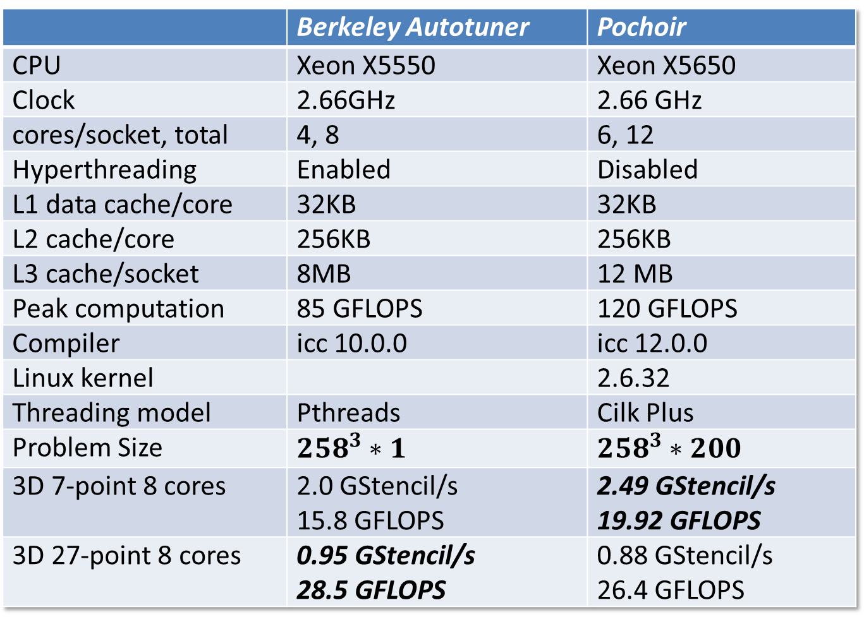
 | Berkeley Autotuner | Pochoir
CPU | Xeon X5550 | Xeon X5650
Clock | 2.66GHz | 2.66 GHz
cores/socket, total | 4, 8 | 6, 12
Hyperthreading | Enabled | Disabled
L1 data cache/core | 32KB | 32KB
L2 cache/core | 256KB | 256KB
L3 cache/socket | 8MB | 12 MB
Peak computation | 85 GFLOPS | 120 GFLOPS
Compiler | icc 10.0.0 | icc 12.0.0
Linux kernel |  | 2.6.32
Threading model | Pthreads | Cilk Plus
Problem Size | $${258}^{3}∗1$$ | $${258}^{3}∗200$$
3D 7-point 8 cores | 2.0 GStencil/s 15.8 GFLOPS | 2.49 GStencil/s 19.92 GFLOPS
3D 27-point 8 cores | 0.95 GStencil/s 28.5 GFLOPS | 0.88 GStencil/s 26.4 GFLOPS

Slide 21
Current User List
Oscar Barenys, Univ. Politechnica of Catalonia, Spain.
Volker Strumpen, Johannes Kepler University, Austria.
Nicolas Pinto, MIT/Harvard
Nicolas Vasilache, Reservoir Lab.
Patrick S. McCormick, Los Alamos National Lab.
Mohammed Shaheen, Max Planck Institut Informatik, Germany
Wim Vanroose, Universiteit Antwerpen, Belgium.
Tom Henretty, Ohio State Univ.
Protonu Basu, Univ. of Utah.
Shoaib Kamil, Berkeley.
Hal Finkel, Argonne National Lab.
Matthias Christen, Klingelbergstrass, Basel, Switzerland.
Vinayaka Bandishti, Indian Institute of Science, Bangalore, India.
Hans Vandierendonck, Ghent University, Belguim.

Slide 22
Benchmark Suite
Physics
Heat equation
Wave equation
Maxwell’s equation
Lattice Boltzmann Method
Computational Biology
RNA secondary structure prediction
Pairwise sequence alignment
Computational Finance
American Put Stock Option Pricing
Mechanical Engineering
Compressible Euler Flow
Others
Conway’s Game of Life
…

Slide 23
Release 1.0
Aug. 2012
Bug Fixes
User’s feedback
Variadic Template Support
Even Simpler user interface

Slide 24
Release 2.0
TBD
Inhomogeneity
Macroscopic Inhomogeneity
Microscopic Inhomogeneity
Generalized Dependency
Both PUSH and PULL
Slope 0 cut
from orthogonal grid to general graph
Beyond Multicore
Distributed memory clusters
MIC
GPU
FPGA
Exascale …

Slide 25
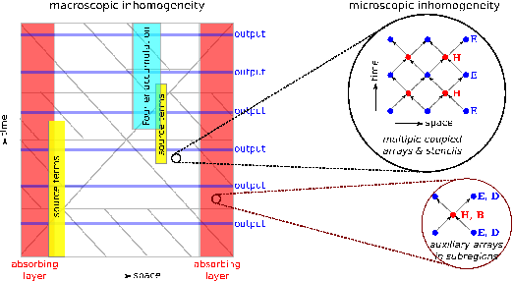
Inhomogeneity

Slide 26
Inhomogeneity
How to specify the stencil
Macroscopic specification:
Pochoir.Register_Tile_Kernel(guard, kernel);
Pochoir.Register_Tile_Kernel(guard, tile);
Tile for microscopic inhomogeneity
How to execute the specification
Define an “Inhomogeneity” metric
partial order, norm, arithmetic op, etc.
Jitting the kernels
Preprocessing stage versus runtime ?
Range Bit-wise Operation Query
Meta-algorithm, triangular query, polygon query
Code clone selection puzzle
Prune to save code generation overhead
Minimize the # if conditionals in inner-most loops

Slide 27
JIT framework
Preprocess
Get the Inhomogeneity metric
Prepare data structures for runtime query
Generate Only necessary (possibly pruned) kernels
genstencils + icc
Disk as medium (what if everything in memory?)
Can we call icc as a standalone library?
Generate the kernels at preprocessing stage versus at runtime.

Slide 28
Summary
What we have done:
Simple, concise, declarative, and easily verifiable DSL embedded in C++, with Intel Cilk Plus extension.
Arbitrary shaped, arbitrary depth stencil on arbitrary d-dimensional space-time grid, with complex boundary condition.
What we plan to do:
Further improve the performance for complex stencil kernels
Multiple inhomogeneous kernels (possibly overlapping)
Macroscopic inhomogeneity
Microscopic inhomogeneity
Generalized dependency
From orthogonal grid to general graph
Recurrence solver, dynamic programming
JIT compiler for stencil
Platform portability

Slide 29
How Intel Can Help (market plan)
Embed Pochoir technology in the ICC compiler
Optimizing techniques for a family of computation
Bind EDSL with compiler and runtime system
Extending Pochoir technology to new architectures such as GPU, MIC, etc.
JIT interface to ICC (call icc as a standalone library)
Collaborating with Intel Exascale Computing lab on complex stencil kernels
Apply Pochoir technology to non-HPC applications, such as video processing, recurrence solver, dynamic programming
Help with Intel Cilk Plus and related tools, such as cilkprof
Incorporate ISAT with heuristic autotuning
Research support for Yuan Tang
Open source like FFTW?

