Slide 1
Diabetes Prediction Using Machine Learning

Slide 2
Problem Statement
Diabetes is a major chronic disease. This project develops a machine learning model to predict diabetes early using demographic, lifestyle and clinical data.

Slide 3
Business Objective
• Early diabetes prediction
• Support clinical decisions
• Reduce complications
• Enable preventive healthcare

Slide 4
Dataset Overview
• Records: 100,000
• Target: Diabetes (0/1)
• Features: Age, Gender, BMI, Hypertension, Heart Disease, Smoking History, HbA1c, Blood Glucose
• Missing Values: None

Slide 5
Data Preprocessing
• Data Cleaning
• One-Hot Encoding
• Train-Test Split (80:20)
• Feature Scaling

Slide 6
EDA Highlights
• Diabetes prevalence: 8.5%
• Higher HbA1c and Blood Glucose linked with diabetes
• Hypertension & Heart Disease increase diabetes risk
• Age and BMI show positive association

Slide 7
Models Implemented
• Logistic Regression
• Decision Tree
• Random Forest

Slide 8
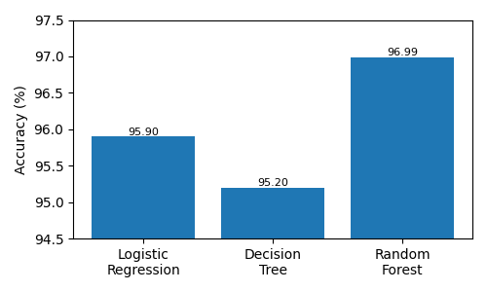
Model Comparison
Logistic Regression: Accuracy 95.90%
Decision Tree: Accuracy 95.20%
Random Forest: Accuracy 96.99%

Slide 9
Best Model
Random Forest
Accuracy: 96.99%
Precision: 95%
Recall: 69%
F1 Score: 80%

Slide 10
Feature Importance
Top predictors:
1. Blood Glucose Level
2. HbA1c Level
3. Age
4. BMI
5. Hypertension
6. Heart Disease

Slide 11
Business Recommendations
• Regular screening
• Monitor HbA1c & glucose
• Lifestyle awareness
• Monitor high-risk patients

Slide 12
Future Scope
• Web App
• Hospital integration
• Larger datasets
• Real-time prediction

Slide 13
Conclusion
Random Forest achieved the best overall performance and is recommended for early diabetes prediction.

Slide 14
Thank You

