Slide 1



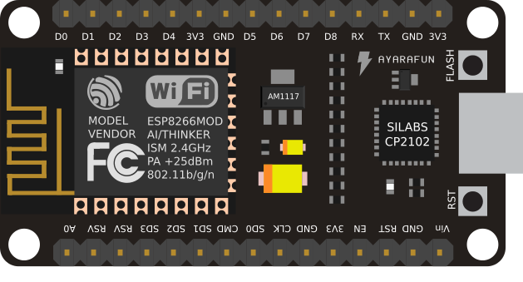
Working of Blynk
Server
APP
NodeMCU - with
Blynk Libraries

Slide 2
