Slide 1

Course Introduction
Analysis and Design of Algorithms (ADA)
GTU #3150703
Rupesh Vaishnav
Computer Engineering Department
rupesh.vaishnav@darshan.ac.in
9428037452

Slide 2
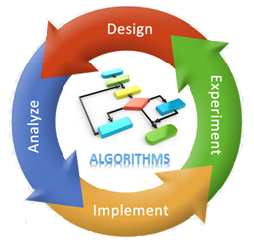
Course Objective
Designing an algorithm
Analyzing Running Time
Experiments under various Conditions
Programming using Specific Language

Slide 3
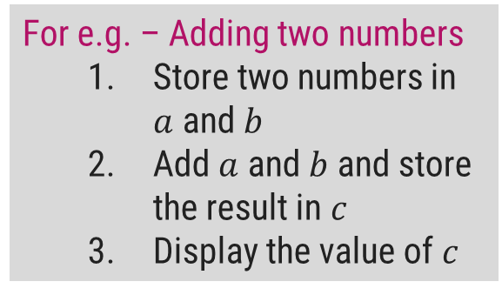
Algorithm Designing
An Algorithm provides a method of doing the things, from our daily life to every other complex problem of the world.
Knowingly or unknowingly we execute a lot of complex programs in our daily life written using algorithms.
For e.g. - A visit to a new city
Collect information
Book tickets
Identify locations to visit
Pack up and go
For e.g. – Adding two numbers
Store two numbers in $a$ and $b$
Add $a$ and $b$ and store the result in $c$
Display the value of $c$

Slide 4
Algorithm Designing
So, basically algorithm tells exactly how to do something to reach our goal or to achieve the required output or to accomplish our task.
Computer is a machine, designed to follow the human orders.
We have to instruct it properly after considering every aspect, so that nothing is left behind or wrongly entered.
Even a slight mistake can change the execution of a command which will change the end result.
In order to design a perfect computer program to solve the real world complex problems, we have to write an appropriate algorithm first.

Slide 5
Real Life Applications
To find the shortest or the best path to travel from one location to another (Google Maps).
To do the weather forecasting.
DNA pattern matching and to cure diseases.
For making games like chess, Go, etc. that can defeat the human champions.
For building smart robots ( like drones ).
Every time you hit the search button on Google.
In fact, every time you access an ATM, enlist for a unique identity number under Aadhaar, book an air or train ticket or buy something online, you are expanding the scope and range of algorithms.

Slide 6
Course Objective
Designing an algorithm
Analyzing Running Time
Experiments under various Conditions
Programming using Specific Language

Slide 7
Algorithm Analysis
The algorithm is the basic technique used to get the task done.
There are often many different ways or algorithms to accomplish the given task.
For e.g., let's say that you have a friend arriving at the airport, and your friend needs to get from the airport to your house. Here are four different algorithms that you might give your friend for getting to your home:

Slide 8
Algorithm Analysis
The taxi algorithm:
Go to the taxi stand.
Get in a taxi.
Give the driver my address.
The rent-a-car algorithm:
Call OLA and Rent a car.
Follow the directions to get to my house.
The call-me algorithm:
When your plane arrives, call my cell phone.
Meet me outside baggage claim.
The bus algorithm:
Outside baggage claim, catch bus number 70.
Transfer to bus 14 on Main Street.
Get off on high street.
Walk two blocks north to my house.

Slide 9
Algorithm Analysis
All four of these algorithms accomplish exactly the same goal, but each algorithm does it in a completely different way.
Each algorithm also has a different cost and a different travel time.
Taking a taxi, for example, is probably the fastest way, but also the most expensive.
Taking the bus is definitely less expensive, but a whole lot slower.
So, by analyzing the different algorithms that are solving the same problem, we can compare them and find out which algorithm is better and which algorithm is best suited for our scenario.

Slide 10
Course Objective
Designing an algorithm
Analyzing Running Time
Experiments under various Conditions
Programming using Specific Language

Slide 11
Implementation
Algorithms are generally written using descriptive English language.
They are independent of any programming language.
Some times written using the pseudocodes also, which is a semi-programming language used to describe the steps in an algorithm.
So, once an algorithm is designed and analyzed theoretically, it is coded using a specific programming language.
Implementation of algorithm into a program is required to make it work for producing the desired output.

Slide 12
Course Objective
Designing an algorithm
Analyzing Running Time
Experiments under various Conditions
Programming using Specific Language

Slide 13
Experiments
After successful implementation of an algorithm, it is executed / run under different input conditions.
Before applying an algorithm to a real world application, it is necessary to test the correctness of the algorithm.
Sorting numbers with 100 numbers and 10 lakhs numbers
Accessing a website by 100 users or 1 lakh users

Slide 14
Design an algorithm for Music Shuffling
Artist
Album
Genre
Decade

Slide 15
Design an algorithm for Music Shuffling
Weight_Gen(currently_playing)
1. song.weight=0
2. If currently_playing.artist == song.artist
3. song.weight +=1
4. If currently_playing.album == song.album
5. song.weight +=1
6. If currently_playing.genre == song.genre
7. song.weight +=2
8. If currently_playing.decade == song.decade
9. song.weight +=1
Ref: Prateek Singh et al, / (IJCSIT) International Journal of Computer Science and Information Technologies, Vol. 6 (5) , 2015, 4159-4162

Slide 16
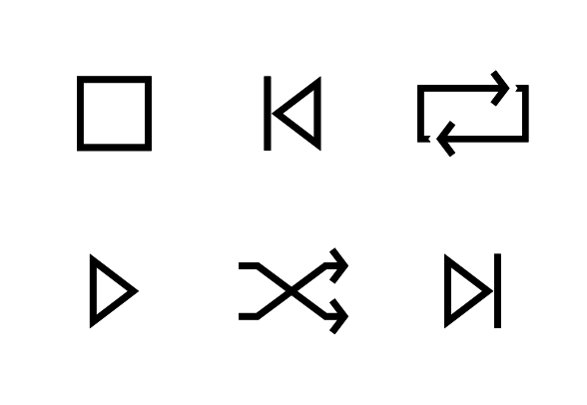
Design an algorithm for Music Shuffling
The duration for which the current track is played is directly related to its likability by the user.
If the first song is changed immediately, another random song is played.
If the song is played for a minimum time say t1, weight generator is called.
A point in duration of the song is referred to as t2.
t2 can be referred to as the time for which if the song is played succinctly established that it is liked by the user.
If the duration crosses t2 and user requests a new song, the next song would be the one most similar to the song played.
If the duration is less than t2, there is a logic in place to assure that the user does not listen to the same kind of songs

Slide 17
Design an algorithm for Music Shuffling
Random_Song
Priority_Play
Average_Play
Pool_Play

Slide 18

GTU Syllabus
Basics of Algorithms and Mathematics
Analysis of Algorithm
Divide and Conquer Algorithm
Dynamic Programming
Greedy Algorithm
Exploring Graphs
Backtracking and Branch and Bound
String Matching
Introduction to NP-Completeness
Looping

Slide 19
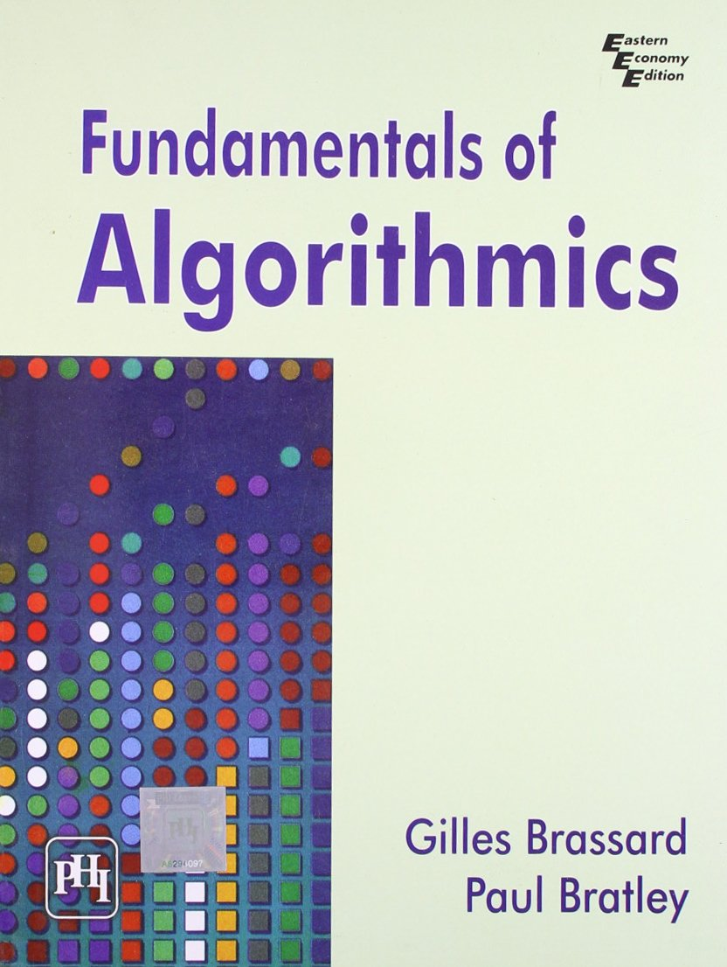
Reference Books
Fundamental of Algorithmics by Gills Brassard, Paul Bratley, PHI.
Introduction to Algorithms, Thomas H. Cormen, Charles E. Leiserson, Ronald L. Rivest and Clifford Stein, PHI.

Slide 20
The Course Scope
Understand and learn different types of existing algorithms.
Learn to analyze these algorithms mathematically and compare them.
Implement some of these algorithms using C/C++ during lab sessions.
Make some efforts to design the new algorithm for a few small problems.

Slide 21
Course Outcome
Analyze the asymptotic performance of algorithms.
Derive and solve recurrences describing the performance of divide-and-conquer algorithms.
Find optimal solution by applying various methods.
Apply pattern matching algorithms to find particular pattern.
Differentiate polynomial and non-polynomial problems.
Explain the major graph algorithms and their analyses. Employ graphs to model engineering problems, when appropriate.

Slide 22
Examination Scheme
Prerequisite: Programming (C or C++), Data and file structure
Examination Marks |  |  |  | Total Marks
Theory Marks |  | Practical Marks
ESE (E) | PA | ESE (V) | PA (I)
70 | 30 | 30 | 20 | 150

Slide 23
Happy Learning
Thank You!!

Slide 24
Analysis and Design of Algorithms (ADA)
GTU #3150703
Rupesh Vaishnav
Computer Engineering Department
rupesh.vaishnav@darshan.ac.in
9428037452

