Slide 1
Introduction to Phyloseq
Daniel Vaulot

Slide 2
Why use R ?
Script vs. Menu driven software
Can be re-rerun with new data
R works with vectors and tables
Z <- X + Y where X and Y are vectors
"Tidy" worflow
Select(Tara_table, fraction="0.2-5")
Tidy "universe" : tidyverse
Incredible graphics and plots
ggplot2 family
Work environment
R studio
Document your data processing
R markdown
Share your data and workflow
GitHub

Slide 3
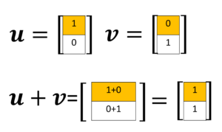
R works with vectors
station | fraction | diatoms | bolidos | stramenos | diatoms_pct
4 | Nano | 17165 | 12 | 17177 | 0.999
4 | Pico | 59786 | 1293 | 61079 | 0.979
72 | Nano | 6951 | 3 | 6954 | 1.000
72 | Pico | 3815 | 494 | 4309 | 0.885
Concept of data frame
Each column correspond to a vector
Some columns can be numeric, characters, dates
Creating new vectors
strameno<-diatoms+bolidos
diatoms_pct<-diatoms/strameno

Slide 4
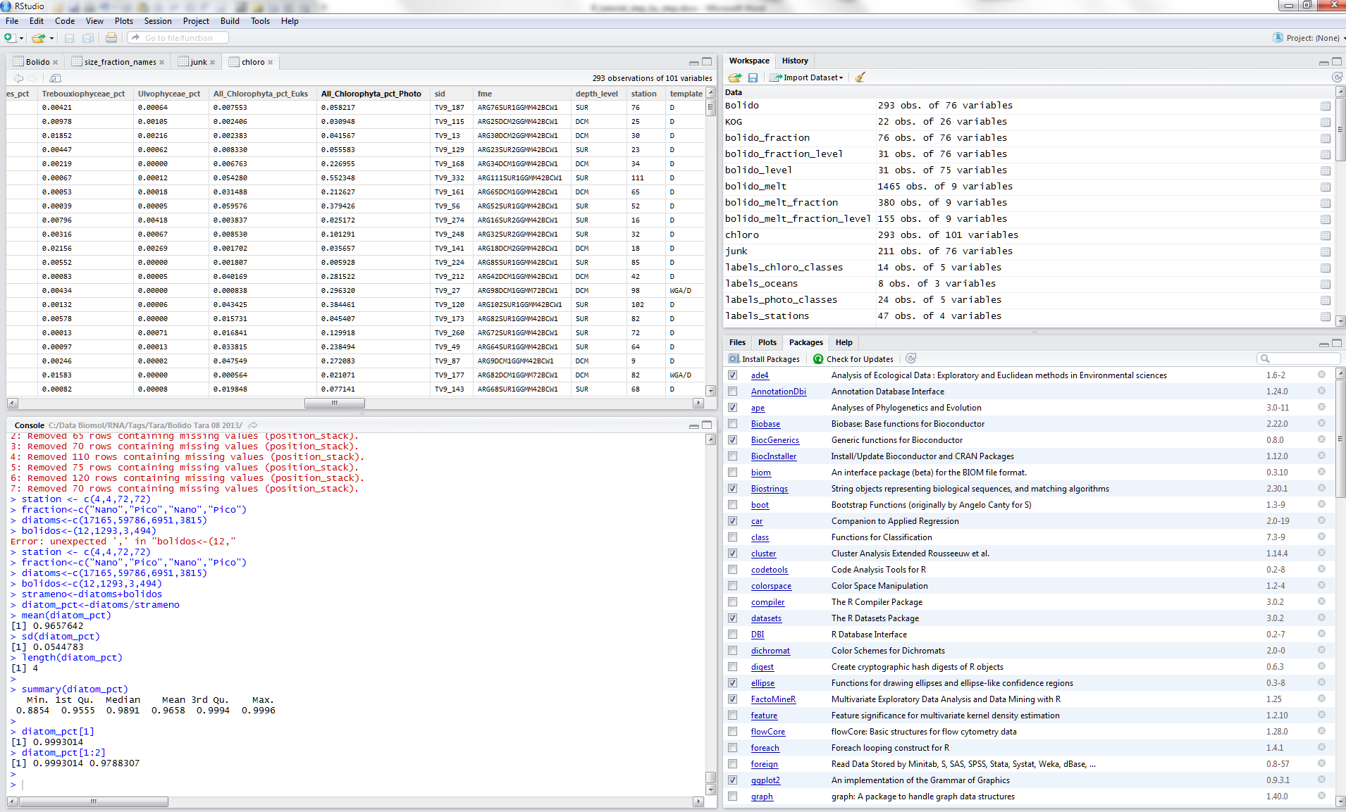
R studio

Slide 5
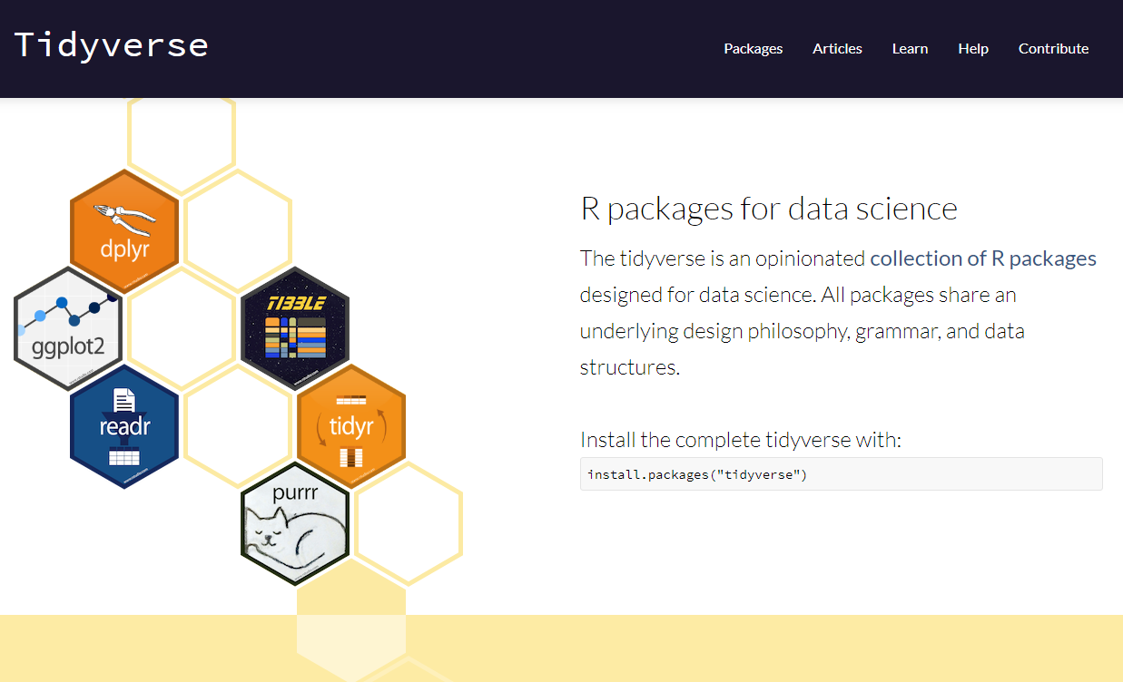
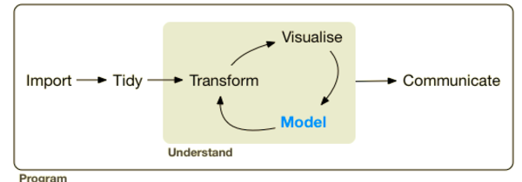
Tidyverse

Slide 6
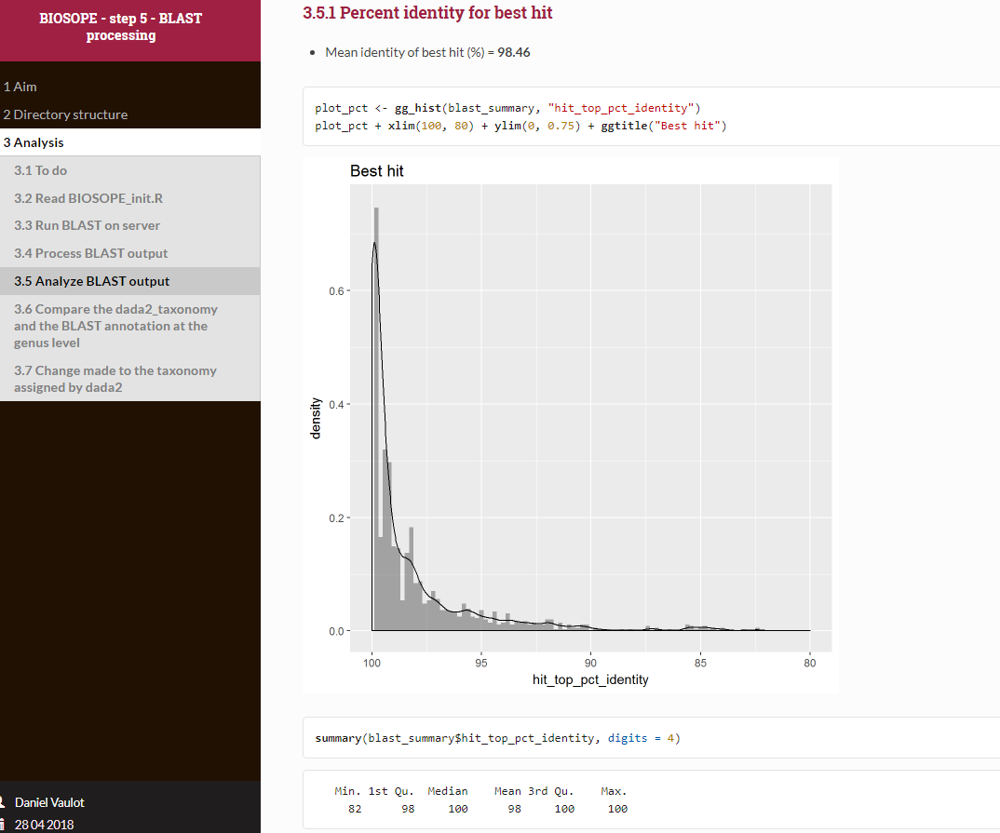
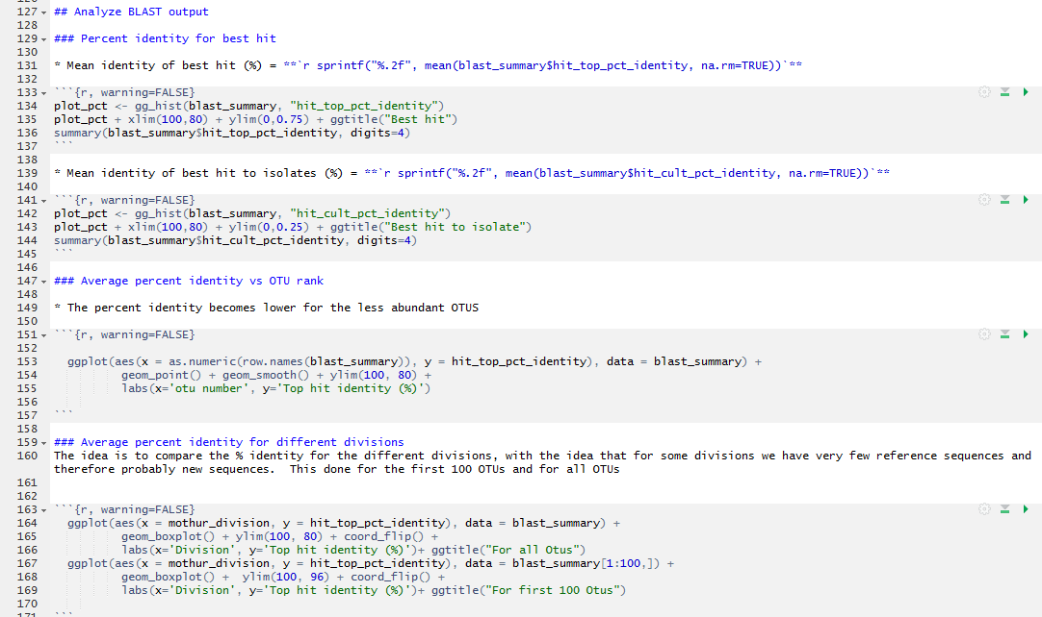
Document your work and recycle

Slide 7
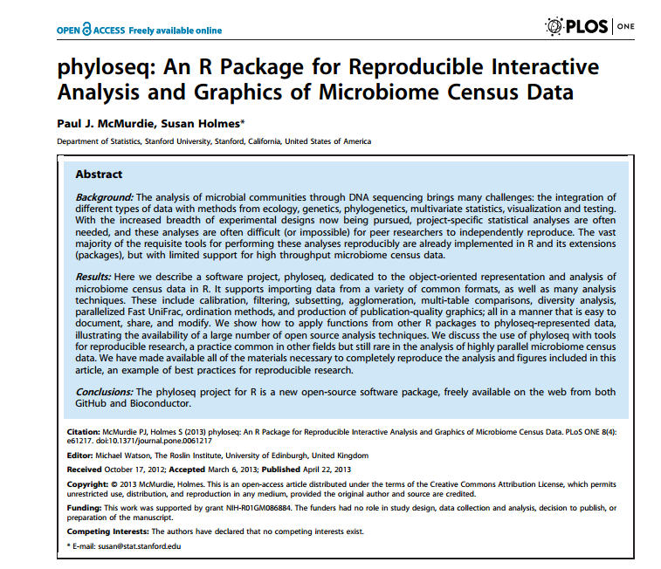

Slide 8
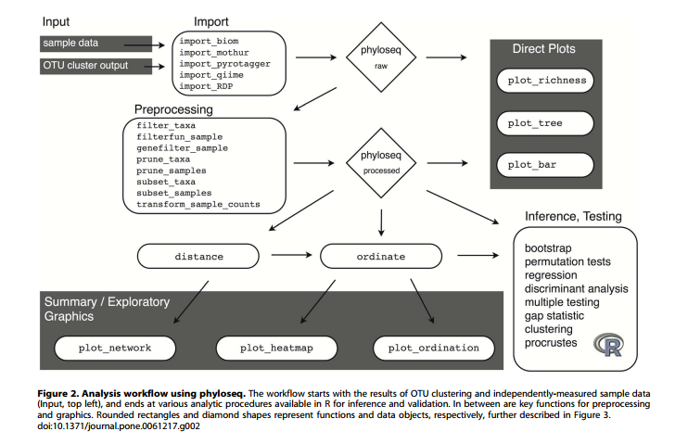

Slide 9
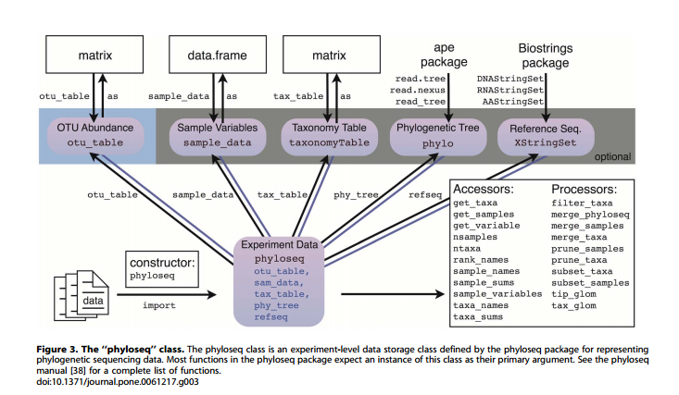

Slide 10
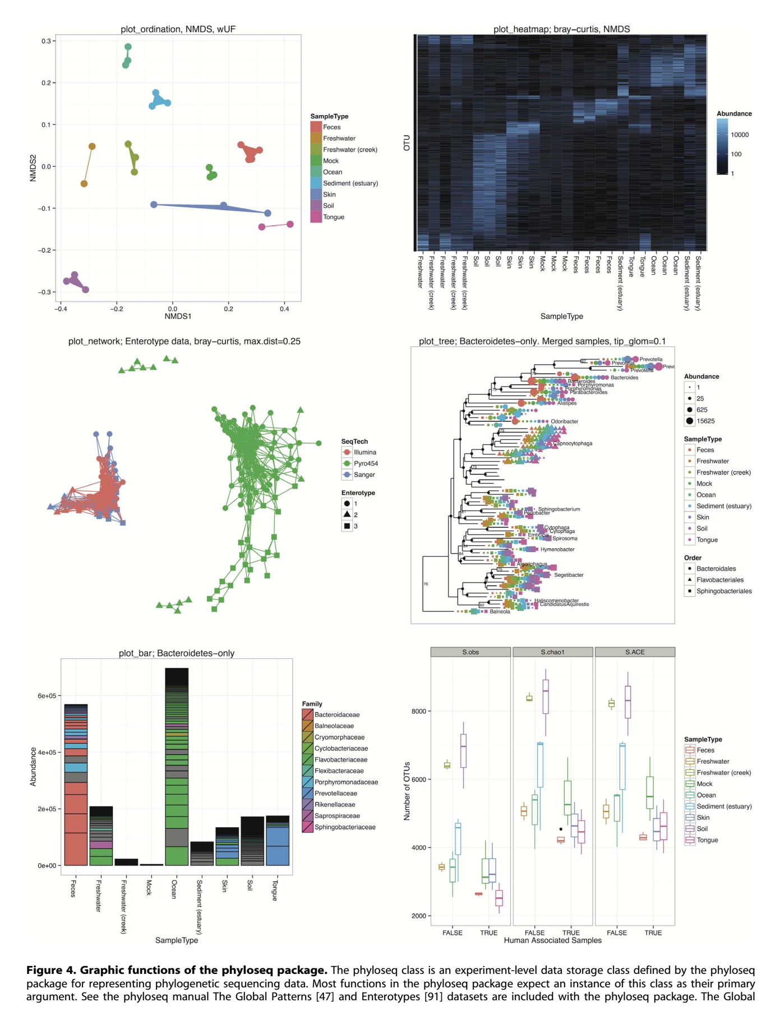

Slide 11
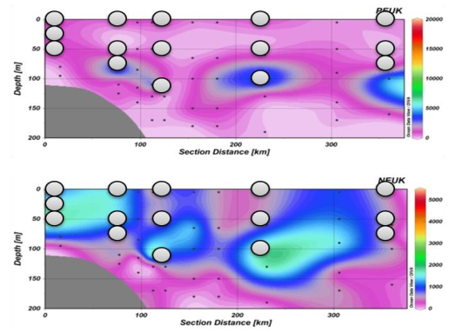
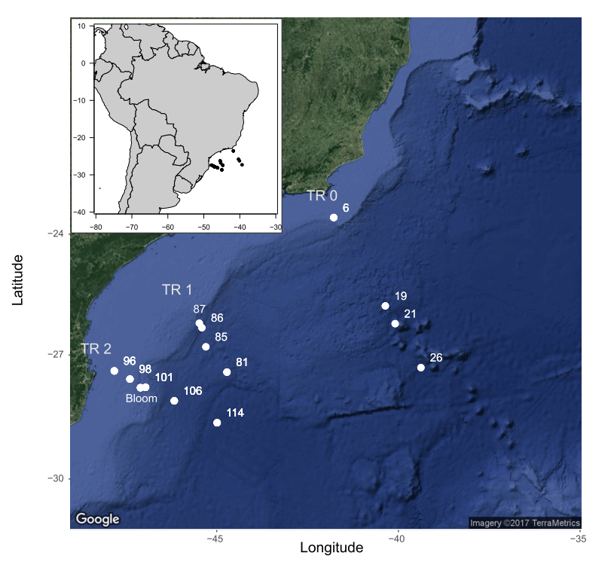
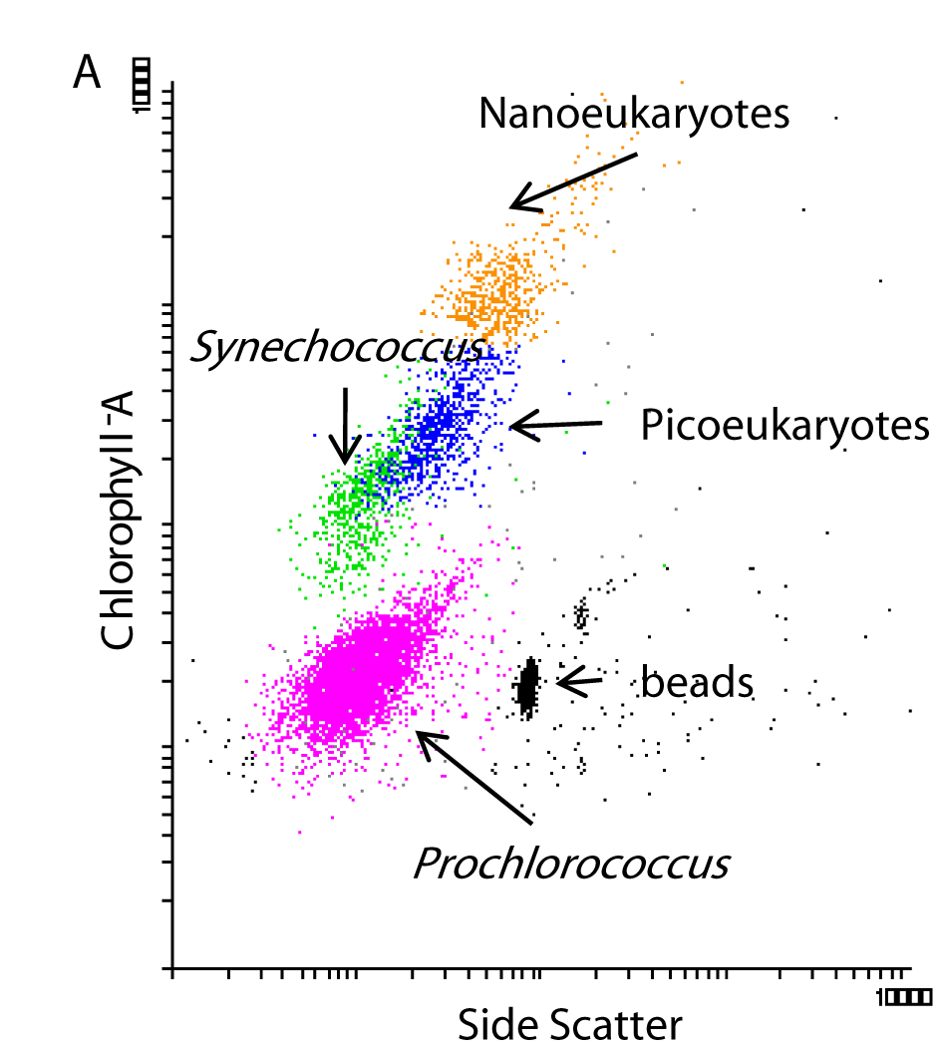
CARBOM cruise
Sorted samples
Pico vs Nano
Surf vs Deep
18S V4
Illumina 2*250 bp
C. Ribeiro and A. Lopes dos Santos, unpublished.

Slide 12
Preparation
Unzip files from phyloseq_tutorial.zip
Copy to local or remote directory
Open R studio either locally or on server
Open « phyloseq_tutorial.Rmd» with R studio
Set your working directory where the files are

Slide 13
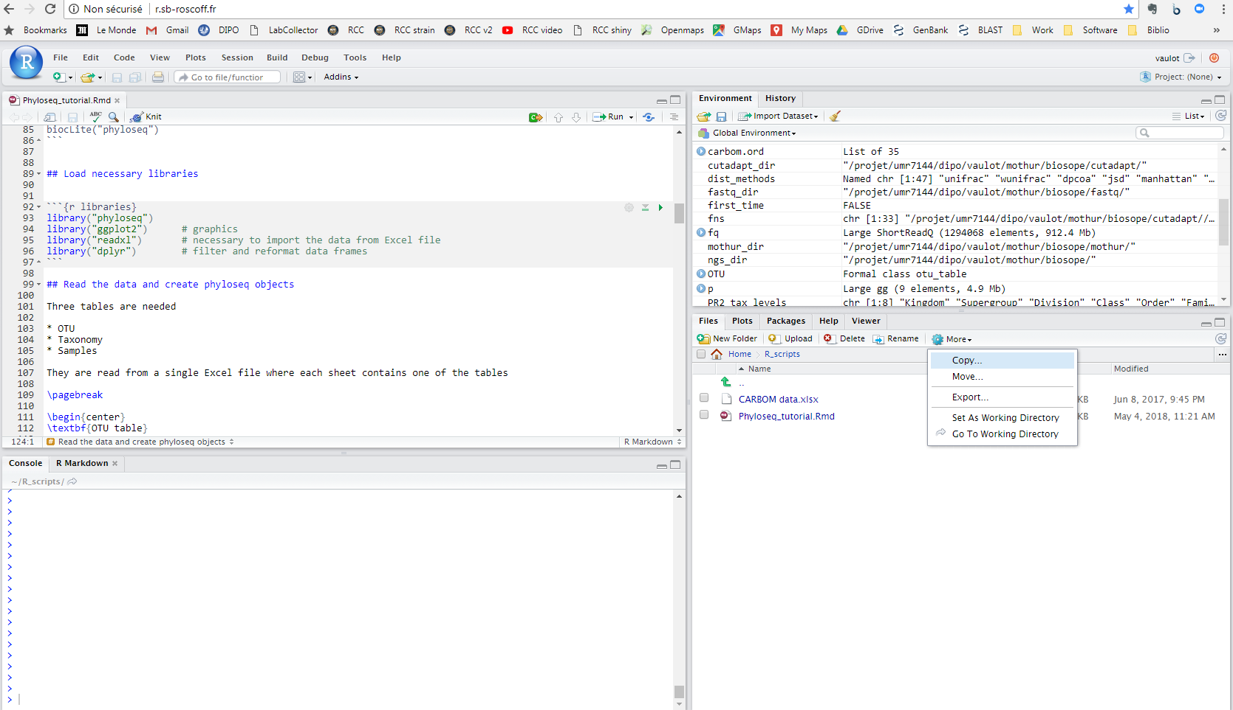

Slide 14
Import data
Necessary
OTU table
Taxonomy table
Sample variables
Optional
Tree
Sequences

Slide 15
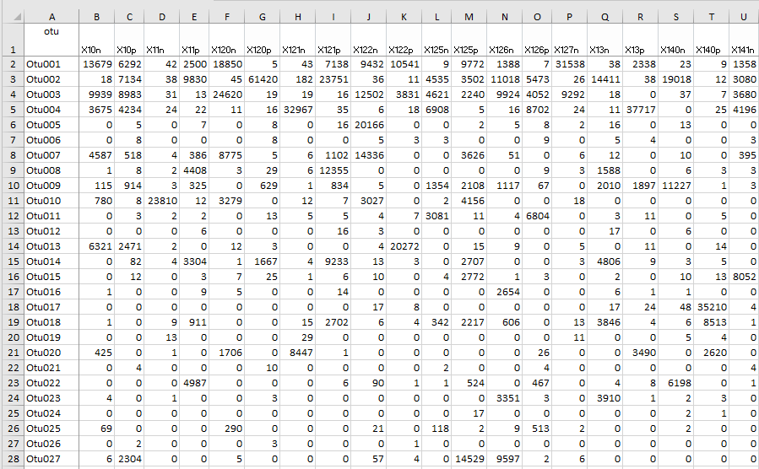
1 - Otu table

Slide 16
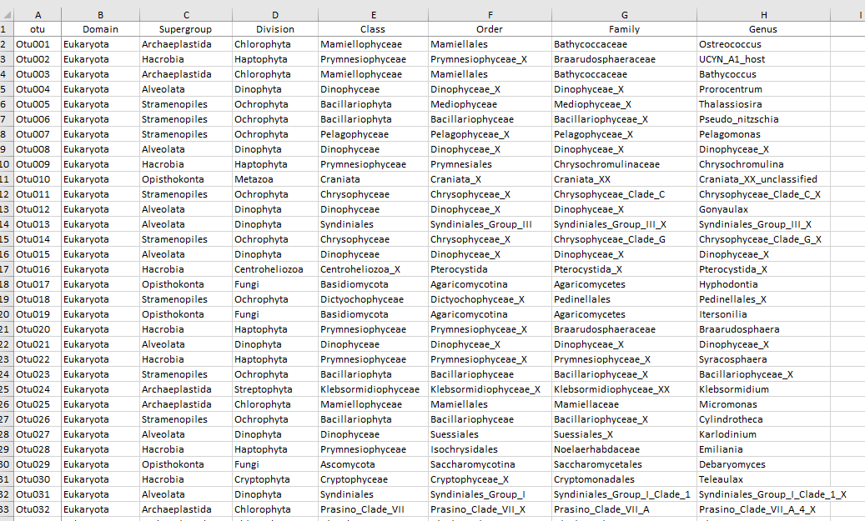
2 - Taxonomy Table

Slide 17
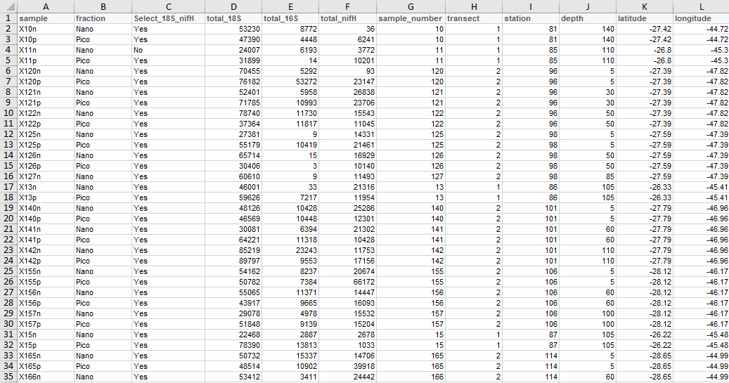
3 - Sample table

Slide 18
Steps
Import data
Combine into "phyloseq" object
Filter the data
taxonomy : e.g. only keep photosynthetic eukaryotes
samples : remove samples with low reads
abundance : remove OTUs with low abundance for some analyses
Barplots
Heatmaps
Alpha diversity
Multivariate analysis
Network analysis

Slide 19
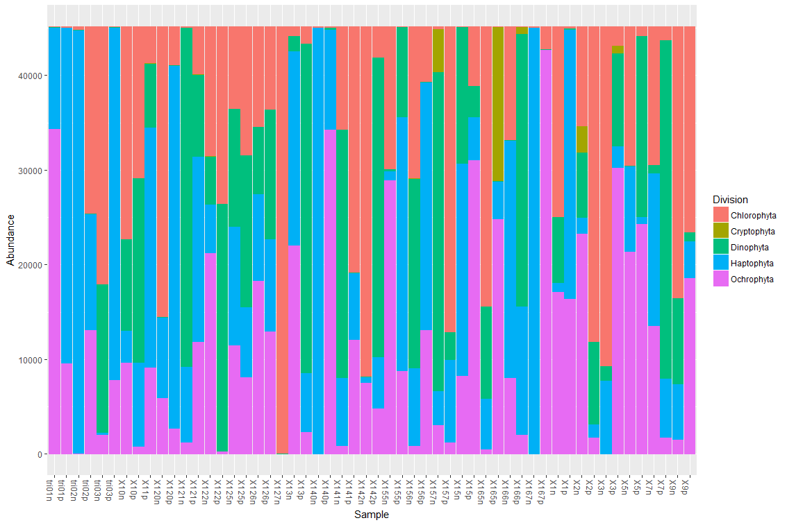
Barplots

Slide 20
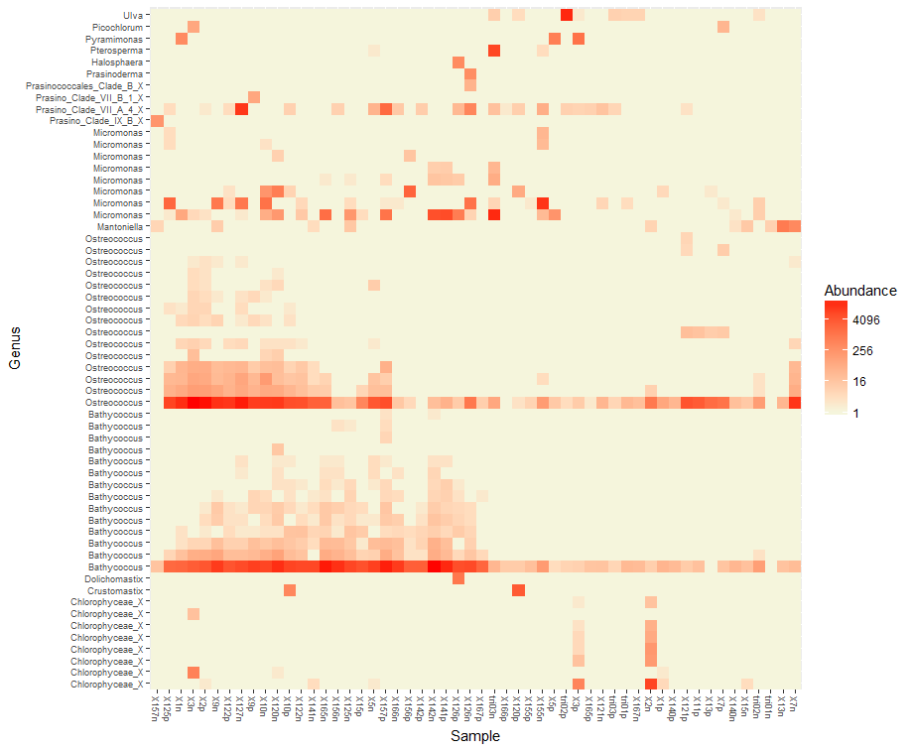
Heatmaps

Slide 21
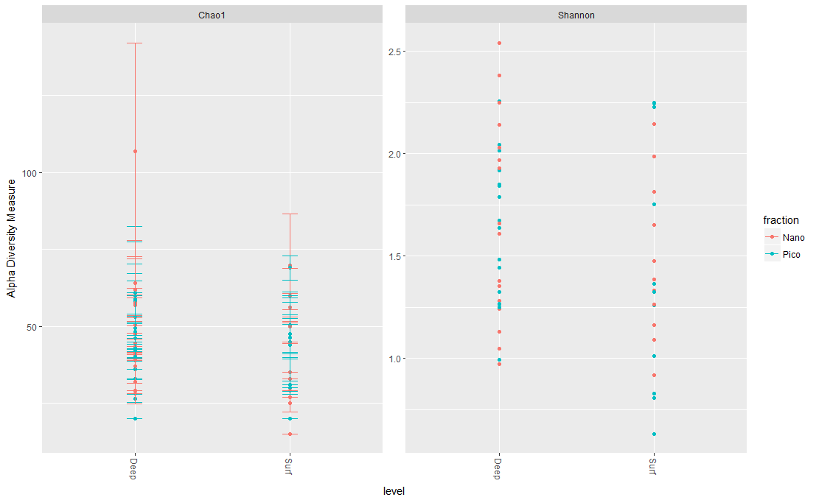
Alpha diversity

Slide 22
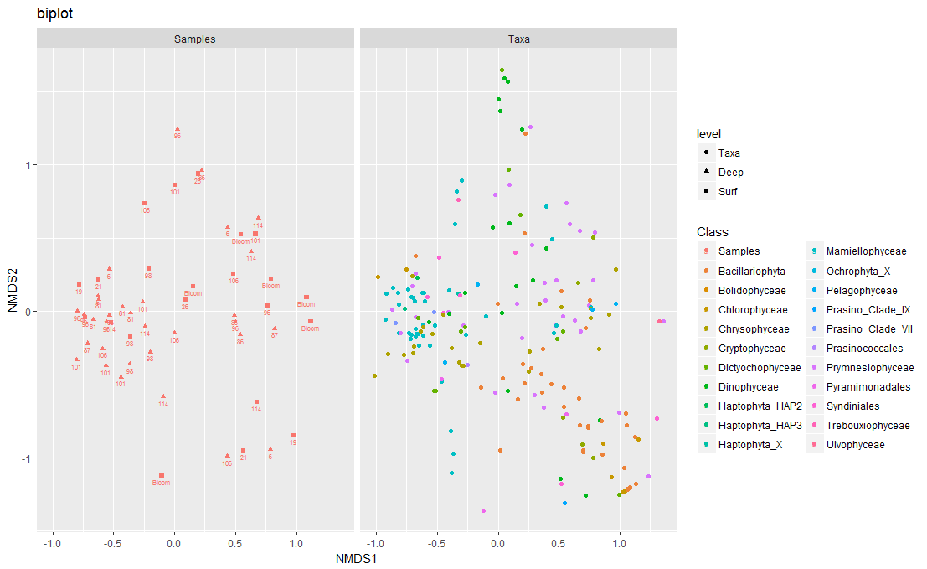
Multivariate analysis

Slide 23
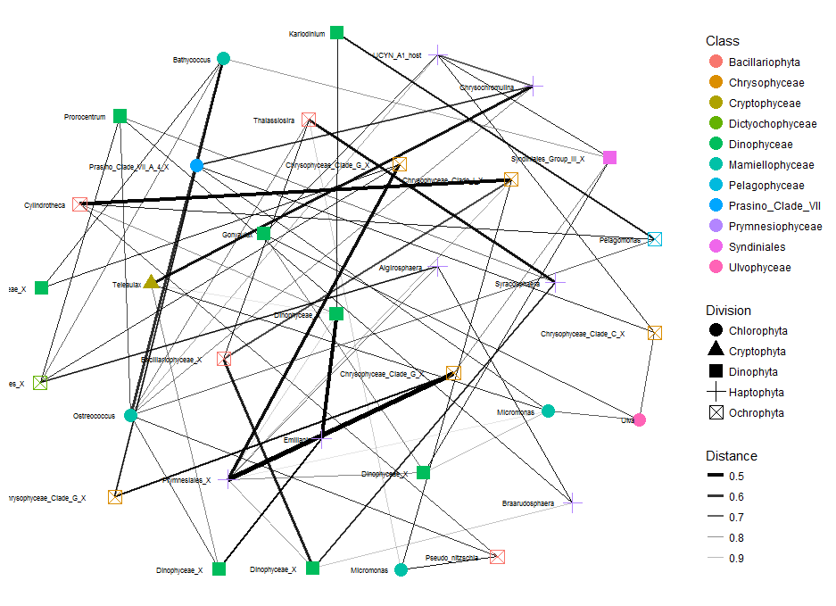
Network analysis

Slide 24
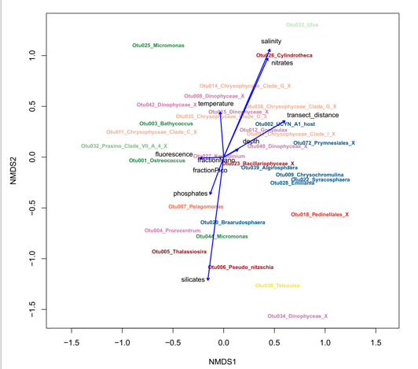
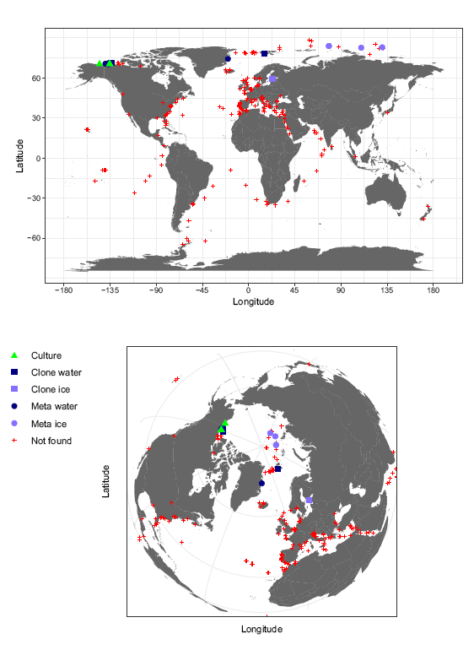
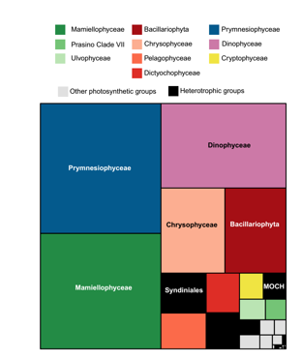
Other useful R packages
ggplot2
Best package for plotting things
vegan
Multivariate analyses
dplyr
Sorting, filtering, reformating data
maps
Plot the distribution of your data
treemaps
Summary plots
Tableau
Very intuitive software for data exploration

