Slide 1

Portfolio Website
Hiren Gondhiya

Slide 2
Design Brief & Decisions
Simple Layout.
Minimal color template for high contrast.
Large menu for selection accuracy on mobile.
Show my web development skills to perspective employers.

Slide 3
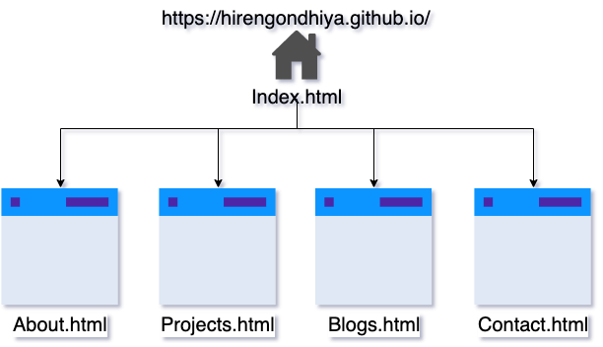
Site map

Slide 4
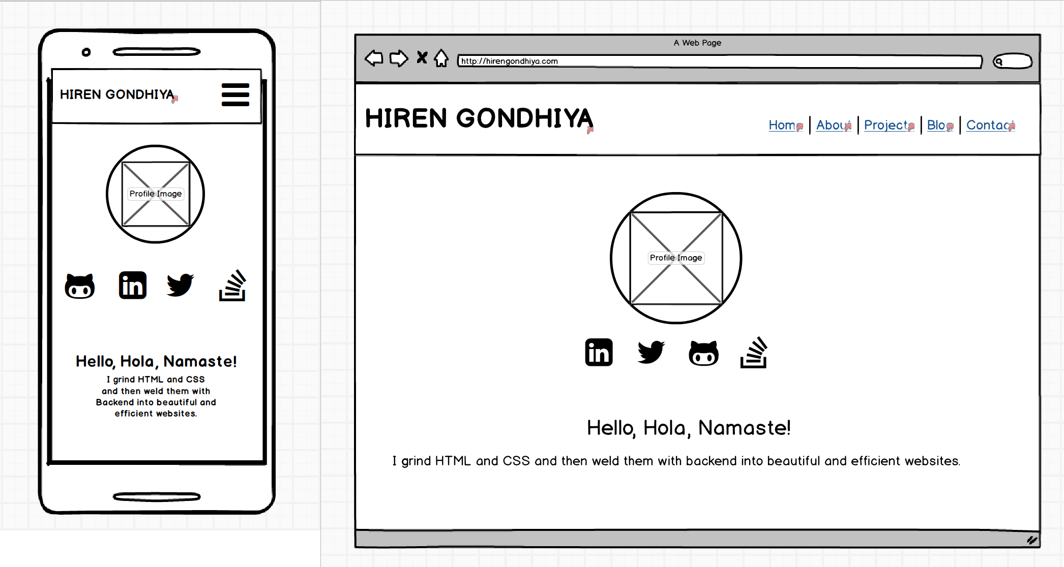
Home Page

Slide 5
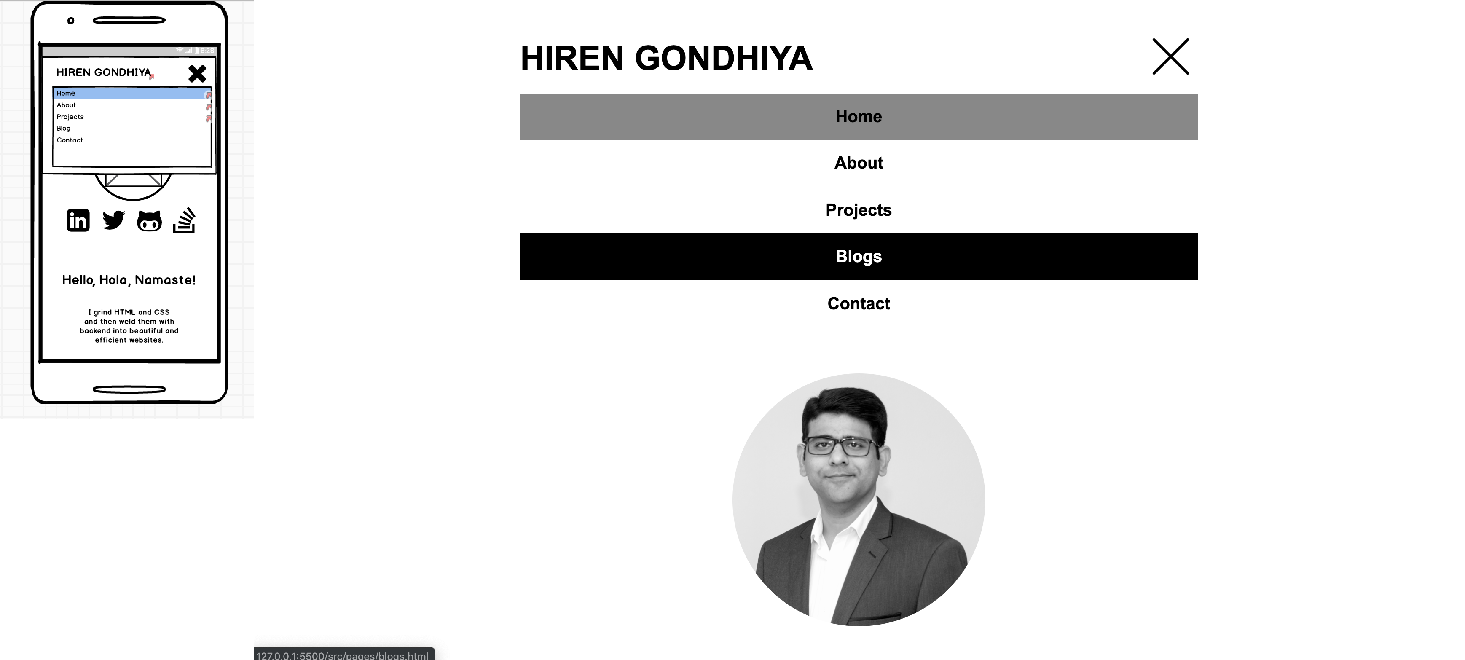
Menu

Slide 6
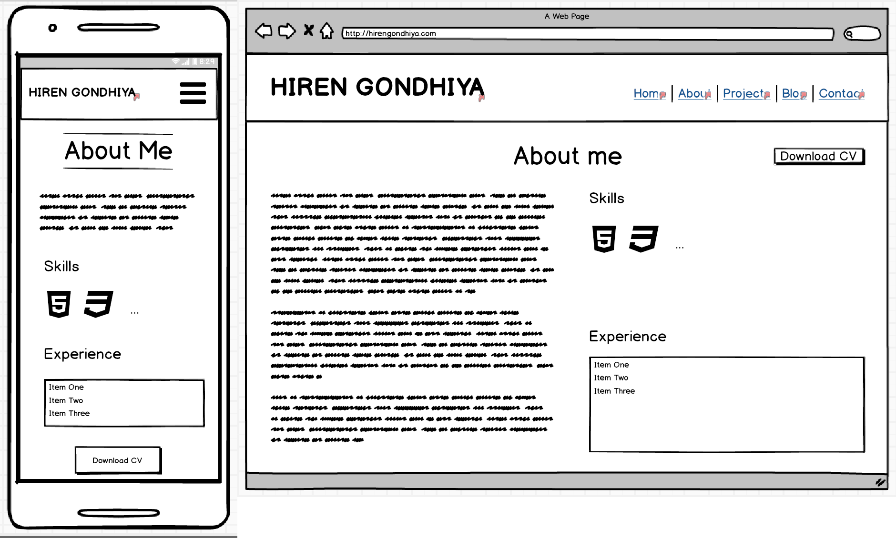
About Page

Slide 7
Key Learning
Mobile first
Component based thinking
SASS and Responsive Design

Slide 8
Key challanges
CSS.
Never undersestimate simple things.

