Slide 1
Review Sentiment Prediction
Binary Classification Problem
Prepared By: Hiren Kelaiya

Slide 2
Index
Initial Data Observation
Exploratory Data Analysis (EDA)
Feature Encoding
Class imbalance handling and Train/Test split
Machine Learning Models
Evaluation metric
Conclusion

Slide 3
Initial Data Observation
Training data has 3 features: id, text and category
Here text is already converted into numbers but given in string format
Category is the sentiments containing positive (1) and negative (0) classes
Training data has 2598 entries while testing data has 866 entries
None of the features have missing values
Target variable has imbalanced class distribution
Scaling is not required as all the numerical features are in similar scale

Slide 4
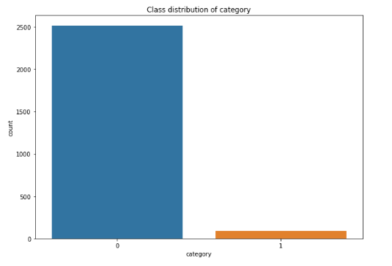
Exploratory Data Analysis (EDA)
Distribution of Target Classes
  Heavily class imbalance is observed. From the above figure, we can clearly see that class 1 (positive sentiment) is very less that class 0 (negative sentiment).

Slide 5
Feature Encoding
Here, following 3 different NLP techniques are tried to vectorize the text feature:
  Count Vectorizer converts a collection of text documents to a matrix of token counts
  TFIDF Vectorizer converts a collection of raw documents to a matrix of TF-IDF features.
  Hash Vectorizer converts a collection of text documents to a matrix of token occurrences

Slide 6
Class imbalance handling and Train/Test split
The target variable category has imbalance between two classes.
Class 1 needs to be up-sampled in order to make it equivalent to the class 0. SMOTE technique is used to handle class imbalance.
Here, 80:20 splitting of training and validation data lead to higher precision score compare to other splits.

Slide 7
Machine Learning Models
Tried following few classifiers and selected the best performing model for further tuning and testing.
Logistic Regression
Random Forest
XGBoost
Stochastic Gradient Descent (SGD) Classifier
Out of these models, Logistic Regression outperformed all others with having precision score of 0.96 on test data.

Slide 8
Evaluation metric
For this problem, precision score with micro average is used to evaluate the model on test data.
Precision attempts to answer the following question: What proportion of positive identifications was actually correct? The precision is intuitively the ability of the classifier not to label as positive a sample that is negative.
The best value is 1 and the worst value is 0.
Precision = TP / (TP + FP)

Slide 9
Conclusion
This is the binary classification problem with imbalanced target classes.
The given feature text is already tokenized and converted into numeric values.
id is removed from the data due to unimportance in predicting target variable.
Logistic Regression performs better compare to other known classifiers with Precision of 0.96 on test data.

Slide 10
Thank you

