Slide 1
MediAid
A Clinical Decision Support System
for
Diabetes and Chronic Kidney Disease
Oliver Lorenz-Cristea, Emmanouil Damilakis, Nicolas Bopp
FHNW – Pharmaceutical Informatics – Digital Transformation in Healthcare
11.12.2024

Slide 2
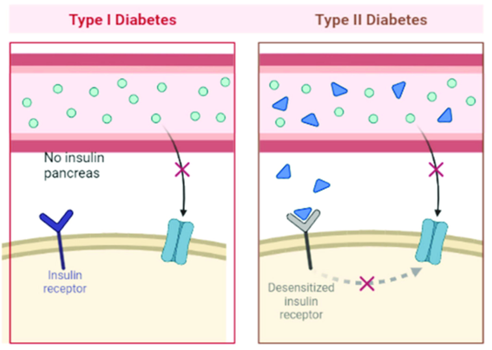
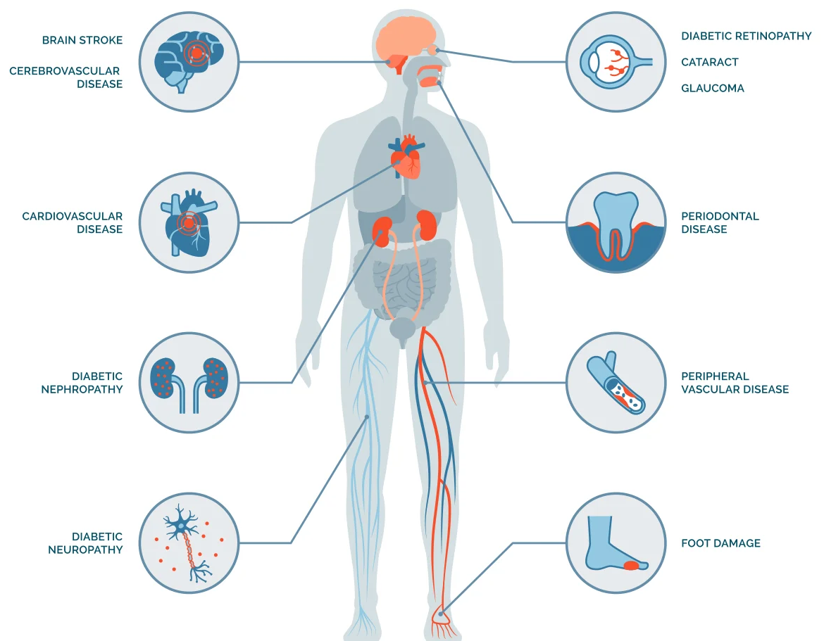
Early detection of diabetic related complications is still a challenge
Problem
CDSS supported
prediction monitoring
https://doi.org/10.3390/nano13071247
Diabetes Complications | Endocrine Society

Slide 3
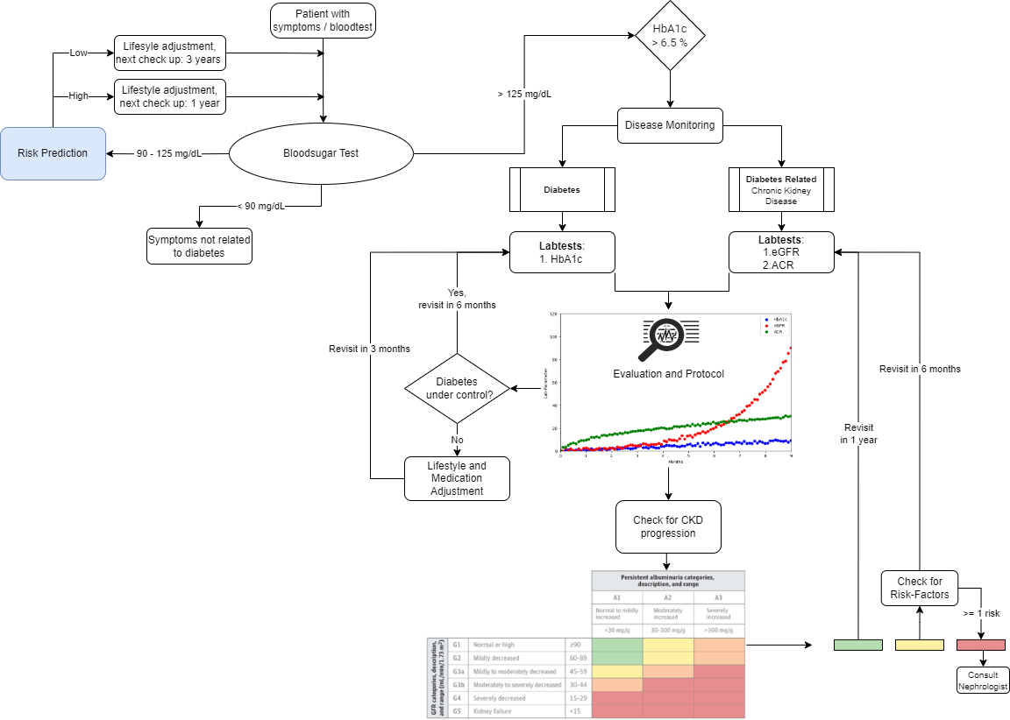
Manage type 2 diabetes and related diseases via patient monitoring.
Solution
Development of a CDSS
Machine learning aided type 2 diabetes risk prediction

Slide 4

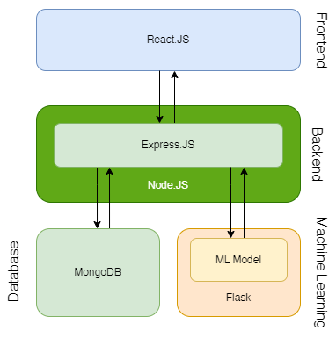
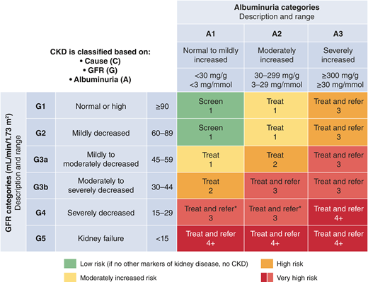
ML Model for Diabetes Risk Prediction:
Methods
Input
Output
High Blood Pressure
BMI
Diabetes Risk Score
Physical Activity
Gradient Boosting Classifier
Chronic Kidney Disease Ranking:
Based on American Diabetes Association (ADA) and Kidney Disease Report
https://doi.org/10.2337/dci22-0027

Slide 5
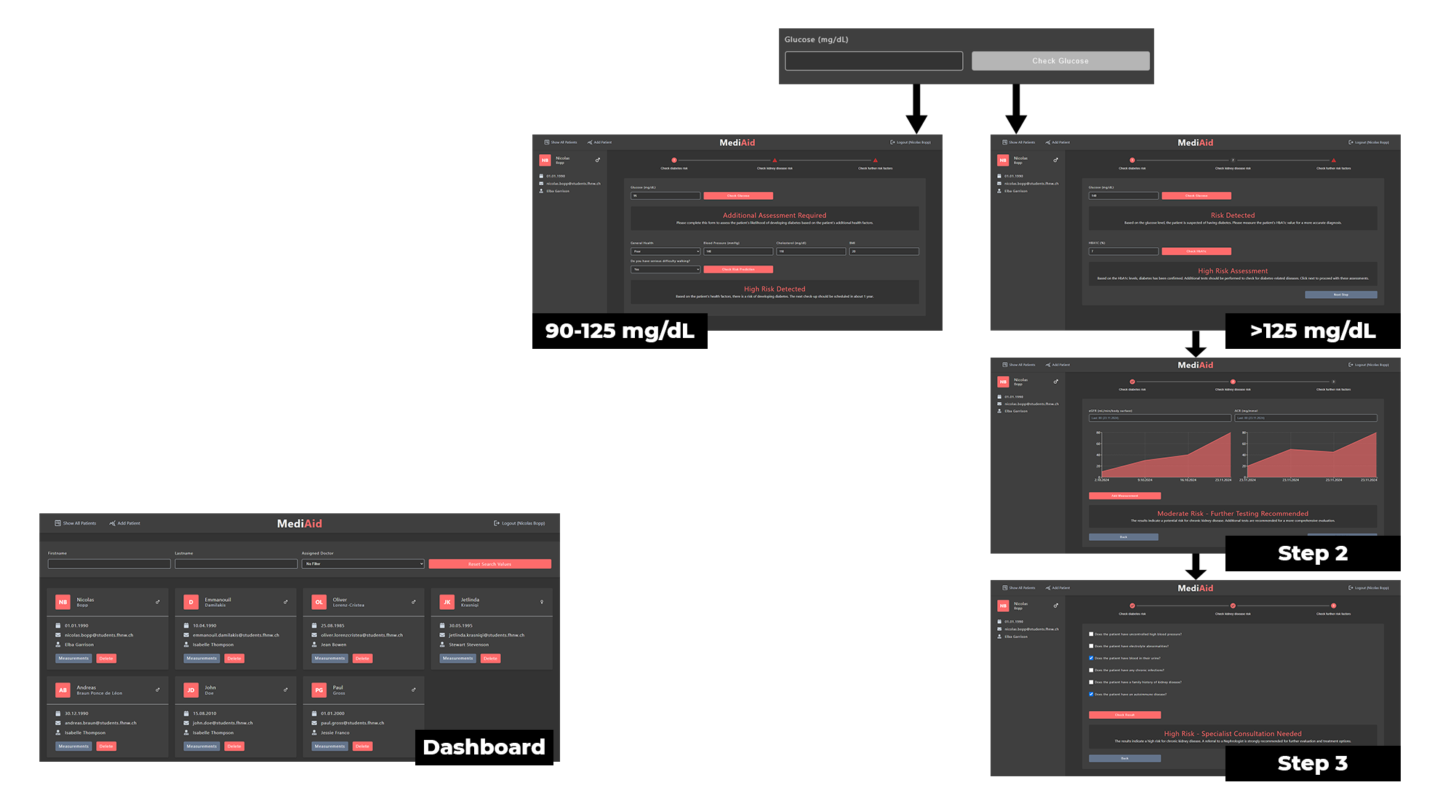
Result
Clinical Decision Support System (CDSS)
User Authentication System
Patient Management Dashboard
AI-based Diabetes Risk Prediction & Diagnostics
Chronic Kidney Disease Diagnostics

Slide 6
The cost of chronic disease worldwide is estimated to reach $47 trillion by 2030*
Impact
*https://doi.org/10.1016/j.mayocpiqo.2023.08.005
Increasing Prevalence and Cost: Diabetes prevalence is rising, with potential 700 million adults affected by 2025. The disease's global cost was $966 billion in 2021.
Diabetes development is linked to lifestyle and behaviors, yet prevention investment is low compared to treatment.
MediAid filling the gap in prevention of diabetes and its related diseases leading to reduction of healthcare costs and more important to increasing quality of life.

Slide 7
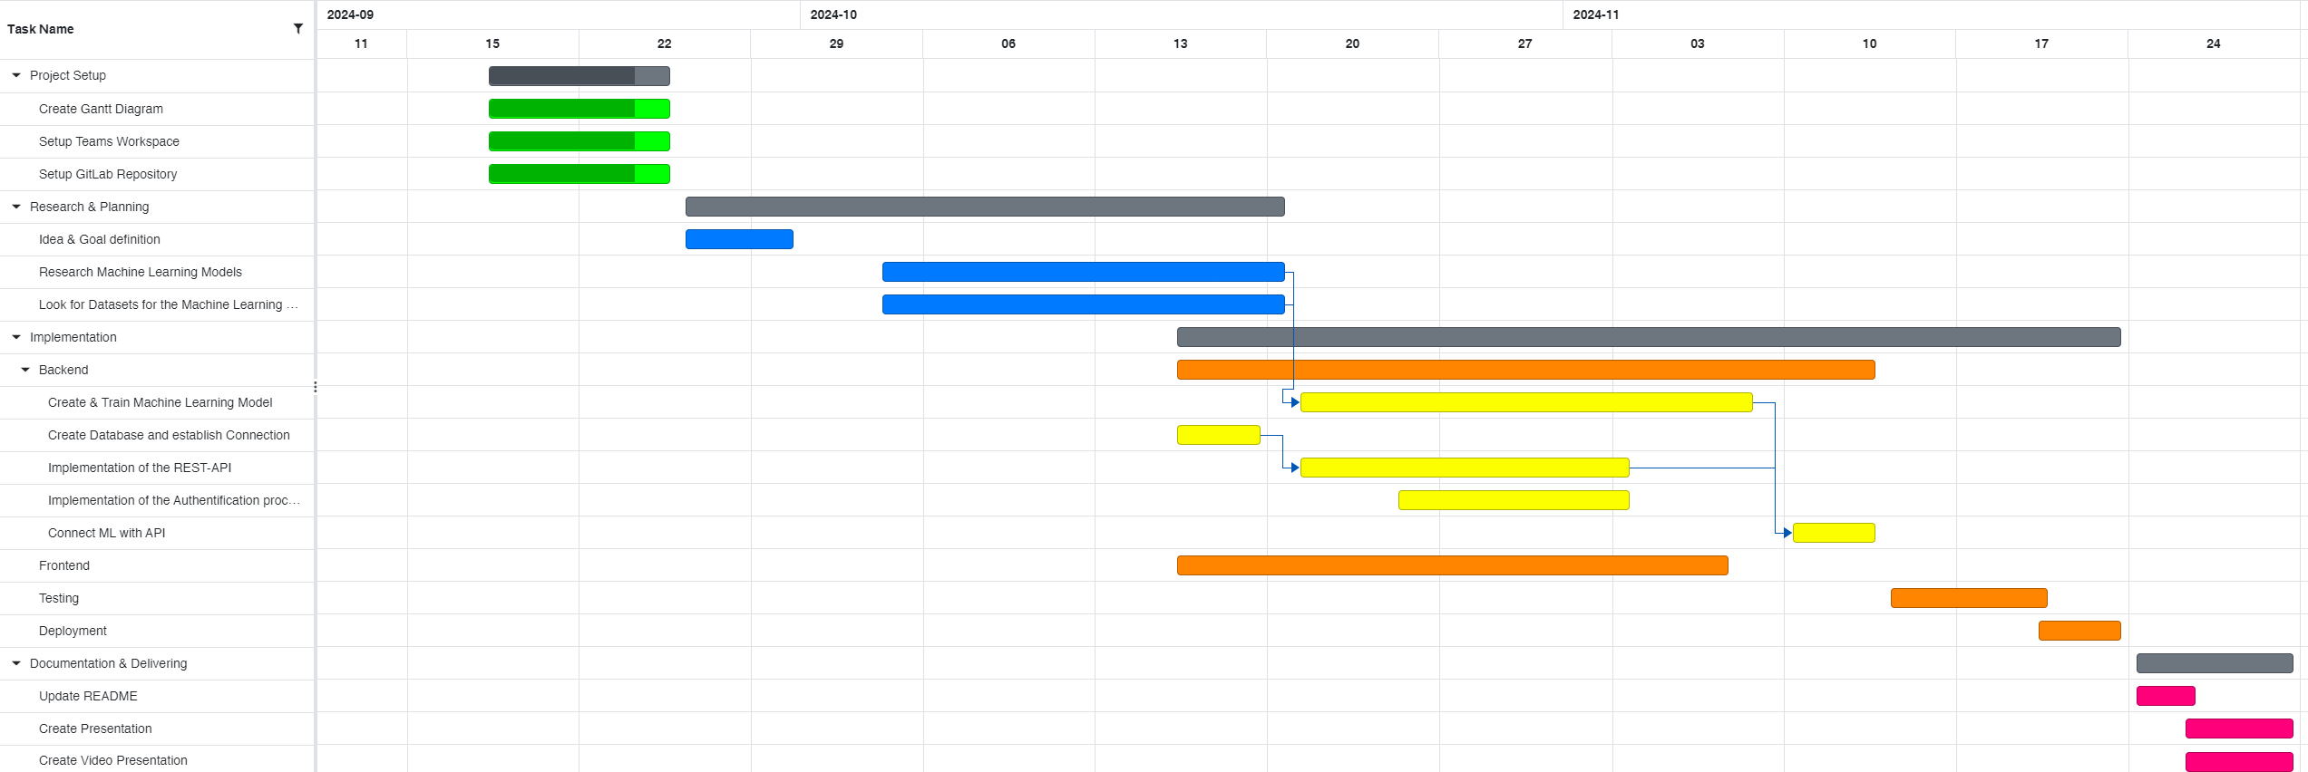
Gantt
Development period from September to December 2024
4 Main Phases:
Project Setup
Research & Planning
Implementation
Documentation & Delivering

Slide 8
Implement other diabetes related diseases and optimized ML methods for risk detection
Vision
“We envision the app evolving into a comprehensive clinical decision support system, serving as a chronic disease all-rounder in the healthcare sector.”
Diabetes Complications | Endocrine Society

Slide 9
MediAid
Thank you!
Any questions?
Acknowledgements:
Enkelejda Miho
Jan Kruta
Nico Grütter

