Slide 1
Part1 : Collecting data from network devices

Slide 2
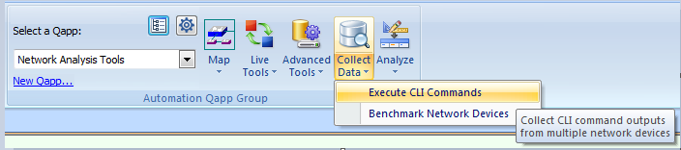
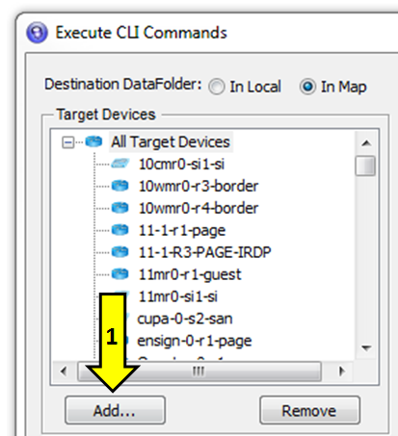
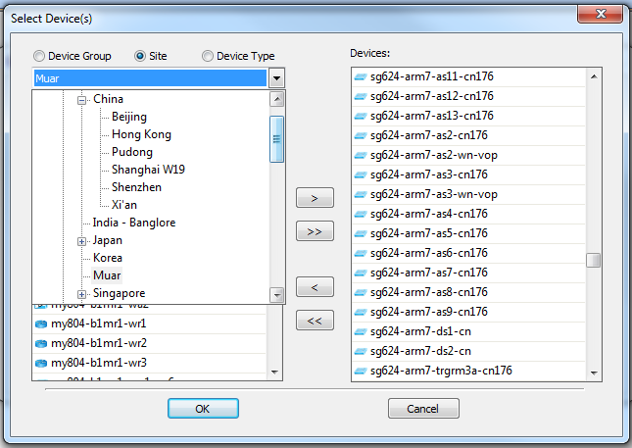
Step 1 – Launch Netbrain CLI Commands
Step 2 – Add each site device
2
3

Slide 3
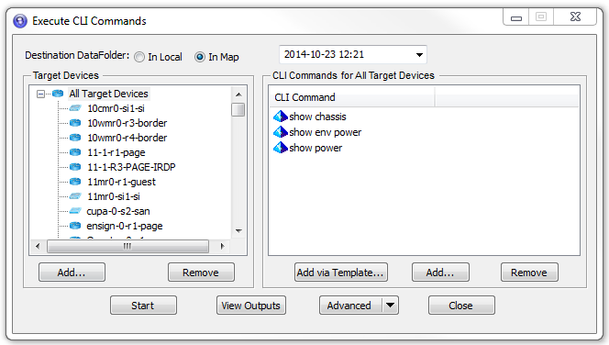
Step 3 – Add commands & Start the Session
Step 4 – On completion. View Outputs

Slide 4
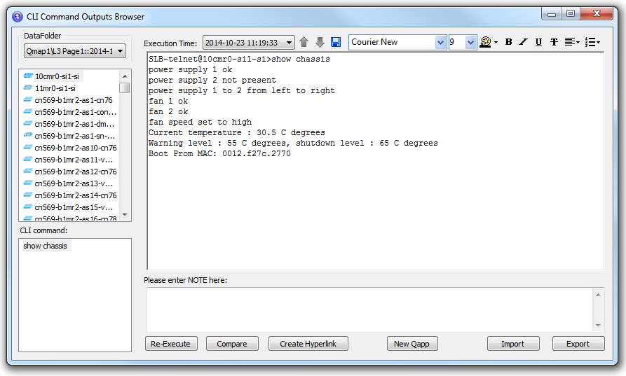
Step 5 – Export output to a folder.

Slide 5
Part2 : Collating data into Excel Format.

Slide 6

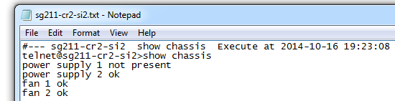
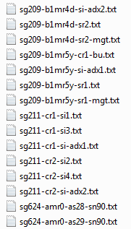
Step 1 – Collect the CLI Results
Keep an easily searched folder of all the Netbrain CLI commands output.

Slide 7
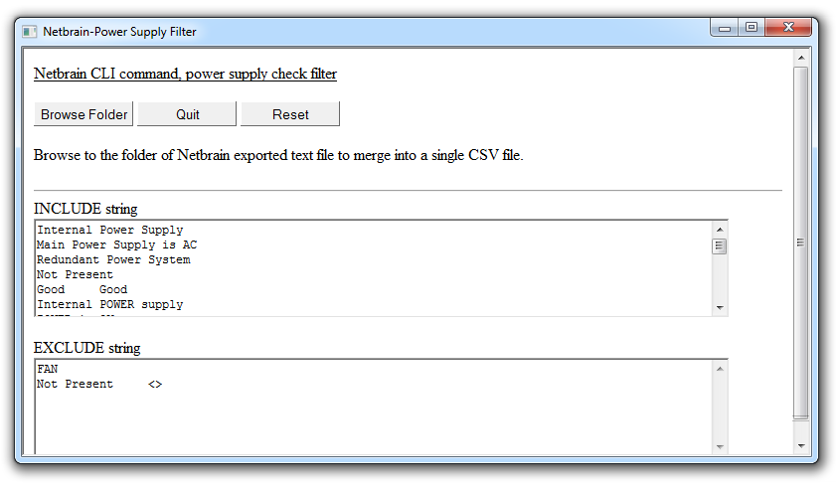
Step 2 – Launch the script.
Launch the script. Add in the string to look for inside the INCLUDE box and what to ignore into the EXCLUDE box. There are already several lines by default listed in the script. Edit it accordingly.
Click Browse Folder.

Slide 8
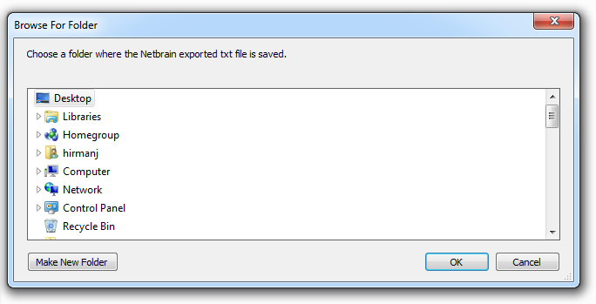
Step 3 – Browse to the folder.
Browse and look for the folder where the Netbrain CLI Command text file output had been exported to. Click OK.

Slide 9
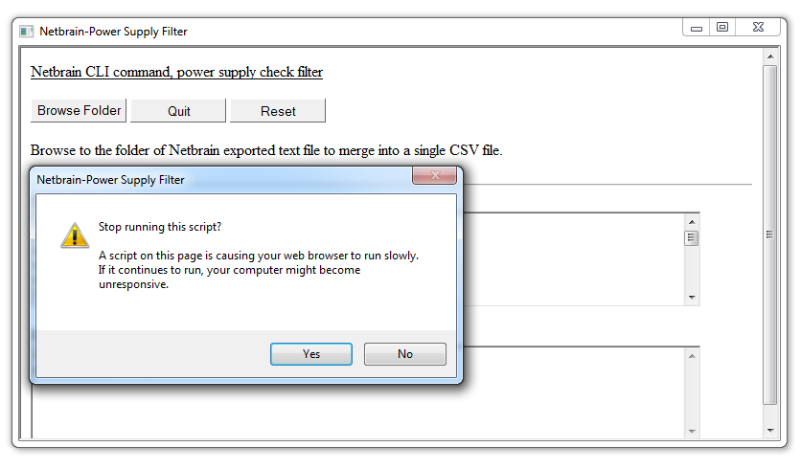
Step 4 – Wait for completion
The script is wrapped over HTML. For large number of files processing, which is taking a much longer loop time. Internet Explorer will pop up a warning of slow website. This is due to time limit settings in the Registry. This can be alleviated by editing Windows Registry or simply processing less number of text files per session. Click no to continue processing the files.

Slide 10
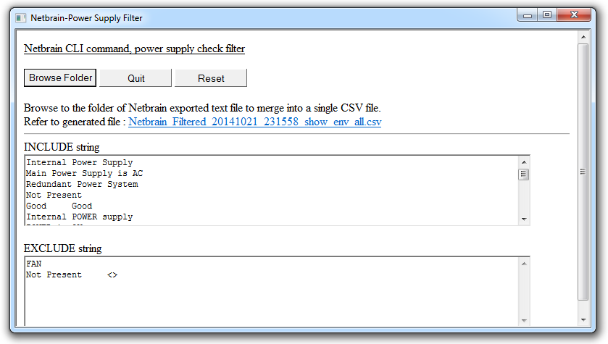
Step 5 – Process Completion
The file name of the completed filter result will be printed on the script page. Simply click directly on it to launch Excel and view. This file will also be located in the same folder as the script.
Filename format : Netbrain_Filtered_YYYYMMDD_HHMMSS_FolderName

Slide 11
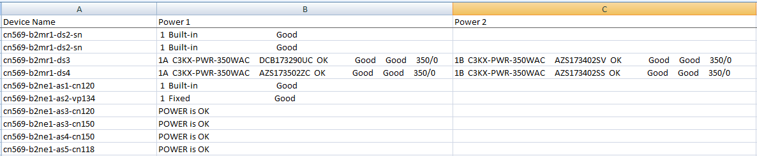
Step 6 – File output example
Based on the INCLUDE & EXCLUDE string entered in the script it will collect the data accordingly from the Netbrain CLI command exported files.
The text file named exported by Netbrain will be used in the first column. This is the device name.
Each found entry from each text file exported, will be printed to the right of it.
Depending on how many lines of string found. Each lines will be printed into a new column to the right.

Slide 12
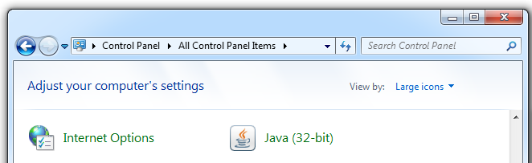
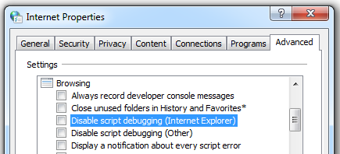
Optional –Disabling script warning
Script running too slow warning can be disabled using Internet Properties. But seems it do not work.
Another means is through Registry Editing.
http://support2.microsoft.com/default.aspx?scid=kb;en-us;175500

Slide 13
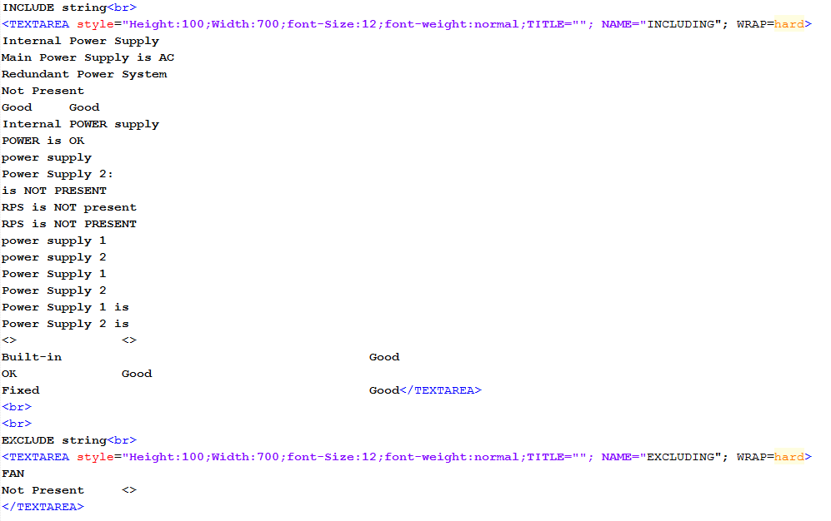
Optional – Changing search string
The script is basically a HTML page running a scripting language. The HTML page can be edited especially the search string, so as that on every launch it uses the same search criteria.

