Slide 1
Welcome

Slide 2
Group Details
Soni Rajeev Kumar : Roll no. 520817883
Internal Guide : -
External Guide :- Shri Hiren Dave sir
SUBMITTED TO
Sikkim Manipal University
Manipal

Slide 3
Z commerce Coaching’s
Company Overview
COMPANY NAME :--
Project Title :-
Student and Result Management

Slide 4

Company Profile
COMPANY NAME :-
Z
Commerce Coaching’s
LOGO :-

Slide 5
Department Overview
DEPARTMENT NAME :-
In college department it have three parts
First is for F.Y.BCOM, second is for S.Y.BCOM and
third is T.Y.BCOM
College

Slide 6
Organization Chart
OWNER
(MR. KANTI PATEL)
ADMIN
STUDENTS

Slide 7
Technology
SOFTWARE SPECIFICATION :-
A. Developer :-
1. Operating system :- Windows -XP
2. Technology :- Microsoft Visual Basic .NET
2008 And SQL server 2005
B. User:-
1. Operating system :- Windows -XP
2. Technology :- Microsoft Visual Basic.NET2008 &
SQL server 2005

Slide 8
Front End :-
Visual basic .net [VB.NET]
Vb.net content ‘s many useful features like MDI, Login form
etc… but this type of features are not available in any other application.
Vb.net content Framework so it help us to make a program
easily.
By using vb.net we can create an application.
So, vb.net is easy for make an application for us.

Slide 9
Back End :-
SQL Server - 2005
SQL Server has a power full security level.
By using SQL Server we can create database easily.
We can find any data from the database by using
query in SQL Server.
so, we use SQL Server.

Slide 10
NEED FOR PROJECT
Z commerce coaching is store all data
manually. So,
It is keeping all the information in Register so it creates problem to maintain the data for long time.
It is taking time for inputting the data.
It is difficult for finding the data.
Difficult to Generate the reports.

Slide 11
EXISTING SYSTEM
This Institute is currently working manually.
Record keeping in system is manually in Register.
This Institute writing data in different Registers.
This Institute generate the reports, Attendance sheet on paper.

Slide 12
ADVANTAGES OF EXISTING SYSTEM
You can get the information about students, faculties and staff etc..
This System used for data entry, storage & creating reports.

Slide 13
DISADVANTAGES OF EXISTING SYSTEM
Working speed is slow.
Difficult to maintain data for long time.
We cannot find data easily.

Slide 14
Proposed System
We will create computerized system.
Data are stored in Database.
Admin can create report of students easily.
Only Admin can edit & delete the data so mistakes are resolved easily.
Student can update his information only.
Admin can generate the student ‘s reports.

Slide 15
Advantages Of Proposed System
Less man-power needed.
This System is user Friendly.
This System is not time Consuming.

Slide 16
Disadvantages Of Proposed System
This System is costly.
Training is required for user.

Slide 17
Constraint of system
Primary requirement :- Computer
Software requirement :- SQL server 2005, V.B.NET Framework 2008

Slide 18
Authorization / Communities
That use your Project
Types of User’s :-
Admin
Student
Admin :- Control whole Reports and Databases
Student :- To see only Progress Reports
and Attendance Reports

Slide 19
SRS (System Required Specification)
HARDWARE SPECIFICATION :-
1. Developer :- Processor speed 1.8GHz
Hard disk 40 GB
32* CD ROM
128 MB RAM
2. User :- Processor speed 1.8GHz
Hard disk 40 GB
32* CD ROM
128 MB RAM

Slide 20
SOFTWARE SPECIFICATION :-
A. Developer :-
1. Operating system :- Windows 2000/XP
2. Technology :- Microsoft Visual Basic .NET
2008 And SQL server 2005
B. User:-
1. Operating system :- Windows XP
2. Technology :- SQL server 2005,vb.net framework 2008.

Slide 21
Process:-
Only administrator can change whole information.
&
Student can change only his details and see report.
INPUT:-
1) Student Information.
2) Course Information.
3) Subject Information.
4) Area Information.
5) Students Attendance.
6) Exam Marks.
7)Subject wise Fees.
8)Student wise Fees.
OUTPUT:-
1) Students Report.
2) Attendance Report.
3) Course Report.
4) Subject Report.
5) Area Report.
6) Marks Report.
7)Fees Report.

Slide 22
Feasibility study
There are four types of feasibility studies : -
OPERATIONAL FEASIBILITY
TECHNICAL FEASIBILITY
ECONOMICAL FEASIBILITY
SCHEDULE FEASIBILITY

Slide 23
(A). OPERATIONAL FEASIBILITY
In this System we can enter student details, student attendance and see the student’s reports.
We can get the progress report of the whole year.
Propose system will be used effectively because we are using database in our system.
it is stand alone system so database is safe.

Slide 24
(B). TECHNICAL FEASIBILITY
In proposed system we can used hardware and software
Organization will provide all the necessary resources need for the system.
Institute have only need basic technical experience.

Slide 25
(C). ECONOMICAL FEASIBILITY
The cost of the conducting a full system can be calculated after the development
If All the factors perform positively then The cost of system as per planning
In this system users will not required any special training so reduce the cost.

Slide 26
(D). SCHEDULE FEASIBILITY
Our project time duration is maximum 7 months.
They have to face may problem that affect schedule of the project.

Slide 27
Time Line-Chart
O
P
E
R
A
T
I
O
N
A
L
&
S
U
P
P
O
R
T
UNIT TESTING
IMPLEMENTATION
COADING
DESIGNING
ANALYSIS
PLANNING
JUNE
AUG
SEP
OCT
NOV
DEC
JAN

Slide 28
Main Module
Student
Admin
Exams
Progress Reports
Sub Module
Information
Attendance
Sub Module
Modules

Slide 29
Data Flow Diagram
(DFD)

Slide 30
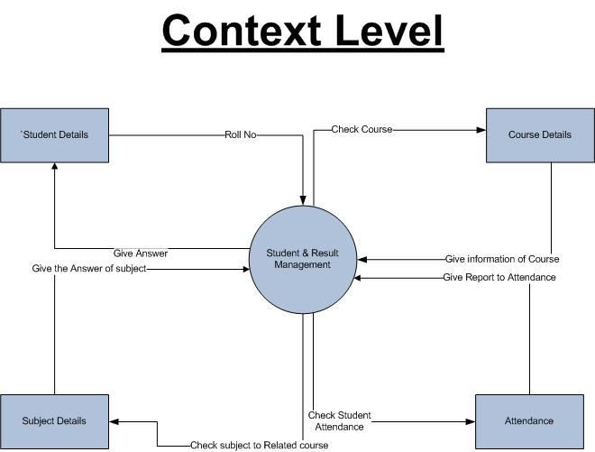

Slide 31
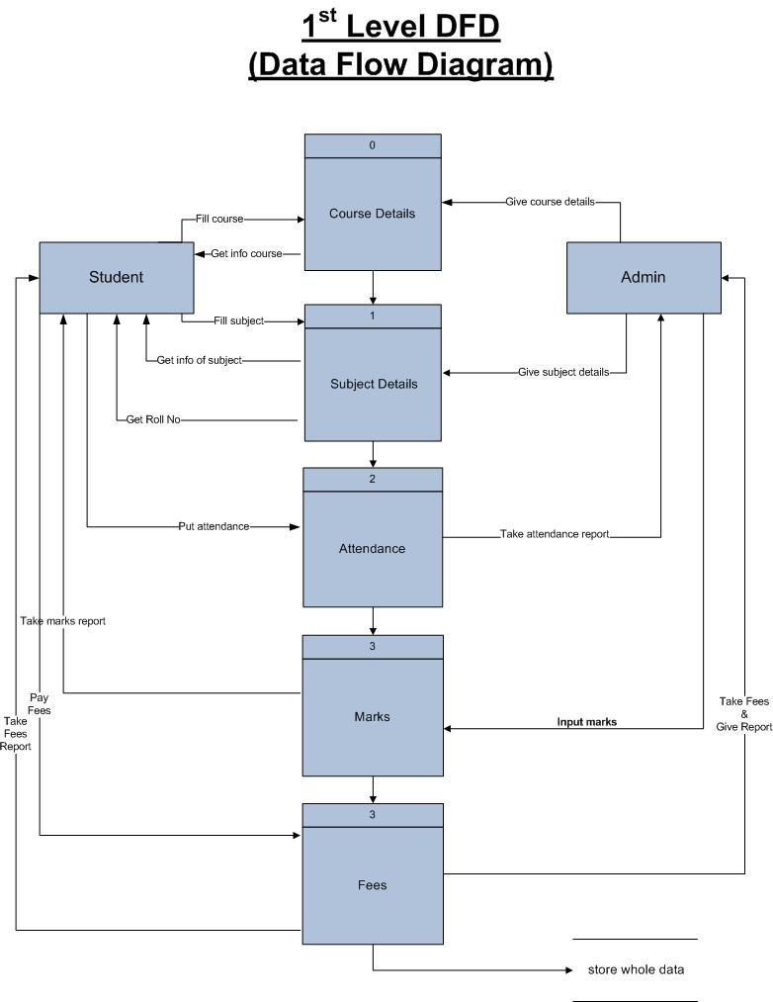

Slide 32
ER Diagram

Slide 33
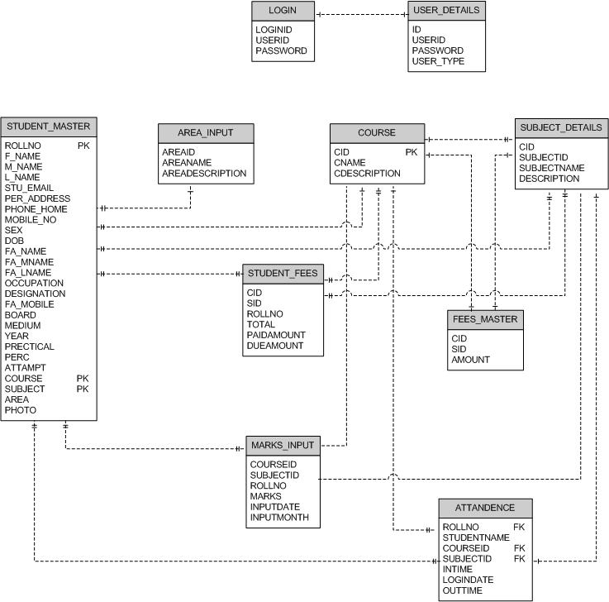

Slide 34
Data Dictionary

Slide 35
TABLE DETAILS
TABLE NAME : LOGIN
DESCRIPTION: It contains details of Login of all Users
FIELD NAME | DATATYPE |  | SIZE | CONSTRAINTS | DESCRIPTION
LOGIN_ID | NVARCHAR |  | 10 | PK | LOGIN IDENTIFICATION NO.
USER_ID | NVARCHAR |  | 30 | NOT NULL | USER IDENTIFICATION NO.
PASSWORD | VARCHAR |  | 50 | NOT NIULL | PASSWORD OF USER
USER_TYPE | VARCHAR |  | 50 | NOT NIULL | TYPE OF USER
FOREIGN KEY DETAILS :
FOREIGN KEY |  |  |  | REFERENCES TABLE NAME
-- |  |  |  | --

Slide 36
TABLE DETAILS
TABLE NAME : USER DETAILS
DESCRIPTION: It contains details of all Users
FIELD NAME | DATATYPE | SIZE | CONSTRAINTS | DESCRIPTION
ID | NVARCHAR | 10 | PK | LOGIN IDENTIFICATION NO.
USER_ID | NVARCHAR | 30 | NOT NULL | USER IDENTIFICATION NO.
PASSWORD | VARCHAR | 50 | NOT NIULL | PASSWORD OF USER
USER_TYPE | VARCHAR | 50 | NOT NIULL | TYPE OF USER
FOREIGN KEY DETAILS :
FOREIGN KEY |  |  | REFERENCES TABLE NAME
-- |  |  | --

Slide 37
TABLE DETAILS
TABLE NAME : AREA DETAILS
DESCRIPTION: It contains details of all AREAS.
FIELD NAME | DATATYPE | SIZE | CONSTRAINTS | DESCRIPTION
AREA_ID | NUMERIC | (18,0) | NOT NULL | Area Identification Number.
AREA _NAME | NVARCHAR | 50 | NOT NIULL | Area Name
AREA_DESCRIPTION | NVARCHAR | 200 | NOT NIULL | Area Description.
FOREIGN KEY DETAILS :
FOREIGN KEY |  |  | REFERENCES TABLE NAME
-- |  |  | --

Slide 38
TABLE DETAILS
TABLE NAME : COURSE
DESCRIPTION: It contains details of all Courses.
FIELD NAME | DATATYPE | SIZE | CONSTRAINTS | DESCRIPTION
C_ID | NUMERIC | (18,0) | PK | Course Identification Number.
C_NAME | NVARCHAR | 50 | NOT NULL | Course Name.
Description | NVARCHAR | 50 | NOT NIULL | Course Description
FOREIGN KEY DETAILS :
FOREIGN KEY |  |  | REFERENCES TABLE NAME
-- |  |  | --

Slide 39
TABLE DETAILS
TABLE NAME : SUBJECT
DESCRIPTION: It contains details of all Subjects.
FIELD NAME | DATATYPE | SIZE | CONSTRAINTS | DESCRIPTION
SUB_ID | NUMERIC | (18,0) | PK | Subject Identification Number.
SUB_NAME | NVARCHAR | 50 | NOT NULL | Subject Name.
Description | NVARCHAR | 50 | NOT NIULL | Subject Description
FOREIGN KEY DETAILS :
FOREIGN KEY |  |  | REFERENCES TABLE NAME
-- |  |  | --

Slide 40
TABLE DETAILS
TABLE NAME : SUBJECT DETAILS
DESCRIPTION: It contains details of all Subjects.
FIELD NAME | DATATYPE | SIZE | CONSTRAINTS | DESCRIPTION
C_ID | NUMERIC | (18,0) | PK | Course Identification Number.
SUB_ID | NUMERIC | (18,0) | PK | Subject Identification Number.
SUB_NAME | NVARCHAR | 50 | NOT NULL | Subject Name.
Description | NVARCHAR | 50 | NOT NIULL | Subject Description
FOREIGN KEY DETAILS :
FOREIGN KEY |  |  | REFERENCES TABLE NAME
-- |  |  | --

Slide 41
TABLE DETAILS
TABLE NAME : STUDENT_MASTER
DESCRIPTION: It contains details of students
FIELD NAME | DATATYPE | SIZE | CONSTRAINTS | DESCRIPTION
YEAR ROLL_NO | NVARCHAR | 10 | PK | GENERAL REGISTER NUMBER
F_NAME | NVARCHAR | 20 | NOT NULL | STUDENT FIRST NAME
M_NAME | NVARCHAR | 20 | NOT NULL | STUDENT MIDDLE NAME
L_NAME | NVARCHAR | 20 | NOT NULL | STUDENT LAST NAME
STU_EMAIL | NVARCHAR | 40 | NOT NULL | STUDENT E-MAIL ID
PER_ADDRESS | NVARCHAR | 100 | NOT NULL | STUDENT PERMANENT ADDRESS
PHONE_HOME | NUMERIC | (18,0) | -- | STD NO. OF PER_ADDRESS
MOBILE_NO | NUMERIC | (18,0) | -- | PHONE NO. OF PER_ADDRESS
SEX | NVARCHAR | 10 | NOT NULL | SEX OF STUDENT(M/F)
DOB | DATETIME | -- | NOT NULL | STUDENT BIRTH DATE
FA_NAME | NVARCHAR | 20 | NOT NULL | FATHER’S FIRST NAME
FA_MNAME | NVARCHAR | 20 | NOT NULL | FATHER’S MIDDLE NAME
FA_LNAME | NVARCHAR | 20 | NOT NULL | FATHER’S LAST NAME
OCCUPATION | NVARCHAR | 20 | NOT NULL | OCCUPATION OF FATHER
DESIGNATION | NVARCHAR | 20 | NOT NULL | DESIGNATION OF FATHER
FA_MOBILE | NUMERIC | (18,0) | -- | MOBILE NO. OF OFFICE
BOARD | NVARCHAR | 20 | NOT NULL | H.S.C BOARD OF STUDENT
MEDIUM | NVARCHAR | 15 | NOT NULL | VALUES: (ENG/HINDI/GUJ)
PERC | NUMERIC | (5,2) | NOT NULL | PERCENTAGE OF STUDENT
TOTAL_MARKS _OUT_OF | NUMERIC | (4,0) | NOT NULL | TOTAL MARKS OF ALL EXAM
ATTEMPTS | NVARCHAR | 10 | NOT NULL | NO. OF ATTEMPTS
PHOTO | NVARCHAR | 300 | NOT NULL | PATH OF STUDENT’S PHOTO
FOREIGN KEY DETAILS :
FOREIGN KEY |  |  | REFERENCES TABLE NAME
-- |  |  | --

Slide 42
TABLE DETAILS
TABLE NAME : ATTANDANCE
DESCRIPTION: It contains details of all Students ATTANDANCE.
FIELD NAME | DATATYPE | SIZE | CONSTRAINTS | DESCRIPTION
ROLLNO | NUMERIC | (18,0) | NOT NULL | It contains ROLLNO of Student.
STUDENT _NAME | NVARCHAR | 50 | NOT NULL | It contains Student Name.
COURSE_ID | NUMERIC | (18,0) | NOT NULL | Course Identification Number.
SUBJECT_ID | NUMERIC | (18,0) | NOT NULL | Subject Identification Number.
IN_TIME | NVARCHAR | 50 | NOT NULL | Student Enter Time.
LOGIN_DATE | NVARCHAR | 50 | NOT NULL | Student LOGIN Date.
OUT_TIME | NVARCHAR | 50 | NOT NULL | Student OUT TIME.
FOREIGN KEY DETAILS :
FOREIGN KEY |  |  | REFERENCES TABLE NAME
-- |  |  | --

Slide 43
TABLE DETAILS
TABLE NAME : MARKSINPUT
DESCRIPTION: It contains details of all Students EXAM MARKS INPUT.
FIELD NAME | DATATYPE | SIZE | CONSTRAINTS | DESCRIPTION
COURSE_ID | NUMERIC | (18,0) | PK | Course Identification Number.
SUBJECT_ID | NUMERIC | (18,0) | PK | Subject Identification Number.
ROLLNO | NUMERIC | (18,0) | PK | It contains ROLLNO of Student.
MARKS | NUMERIC | (18,0) | NOT NULL | It contains Student MARKS.
INPUT_DATE | NVARCHAR | 50 | PK | Student Input Date.
INPUT_MONTH | NUMERIC |  | NOT NULL | Student Input Month.
FOREIGN KEY DETAILS :
FOREIGN KEY |  |  | REFERENCES TABLE NAME
-- |  |  | --

Slide 44
Screen Layout

Slide 45
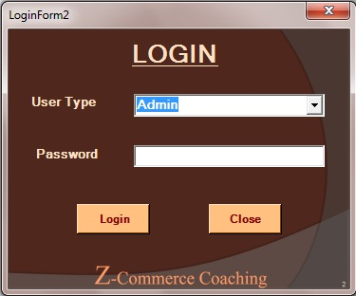
Admin Login

Slide 46
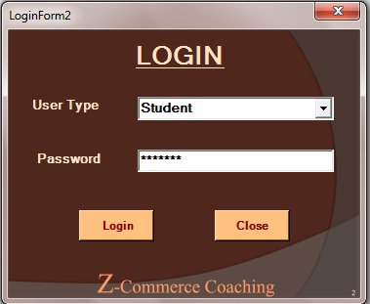
Student Login

Slide 47

Main MDI

Slide 48
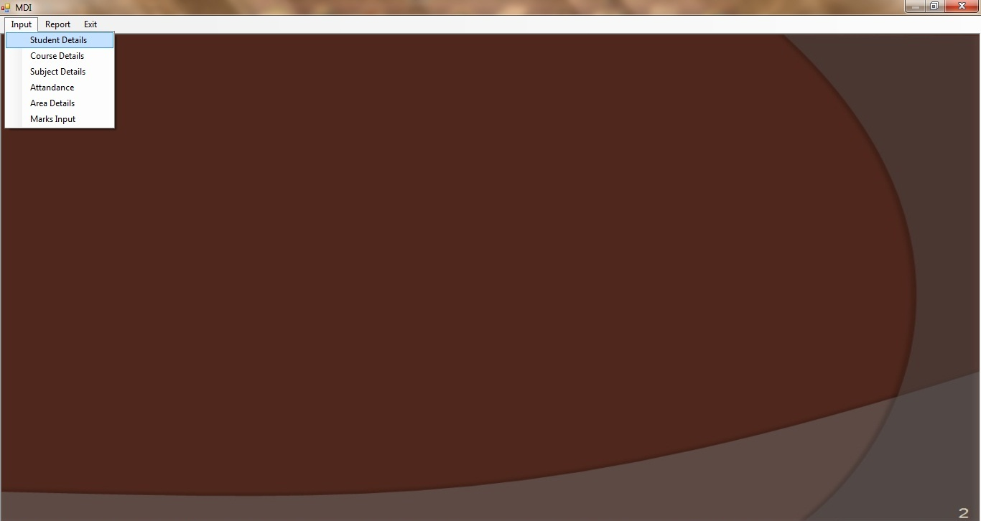
Admin MDI

Slide 49
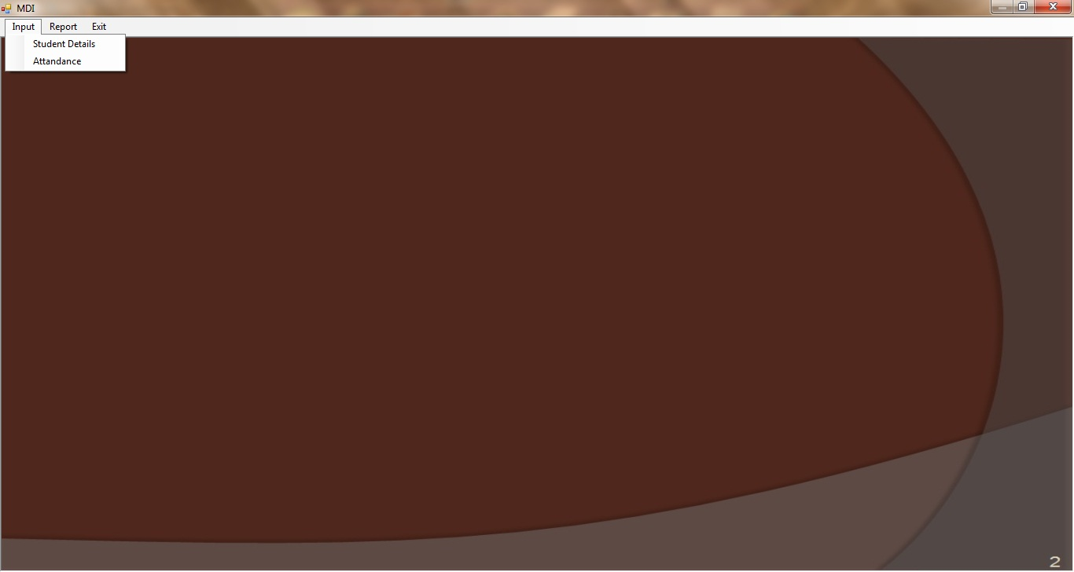
Student MDI

Slide 50
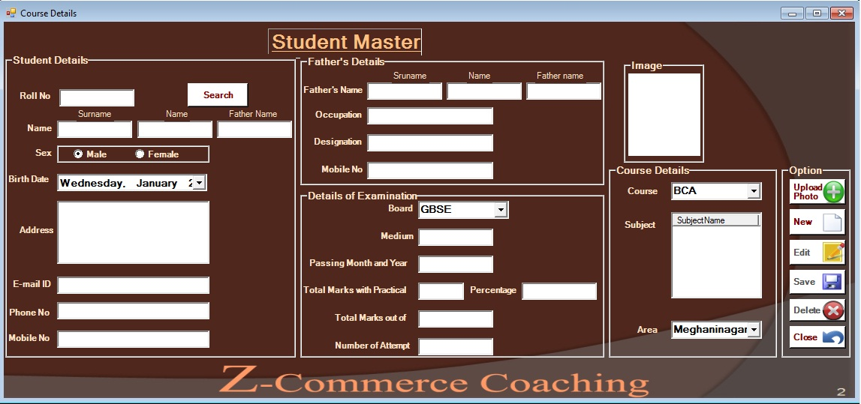
Student Details

Slide 51


Slide 52
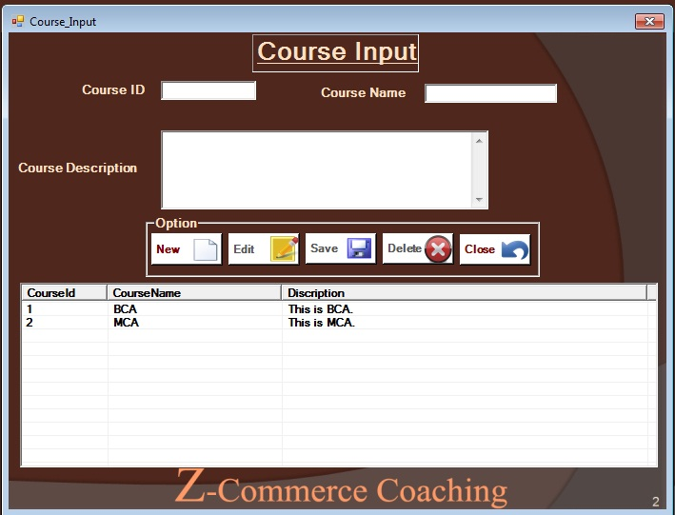

Slide 53
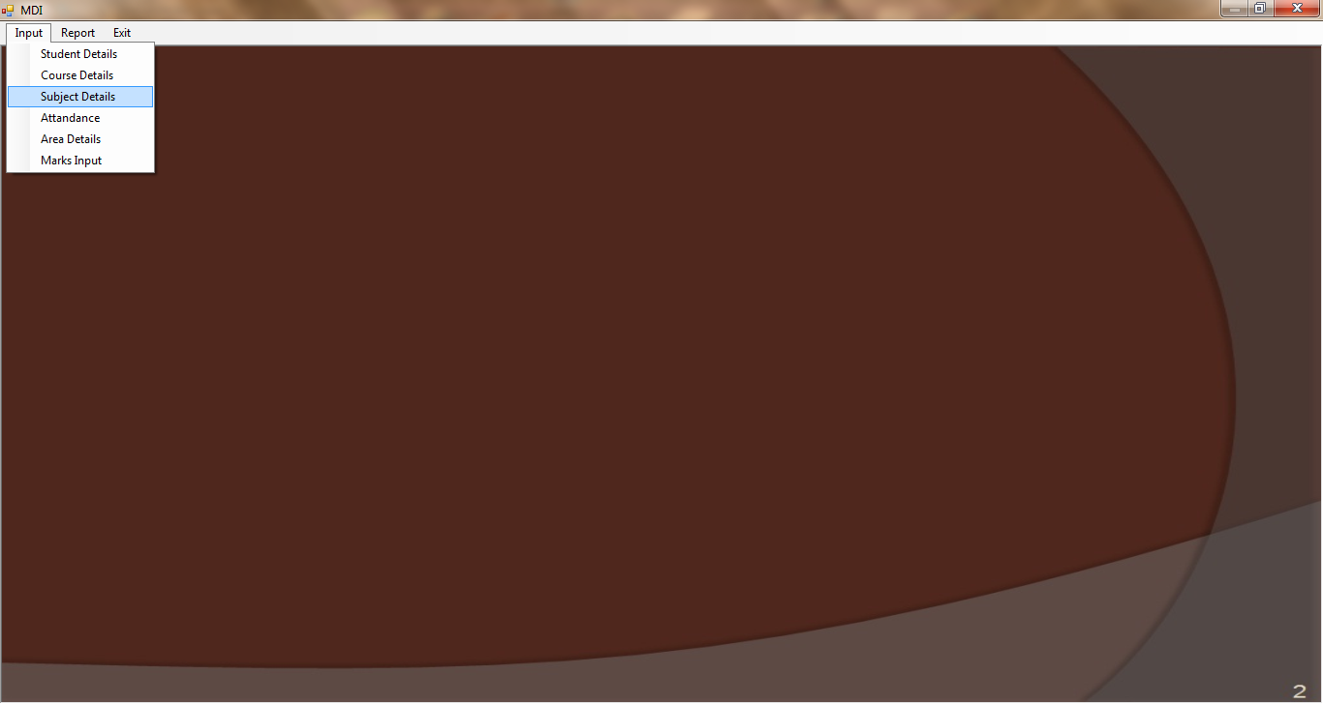

Slide 54
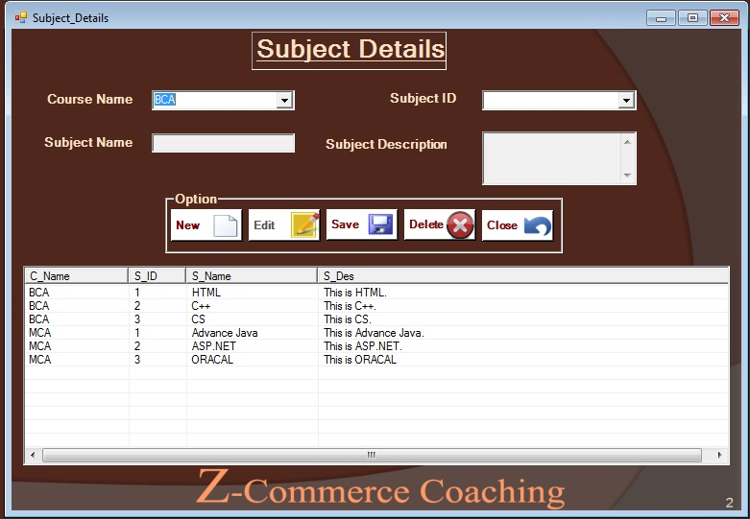

Slide 55


Slide 56
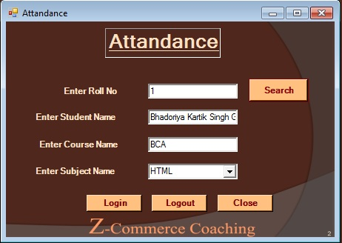

Slide 57


Slide 58
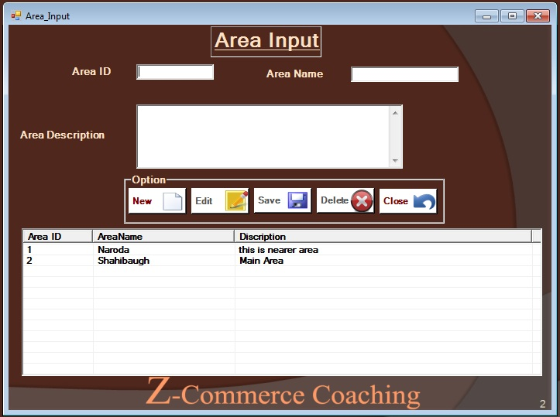

Slide 59


Slide 60
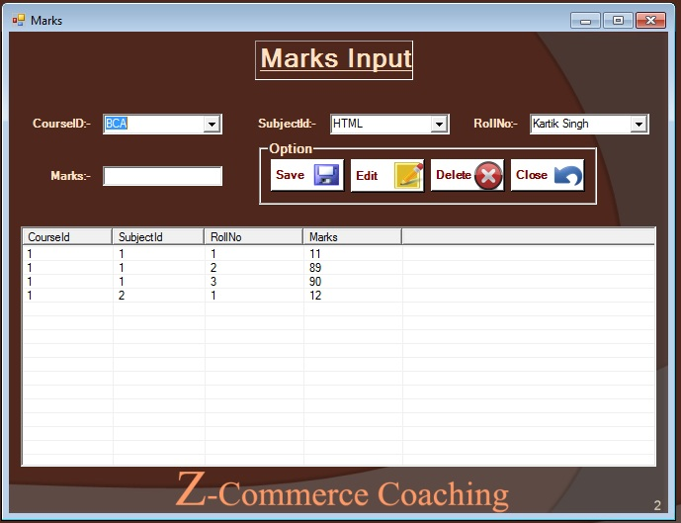

Slide 61
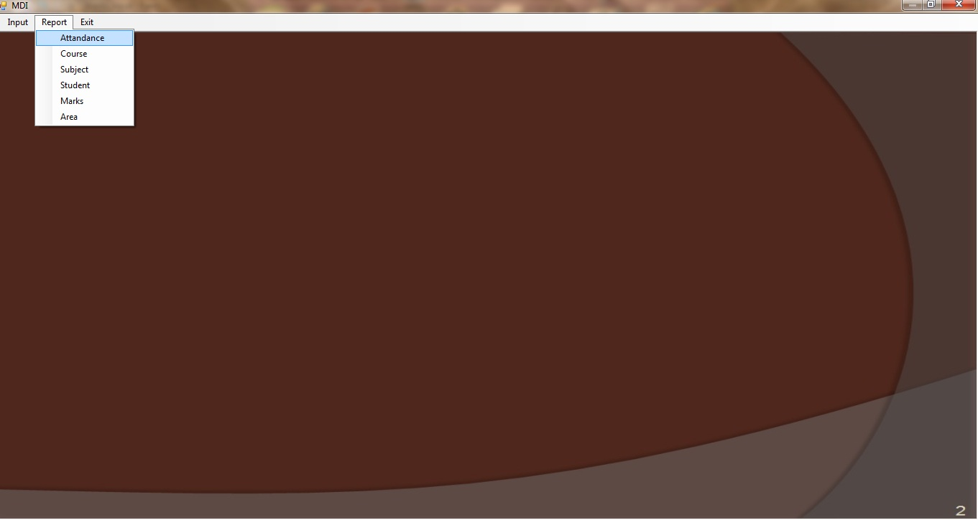

Slide 62
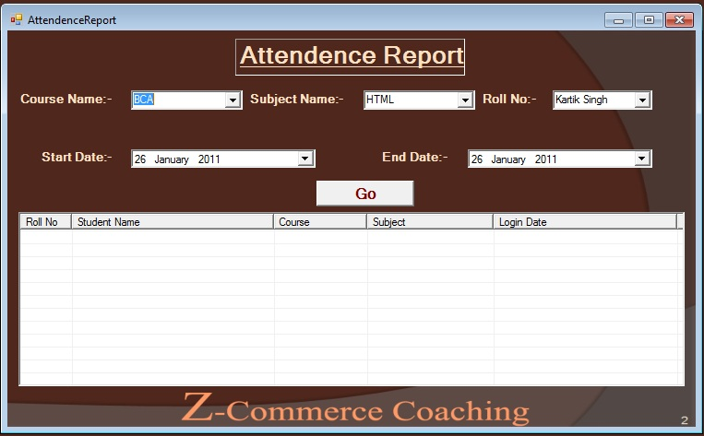

Slide 63
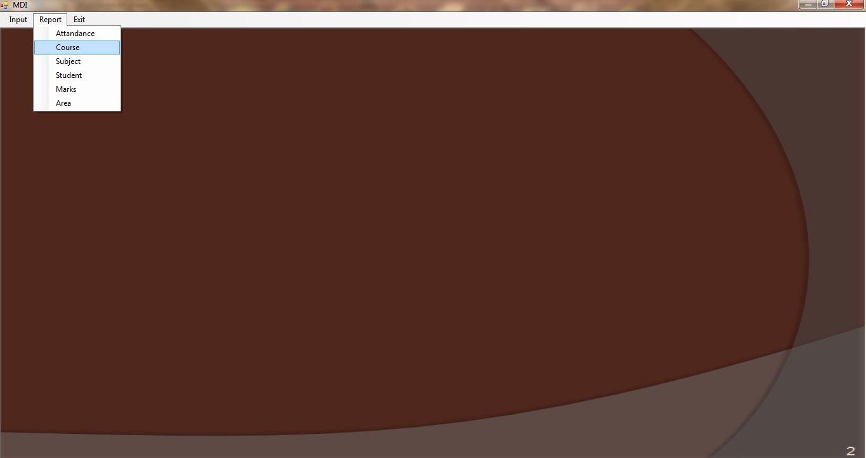

Slide 64
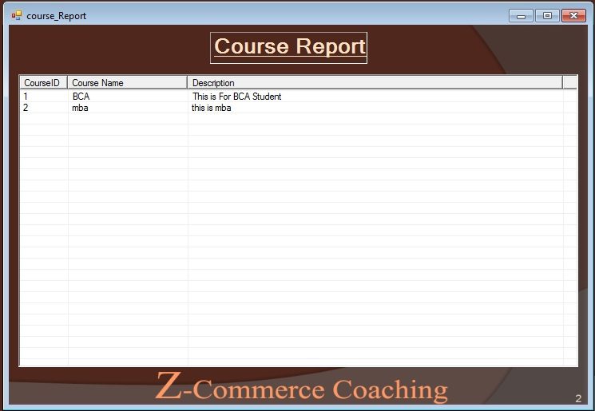

Slide 65


Slide 66
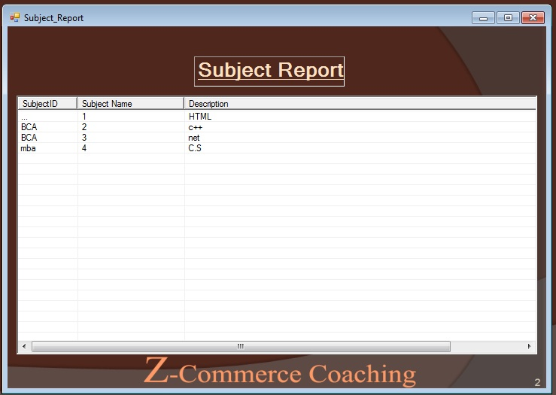

Slide 67
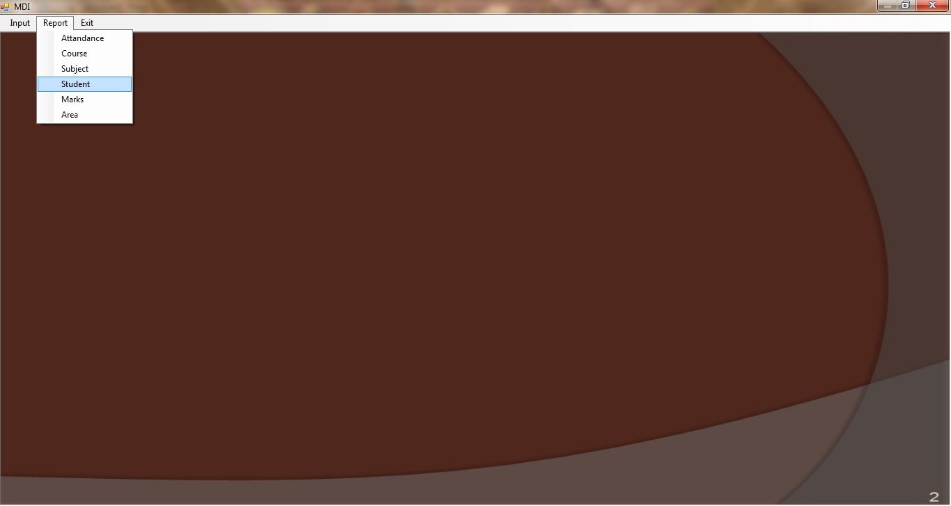

Slide 68
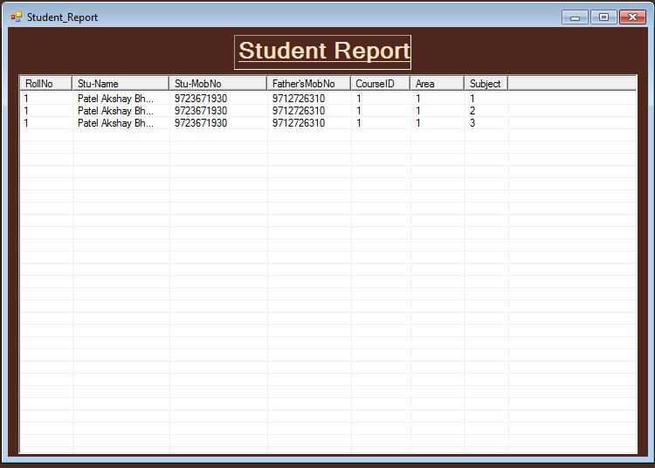

Slide 69


Slide 70
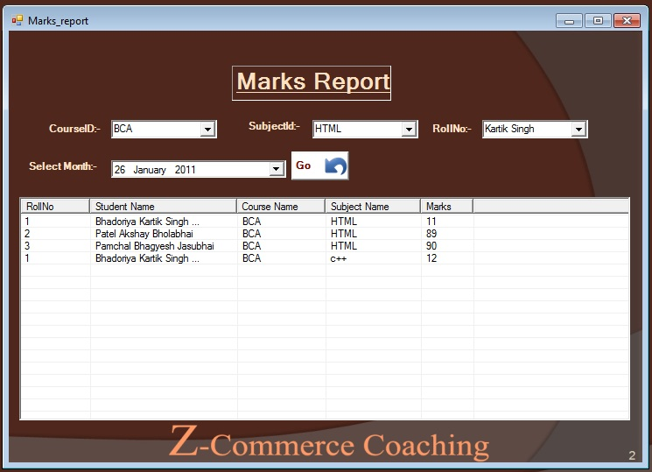

Slide 71


Slide 72
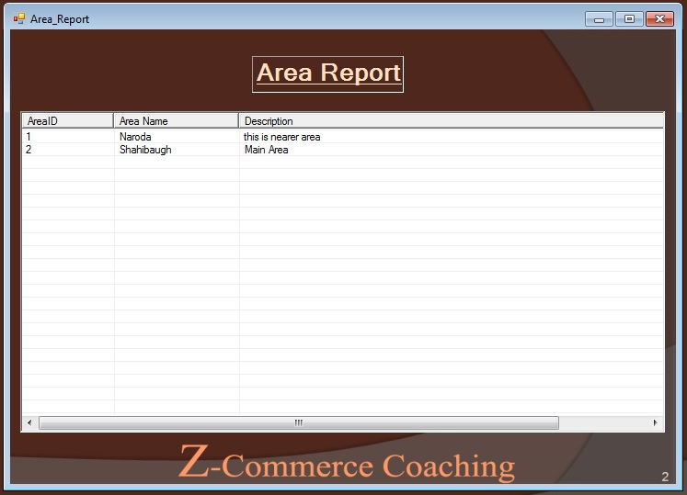

Slide 73
Thank You

