Slide 1
PowerPoint Indexing Labeler Example
Version 1.0

Slide 2
1.1) Chapter 1, Page 1 !!S_1!!
DT-code は章・節番号へと置換されます
この形式の文字列は変換結果の照合用符号です。開発用にのみ使用します。通常、利用者が知る必要はありません。
The DT-code is replaced with the chapter and the section numbers.
This format of string serves as a code for verifying conversion results. It is used only for development purposes and is not typically necessary for users to know."
DT-code とは、 #DT# の後に英数文字が続くコードであり、下記正規表現にマッチするものです。
"DT-code" refers to a code consisting of alphanumeric characters following '#DT#', which matches the following regular expression.
DT-code regexp for a chapter number only
DT-code regexp for a chapter and section number

Slide 3
Ａ simple sentence without DT-code stays the same
DT-code を含まない単純な文は変更されません。
Ａ simple sentence without DT-code stays the same.
1.2) DT-code in content area !!S_2!!
DT-code はコンテンツエリアにあっても機能します。
The DT-code also works in the content area.

Slide 4
1.3) DT-code without numeric !!S_3!!
DT-codeは英文字だけでも機能します。出現順にナンバリングされます。
DT-codes don't require numeric characters, those with alphabetic characters only can also work, and is numbered in the order of appearance.

Slide 5
2.1) DT-code without numeric !!S_4!!
上記コードは 2.1 に変換されます。
chapter コードは WX1, WXB の順に出現したので
WX1＝１，WXB＝2 に変換されます。
Section コードは同一 chapter コード内でナンバリングされます。
PGXはWXB内で初めて出現したので１となります。
The code above is converted to 2.1. The chapter codes appeared in the order of WX1, WXB, thus they are converted to 1 and 2. Section codes are numbered within the same chapter code. Since PGX appeared the first time within WXB, it is numbered as 1.

Slide 6
Ａ slide can contain multiple DT-codes
2.3) 1st DT-code in a slide !!S_5!!
2.2) 2nd DT-code in the same slide !!S_6!!

Slide 7
Acceptable DT-code format examples.
2.4) chapter and section should be alphanumeric !!S_7!!
alphanumeric
3.1) short and long code sample !!S_8!!
DT#WXC-PGX separator and terminator !!S_9!!
terminator can be several non-alphanumerical characters, such as ')', ':', '>', '|', but can't be '_' and '.'
separator can be '-'
4) just a chapter code without section also available !!S_10!!

Slide 8
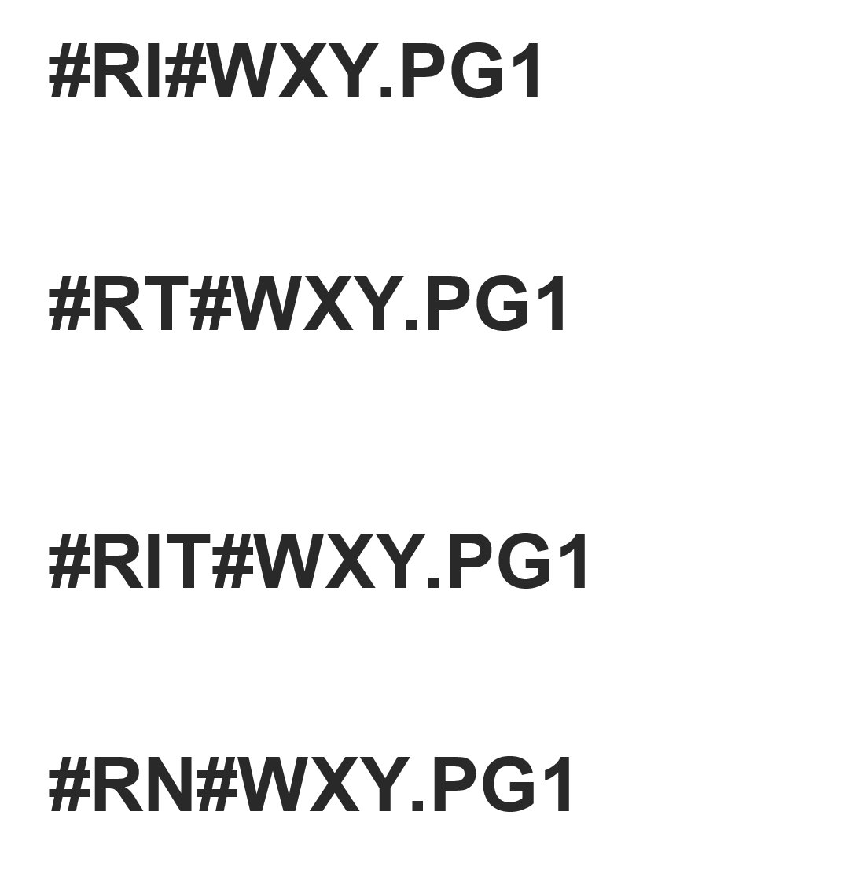
Several Reference code format examples.
DT-code defines a signifier of a title text.
signifier
title text
5.1) 101 of digital marketing
You can use R-codes to cite the related information defined by the DT-code.
index number only
5.1 !!S_11!!
title text only
101 of digital marketing !!S_12!!
index and title only
5.1 101 of digital marketing !!S_13!!
slide number only
7 !!S_14!!

Slide 9
Index Page
The following shapes will be replaced with the table of contents.
1.1) Chapter 1, Page 1 !!S_1!! 1.2) DT-code in content area !!S_2!! 1.3) DT-code without numeric !!S_3!!
1 2 3
#RLISTIT#WX2
#RLISTSN#WX2

