Slide 1
COMPANY A | CUSTOMER RETENTION PoC
Retain the Right Customers Before They Leave
An AI-powered churn prevention proposal built from 100,000 customer records
Recommendation: rank customers weekly and focus retention actions on the highest-risk 20%.
GCI World 2026 Final Assignment

Slide 2
Executive recommendation
Move from broad retention campaigns to risk-ranked, action-specific outreach
0.702
30.0%
1.50×
$1.65M
Held-out ROC-AUC
Churners captured
Risk lift
Illustrative net value
20,000-customer test set
by targeting the top 20%
74.4% vs 49.6% baseline
per 100k customers/year
What Company A should do
Why now
• Score active customers weekly using usage, billing, handset and service-quality signals.
• Prioritize the highest-risk 20% for targeted offers, service recovery or handset upgrades.
• Measure incremental retention through a randomized control group before full rollout.
• The data already contains predictive behavior before churn.
• The solution is deployable as a probability-ranked workflow, not a one-time model.
• The business case remains positive under conservative intervention assumptions.
Source: Company A dataset and held-out model evaluation; financial impact is an illustrative scenario.
02

Slide 3
Retention is a telecom growth problem
Saturated markets increase the value of protecting the installed customer base
The strategic tension
Revenue risk
Customers leave with recurring revenue and future lifetime value.
Telecom operators must defend revenue while customers face low switching friction, aggressive offers and rising service expectations.
Service signals
Usage decline, failures and support activity can reveal friction.
Industry signal
22% average annual churn across providers in Deloitte's 2026 outlook.
Action window
The target records churn 31–60 days after observation.
Company A's response should be selective: identify preventable churn early and spend only where intervention is economically justified.
Business question: who should receive which retention action, and when?
Sources: [1] Deloitte 2026 Telecommunications Industry Outlook; [2] Company A dataset description.
03

Slide 4
Company A already has the data required for a retention PoC
100,000
98
2
31–60d
Customers
Raw predictors
Linked tables
Prediction window
Usage
Minutes, calls, peak/off-peak behavior, recent change
Billing
Revenue, recurring charges, overage and roaming
Experience
Dropped, blocked and unanswered calls; care contacts
Lifecycle
Tenure, equipment age, handset and household accounts
Customer
Area, credit class and available demographic attributes
Important caveat: the supplied target is almost 50/50 churn, unlike many live telecom portfolios. Production calibration must use Company A's current base rate.
Source: Client.csv and Record.csv; one-to-one merge on Customer_ID.
04

Slide 5
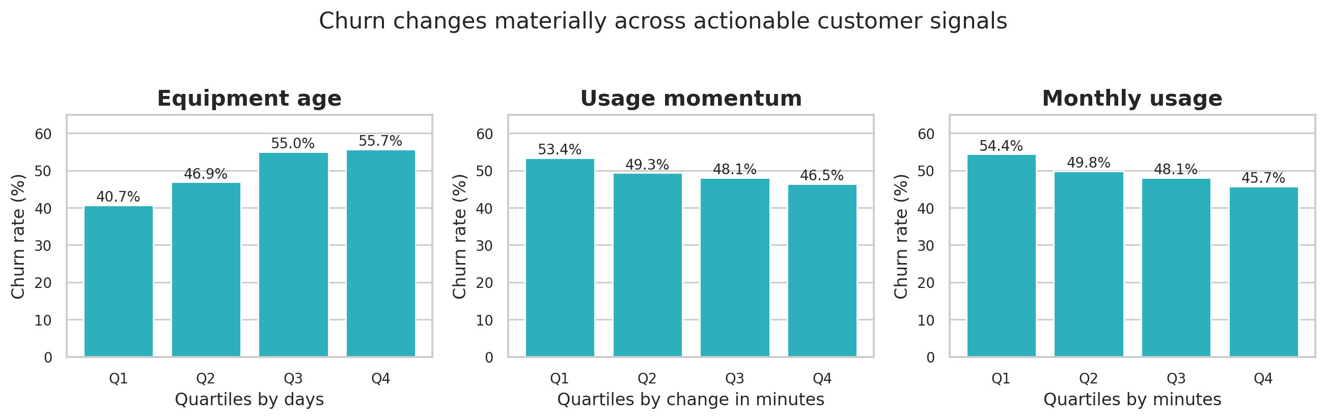
EDA reveals actionable warning signals
Single variables are insufficient, but several behaviors show consistent directional risk
What the patterns say
• Older equipment is associated with higher churn.
• Declining usage is an early warning signal.
• Low current usage indicates weaker engagement.
• No single variable separates churners; multivariate modeling is required.
Actionable hypothesis
Combine lifecycle, engagement and service signals to trigger targeted actions.
Source: Company A EDA; quartiles calculated after excluding missing values for each feature.
05

Slide 6
Problem statement and success definition
Business problem
Company A cannot economically treat every customer, but it lacks a repeatable method to identify who is most likely to churn and which operational lever should be used.
ML objective
Business objective
Success metrics
Rank customers by probability of churn 31–60 days ahead.
Concentrate intervention spend where avoidable revenue risk is highest.
ROC-AUC and PR-AUC for ranking; capture, lift and incremental retention for business value.
Decision rule for the PoC: use risk ranking to define campaign capacity; do not treat the model threshold as an automatic cancellation or denial decision.
Source: Project problem formulation based on Company A's churn label and available intervention signals.
06

Slide 7
Solution: a weekly risk-ranking and action engine
1
Ingest
2
Engineer
3
Score
4
Prioritize
5
Act & learn
→
→
→
→
Refresh customer, usage and billing records.
Create 34 lifecycle, trend, value and service ratios.
Blend LightGBM with native-categorical boosting.
Rank customers and apply campaign capacity.
Deliver offers; measure uplift against controls.
Why this design is practical
Controls built into the workflow
• Works on existing tabular data; no new platform is required for the PoC.
• Produces probabilities that support multiple campaign capacities and cost structures.
• Human-approved action catalogue; no adverse automated decisions.
• Monitoring for drift, calibration, fairness and incremental campaign lift.
Source: Implemented pipeline in telecom_features.py and train_advanced_model.py.
07

Slide 8
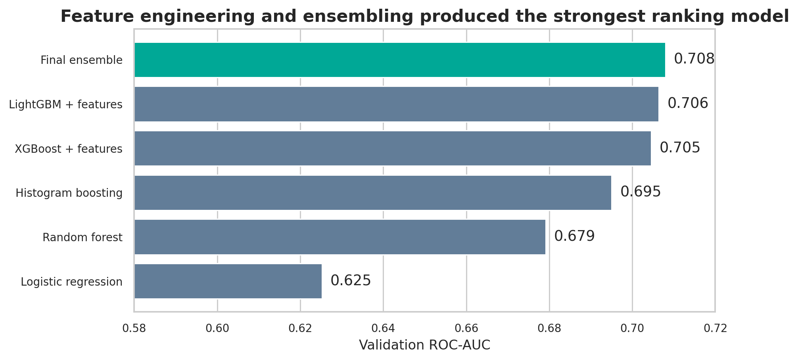
Model development moved beyond the tutorial baseline
Final model
65%
Engineered LightGBM
35%
Categorical ensemble
Selection protocol
• 60% train
• 20% validation
• 20% untouched test
• Selection by validation ROC-AUC
Source: Reproducible model runs; test data excluded from feature, model and blend selection.
08

Slide 9
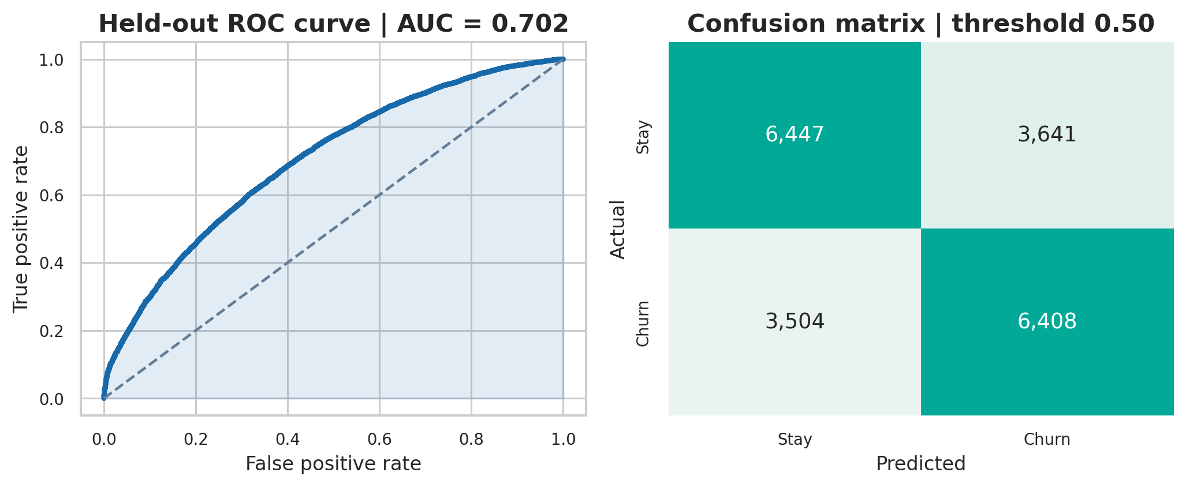
The final model generalizes to unseen customers
0.702
ROC-AUC
0.695
PR-AUC
64.3%
Accuracy
Use ranking, not accuracy alone
Source: Held-out test set, n=20,000. Confusion matrix shown at a 0.50 probability threshold.
09

Slide 10
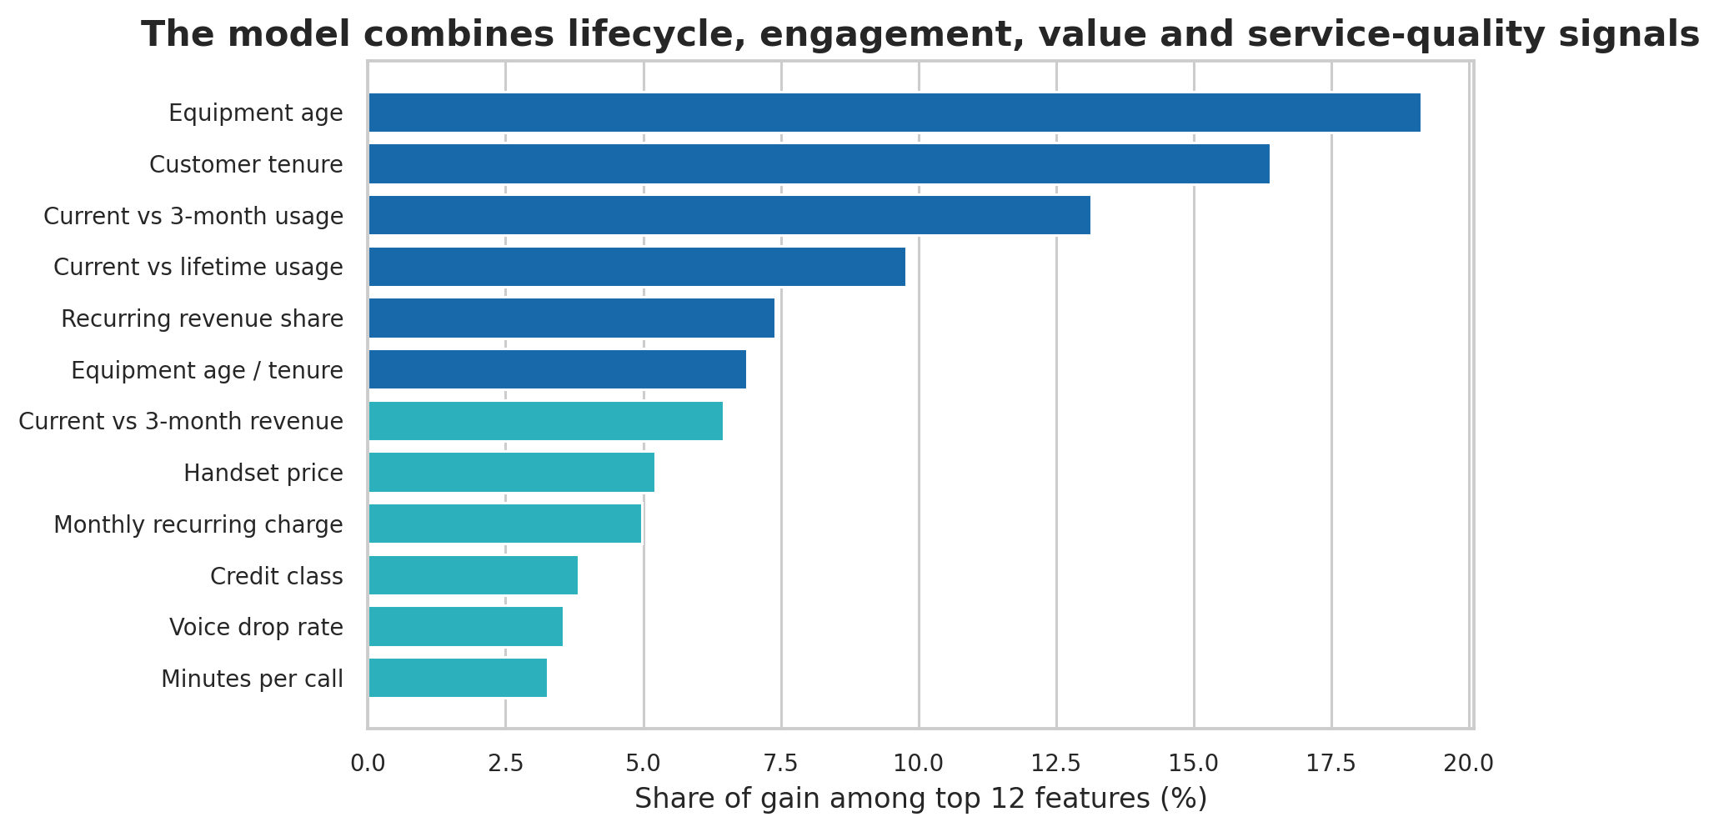
Churn risk is driven by interpretable business signals
Four intervention themes
Lifecycle
Equipment age and tenure
Engagement
Current vs historical usage
Value
Recurring revenue and handset value
Experience
Voice drops and call completion
Interpretation guardrail
Importance identifies prediction signals, not causal effects.
Source: LightGBM gain importance. Causal impact must be validated through controlled interventions.
10

Slide 11
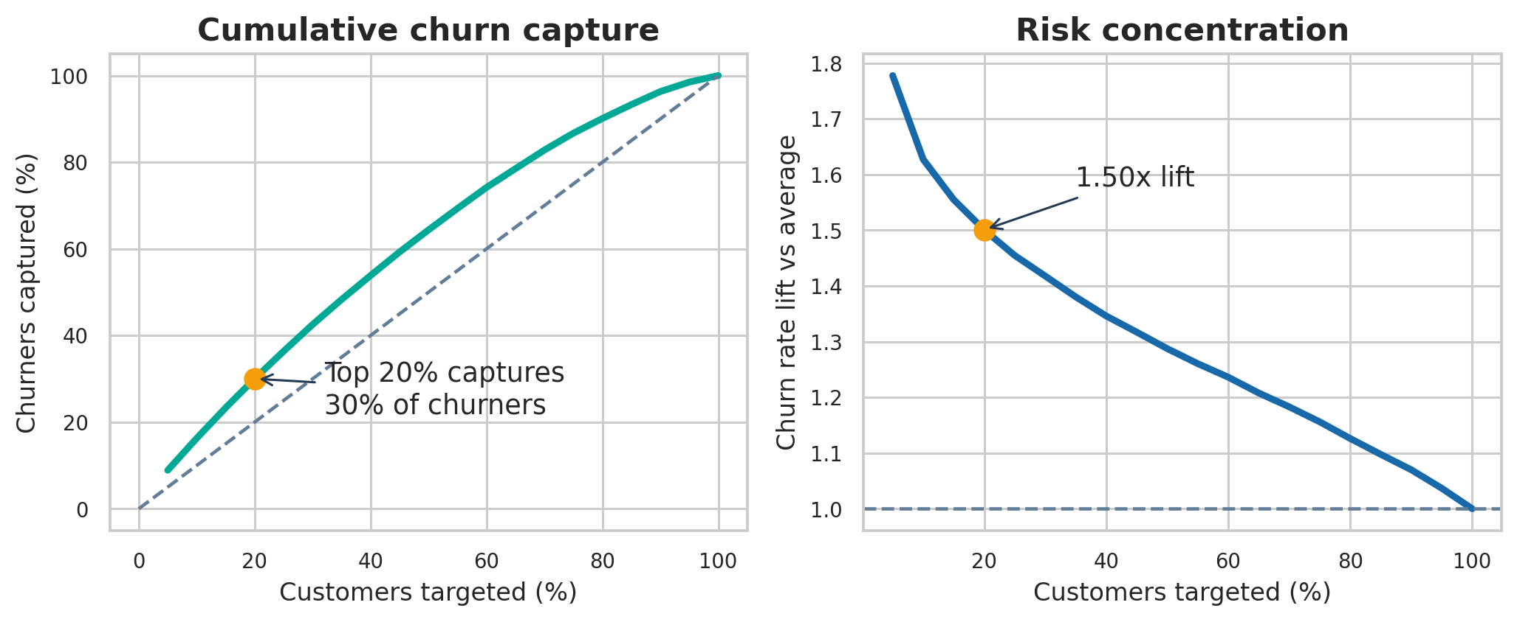
A top-20% strategy concentrates campaign spend
Recommended PoC capacity
20%
of customers
74.4%
observed churn rate
1.50×
lift vs portfolio
Source: Held-out test ranking. Campaign capacity should be tuned to action cost and contact-channel limits.
11

Slide 12
Business proposal: match risk signals to retention actions
Risk pattern
Recommended action
Primary KPI
Ageing handset + high risk
Upgrade offer or device-financing review
Retention uplift
Usage decline
Plan-fit review, personalized bundle or usage benefit
Usage recovery
Service-quality friction
Proactive care call and network/service resolution
Complaint reduction
High-value at-risk customer
Priority outreach with value-capped incentive
Net revenue retained
PoC design: randomly hold out 10% of each risk/action segment to measure incremental retention, not just response rate.
Source: Proposed operating model derived from the leading predictive features.
12

Slide 13
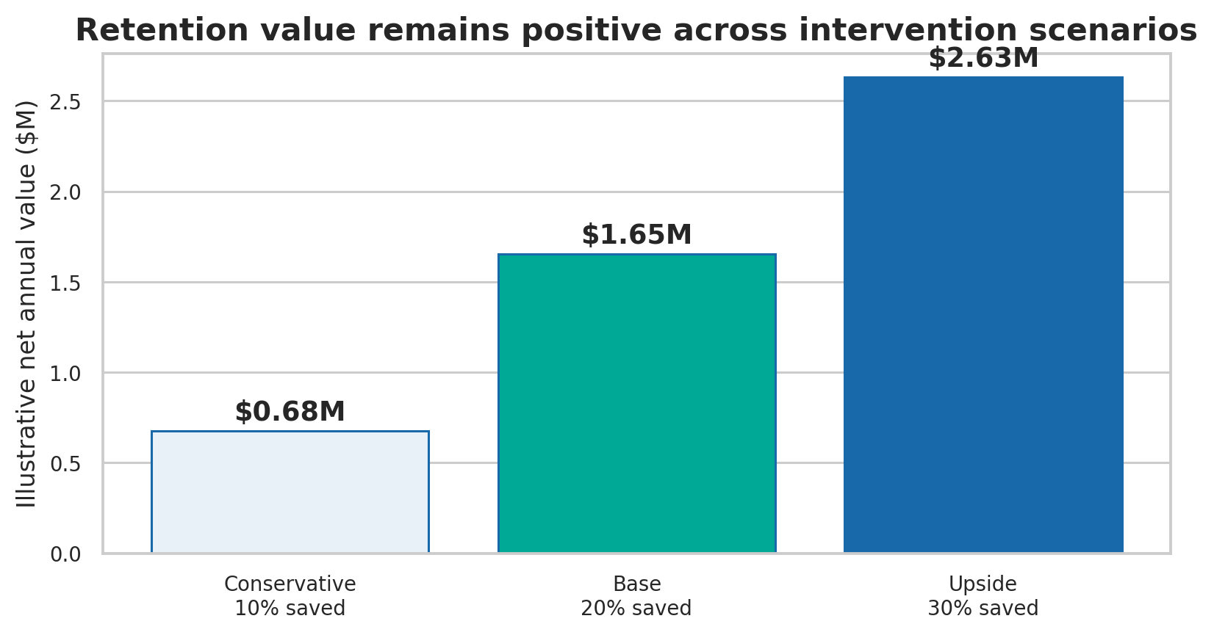
Illustrative economics support a controlled rollout
Scenario per 100,000 scored customers; replace assumptions with Company A campaign costs
Base-case assumptions
• Target top 20% = 20,000 customers
• Capture 30.0% of expected churners
• Average target revenue = $54.74/month
• 20% of contacted churners retained
• $15 intervention cost per targeted customer
• 12 months of retained revenue value
Net annual value
$1.65M
5.5× ROI
Source: Model targeting results plus explicitly stated assumptions. This is a planning scenario, not measured campaign impact.
13

Slide 14
90-day PoC roadmap with decision gates
Weeks 1–2
Weeks 3–5
Weeks 6–9
Weeks 10–12
Validate
Integrate
Experiment
Decide
Confirm data freshness, customer eligibility, costs and action catalogue.
Automate weekly scoring and connect ranked lists to CRM workflows.
Run segmented treatment/control campaigns and monitor operational quality.
Measure incremental retention, net value, fairness and model drift.
Scale only if the PoC passes all four gates
Incremental retention
Positive net value
Stable calibration
No material segment harm
Source: Proposed implementation roadmap and model-risk controls.
14

Slide 15
Decision requested
References
[1] Deloitte. 2026 Telecommunications Industry Outlook. https://www.deloitte.com/us/en/insights/industry/technology/technology-media-and-telecom-predictions/2026/telecommunications-industry-outlook.html
Approve a 90-day retention PoC targeting the highest-risk 20% of eligible customers, with randomized controls and value-capped interventions.
[2] Company A Dataset Overview. ENG_Company.md. Supplied course material.
[3] GCI World 2026 Final Assignment Tutorial. tutorial.ipynb. Supplied course material.
[4] Company A analysis pipeline: train_models.py, train_improved_model.py, train_advanced_model.py.
Expected PoC outputs
• Incremental churn reduction by segment and action
• Verified campaign ROI and scalable capacity
• Production monitoring and retraining requirements
[5] Held-out metrics and figures: artifacts/advanced/metrics.json and feature_importance.csv.
[6] Sample presentation used for narrative reference: Sample1.pptx.
All financial values on slide 13 are explicitly labeled scenario assumptions.
15

